Slide 1

The US Muon Accelerator Program (MAP)
Exploring the Energy Frontier without ever going off site
Alan Bross
Fermilab
NuFact 10, Mumbai

Slide 2
Outline
My Talk
Why Muon Accelerator Facilities? Inspirational
  Physics motivation for and nature of possible future facilities based on ultra-high intensity muon beams
  Low-Energy muon physics to the Energy Frontier
  And, of course, the NF is one step along this path
The Muon Accelerator Program
  What it means
  Describe its structure
  Principal goals
Conclusions

Slide 3
Physics in Evolution
What we might do at a Muon Accelerator Facility

Slide 4
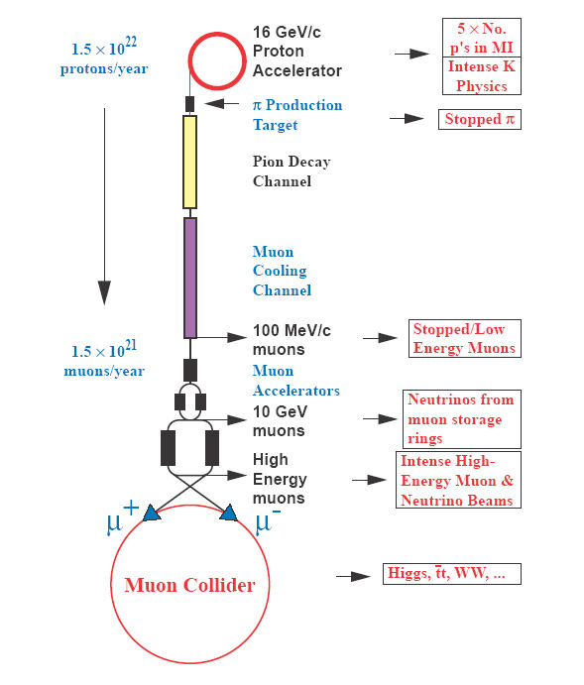
Evolution of a Physics Program
From Snowmass 96
A μ source providing 1-2 X 10²¹ μ/yr supports a rich physics program:
Intense Low-energy muon physics (LFV)
  μ → e conversion experiment
Neutrino Factory
  Low Energy 4 GeV
  High Energy 25 GeV
Energy Frontier Muon Collider
  1.5 - 4 TeV+
    With maybe a lower E_{com} machine (Higgs, Z’) first.
PRSTAB 2002

Slide 5
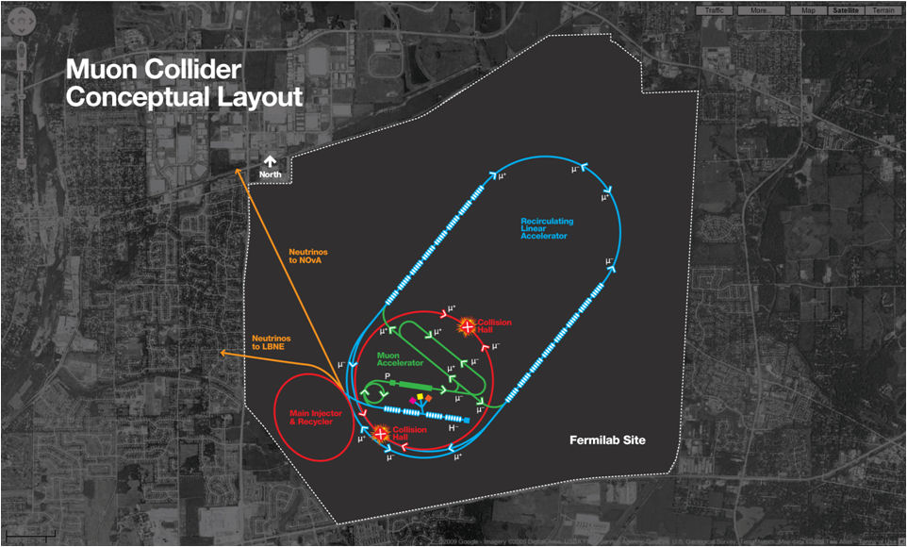
The Energy Frontier
Focus of the Muon Accelerator Program is to prepare for “Next” (beyond the LHC) Energy Frontier

Slide 6
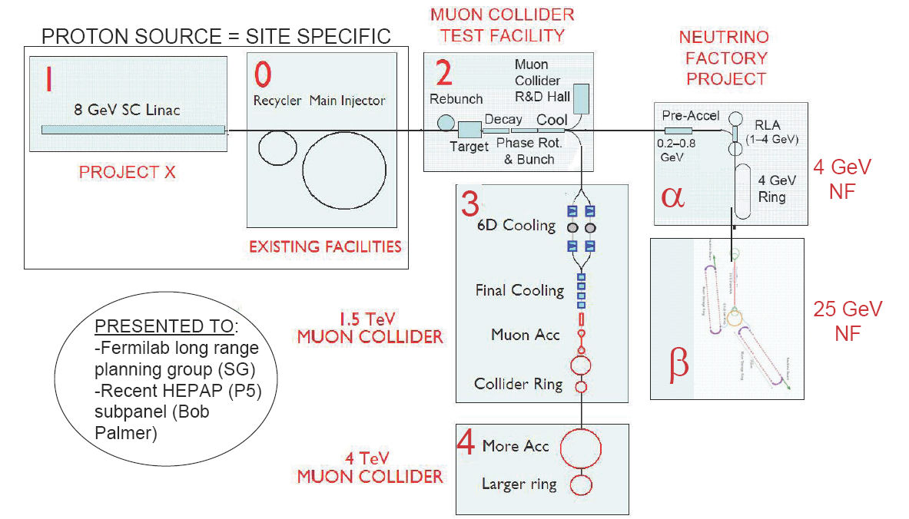
Muon Complex Evolution At Fermilab
Starting with a high-intensity proton source: Project X
  We see a natural evolution of “muon” program for Fermilab
Project X → Low-Energy NF (pointing to Homestake) → High-Energy NF → 1.5 TeV MC → 4 TeV MC
But MAP’s main focus is the Energy Frontier

Slide 7
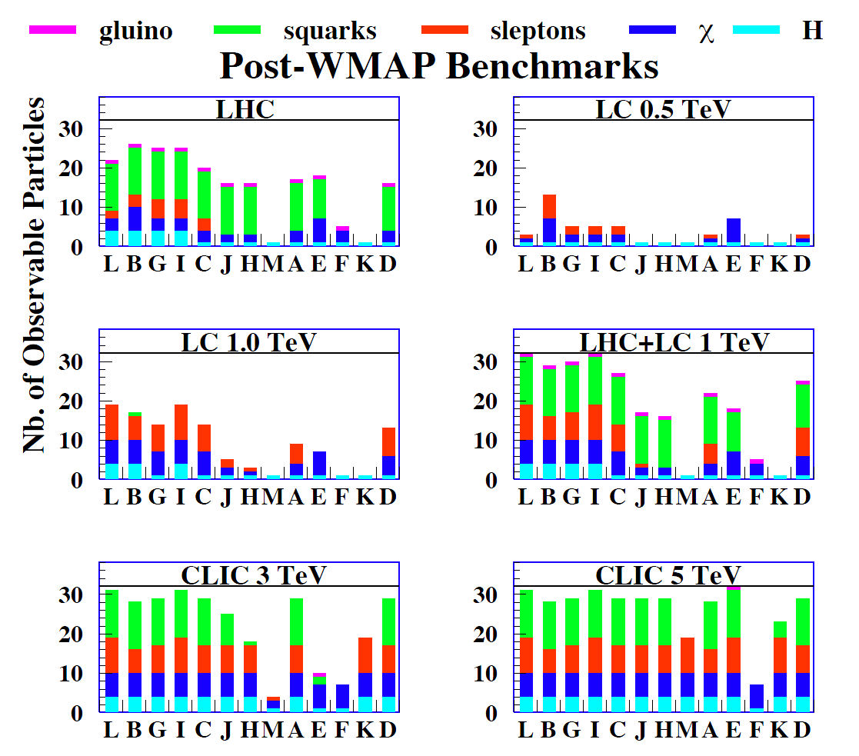
The Next Energy Frontier - Why Look Beyond the ILC?
The Supersymmetric Particle Zoo
Independent of actual supersymmetric mass scale and the reach of the ILC, the 2004 CLIC Study conclusions are still valid
  “A Multi-TeV machine is needed for extended coverage of the mass range
cMSSM
2004 CLIC Physics Study

Slide 8
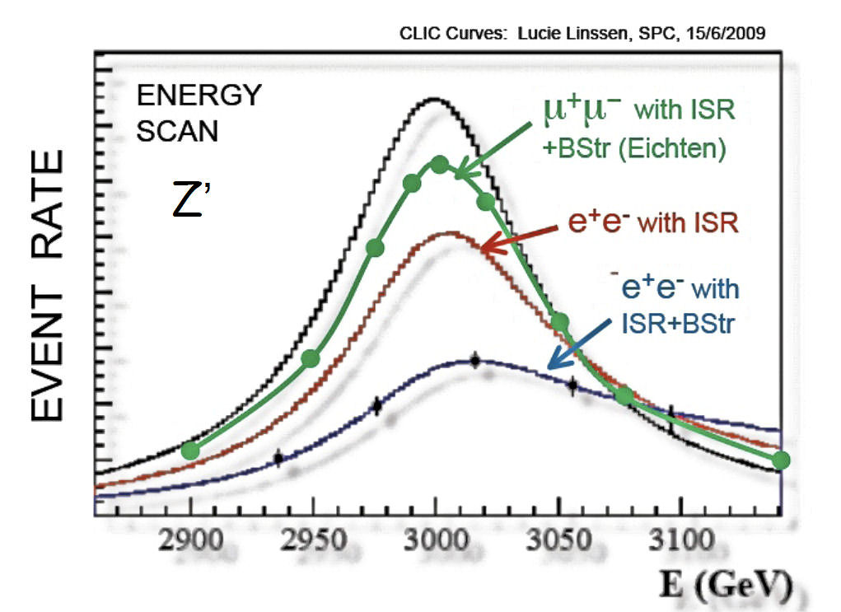
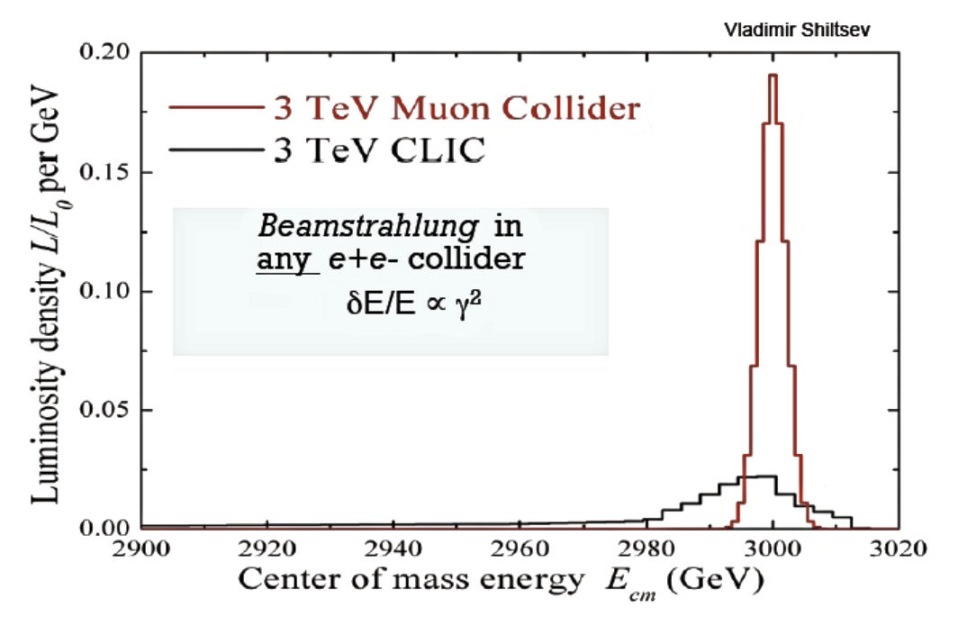
Why consider a Muon Collider?
Precision Energy Scans
Excellent energy resolution
  MC: 95% luminosity in ΔE/E ~ 0.1%
  CLIC: 35% luminosity in ΔE/E ~ 1%

Slide 9
Why consider a Muon Collider II?
Complexity of Colliders
 | LHC | MC | CLIC
state of the art magnets | √ | √ | -
state of the art RF system | - | √ | √
state of the art beam dynamics | - | √ | √
Total # of elements | ~4000 | ~4000 | ~200,000
Luminosity | >1e34 | >1e34 | >1e34
Complexity and footprint likely to have a positive impact on Cost

Slide 10
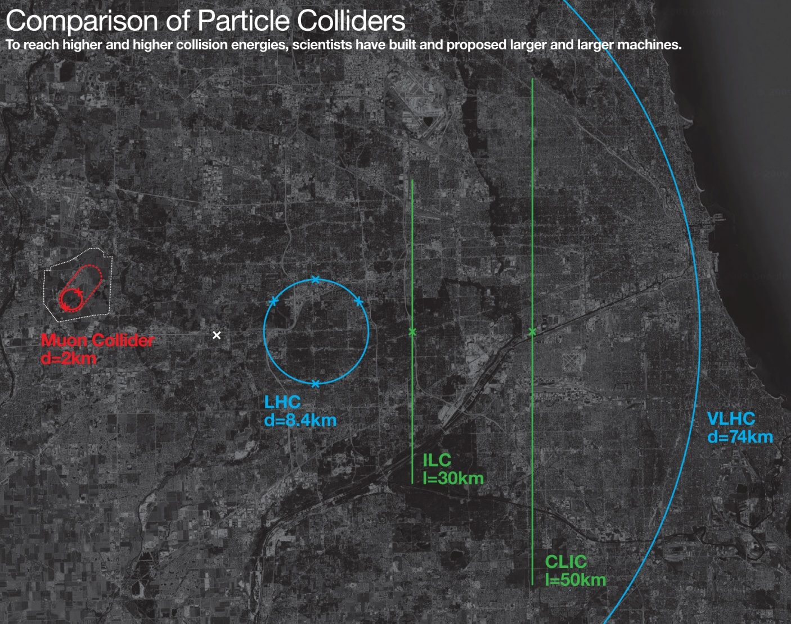
With respect to footprint
Muon Collider represents $$$ in the bank

Slide 11
Finally, with respect to a staged Physics Program
The Muon Accelerator Facility is unsurpassed
  Low-energy μ physics
  Neutrino Factory
  Energy Frontier Muon Collider
    With a Higgs Factory also a possibility
I have described the MC. This meeting is about the Neutrino Factory and the connection is clear (Dan will make it even clearer next.) You may not appreciate the potential synergy between a Muon Collider and a the low-energy μ physics program.

Slide 12
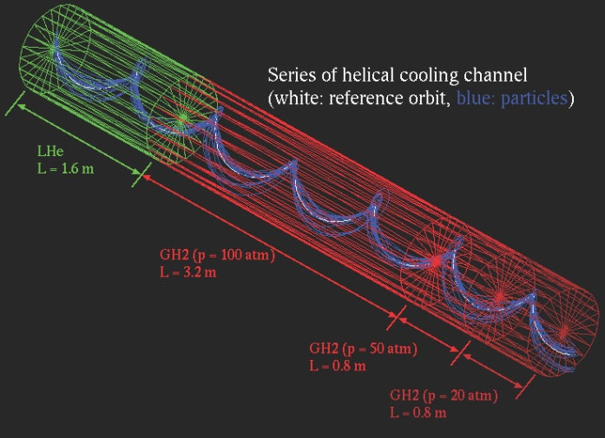
μ → e conversion Experiments
& 6D Muon Ionization Cooling
6D Muon Ionization Cooling
Increase the Intensity of low energy μ beam & improve target stopping power
  Cooling increases 6D particle density
  Test bed for 6D Muon Ionization Cooling for MC with intense μ beam
    Note: Not part of baseline, but may improve performance of the NF

Slide 13
Muon Collider Design
Brief Overview

Slide 14
Muon Collider options
A number of design options have been under study
GOAL of MAP is to converge on One
Low Emit. High Emit. MCTF07 MCTF08
√s (TeV) 1.5
Av. Luminosity (10³⁴/cm²/s) * 2.7 1 1.33-2
Av. Bending field (T) 10 6 6
Mean radius (m) 361.4 500 500 ⇒ 495
No. of IPs 4 2 2
Proton Driver Rep Rate (Hz) 65 13 40-60
Beam-beam parameter/IP 0.052 0.087 0.1
β* (cm) 0.5 1 1
Bunch length (cm) 0.5 1 1
No. bunches / beam 10 1 1
No. muons/bunch (10¹¹) 1 20 11.3
Norm. Trans. Emit. (μm) 2.1 25 12.3
Energy spread (%) 1 0.1 0.2
Norm. long. Emit. (m) 0.35 0.07 0.14
Total RF voltage (GV) at 800MHz 407×10³α_{c} 0.21** 0.84** ⇒ 0.3†
Muon survival Nμ/Nμ0 0.31 0.07 0.2 ?
μ+ in collision / proton 0.047 0.01 0.03 ?
8 GeV proton beam power 3.62*** 3.2 1.9-2.8 ?
---------------------------------------------------------------------------

Slide 15
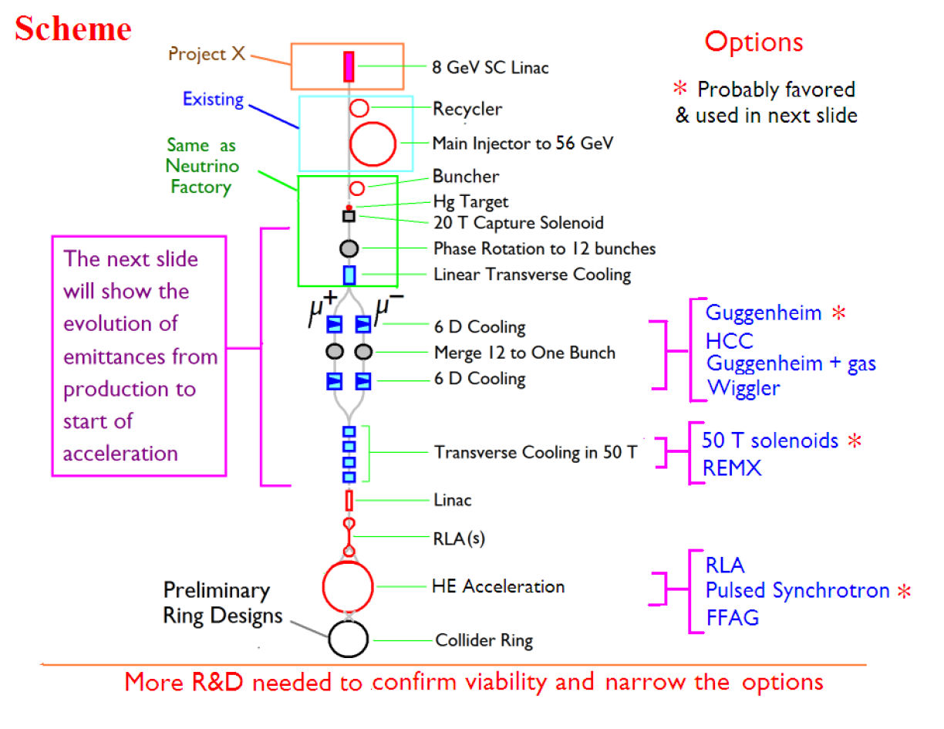
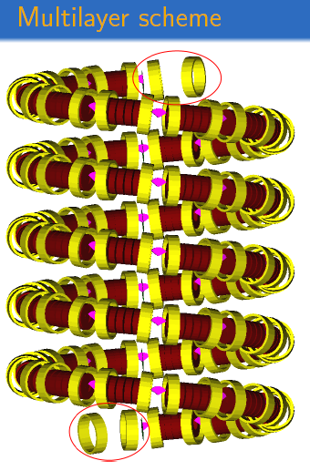
Muon Collider Facility
Options
*Probably favored at this time
Cooling
R&D is needed to reduce # of options & establish viability

Slide 16
Muon Acceleration Program

Slide 17
Muon Accelerator Program
MAP is the combination of two programs
NFMCC (Neutrino Factory & Muon Collider Collab.)
  National collaboration funded since 1999.
  Pursues Neutrino Factory & Muon Collider R&D.
  NF R&D pursued with international partners
MCTF (Muon Collider Task Force)
  Task Force established at Fermilab in 2006
  Pursues Muon Collider R&D, utilizing FNAL assets and extends & complements the NFMCC program

Slide 18
Muon Accelerator Program II
Proposal submitted to US DOE & reviewed in August of this year
  7 Year R&D program – ≈ $120M
  Principal deliverables
    Design Feasibility Study for Muon Collider
      Including Cost Estimate
    US Participation in the International Design Study for a Neutrino Factory (IDS-NF)
      Strong US support for Muon Ionization Cooling Experiment (MICE)

Slide 19
Muon Accelerator Program III
August Program Review
Primary Charge (there were others, but this is the important one):
  Determine if this proposal is suitable for funding
Answer
  “Yes, because of the importance of the Muon Collider to the HEP community”
  Corollary
    A Muon Collider strategy that is based on a staged approach – concentrating current resources on technology demonstrations needed to convince the community that a Neutrino Factory is feasible – should be considered

Slide 20
MAP Organization
With >$$$ comes -

Slide 21
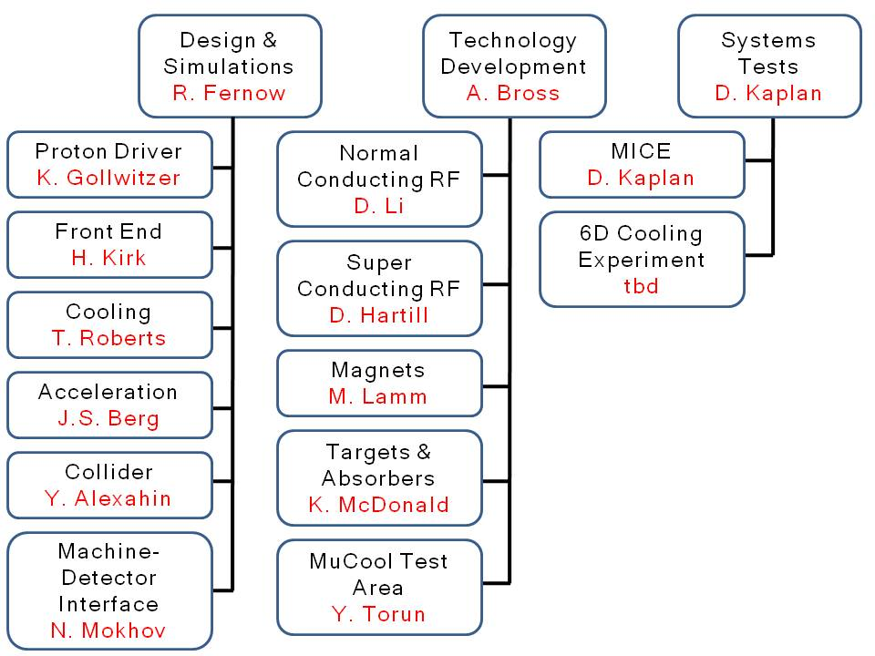
MAP Organization II

Slide 22
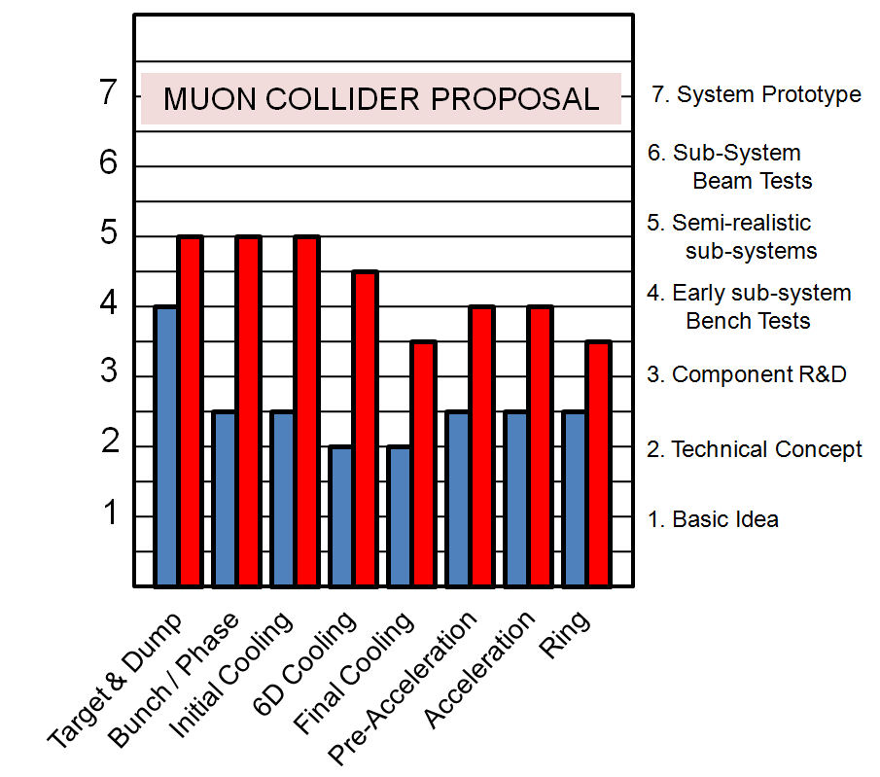
Muon Collider Design Feasibility Study
NOW
PROPOSED MC-DFS
End of 7 Year Program

Slide 23
Finances

Slide 24
Muon Collider Machine-Detector Interface
If a Multi-TeV Muon Collider is built
Can a detector be designed that will do the physics?

Slide 25
Muon Collider Physics & Detector Studies
Physics and Detectors Studies are outside the scope of the MAP program, but
  There is a machine-detector interface group within MAP
  A parallel Physics & Detector effort has been initiated
    Identify benchmark processes
    Examination of collision point environment and detector performance criteria
First Workshop was in 2009
    http://www.fnal.gov/directorate/Longrange/Steering_Public/workshop-muoncollider.html

Slide 26
ADVERTISEMENT
  First International Muon Collider
  General Meeting
  27th June - 1st July 2011
  Venue TBD
  Will cover
  Accelerator Facility
  Physics
  Detector
  No WEB page yet – Stay Tuned

Slide 27
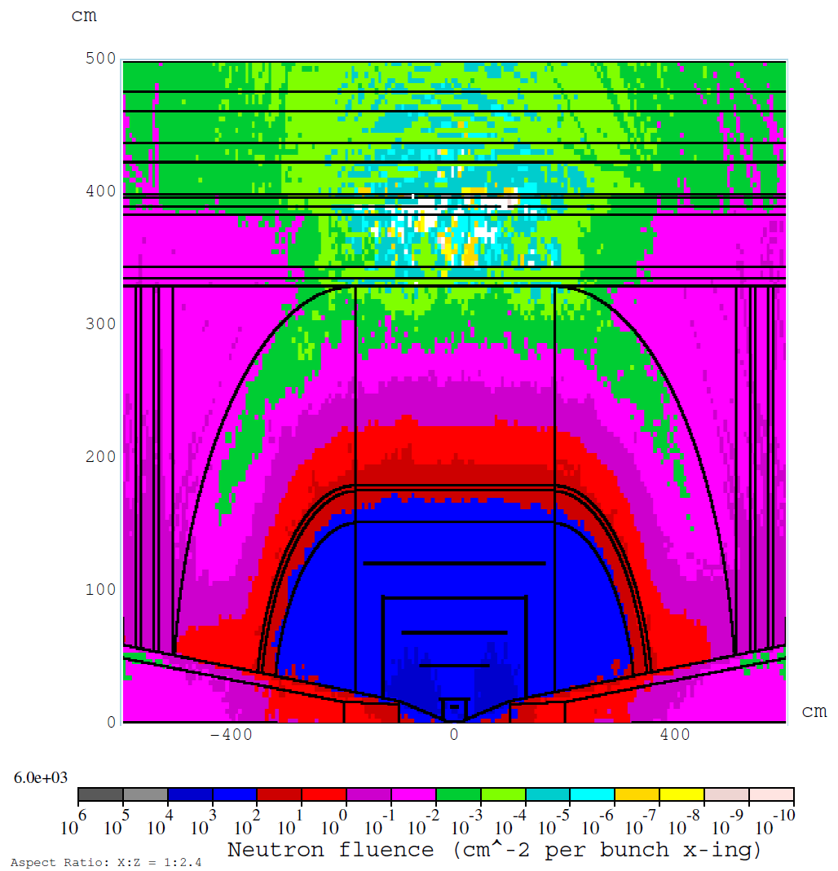
Muon Collider Detector Issues
Shielding Backgrounds
MC detector backgrounds studied actively 10 years ago (1996-1997).
  Large background from decay electrons
Shielding strategy
  Electron “sweeping” & IP shielding high-Z cone
New studies have advanced our understanding and show that this strategy can work extremely well.
  Note: Tungsten cone in forward direction with angle 10º
    CLIC detector uses 7º cone
MARS simulation - 1.5 TeV MC
Total dose in Si detector ≈ ½ that at
LHC @ L=10³⁴

Slide 28
The Way Forward

Slide 29
Muon Accelerator Program
The 7 Year Plan
A 7 Year R&D Program on Muon Accelerator R&D has been endorsed by a review panel convened by the US DOE OHEP
  & we are in Year 2 of it
Goals of the program
  Define a MC initial design configuration based on physics requirements
  Produce a first end-to-end MC simulation
  Undertake critical component development & proof-of-principle experiments
  Provide the first MC cost estimate
In addition it meets our existing international commitments
  NF-RDR, MICE

Slide 30
Conclusions
The physics program at a Multi-TeV Muon Collider is well motivated
The Muon Accelerator Program is based on over a decade of R&D on facilities based on ultra-intense μ beam
And now plans are in place to expand the activities so that a Design Feasibility Study for a Muon Collider can be delivered to the HEP community by ≈ 2016
  There will also be a parallel Physics & Detector effort
  And in addition, the R&D supports all programs that need intense beams of μ

Slide 31
END

