Slide 1

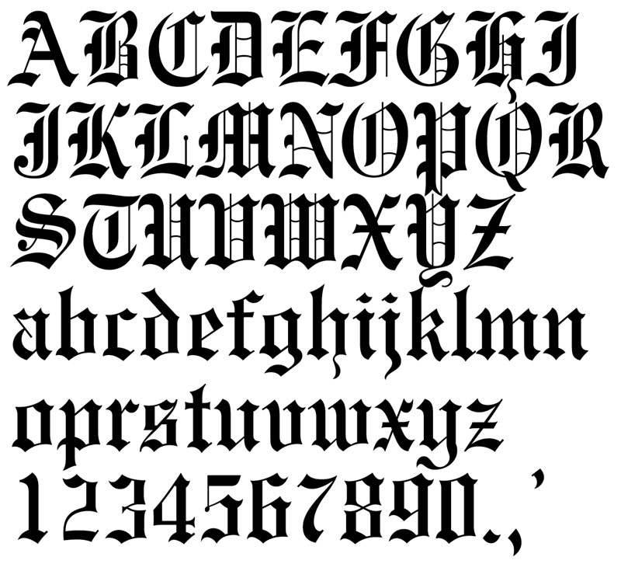
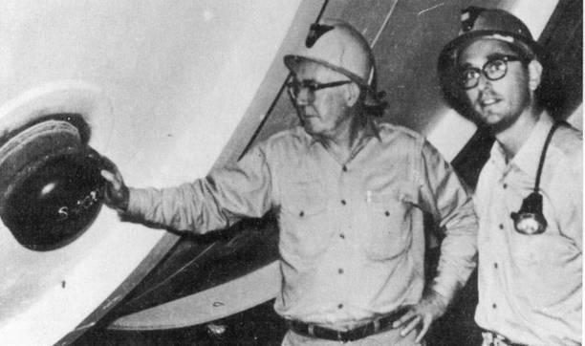
“All the Nu’s that’s fit to print”
’
Neutrinos Exhibit Quantum-Mechanical Oscillations
MEASUREMENTS FROM THE SUN, COSMIC RAYS, ACCELERATORS, REACTORS
Mixing like quarks, implications beyond Standard Model
Neutrinos are probes for new physics beyond SM, no longer an “anomaly,” a “problem,” or an “effect”
U.S. Japan, Europe each building their own facilities
Experiments still pushing for CP Violation in Neutrinos
Neutrinos Don’t Decay or Decohere

Slide 2



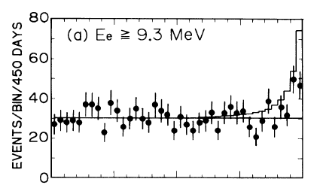
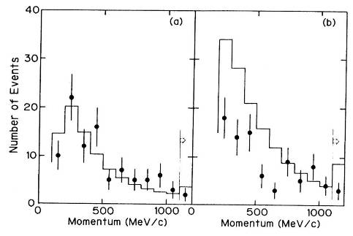

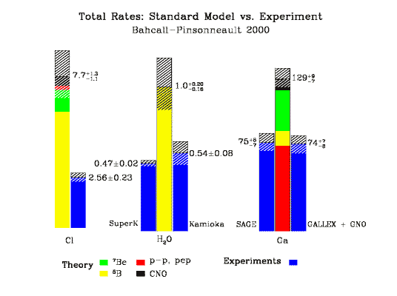
And don’t forget the “LSND Effect,” C. Athanassopoulos et al., Phys. Rev. Lett. 75, 2650 (1995)
1989
ATMOSPHERIC NU “ANOMALY”
Solar Neutrino “Problem”
EXPERIMENTAL STUDY OF THE ATMOSPHERIC NEUTRINO FLUX.
KAMIOKANDE-II Collaboration (K.S. Hirata et al.), Phys.Lett.B205:416,1988
K.S.Hirata et al., Phys. Rev. Lett. 63(1989) 16
“At present this is highly speculative – there is no experimental evidence for neutrino oscillations…”
– D.J. Griffiths (1995), Introduction to Quantum Mechanics
e
μ

Slide 3
ν Mixing Orthodoxy
PMNS: a 3×3 unitary transformation to mass states:
CHOOZ 90%C.L. sinθ₁₃<0.22 @ Δm²=2×10⁻³eV² Phys.Lett.B466,415 (1999)
Is this non-zero??? Large enough to measure CP in ν_{μ} → ν_{e}
sinθ_{solar} <0.62 (Smirnov, hep/0309299)
c_{ij} ≡ cosθ_{ij}
s_{ij} ≡ sinθ_{ij}
Super-K 90%C.L. sinθ₂₃>0.58 @ Δm²=2×10⁻³eV²
(hep-ex/0404034)
Is the mixing angle truly maximal???
In the quarks, matrix has phase δ≠0 responsible for CP.

Slide 4
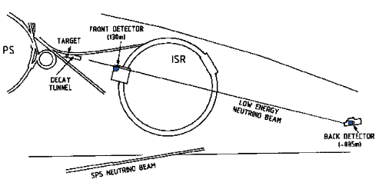
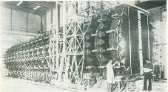
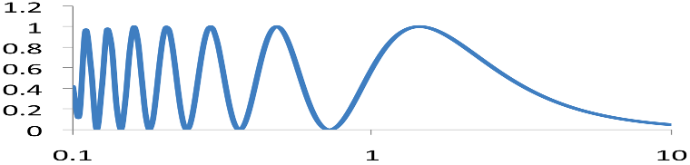
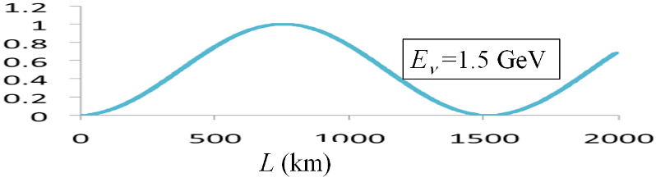
What do We Measure?
Compare ‘front’ and ‘back’ detectors
CERN CHARM/CDHS experiments, 1982-83
FNAL CCFR experiment, 1982-83
L = 735 km
P(ν_{α}→ν_{β})
N(back)/N(front)
E_{ν} (GeV)

Slide 5


LMA is solution, Sun shines on
Data favor MSW effect, suggests mass heirarchy m₁>m₂
Nakahata, Neutrino Telescopes 2009
After 30 yrs, KamLAND and SNO weigh in
CC/NC flux defines
tan² θ₁₂ < 1

Slide 6
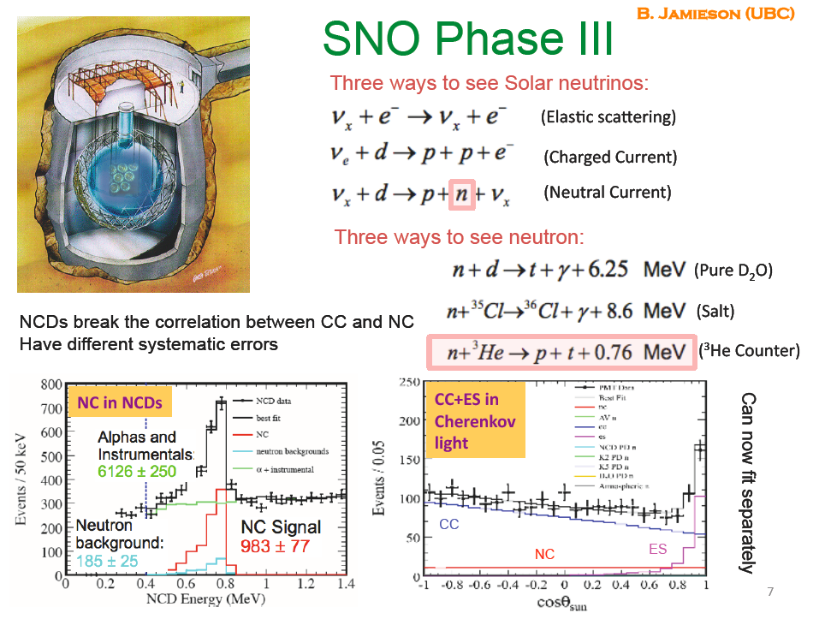
ICHEP08
Phys.Rev.Lett.101:111301,2008

Slide 7
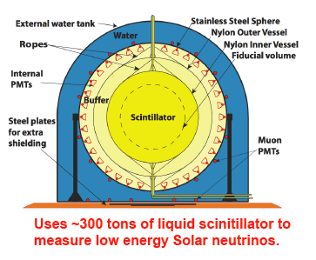
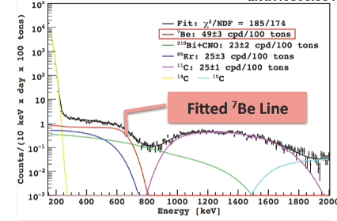
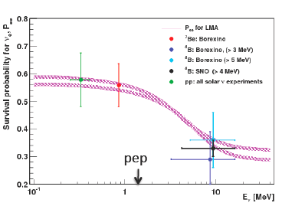
G. Ranucci (Milano) @ ICHEP08
C. Galbiati @ Neutrino 2008
arXiv:0805.3843
Borexino Data
49 ± 3 (stat) ± 4 (sys)
No Osc: 75 ± 4
MSW LMA
48 ± 4 counts/day/100ton
Electron Nu Survival Probability

Slide 8
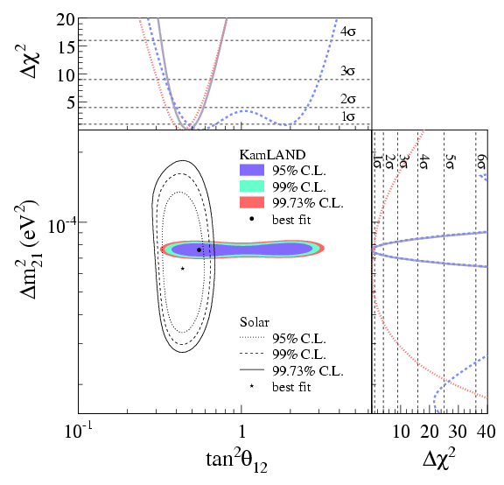
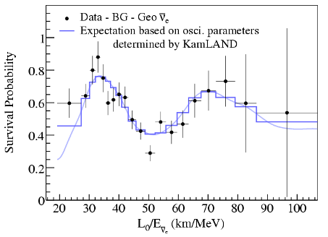
Confirming Solar Neutrinos at a Reactor
S. Abe et al. (KamLAND Collaboration), PRL 100, 221803 (2008)
Electron antineutrino disappearance from 55 nuclear reactors around Japan
Phys.Rev.Lett.100:221803,2008

Slide 9
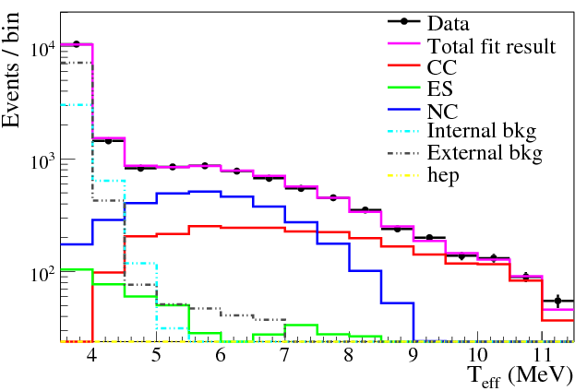
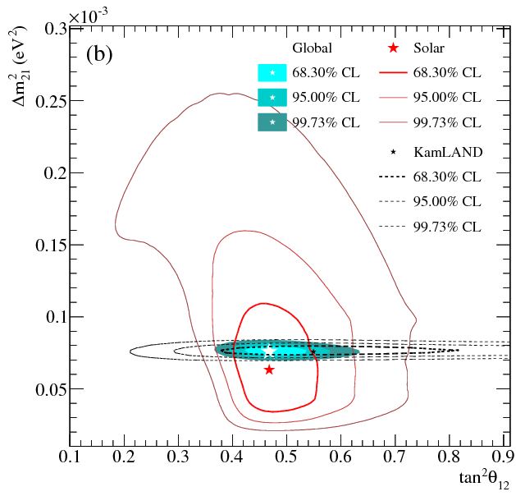
SNO Low Energy Threshold Analysis
LETA joint-phase fit + Phase III
+ all solar expts + KamLAND
(3flavor analysis) BEST FIT:
sin²θ₁₃=2.00 ^{+2.09}_{-1.63} x10⁻²
sin²θ₁₃ < 0.057 (95% C.L.)
J. Klein, Neutrino 2010 Conference (Athens)

Slide 10
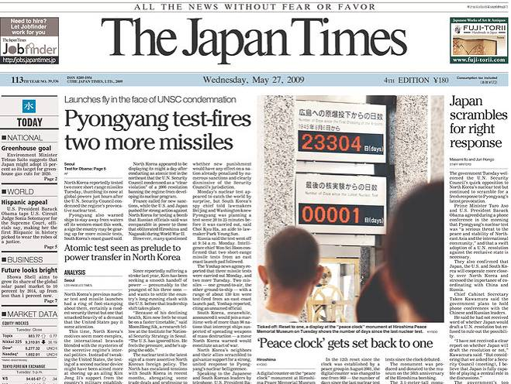
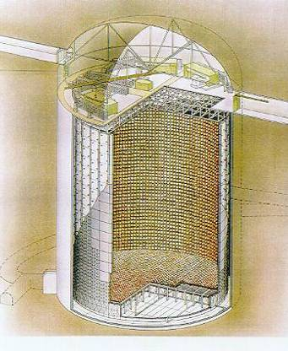
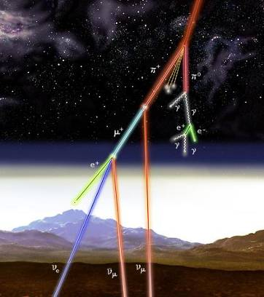
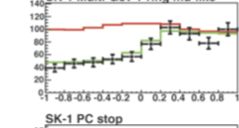
Super Kamiokande Exp’t Observes Zenith Angle-Dependent Loss of ν_{μ}, not ν_{e}
First expt showing dynamic loss of ν’s
Events/bin
ν_{μ}
50kton H₂O (x30 Kamioka)
SK-I – (’96-’00) and SK-III (‘03 -- ) 11100 PMTs ,
SK-II (2000-2003) , 5200 PMTs
cosθ_{zenith}

Slide 11
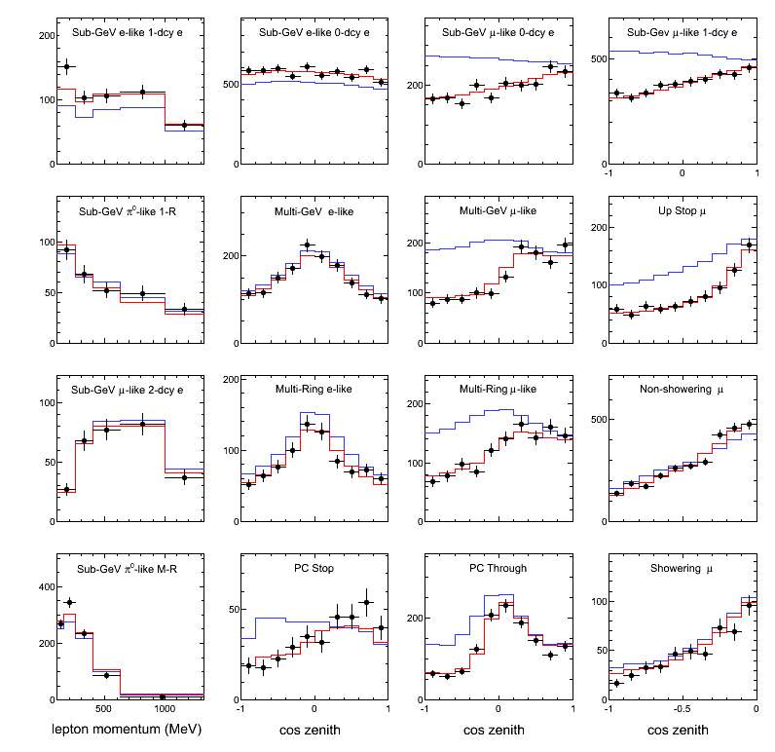
Zenith angle & lepton momentum distributions
ν_{μ}–ν_{τ} oscillation (best fit)
null oscillation
momentum
e-like
μ-like
SK-I+II+III
Preliminary
Live time:
SK-I
1489d (FCPC)
1646d (Upmu)
SK-II
799d (FCPC)
827d (Upmu)
SK-III
518d (FCPC)
636d (Upmu)
Sub-GeV samples are divided to improve sensitivity to low-energy oscillation effects
Y. Takeuchi (Neutrino2010)

Slide 12
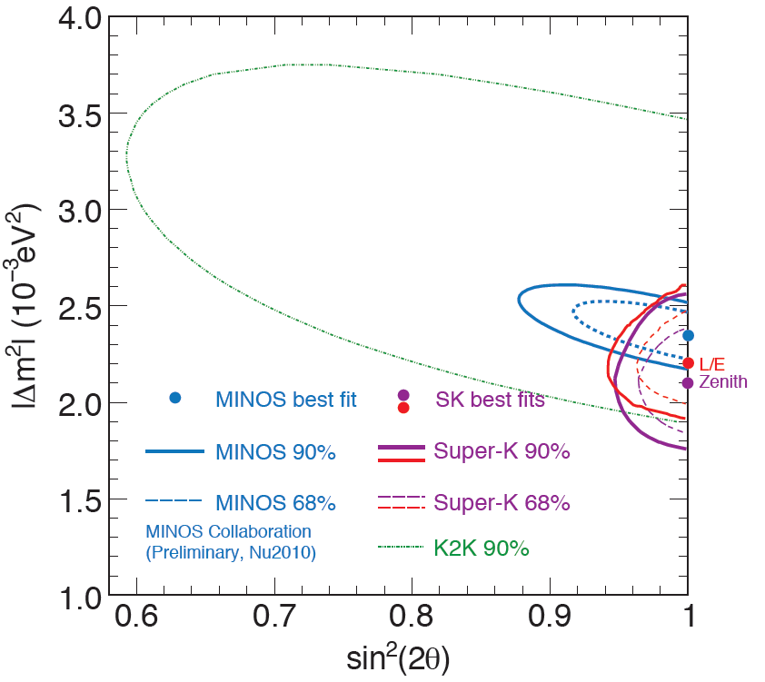
2-flavor oscillation analysis results
SK-I+II+III
Preliminary
Yasuo Takeuchi, Neutrino2010 Conference (Athens)
Zenith Physical Region (1σ)
Δm₃₂²=2.11+0.11/-0.19 x10⁻³
sin²2θ₂₃>0.96 (90%C.L.)
L/E Physical Region (1σ)
Δm₃₂²=2.19+0.14/-0.13 x10⁻³
sin²2θ₂₃>0.96 (90%C.L.)
Both results of zenith angle analysis and L/E analysis are consistent.
SK provides the most stringent limit for sin²(2θ₂₃).

Slide 13
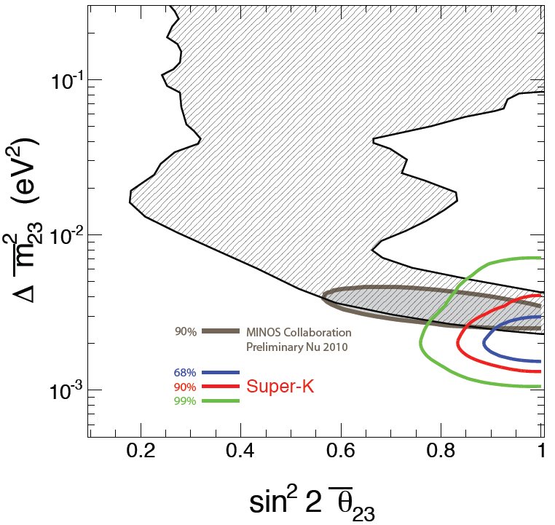
Search for CPT violation in atm. ν
Under the CPT theorem, P(ν→ ν) and P(ν→ ν) should be same.
Test ν oscillation or ν oscillation separately.
Jun 2009
SK-I+II+III
Preliminary
Neutrino:
Δm₃₂²=2.2x10⁻³eV²
sin²2θ₂₃=1.0
Anti-neutrino:
Δm₃₂²=2.0x10⁻³eV²
sin²2θ₂₃=1.0
No evidence for CPT violating oscillations is found
Yasuo Takeuchi (Neutrino 2010 Conference)

Slide 14
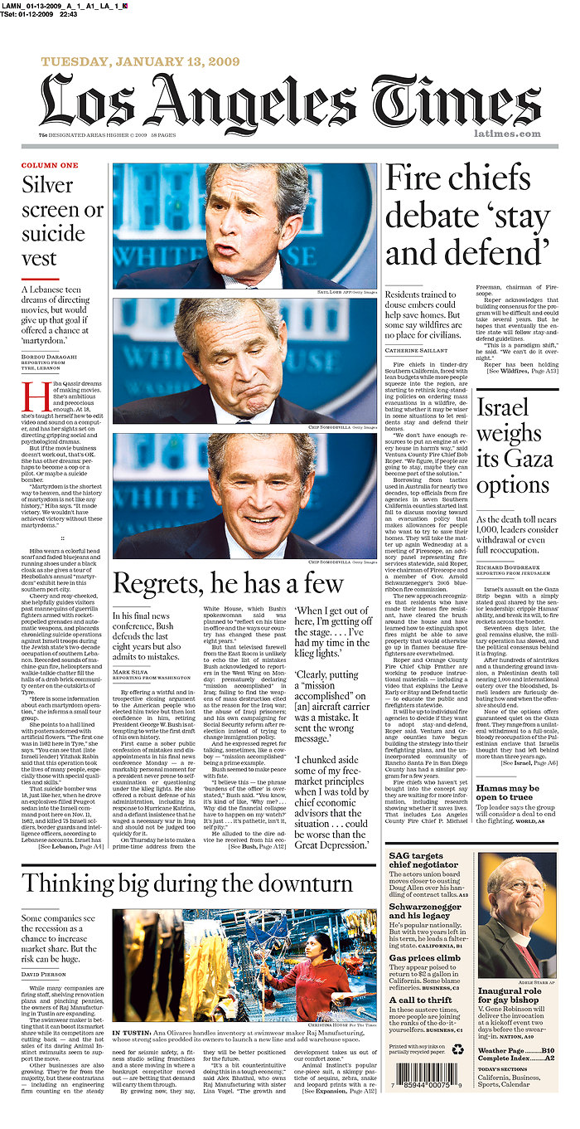
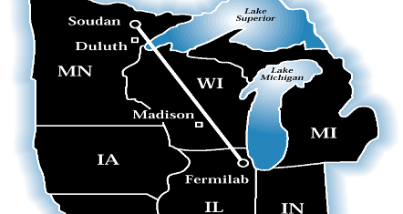
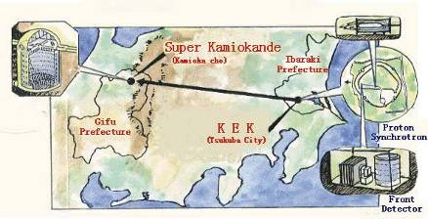
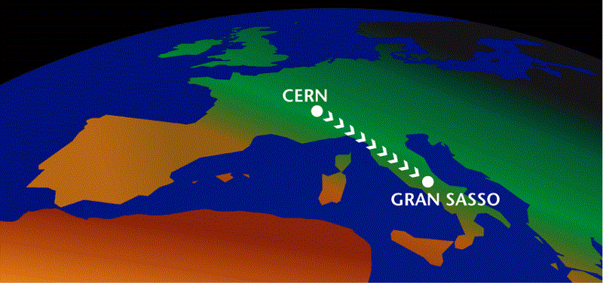
Reproduce Atmospheric Effect With Controlled Accelerator Beam
Exp’ts in U.S. Japan, Europe
MINOS
L = 735 km
K2K: 4σ depletion
(Phys Rev D74,
072003, 2006)
“Thank Goodness Earth is Round” – A. Zichichi
KEK-2-Kamioka
L = 250 km
Near Detector measures flux
Far Detector observes
oscillations
Cern to Gran Sasso
L = 750 km

Slide 15
Moore’s Law for Neutrinos?
LSND
Nomad/
Chorus
Main Injector is 120 GeV proton synchrotron
Simultaneous delivery of protons for
  Production of p (Tevatron collider)
  Production of neutrinos (NuMI)
NuMI designed for
  4×10¹³ppp @ 120 GeV
  Repetition rate ~2 sec.
  Corresponds to average beam power ~400kW
  So far 270kW achieved.
MINOS
K2K
MiniBooNE
2 ν
flavors
Discovery
of NC’s
S. Kopp, “Accelerator Neutrino Beams,” Phys.Rept. 439: 101-159 (2007)

Slide 16

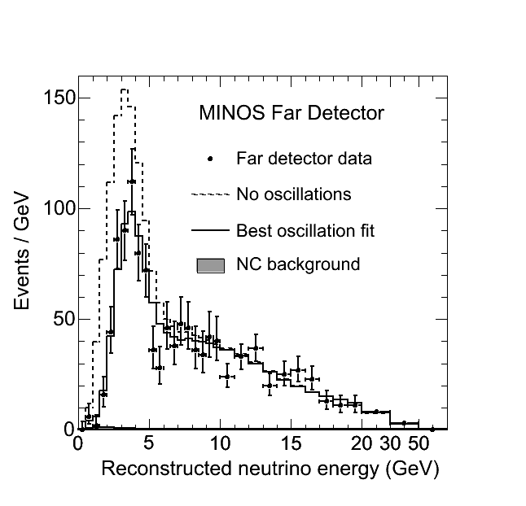
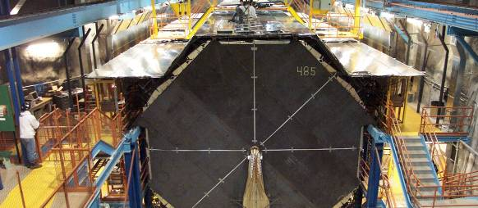
June 15, 2008
MINOS Experiment: Neutrinos do Oscillate
Other theoretical neutrino models disfavored at 6sigma
Energy-dependent deficit of neutrinos observed
World’s most precise oscillation parameters
“Where did they go?” – Pier Oddone
Neutrino Physics transitions from discovery to precision measurements.

Slide 17
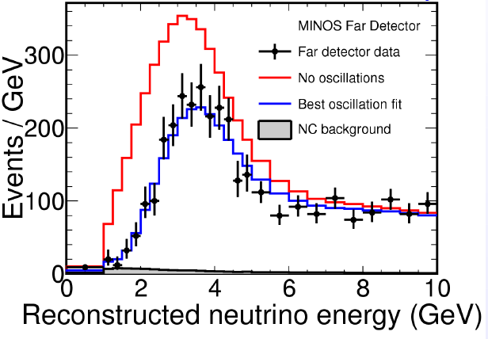
Measurement of ν_{μ} Disappearance
Observed 1986events
Expect 2452 events if no oscillations
Neutrino decay
  V. Barger et al., Phys. Rev. Lett. 82 2640, 1999
  Disfavored at 6σ
  With NC’s: disfavor at 8σ
Quantum decoherence of neutrino wave packets
  G. L. Fogli et al., Phys. Rev. D67 093006, 2003
  Disfavored at 8σ.

Slide 18
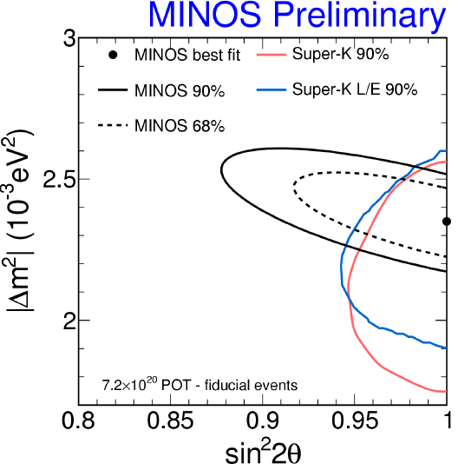
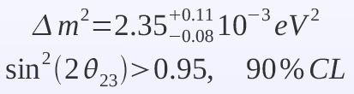
MINOS Oscillation Hypothesis Fit
P. Adamson et al, Phys. Rev. Lett.101: 131802 (2008)

Slide 19
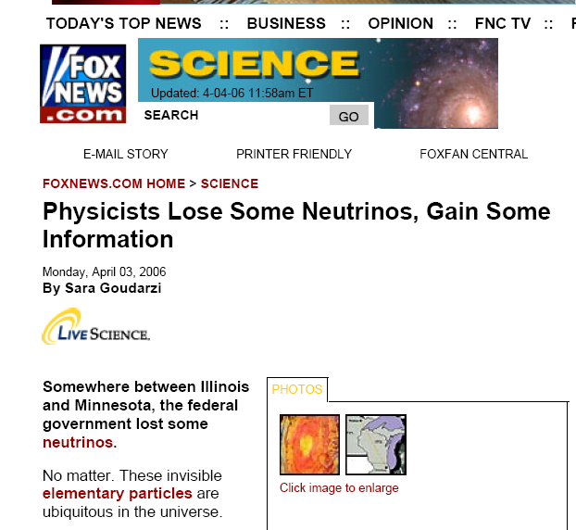
FOX News: “Fair and
Balanced”
S. Kopp, Lepton-Photon 2009

Slide 20
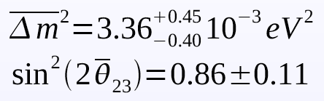
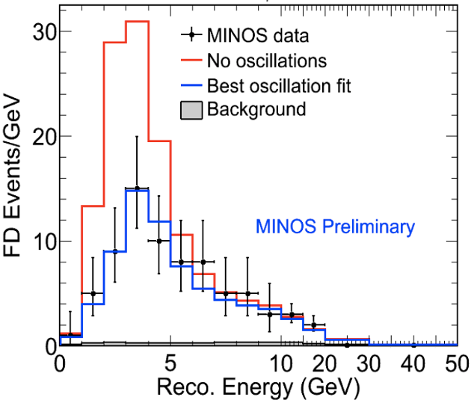
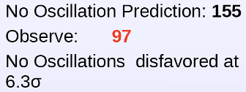
MINOS Results from Antineutrino Running

Slide 21
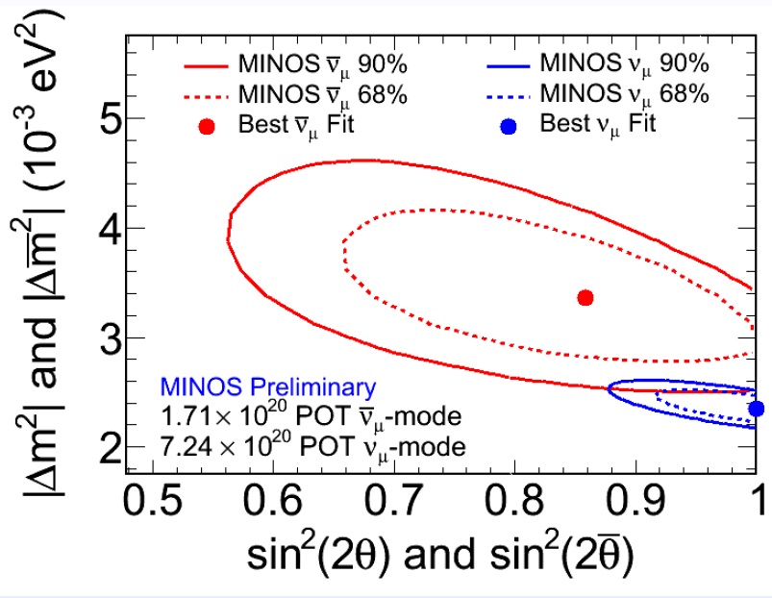
MINOS Results from Antineutrino Running

Slide 22
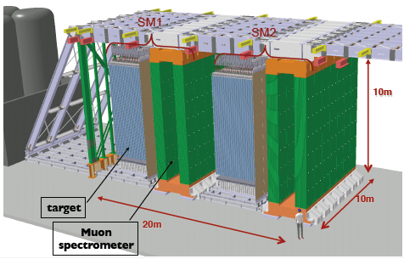
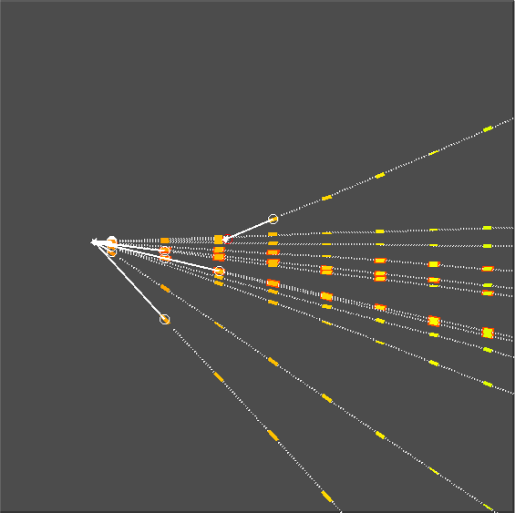
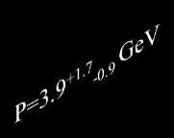
Opera
Total target mass 1.2 kton
2 super modules:
  Spectrometer: 22 RPC planes in Bfield (1.5T), 6 Drift tube planes
  Target: 27 lead emulsion brick walls, alternated with scintillator planes
μ⁻ (undetected)
ν_{μ}
D⁺
h⁺
neutrals
Recorded ~2x10¹⁹ POT 2008 After 5 year exposure
    22.5x10¹⁹ POT
    10-15 ν_{τ} (depending on Δm²)
    fewer than 1 BG
θ_{kink}=0.204 rad
figures courtesy M. Dracos, IN2P3

Slide 23

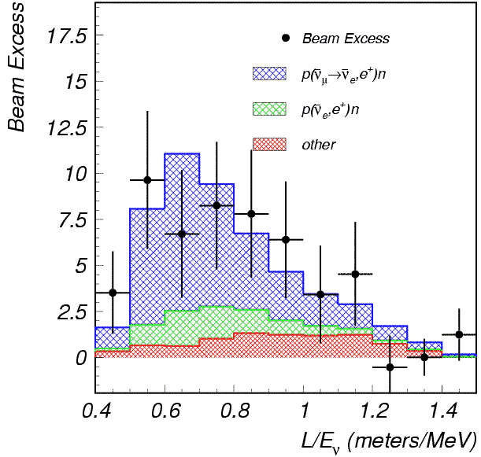
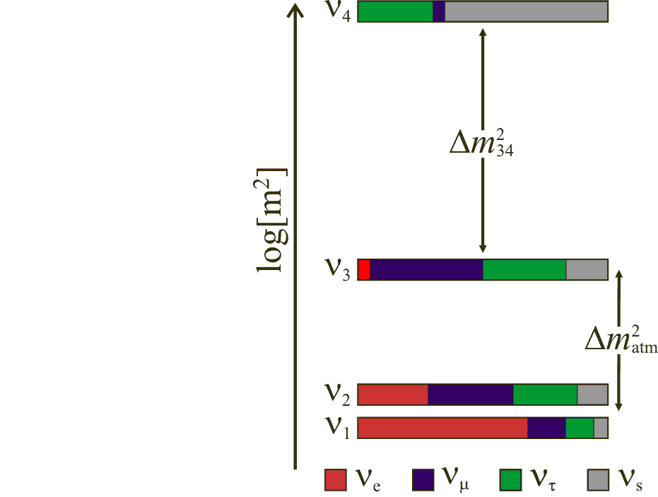
e
le
Did LSND result at Δm²~1 eV² imply a 4th mass state?
Expt claims 3.8σ evidence
NEW ν STATES IN OSC EXPTS?
Aguilar et al. PRD64:112007,2001

Slide 24
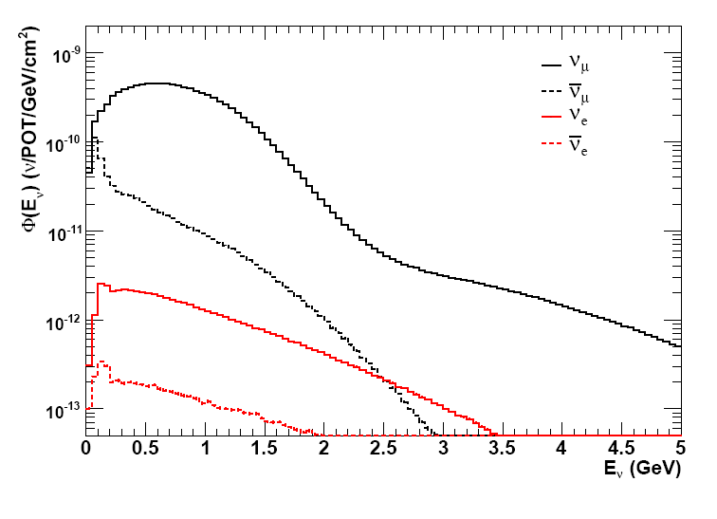



MiniBooNE
ν-mode
(GEANT4)
ν_{μ} ~ 6%
ν_{e} ~ 0.5%
Keep L/E same as LSND
(change systematics, <E>, evt signal)
  6.5×10²⁰ PoT (ν-mode)
  5.1×10²⁰ PoT(ν-mode)
  approved 5 × 10²⁰ PoT more
target and horn
decay region
absorber
dirt
detector
K⁺
ν_{μ} → ν_{e} ???
Booster
π⁺
800t mineral oil
Cherenkov detector
primary beam
secondary beam
tertiary beam
(protons)
(mesons)
(neutrinos)
Order of magnitude
higher energy (~500 MeV)
than LSND (~30 MeV)
Order of magnitude
longer baseline (~500 m)
than LSND (~30 m)
figures courtesy S. Brice, FNAL

Slide 25
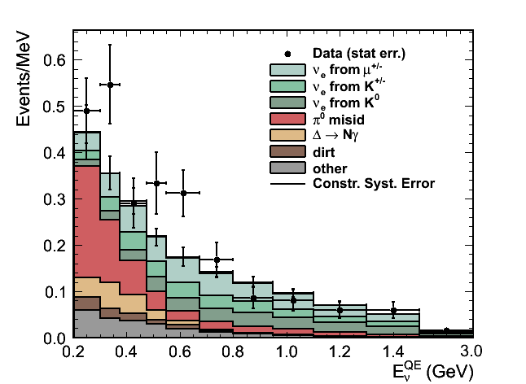
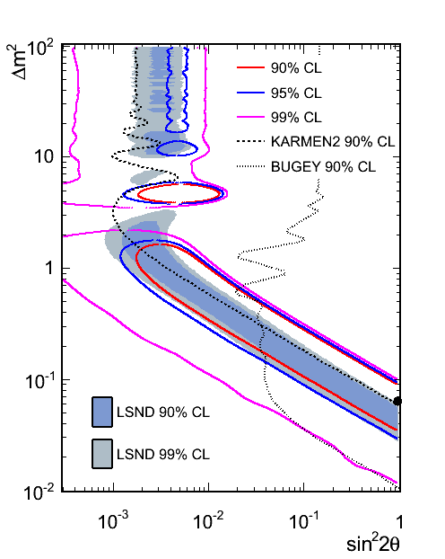
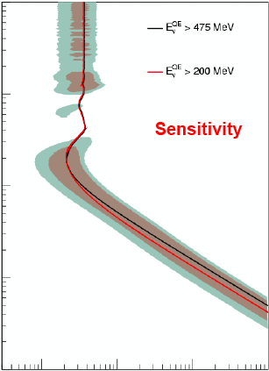
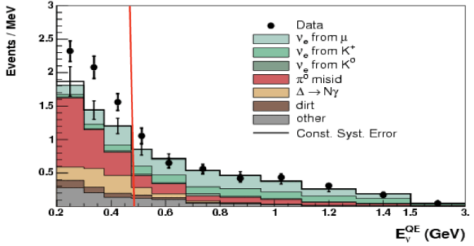

MiniBooNE
R. Vander Water, Neutrino 2010 Conference (Athens)
Excess
18.5 ± 14.3 evts
ν_{e}
Excess 43.2 ± 22.5 events
Excess
84 ± 25 evts
ν_{e}
Excess 22 ± 36 events
ν_{e}
A.A. Aguilar-Arevalo et al. PRL 98, 231801 (2007);
A.A. Aguilar-Arevalo et al. PRL 102, 101802 (2009)
figures courtesyR. Vander Water, LANL

Slide 26
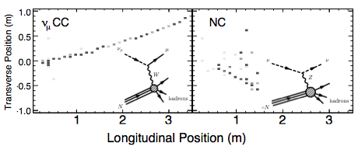
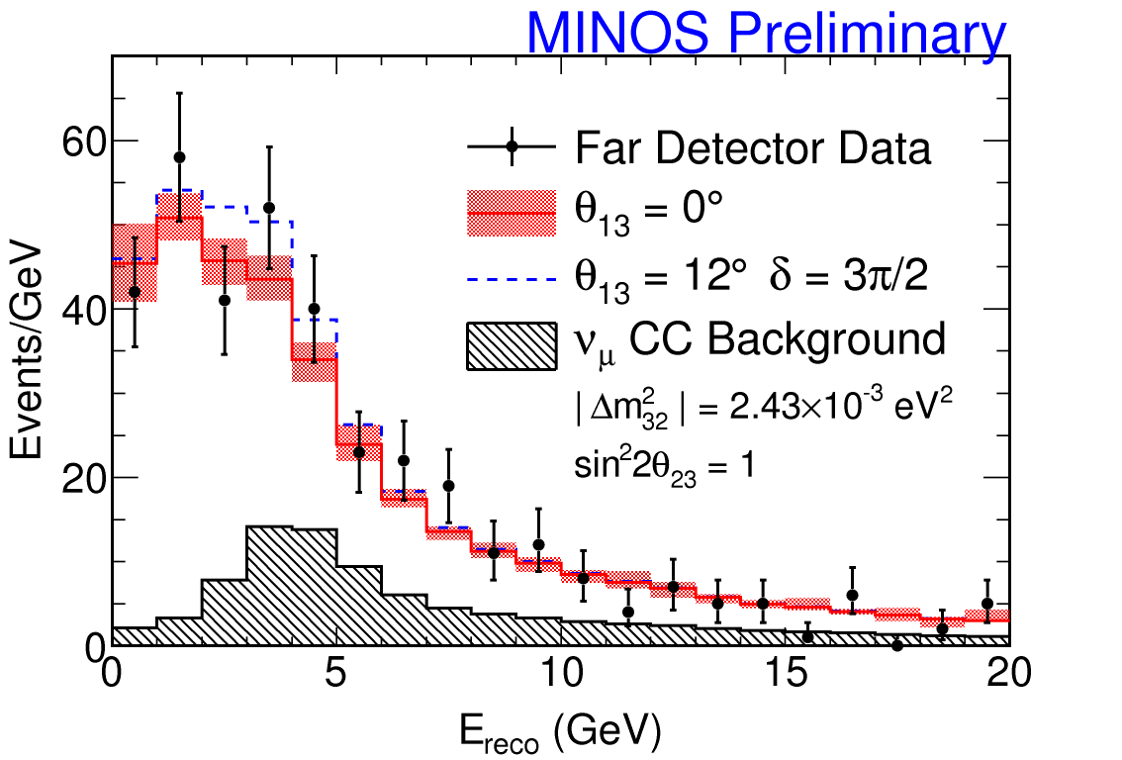
MINOS Search for ν_{μ}→ν_{sterile}
Charged current – identifies flavor of interacting ν_{μ}
Neutral current – inclusive, all “active” ν flavors interact
A ν_{μ}→ν_{sterile} oscillation would result in a deficit of NC events at the Far Detector
see Phys.Rev.Lett.101:221804 (2008) updated for 3×10²⁰POT (submitted PRD)
figures courtesy B. Rebel (FNAL), A. Sousa (RAL), Fermilab seminars

Slide 27





MINOS 4-Flavour Analysis
Assume additional sterile ν and an additional Δm²
Extend mixing matrix with extra angles & phases
  |Δm²₄₁| >> |Δm²₃₁|
|Δm²₄₁| << |Δm²₃₁|
(effectively θ₁₄=θ₂₄=0° in this case)
figures courtesy B. Rebel, A. Sousa
Notes:
θθ

Slide 28



CP-Violating
ν_{μ}→ν_{e}Escapes Detection: Experiments Step Up The Search
Search for θ₁₃ via reactors (disappearance) or accelerators (appearance)
Must find θ₁₃>0 to study CP
Δm² (eV²)
MINOS Δm²
CHOOZ limit sin²(2θ₁₃)<0.15 Eur.Phys.Journal C27:331-374, 2003
sin²(2θ₁₃)

Slide 29

MINOS ν_{μ} → ν_{e} Search
Expected background
49±7(stat) ±3(syst)
(mis-reconstructed showers, beam ν_{e})
Observed:
54 events
Observed is 0.7σ over bckgd. expectation
figures courtesy M. Sanchez, P. Vahle

Slide 30

MINOS ν_{e} Appearance
For δ_{CP}=0, sin²2θ₂₃=1, |Δm₃₂²|=2.43×10⁻³eV² ,
  sin²2θ₁₃<0.12 (90%CL for Δm²>0)
  sin²2θ₁₃<0.20 (90%CL for Δm²<0)
S. Kopp, Lepton-Photon 2009
figures courtesy M. Sanchez, P. Vahle

Slide 31

Fogli et al. Global Fit to Data on θ₁₃
arXiv:0905.3549
θ₁₃ = 0 disfavored by ~2σ
Central value sin²θ₁₃ = 0.02 or sin²(2θ₁₃) = 0.08

Slide 32



P(ν_{e}→ν_{e}) = 1 – cos⁴θ₁₃ sin²2θ₁₂ sin²(Δm²₁₂ L/4E)
– sin² 2θ₁₃ sin²(Δm²_{atm} L/4E)
On peut measurer θ₁₃
sans l’effects
de la matière
oú du “CP”
subdominant
θ₁₃ oscillation
Plusieurs expériences sont preparés en France, la Chine, et la Coreé
dominant
θ₁₂ oscillation

Slide 33






Experiments Under Construction
Exp’t | Power (GWth) | Distance N/F (m) | Target N/F (t)
Double Chooz | 8.6 | 400/1050 | 8.6/8.6
RENO | 17.3 | 290/1380 | 16/16
Daya Bay | 11.6 (17.4) | 360(500)/ 1990(1620) | 2x40/80
S. Kopp, NuFact 2010
figures courtesy M. Dierckxsens, Chicago

Slide 34


Status of Double Chooz
Far hall
Far detector under construction
Buffer PMTs installed last
month, acrylic vessels
integration started
Phase I: data taking with far
detector only (soon!)
Near lab will be available
at end of 2011
Phase II: data taking with
both detectors in 2011
Far PMTs
figures courtesy M. Dierckxsens
S. Kopp, NuFact 2010

Slide 35



Status of RENO
Near & far tunnels completed
Oct 2009: Steel/acrylic vessels &
support installation
Late 2010: both detectors ready for
data taking
Test mock-up detector (1/10) ongoing
Tunnel entrance
Detector pit
Mock-up detector
S. Kopp, NuFact 2010
figures courtesy S.B. Kim

Slide 36



Status of Daya Bay
Assembly building
Tunnel
Acrylic
vessel
March 2009: surface assembly building
occupancy
Summer 2009: DB near hall occupancy
Fall 2009: first detector ready
Summer 2010: DB near hall ready for data
Summer 2011: far hall ready for data
figures courtesy K.B.Luk
S. Kopp, NuFact 2010

Slide 37



Expected Sensitivities
90% CL
RENO
Double Chooz
Near & Far
Δm²₃₁ (x10⁻³)
sin²2θ₁₃
Far only
sin²2θ₁₃
Exposure time (years)
90% CL
Expt | σ_{stat} [%] | σ_{syst} rel. [%] | sin²2θ₁₃ > (90% CL)
Double Chooz | 0.5 | 0.6 | 0.03
RENO | 0.3 | 0.5 | 0.02
Daya Bay | 0.2 | 0.4 | 0.01
Daya Bay
sin²2θ₁₃
S. Kopp, NuFact 2010
figures courtesy M. Dierckxsens, Chicago

Slide 38

Reactor + Geo ν’s from Borexino
S. Kopp, NuFact 2010

Slide 39


“All the Nu’s that’s fit to print”
’
Neutrinos Exhibit Quantum-Mechanical Oscillations
CAN NEUTRINO CP EXPLAIN BARYON ASYMMETRY?
direct m_{ν}
long baseline
accelerator
double-beta
Mixing like quarks, implications beyond Standard Model
atmospheric
solar
reactor
LSND/MiniBooNE
World-Wide Effort to Interpret Nu Disappearance, Mass
Experiments still pushing for CP Violation in Neutrinos
Stay tuned!
New facilities, discoveries!

Slide 40

Masses & mixings http://pdglive.lbl.gov/
2.35 +0.11 -0.08 (2010)

Slide 41

New KamLAND fit

Slide 42
KamLAND fit

Slide 43

Care is needed!
θ₁₃ limits are expressed several different ways
Several factors of 2
Confusion is possible
U_{e3}² = sin²θ₁₃ ~ ½ sin²θ_{μe} ~ 1/4 sin²2θ₁₃

Slide 44

New CHOOZ limit
CHOOZ limit curve has not changed
CHOOZ limit in 2008 PDG is: sin²2θ₁₃ < 0.19
You also see 0.10, 0.11, 0.14, 0.15, 0.20, …
PDG was at 2.0 10⁻³ eV² based on 1σ low Super-K Δm²₃₂ (best fit was in footnote)
For 2010 PDG, sin²2θ₁₃ < 0.15 based on MINOS best fit Δm²₃₂=2.43 10⁻³ eV² [1σ low value (0.16) will be in footnote]
∆m²
Palo Verde
SK allowed sin²2θ₁₃ (90% CL)
Chooz
sin²2θ₁₃

Slide 45
A notation issue
Δm²₁₂ ≡ m₁² – m₂²
Δm²₂₁ ≡ m₂² – m₁²
Δm²₁₃ ≡ m₁² – m₃²
Δm²₃₁ ≡ m₃² – m₁²
Δm²₂₃ ≡ m₂² – m₃²
Δm²₃₂ ≡ m₃² – m₂²
Δm²₁₂ + Δm²₂₃ + Δm²₃₁ = 0
θ₁₂, θ₁₃, θ₂₃ are labels,
Δm²_{jk} are ordered (sign)
Some think θ₁₂ goes with Δm²₁₂ – no
  Much slopply notation in the literature
We know the sign of Δm²₂₁ but not Δm²₃₂
Δm²₃₂ ~ Δm²₃₁ will be good for several editions, but not forever

Slide 46
Issue for PDG
What to encode?
Many measurements test outside that paradigm
  ν vs ν
  4 ν
  5 ν
  Lorentz violation
  Sterile fractions
  NSI
  …
  What is useful?
Through 2004, we encoded 2ν limits, most irrelevant now
We currently encode mixing angles and parameters in the 3 neutrino paradigm
  Also LSND regions

