Slide 1


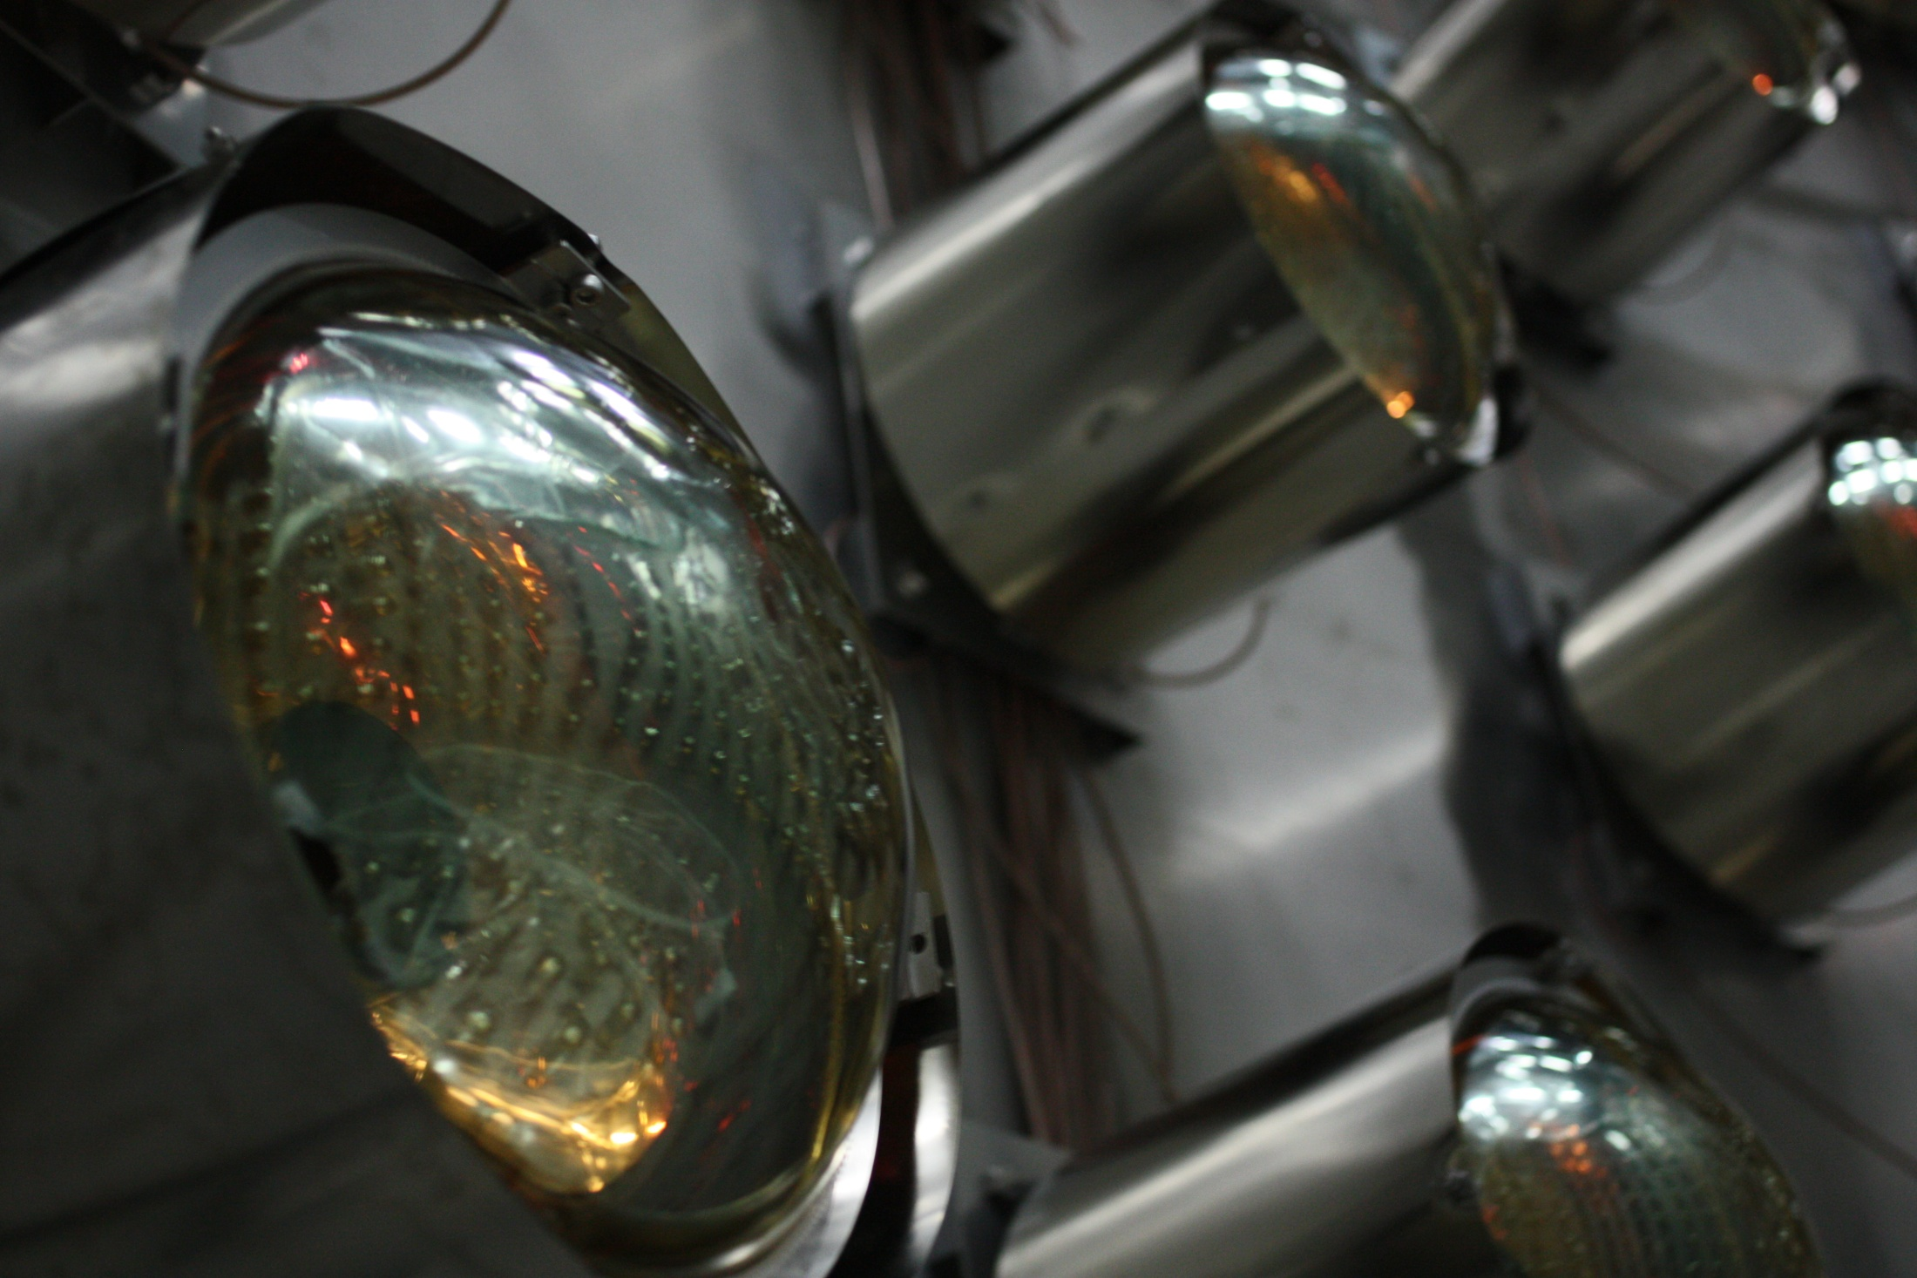
Status of RENO Experiment
NuFact2010, Oct. 20-25 2010, Mumbai, India
J.S. Jang
Chonnam National University
for RENO collaboration
Oct. 24, 2010

Slide 2
Outline
Overview of the RENO Experiment
- Experimental Method
- YongGwang Power Plant & Experimental Setup
- Statistical & Systematic Uncertainties
- Expected θ₁₃ Sensitivity
- Schedule
Construction Status of the RENO Experiment
- Tunnel
- Detector
- DAQ & Data Analysis Tools

Slide 3
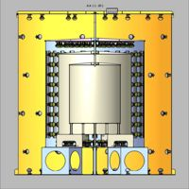
Experimental Method of θ₁₃ Measurement
ν_{e}
Oscillations observed as a deficit of anti-neutrinos
ν_{e}
ν_{e}
ν_{e}
ν_{e}
ν_{e}
1.0
sin²2θ₁₃
flux before oscillation
Probability ν_{e}
Distance
1200 to 1800 meters
Find disappearance of ν_{e} fluxes due to neutrino oscillation as a function of energy
Identical detectors reduce the systematic errors in 1% level.

Slide 4
Detection of Reactor Neutrinos in Gd-LS detector

Slide 5
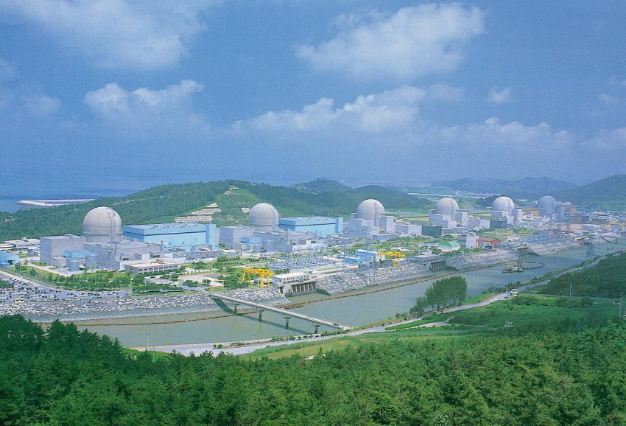
YongGwang Nuclear Power Plant
Located in the west coast of southern part of Korea
~400km from Seoul
6 reactors are lined up in roughly equal distances and span ~1.3 km
Total average thermal output ~16.4GW_{th}
(2nd largest in the world)
YongGwang :
靈光(Glorious light)

Slide 6
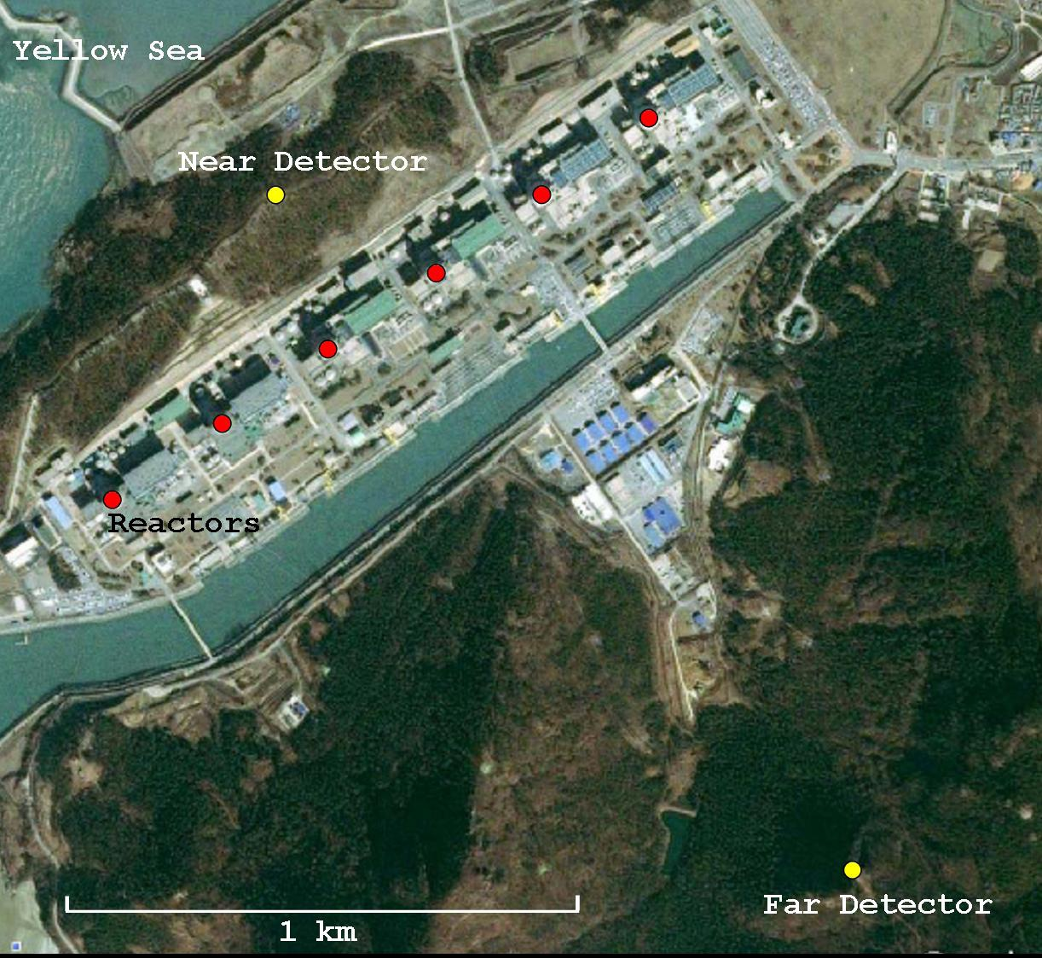
Google Satellite View of Experimental Site
~290m
~1380m

Slide 7


RENO collaboration
(13 institutions and 40 physicists)
Chonnam National University
Chonbuk National University
Dongshin University
Gyeongsang National University
Kyungpook National University
Pusan National University
Sejong University
Seokang Information University
Seokyeong University
Seoul National University
Sungkyunkwan University
Institute of Nuclear Research RAS (Russia)
Institute of Physical Chemistry and Electrochemistry RAS
(Russia)
+++ http://neutrino.snu.ac.kr/RENO

Slide 8
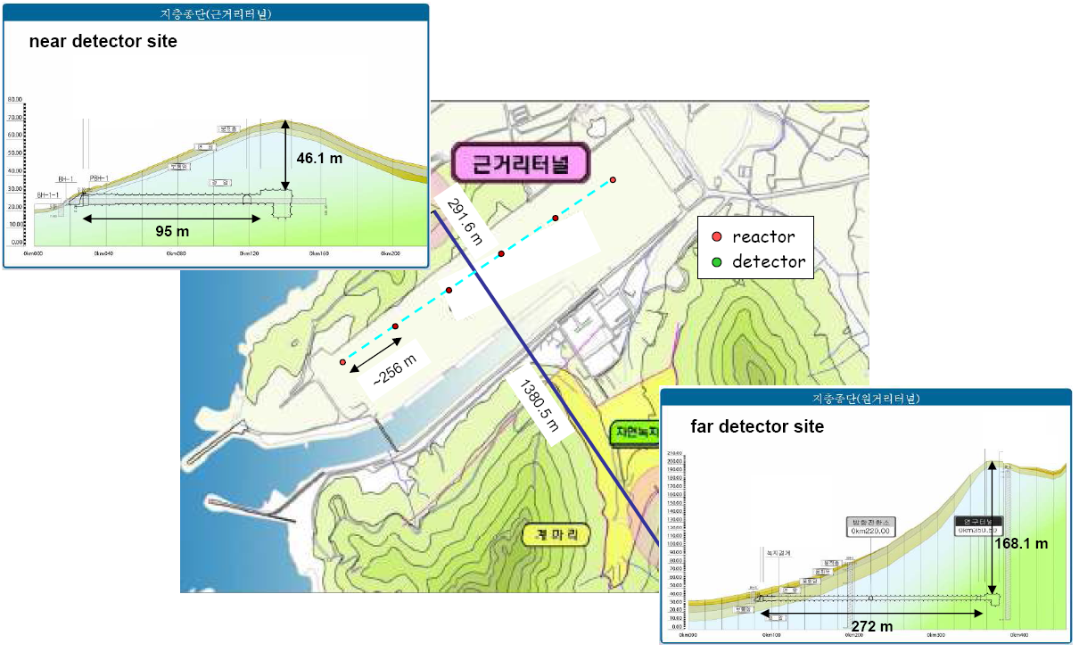
RENO Experimental Setup
Experiments | Location | Thermal Power (GW) | Distances Near/Far (m) | Depth Near/Far (mwe) | Target Mass (tons) | Cost (US $) | # of people
Double-CHOOZ | France | 8.7 | 410/1050 | 115/300 | 10/10 | ? | > 160
RENO | Korea | 17.3 | 290/1380 | 120/450 | 16/16 | ~10M | 40
Daya Bay | China | 11.6 | 360(500)/1985(1613) | 260/910 | 40×2/80 | ? | > 230

Slide 9
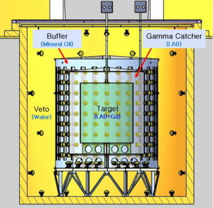
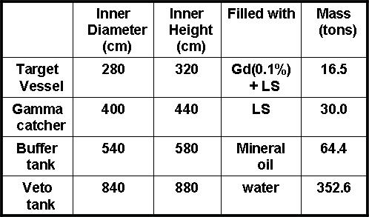
RENO Detector
(Gd loaded liquid scintilllation detector)
354, 10” Inner PMTs
: 14% surface coverage
67, 10” Outer PMTs

Slide 10
Expected Number of Neutrino Events at RENO
2.73 GW per reactor ⅹ 6 reactors
1.21x10³⁰ free protons per targets (16 tons)
Near : 1,280/day, 468,000/year
Far : 114/day, 41,600/year
3 years of data taking with 70% efficiency
Near : 9.83x10⁵ ≈ 10⁶ (0.1% error)
Far : 8.74x10⁴ ≈ 10⁵ (0.3% error)

Slide 11
Expected Systematic Uncertainty
Systematic Source |  | CHOOZ (%) | RENO (%)
Reactor related absolute normalization | Reactor antineutrino flux and cross section | 1.9 | < 0.1
 | Reactor power | 0.7 | 0.2
 | Energy released per fission | 0.6 | < 0.1
Number of protons in target | H/C ratio | 0.8 | 0.2
 | Target mass | 0.3 | < 0.1
Detector Efficiency | Positron energy | 0.8 | 0.1
 | Positron geode distance | 0.1 | 0.0
 | Neutron capture (H/Gd ratio) | 1.0 | < 0.1
 | Capture energy containment | 0.4 | 0.1
 | Neutron geode distance | 0.1 | 0.0
 | Neutron delay | 0.4 | 0.1
 | Positron-neutron distance | 0.3 | 0.0
 | Neutron multiplicity | 0.5 | 0.05
combined |  | 2.7 | < 0.5

Slide 12
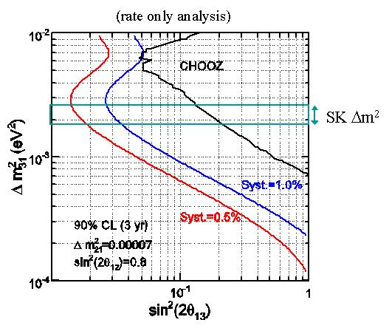
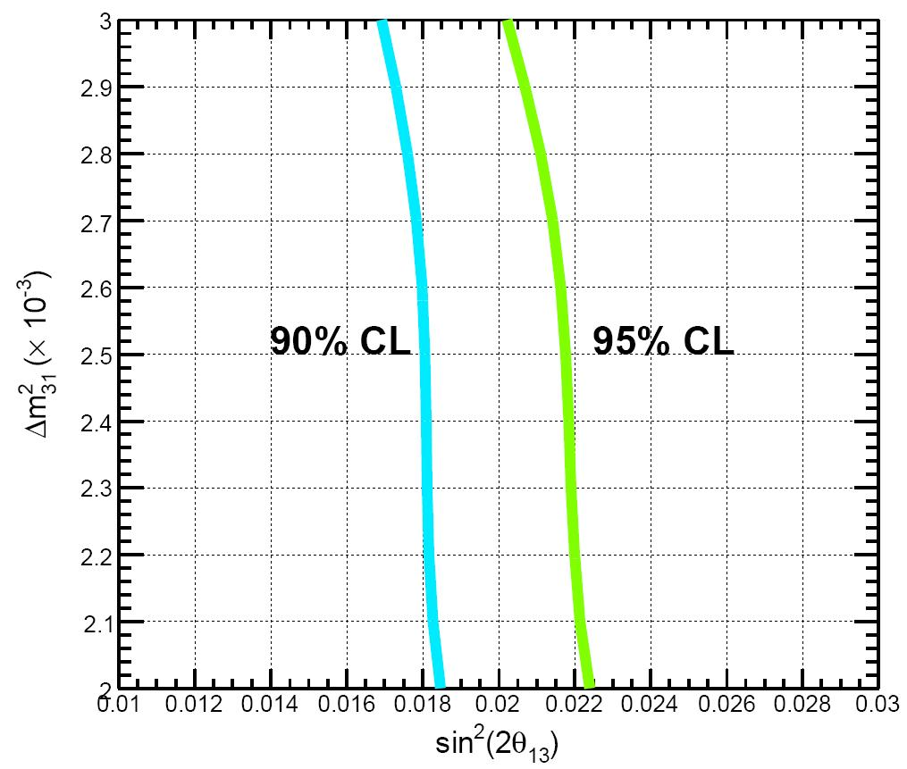
RENO Expected Sensitivity
New!! (full analysis)
10x better sensitivity than current limit

Slide 13
Schedule
Activities
2006
2007
2008
2009
2010
2011
Activities
3
6
9
12
3
6
9
12
3
6
9
12
3
6
9
12
3
6
9
12
3
Detector Design
& Specification
Geological Survey
& Tunnel Design
Detector
Construction
Excavation &
Underground Facility
Construction
Detector
Commissioning &
Data Taking
Tunnel facility, detector structure & buffer steel tanks completed
June 2010 : Acrylic containers installed
Aug. 2010 : PMT test completed
Aug. ~ Oct. 2010 : Installation of PMTs, veto tyvek and liquid handling system
Nov. ~ Jan. 2010 : Installation of DAQ & HV and filling with liquid scintillator
Jan. 2011 : Closing and detector commissioning
Feb. 2011 : Start data taking

Slide 14
Construction status
2007. 03~11 : Geological survey and tunnel design are completed.
2008. 06~12 : Construction of both near and far tunnels are completed.
2008.12 ~ 2009. 06 : Veto tanks and peripheral facilities (electricity, air circulation, drainage, network, etc.) are completed.
2008. 11 : SK new electronics were adopted and ready.
2009. 06~11 : Buffer steel tanks are installed
2010. 06 : Acrylic containers are installed.
2010. 08 : PMT test is completed
Installation of PMTs, Electronics and liquid handling system are underway.
2011. 02 : Both near and far detectors are expected to be ready for data-taking.

Slide 15
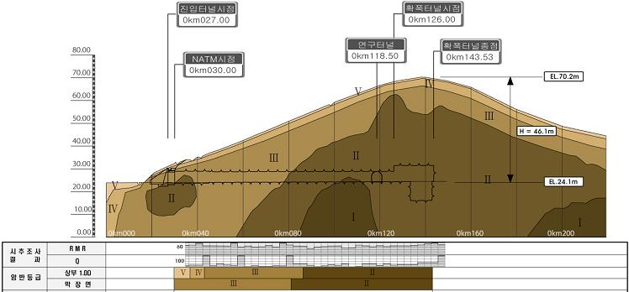
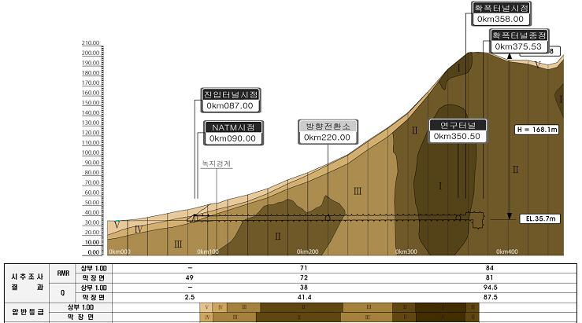
Geological survey
(2007.3~2007.8)
Rock Quality Map
Near detector site:
tunnel length : 110m
overburden
height : 46.1m
Far detector site:
tunnel length : 272m
overburden
height : 168.1m

Slide 16
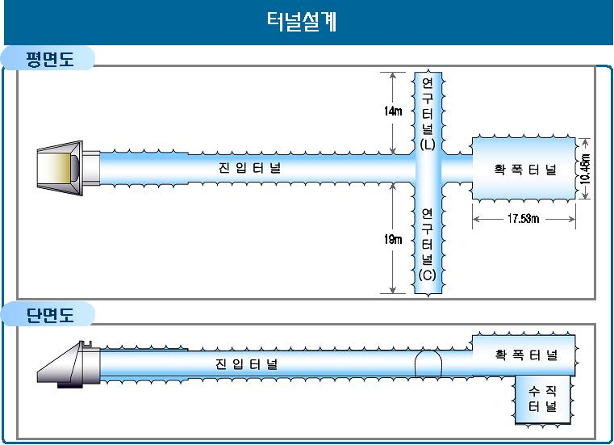
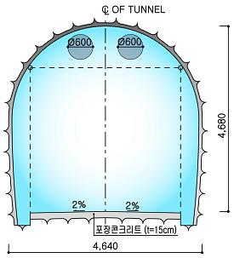
Tunnel design
(2007.9~2007.11)
Design of Tunnel
Wing tunnel(L)
Access tunnel
Experimental hall
Wing tunnel(R)
Detector
Experimental hall
Access tunnel
Wing tunnel(R)
Detectorvertical hall

Slide 17
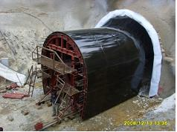
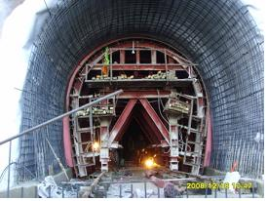
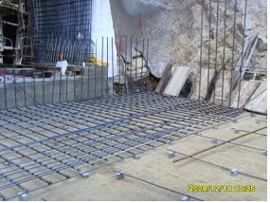
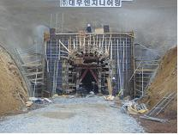
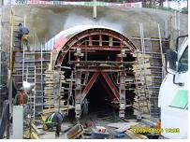
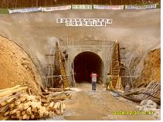
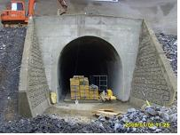
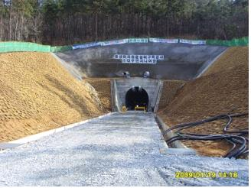
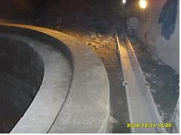
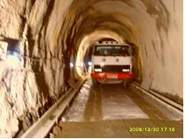
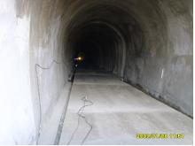
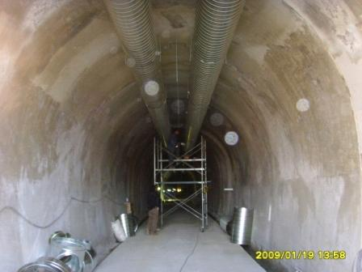
Tunnel construction
(2008.6~2008.12)
Tunnel Construction
by Daewoo Eng. Co. Korea

Slide 18
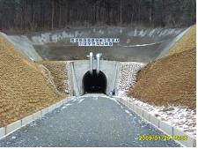
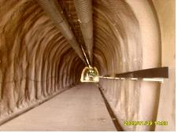
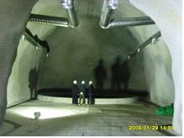
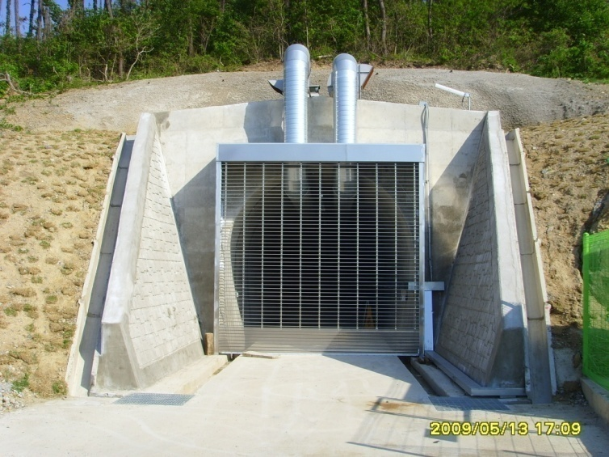
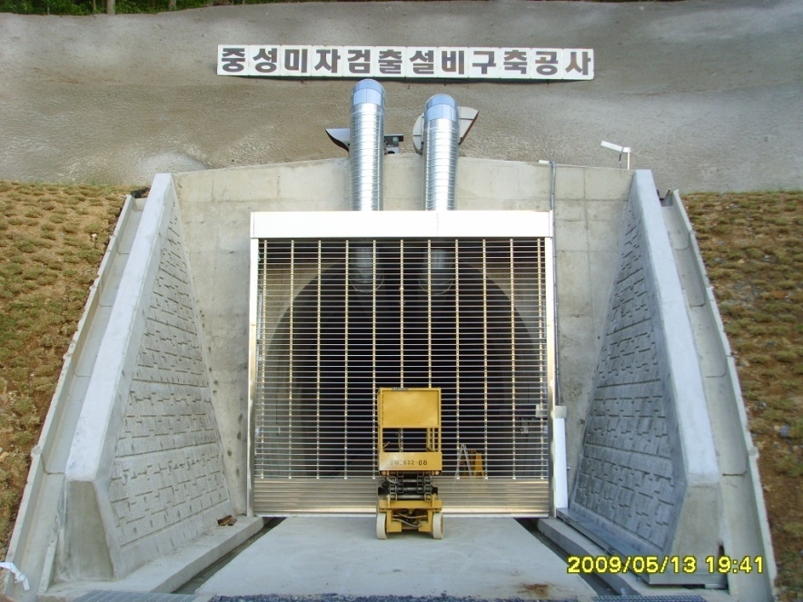
Tunnel completion
(2009.3)
Near & far tunnels are completed
by Daewoo Eng. Co. Korea
Near site
Far site

Slide 19
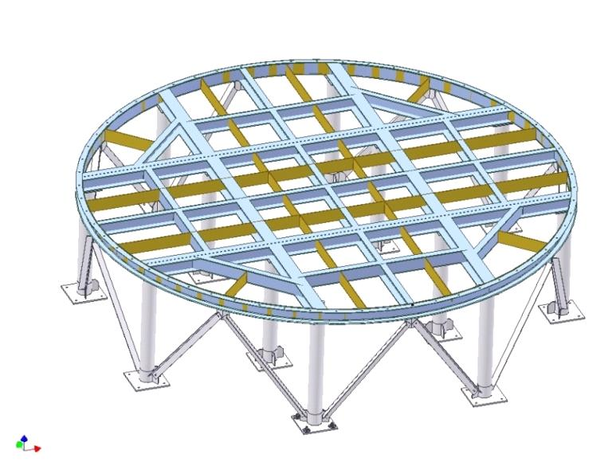
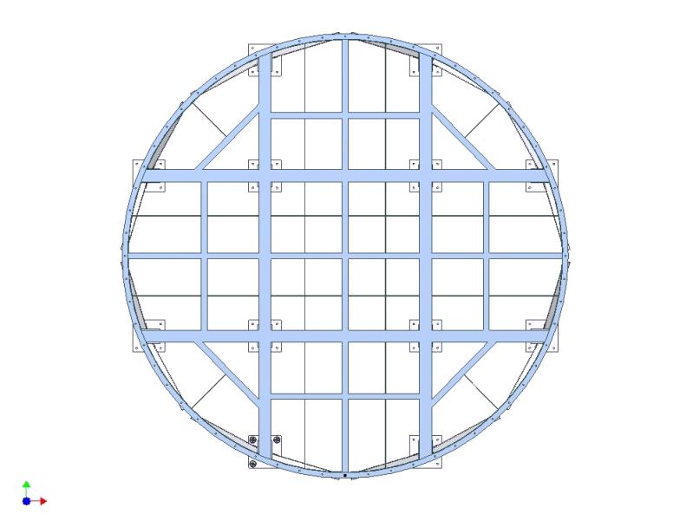
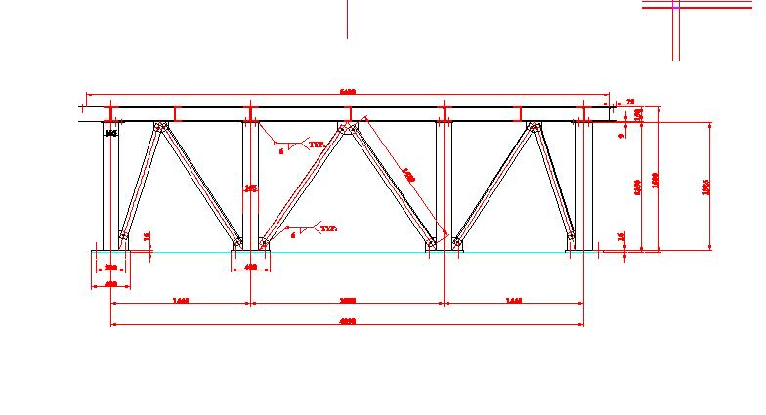
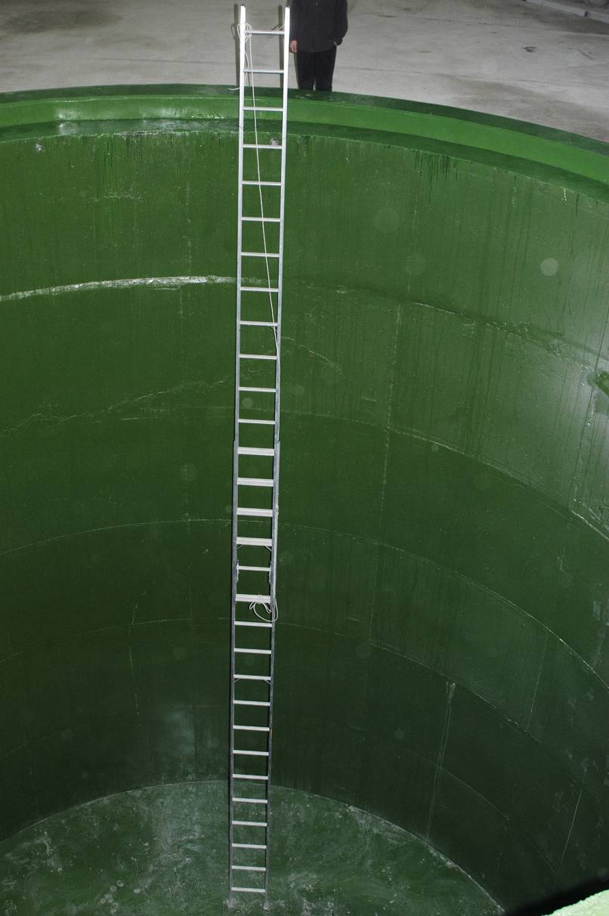
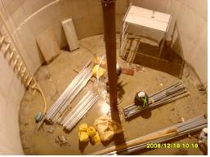
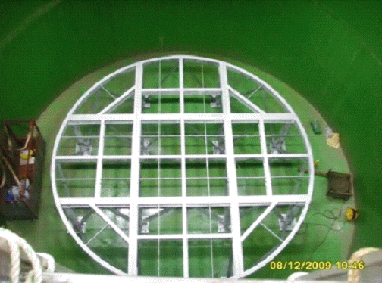
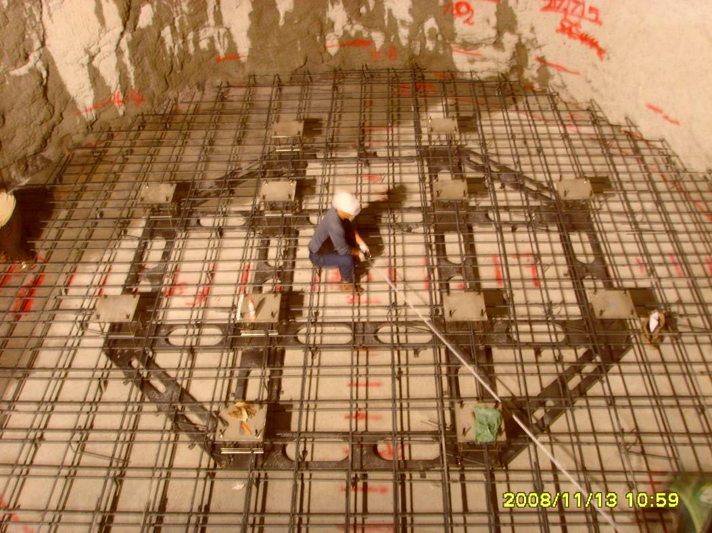
Vertical detector halls & steel structure are ready
(2008. 12~2009. 06)
by NIVAK Co. Korea

Slide 20
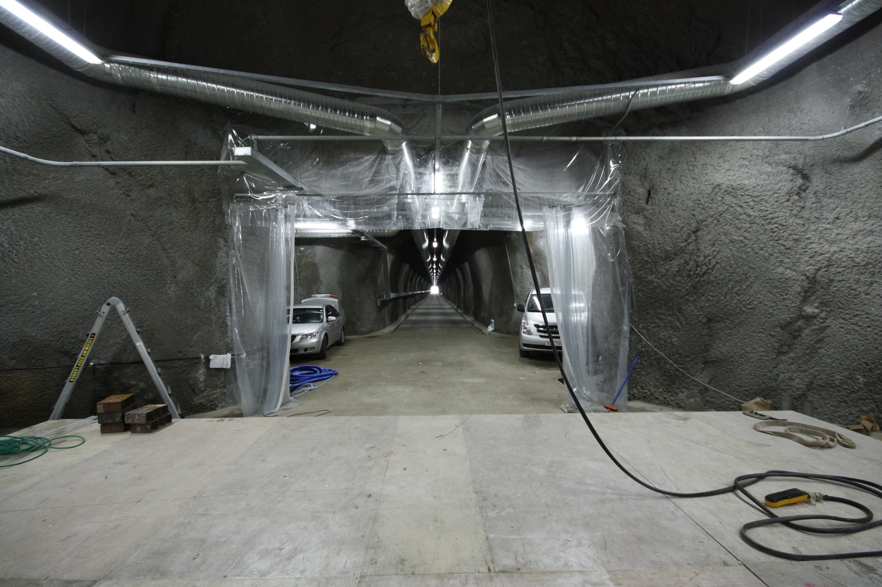
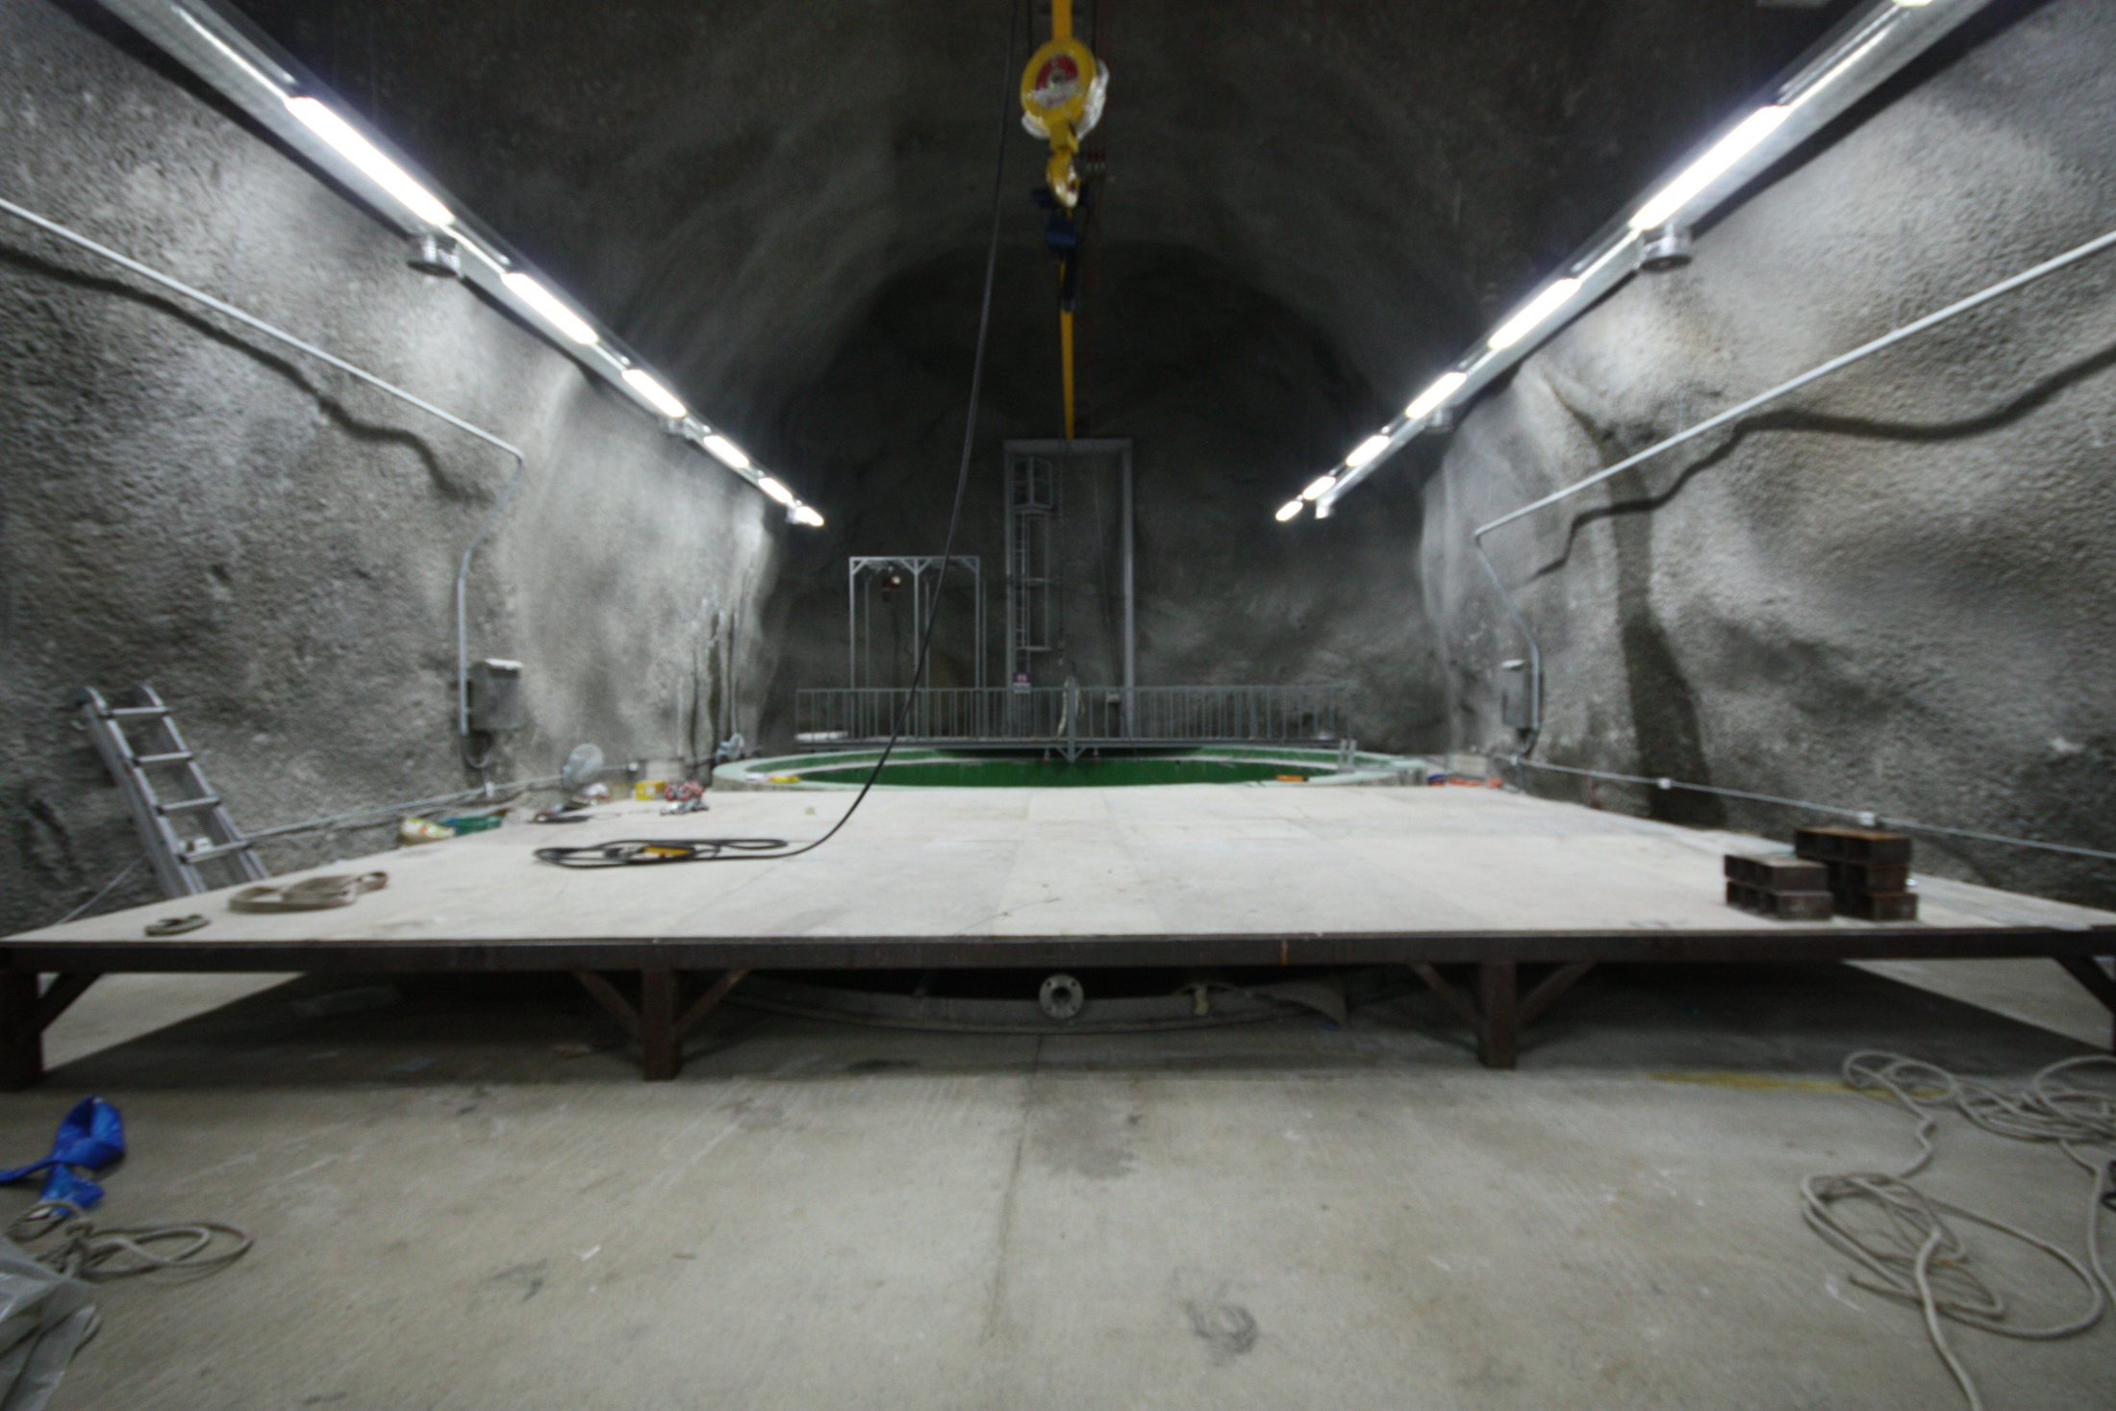
Experimental Hall

Slide 21
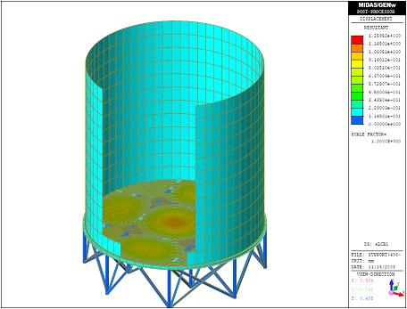
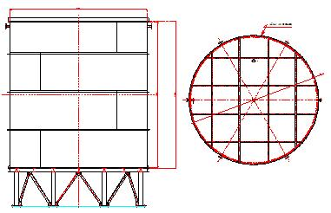
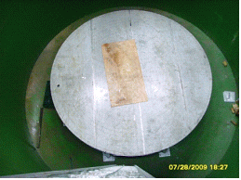
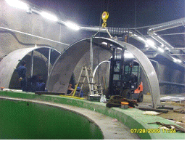
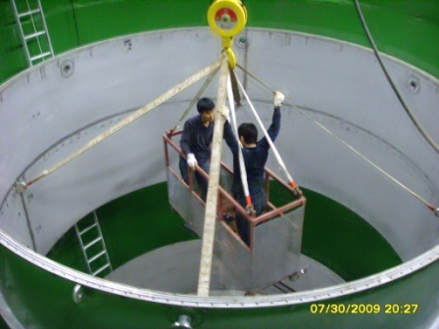
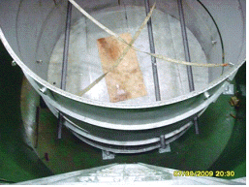
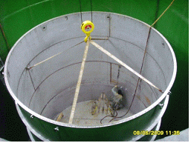
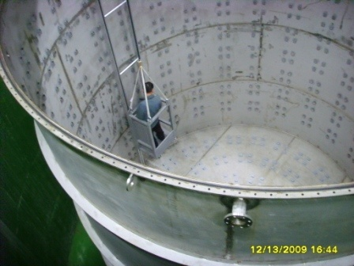
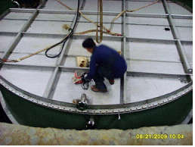
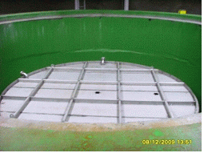
Buffer steel tanks are installed (2009.6~2009.11)
by NIVAK Co. Korea

Slide 22
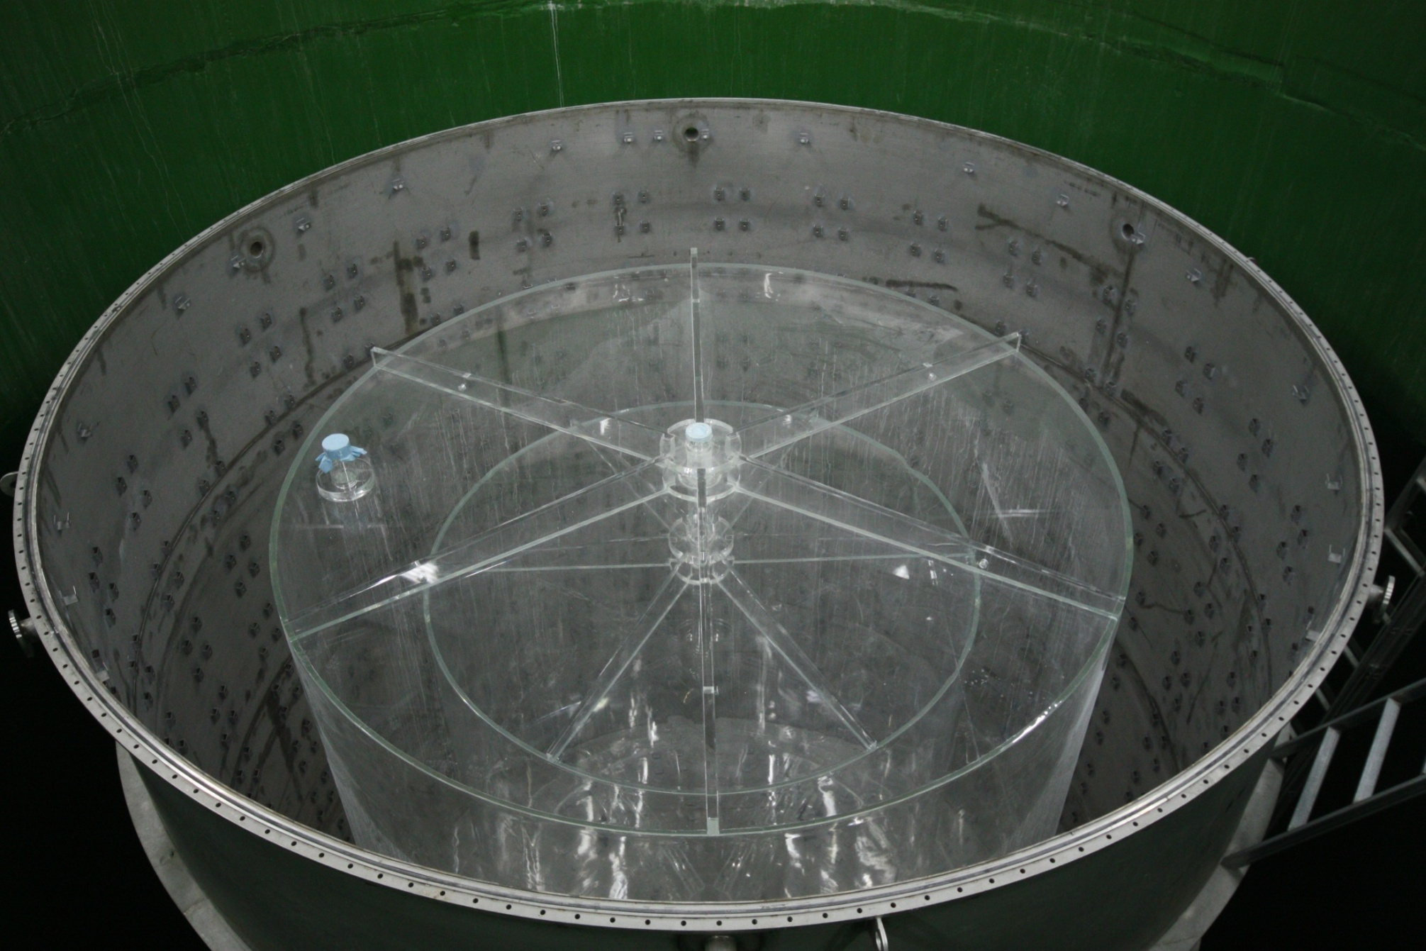







Installation of Acrylic Vessels (2010. 06)
by KOA Tech. Korea

Slide 23

PMT test (2010. 07~ 08)
890 PMTs were tested and 6 PMTs were returned to Hamamatsu.

Slide 24





Production of PMT Holder (2009. 10~12) &
PMT Mounting (2010. 08~10)

Slide 25



Installation of 1st PMT (2010. 08. 17) & bottom PMTs

Slide 26





PMT assembling & barrel PMTs

Slide 27




Installation of VETO tyvek & outer PMTs
Installation of
laser injector

Slide 28
At present,
PMT installation of near and far detectors has been done
except for top PMTs.
On going work (Middle of Oct. 2010)
Installation of top PMTs
Installation of liquid handling system
Preparing
Installation of DAQ and PMT HV system
Filling the liquid
Inner PMT installation of only far detector was done | NOW conference Sep. 2010
PMT installation
including the VETO tyvek
& VETO PMTs
of near and far detector
was done
NuFact
conference,
Oct. 2010

Slide 29





HV Supply System
All of system is ready to install.
HV Supplier
DAQ system
CAEN SY1527
CAEN A1932A

Slide 30



DAQ System
QBEE (QTC Based Electronics w/ Ethernet)
24 channel input
60MHz clock
0.1pC, 0.52nsec resolution
~2500pC/ch large dynamic range
No dead time (w/o hardware trigger)
Fast data transfer via Ethernet R/W
All of DAQ system is ready to install
& online DAQ programs are ready.

Slide 31



Gd Loaded Liquid Scintillator
C_{n}H_{2n+1}-C₆H₅ (n=10~14)
Recipe of Liquid Scintillator
Aromatic Solvent & Flour | WLS | Gd-compound
LAB | PPO + Bis-MSB | 0.1% Gd+TMHA (trimethylhexanoic acid)
High Light Yield : not likely Mineral oil(MO)
replace MO and even Pseudocume(PC)
Good transparency (better than PC)
High Flash point : 147ºC (PC : 48ºC)
Environmentally friendly (PC : toxic)
Components well known (MO : not well known)
Domestically available: Isu Chemical Ltd.
Target is filled with 0.1% Gd(with CBX) loaded liquid Scintillator
Liquid filling system is under construction.

Slide 32

RENO Event Display & Analysis Code
RENO Analysis Control
RACFrameWork
Raw/MC
Data
Production
Modules
Reconstruction
Modules
User
Analysis
Modules
User
ntuples
Online event display and offline analysis code are ready.

Slide 33

Summary
RENO is suitable for measuring θ₁₃ (sin²(2θ₁₃) > 0.02).
RENO is near completion.
Data taking with two detector is expected to start in Feb. 2011.
Thank you!

Slide 34
Backup

Slide 35
Calculation of Muon Rate at the RENO Underground
 |  | J_{μ} [cm⁻²s⁻¹] | <E_{μ}> [GeV]
Far | 250 m | 2.9×10⁻⁵ | 91.7
 | 200 m | 8.5×10⁻⁵ | 65.2
Near | 70 m | 5.5×10⁻⁴ | 34.3
Muon intensity at the sea level using modified Gaisser parametrization + MUSIC or Geant4 (the code for propagating muon through rock)

Slide 36


Calculation of Background Rates due to Radioactivity
 | Concentration ⁴⁰K (ppb) | Concentration ²³²Th (ppb) | Concentration ²³⁸U (ppb) | ⁴⁰K [Hz] | ²³²Th [Hz] | ²³⁸U [Hz] | Total [Hz]
Rock | 4.33(ppm) | 7.58(ppm) | 2.32(ppm) | 1.06 | 7.14 | 0.99 | 9.19
LS in Target | 0.001 | 0.001 | 0.001 | 0.90 | 0.09 | 0.26 | 1.25
Target Contatiner | 0.008 | 0.05 | 0.008 | 0.08 | 0.06 | 0.03 | 0.17
LS in Gamma Catcher | 0.001 | 0.001 | 0.001 | 1.52 | 0.13 | 0.38 | 2.03
Gamma Catcher Container | 0.008 | 0.05 | 0.008 | 0.07 | 0.04 | 0.03 | 0.14
LS in Buffer | 0.001 | 0.001 | 0.001 | 0.08 | ~ 0 | 0.03 | 0.11
Buffer Tank | 0.06 | 0.9 | 0.9 | 0.03 | 0.10 | 0.20 | 0.33
PMT | 13.6 | 208.5 | 49.4 | 2.50 | 5.23 | 2.99 | 10.72
Total |  |  |  |  |  |  | ~24

Slide 37
by Malfunction PMTs
Typical Plot
Error bar = RMS of pC/sqrt(#of hits)
* Error bar is too small in this plot

