Slide 1

Conventional
Neutrino Beam Experiments:
Present and
Future Generations
Deborah Harris
Fermilab
NuFact10
October 20, 2010
The Banjo Lesson by Henry Ossawa Tanner

Slide 2

Outline
Current Generation:
  MiniBooNE
  MINOS
  OPERA
Almost Current Generation
  NOvA
Next Generation(s)
  Building on existing beams: MicroBooNE, T2KK
  New beams, new detectors: LBNE, CERN-Frejus,…
What legacies are being handed down from one generation to the next?
  MINERvA
  T2K
  ICARUS

Slide 3
Goals and Strategies:
From one generation to the next
Current Generation: building foundations
  Pinning down atmospheric mass splitting
    Muon neutrino disappearance
  Figuring out what “LSND signal” means
    Electron Neutrino appearance at short baseline
  First hopes of seeing sin²2θ₁₃ above zero
    Electron neutrino appearance at ~1% level
  Pinning down neutrino interactions in preparation for the goals of measuring sin²2θ₁₃ and beyond

Slide 4
Current Generation
 | Moti-vattion | Beam Power (kW) | Detector | Base-line (km) | ν Ener gy (GeV) | Experi-mental Method | Integrated POT so far
Mini-BooNE | ν_{e} appr. | 30 (max) | Oil Cerenkov | 0.5 | 0.7 (Wide) | 1st max | 15e20
MINOS | ν_{μ} dis-appr. | 350 | Steel-Scint. | 734 | 3.5 (Wide) | 1st max | 11e20
OPERA | ν_{τ} appr. | 500 | Lead-Emulsion | 730 | 25 (Wide) | Before the 1st max | 8e19
ICARUS |  |  | LAr TPC |  |  |  | 2e19
MINERvA | ν inter-actions | 350 | Fine-Grained Scint. | 1.0 | 3.5 ++ (Wide) | Nucl. Targets | 12e19
T2K | ν_{e} appr. | 750 (50 so far) | Water Cerenkov+ND280 | 295 | 0.700 (Narrow) | Off-Axis | 3.4e19

Slide 5
Ingredients for Conventional Neutrino beams
Ingredients
  As many protons as you can get…
  Target
  Horns (at least one, at most three)
  Decay Volume
  Hadron Absorber
  Beamline Monitoring
“Tales from the Front Lines”

Slide 6
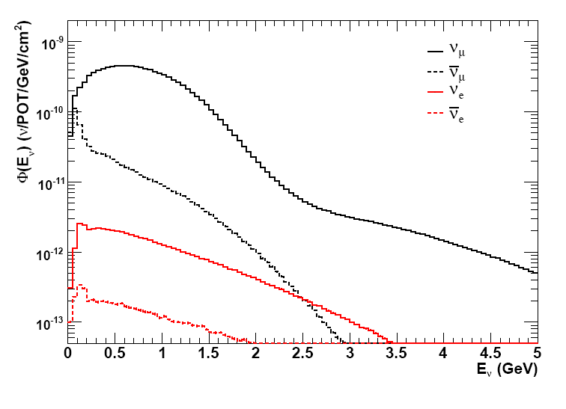
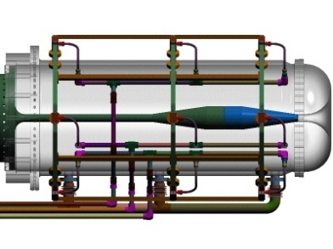

Booster Neutrino Beam
8 GeV protons, Beryllium target,
one horn, short decay pipe
  Enclosures for SciBooNE and
  MiniBooNE detectors
Produces broad band of ν_{μ} events
centered at ~1.4GeV
Designed for ν_{μ}→ν_{e} oscillations,
has found many surprising cross section results in addition to hints of surprising oscillation results
K⁺
Fermilab
Booster
π⁺

Slide 7
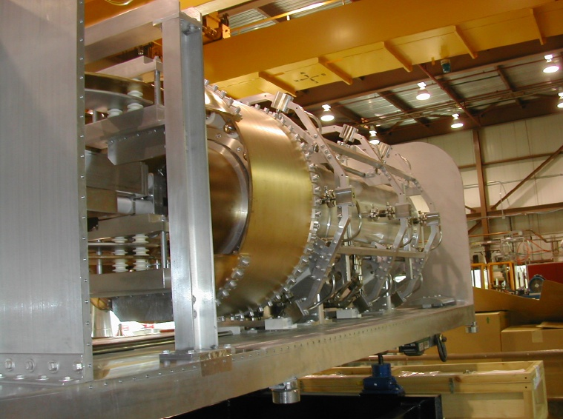
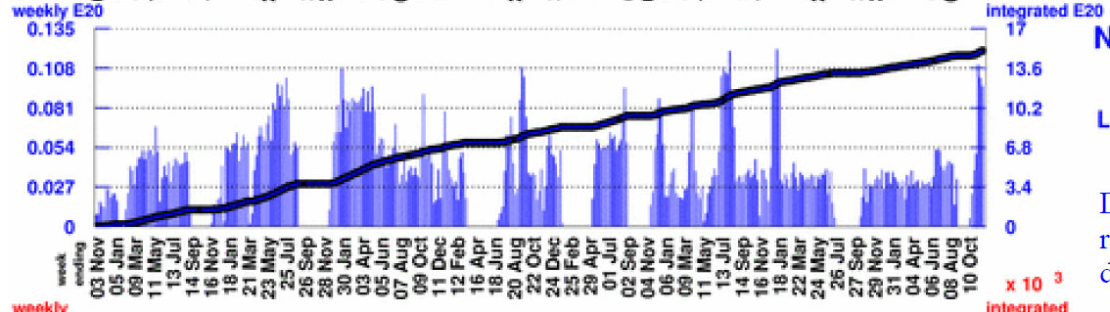
BNB: Tales from the front line
In operation the longest of current neutrino beamlines
15e20 POT as of 10/11/10
Current horn has worked 6 years, 275M pulses
First horn survived 100M pulses
Showing water leak and ground faults, may need to be repaired/replaced soon
Have to replace
horn with target
at same time
W. Huelsnitz, FNAL AEM, 10/11/10

Slide 8
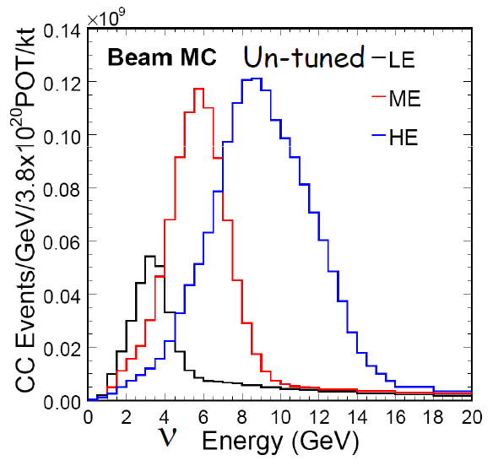
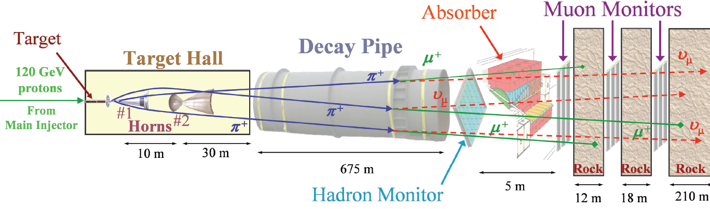
Neutrinos at the Main Injector Beamline
120GeV protons, Graphite target, two horns
Operating since 2005, over 1e21 POT
Flexible enough to produce peak energies
from 3.5 to 10GeV
Three planes of μ monitors, one hadron
monitor at downstream end of decay pipe
Graphics courtesy B. Zwaska

Slide 9
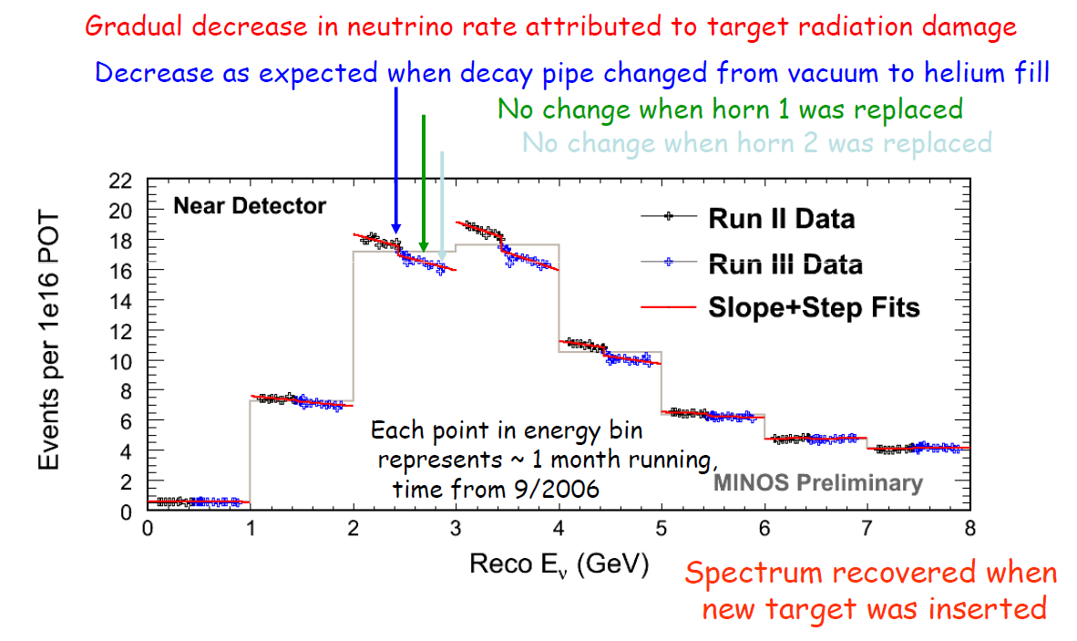
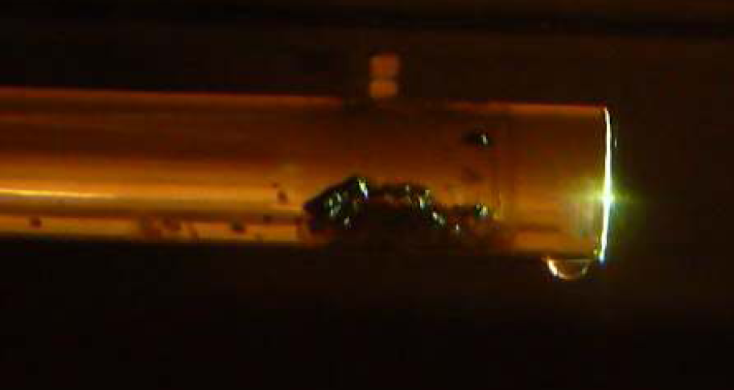
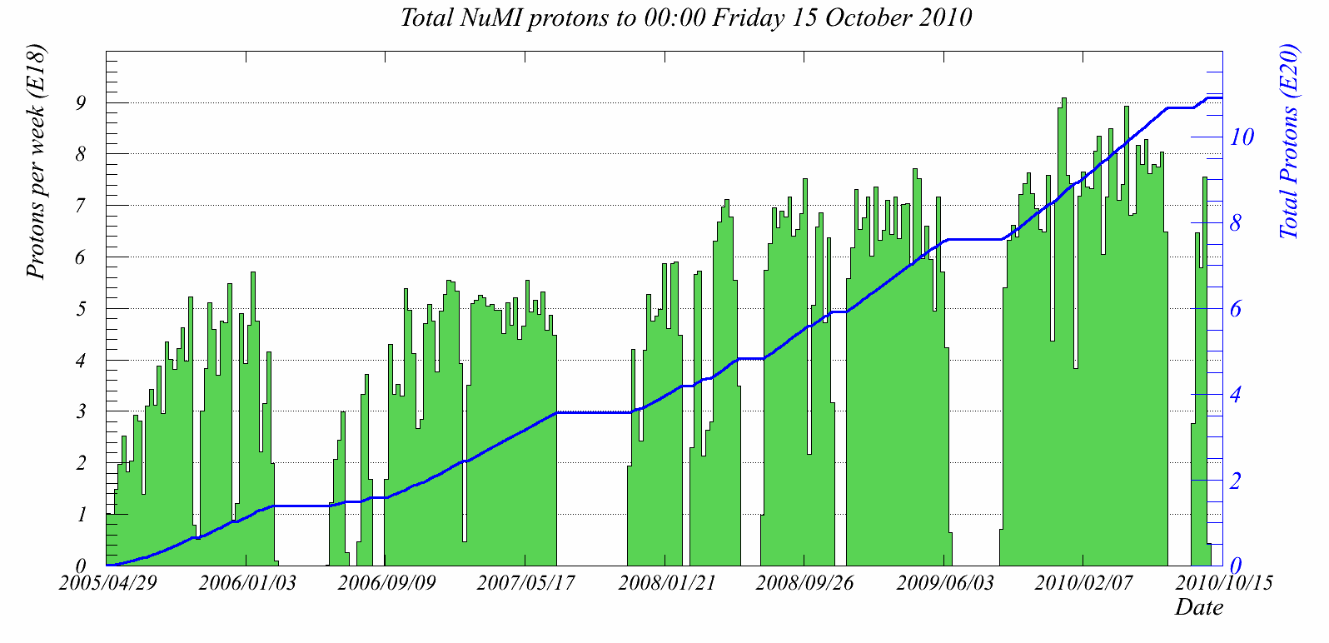
NuMI: Tales from the Front Line
In 5 years, replaced both horns
once, replaced target 4 times
3 target replacements linked to problems
braising graphite to stainless steel
water cooling tubes
Extensive monitoring system
provides ways to evaluate
beamline conditions as problems arise
Still learning about targets…
Plots and chart: J. Hylen, P. Adamson

Slide 10
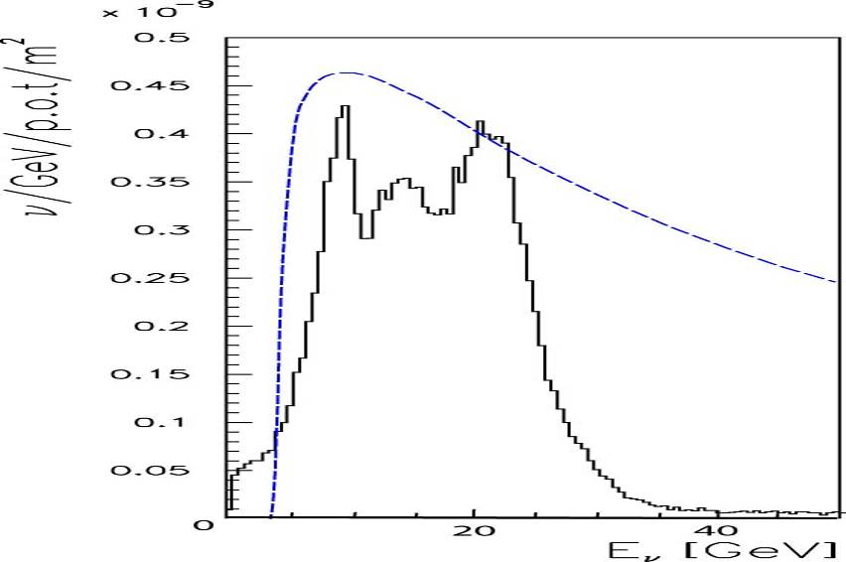
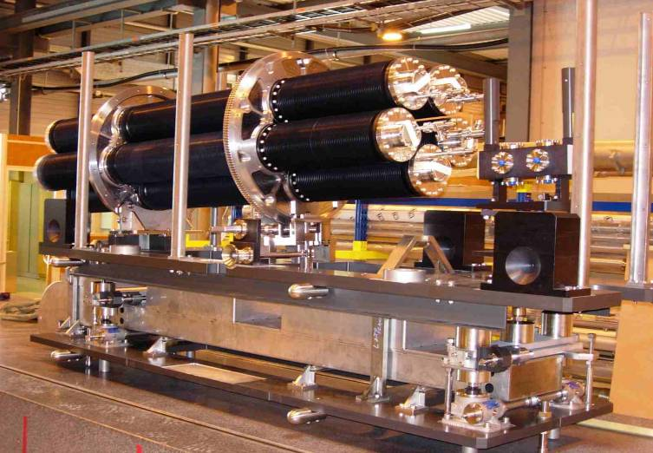
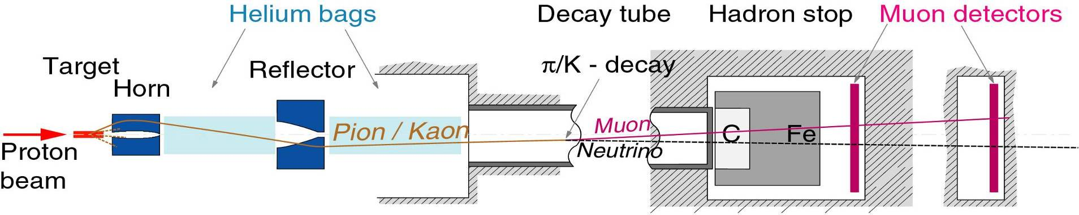
CERN to Gran Sasso Beamline
400GeV protons, air cooled graphite target, 2 horns
design power of 500kW
8E19 protons on target
2 stations of muon
monitors
P_{osc}*σ_{τcc}
(arbitrary units)
ν_{μ}-fluence
Figures courtesy E. Gschwendtner, NBI2010
TBID
2.7m
43.4m
100m
1095m
18m
5m
67m
5m

Slide 11
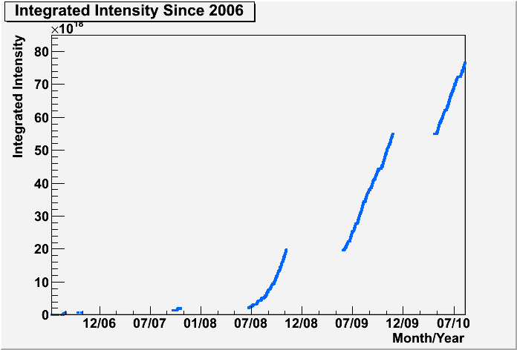
Tales from the front line: CNGS
Total today: 8E19 pot
(Approved for 22.5E19 pot)
Operational problems
  ‘06: Horn problems
  ‘07: Electronics Shielding problems
  ‘09-’10: Tritium in cooling water
2010 today
2.52E19 pot
2009
3.52E19 pot
2008
1.78E19 pot
E. Gschwendtner, NBI2010
2006
0.08E19 pot
2007
0.08E19 pot

Slide 12
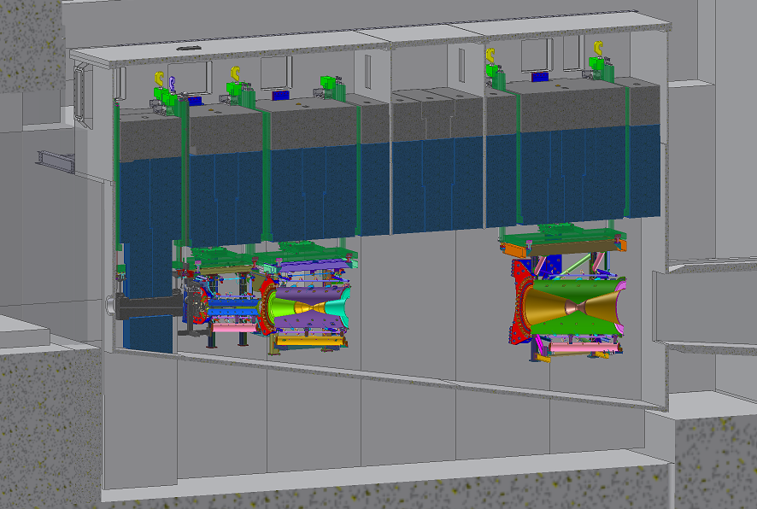
J-PARC ν Beamline
ν energy spectrum (flux × Cross Section)‏
Beam dump
Target station
OA0°
Decay Volume
OA2°
OA2.5°
110m
OA3°
Helium Vessel
Muon
Monitor
H. Kakuno NBI2010
Concrete Blocks
40-50GeV protons, He-cooled target, 3 horns, secondaries all in helium
Highest design power (770kW upgradable to 1.66MW)
2 technologies of muon monoitoring at one shielding depth
Iron shield (2.2m)
BEAM
2nd horn
3rd horn

Slide 13
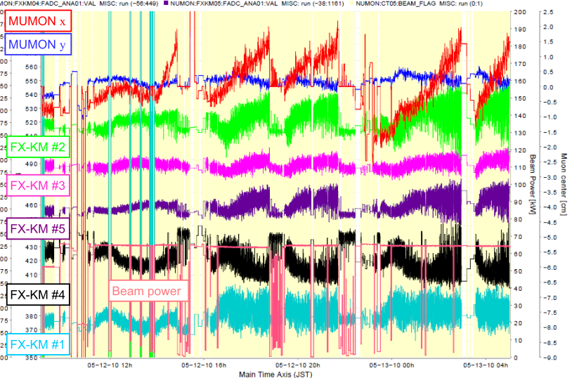
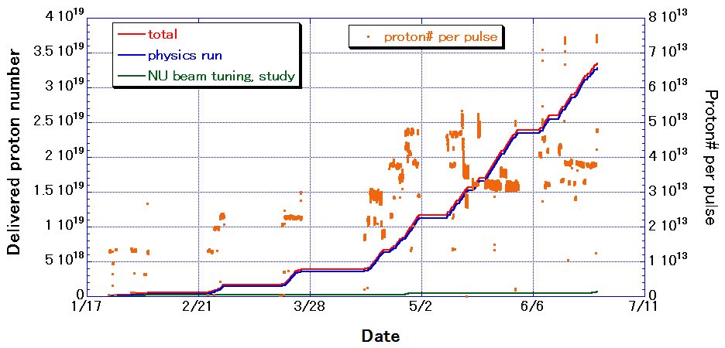
T2K: Tales from the front line
Accumulated 3.35×10¹⁹ protons (3.28×10¹⁹ for physics data analysis) from 1/10 to 6/10
Continuous operation ~50kW
Short (few minutes) trials up to 100kW
Problems with kicker magnets leading to beam center drift, all replaced this summer, minimum functionality tests successful
Slow extraction
started in mid-October
Neutrino beam expected to return November 15 or16
Plots:H. Kakuno NBI2010, schedule from
T. Kobayashi
-

Slide 14
Neutrino Detectors
Brief reminder of detector technologies in use
Detector performance
Milestones reached since NuFact09
  Note: I am not going to talk about the neutrino oscillation or neutrino interaction surprises, that’s the subject of a later talk…
    see Sacha Kopp in the voice and appearance of Maury Goodman for oscillation results
    See Kevin McFarland for Interaction Experiments
  This still leaves me plenty to talk about

Slide 15
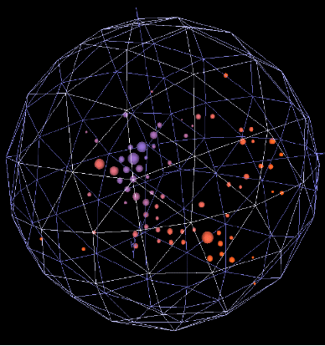
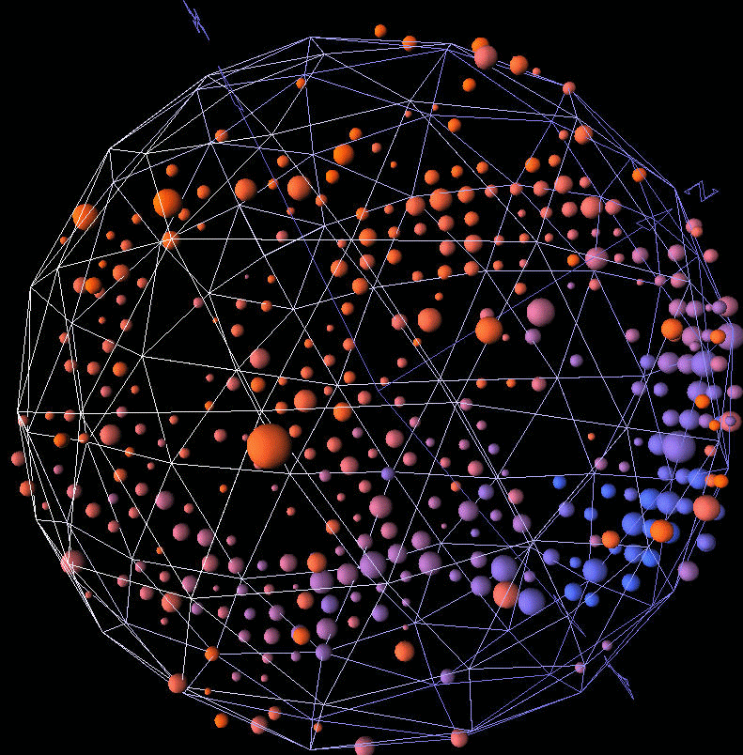
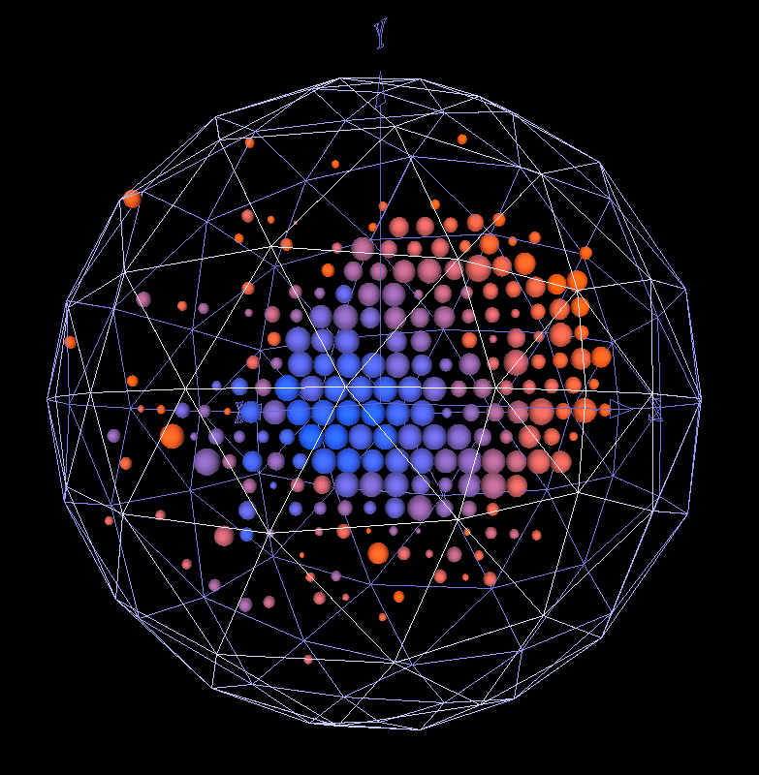
MiniBooNE Detector
Pure mineral oil
  Cherenkov:Scintillator ~ 3:1
  Total volume: 800 tons (6 m radius)
  Fiducial volume: 500 tons (5m radius)
New Reconstruction techniques not previously predicted:
  Three ring events (for charged current pi0 analysis)
  Charged pion tag (look for pi->mu->e chain)
e candidate
π⁰ candidate
μ candidate

Slide 16
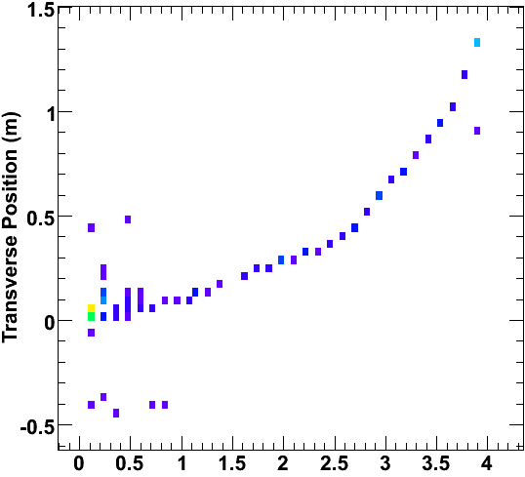
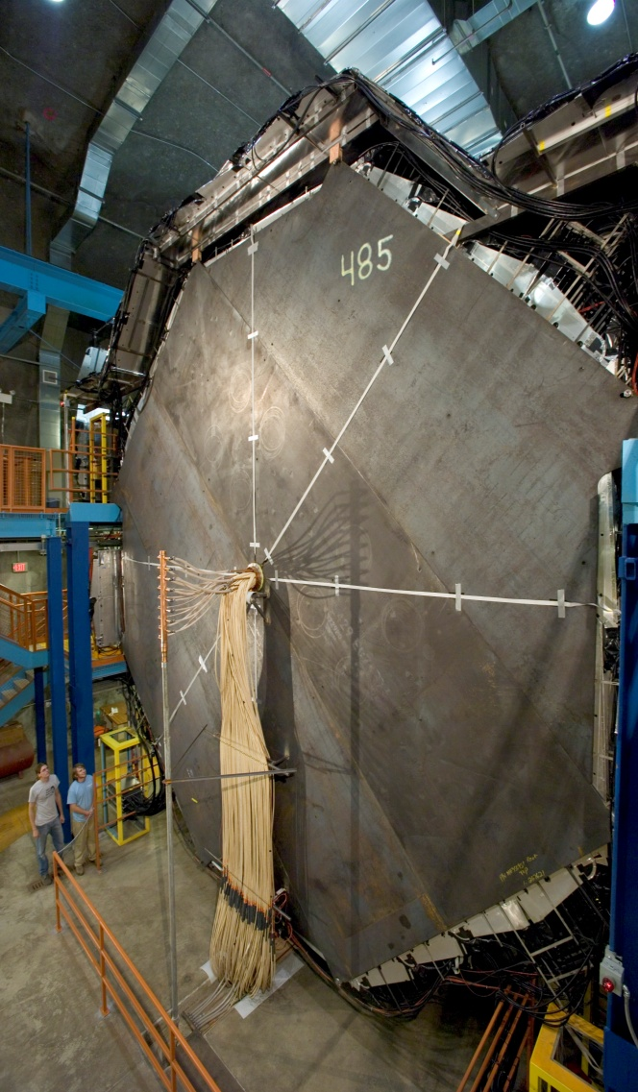
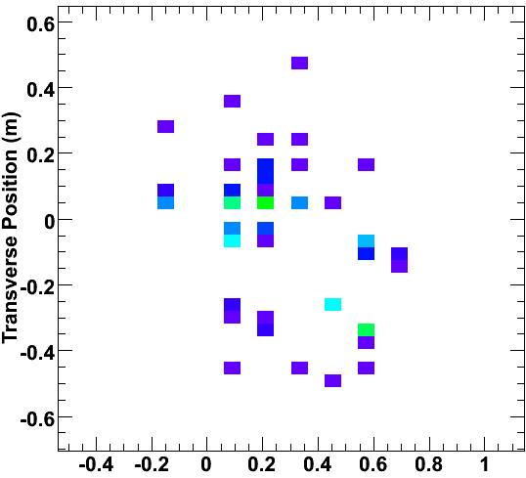
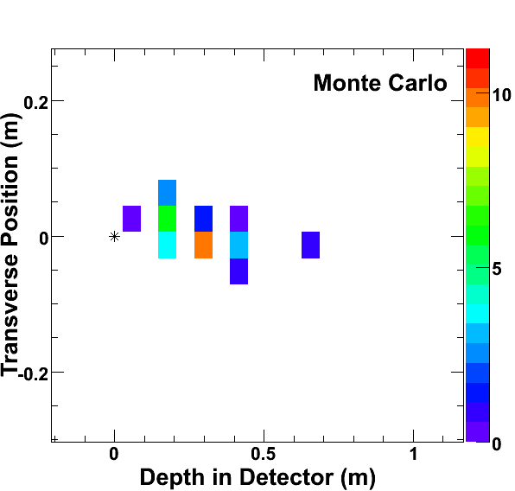
MINOS
ν_{μ} disappearance and ν_{e} appearance with 7.2x10²⁰ POT in neutrino running
Anti-ν_{μ} appearance with 1.7x10²⁰ POT in anti-neutrino running
CC ν_{μ} Event
μ⁻
5.4 kt Far Detector—
1”steel, 1cm scintillator plus magnetic field
NC Event
CC ν_{e} Event
ν
e⁻

Slide 17
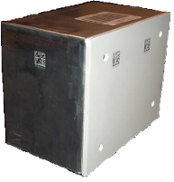
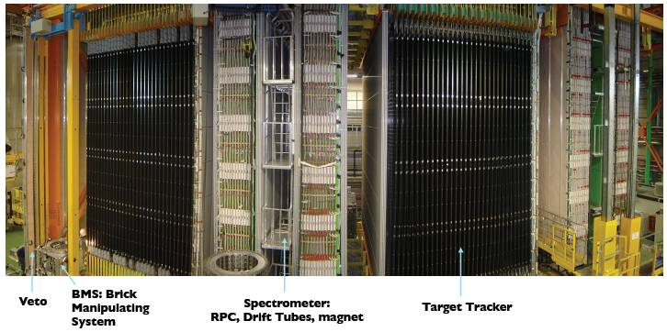
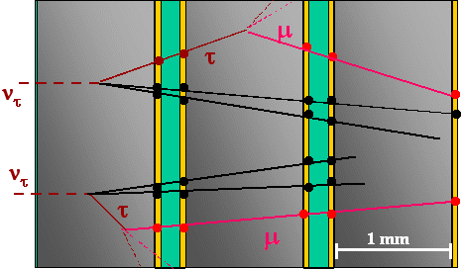
OPERA
1.2kT emulsion detector
  146621 bricks, each 8.3kg
  56 (1mm) Pb sheets
  57 (300mm) FUJI emulsion layers
  2 (300mm) changeable sheets (CS)

Slide 18
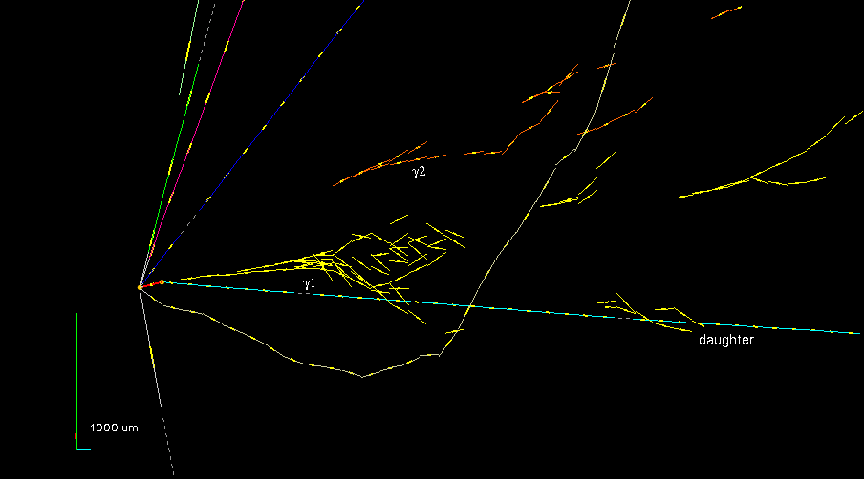
First Tau Neutrino Detected
Events collected in 2008-2009 run: 5391
Tag efficiency times vertex location efficiency: 60%
Total found neutrino vertices 1921
Events for which “decay search” was completed 1088 (187 NC)
(35% of total 08-09 run statistics, 1.85e19POT)
Assuming Δm₃₂²=2.5x10⁻³eV² and full mixing, expect 0.5 ν_{τ} events
Press Release 31 May 2010,
arXiv:1006.1623v1 8 June 2010
Slide courtesy O. Sato, ν2010
Slide courtesy Sato, Neutrino 2010

Slide 19
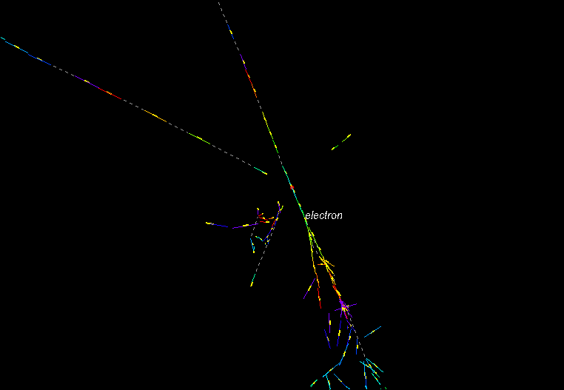
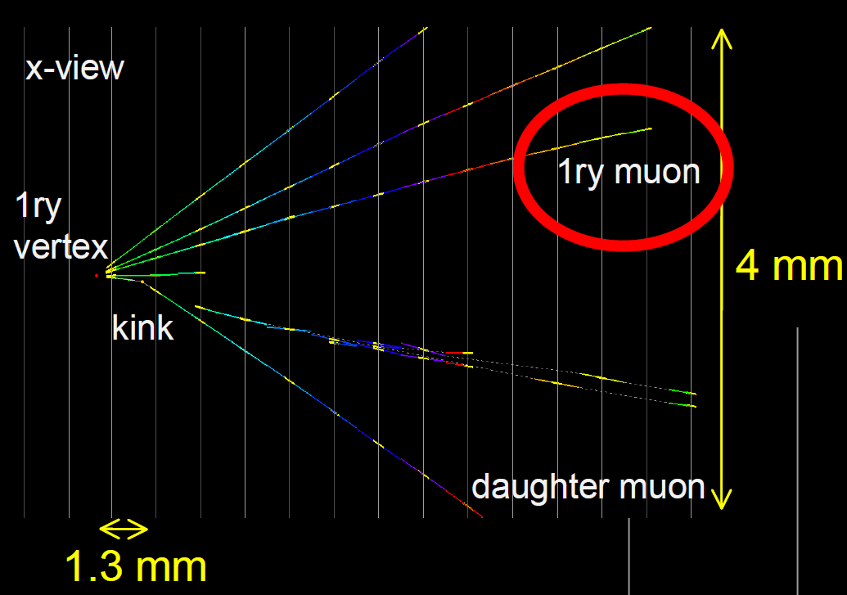
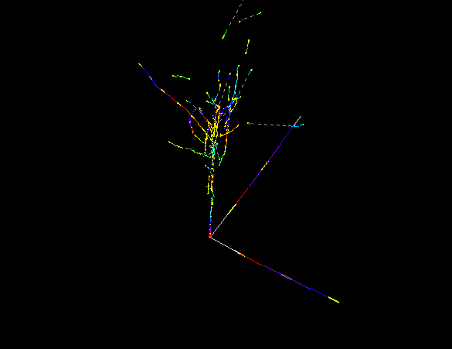
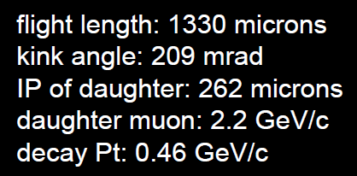
Other interesting events from OPERA
Charm candidates, and 6 electron
neutrino candidates out of
800 located vertices (2 at right)
O. Sato,
ν2010

Slide 20
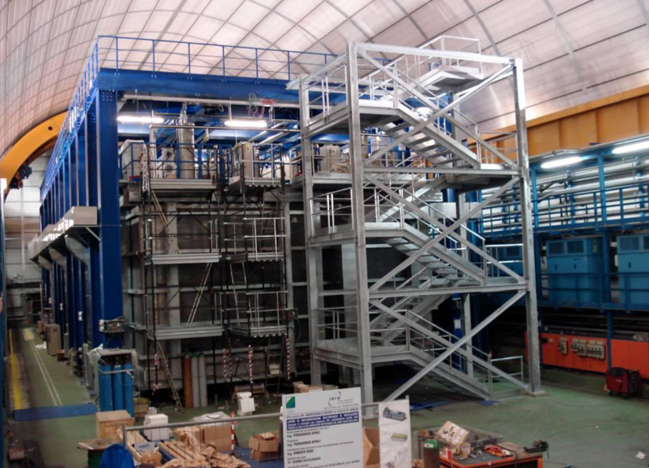
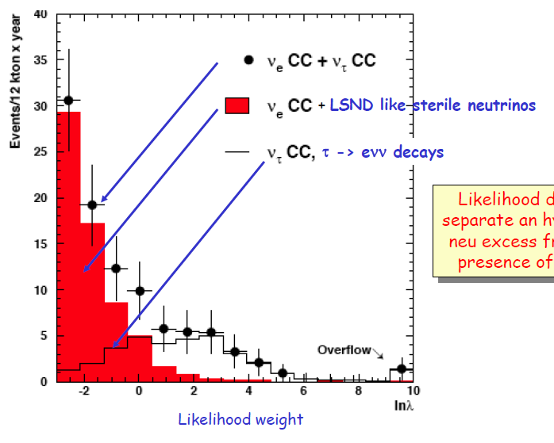
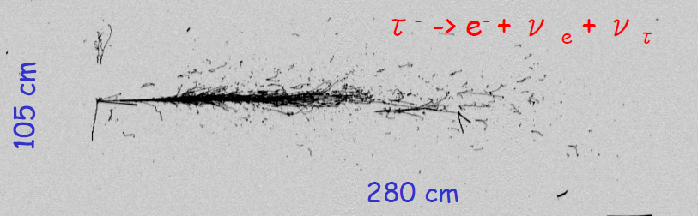
ICARUS
Liquid Argon TPC
Active mass: 475x2 tons
Fiducial mass: 600 tons
Wire spacing: 3mm
Electron drift distance: 1.5m
54000 wires, 3 stereo angles
74 PMT’s for scintillation light
Statistical
measure-
ment
of ν_{τ}
appearance
simulation
Expect 6 beam ν_{e}’s, expect 12 ν_{τ}’s
A. Guglielmi, ν2010

Slide 21
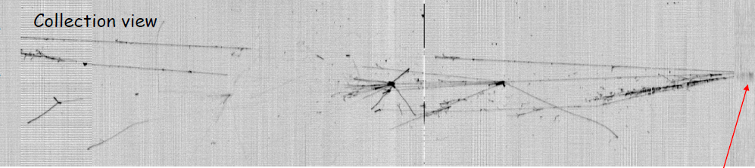
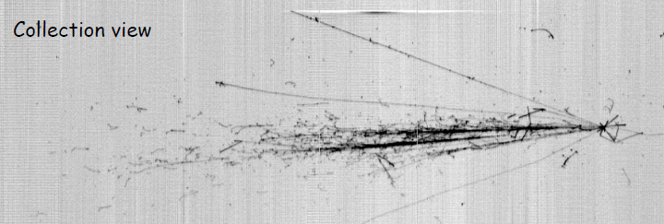
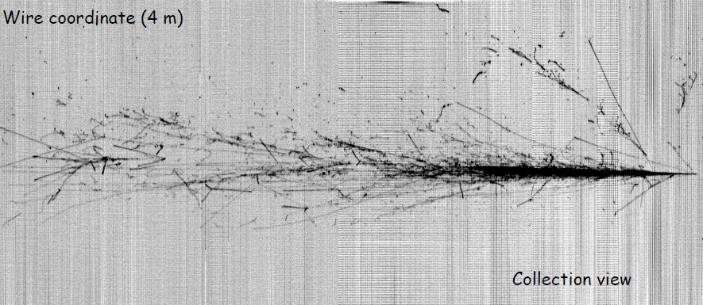
CNGS Beam events in ICARUS
Muon + Hadron Shower Vertex
A. Guglielmi, ν2010
Electromagnetic Shower Vertex
A. Guglielmi, ν2010

Slide 22

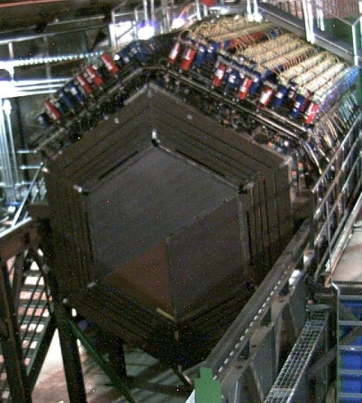
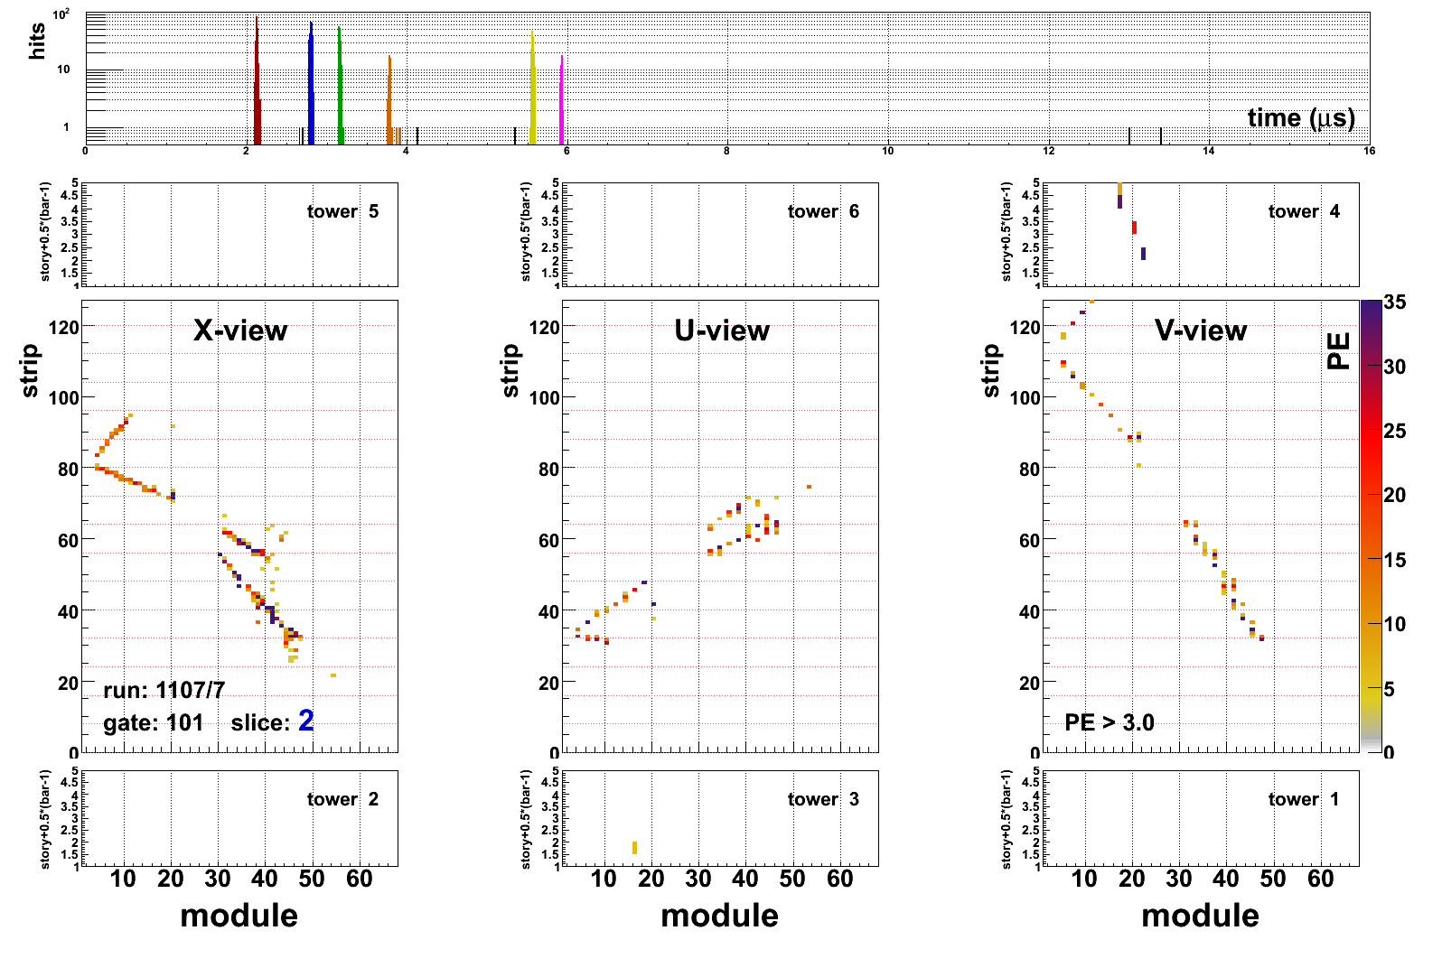
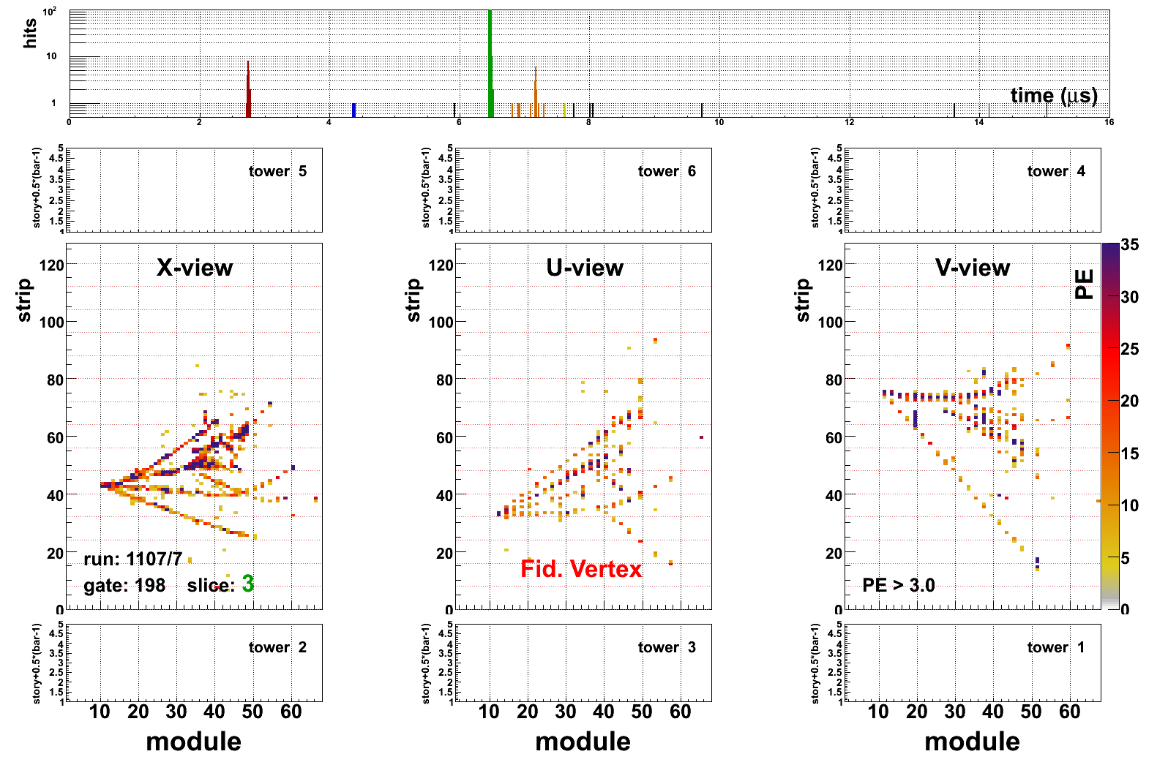
MINERνA Detector
VetoWall
Finely segmented scintillator
planes read out by WLS fibers
Side and downstream
calorimetry, 3-5 ton fiducial
Signals to 64-anode PMT’s
Several ~1ton Nuclear targets
of C, Fe, Pb, in now
Helium and water
targets soon
MINOS
Detector as
muon spectrometer
See K. McFarland’s talk
Cryotarget
Side HCAL (OD)
Fully Active Target
Downstream
HCAL
LHe
Nuclear
Targets
Downstream ECAL
Side ECAL
Notes:
Get a slide that shows more modules installed…

Slide 23
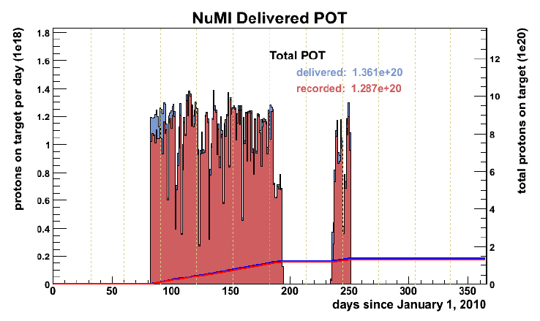
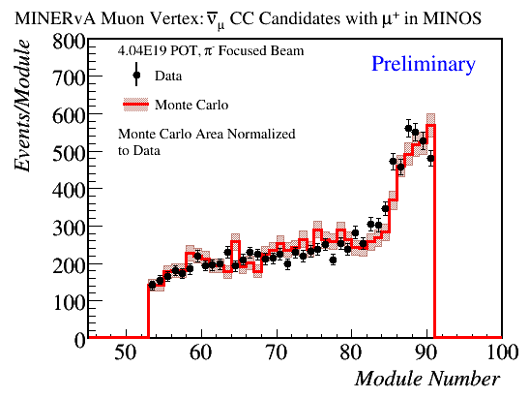
MINERvA run has started
Recorded 1.3e20, of that 1.4e19 in special runs to understand neutrino flux
H. Budd, FNAL AEM 9/13/10
Anti-ν CC candidate vertex distribution
  GENIE 2.6.0
  Geant4 Detector model
G. Perdue, ICHEP10

Slide 24
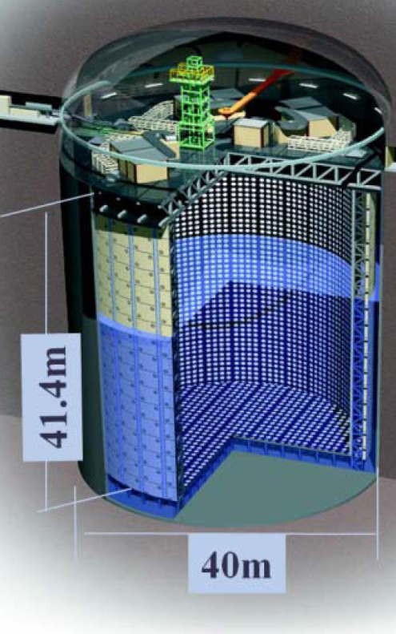
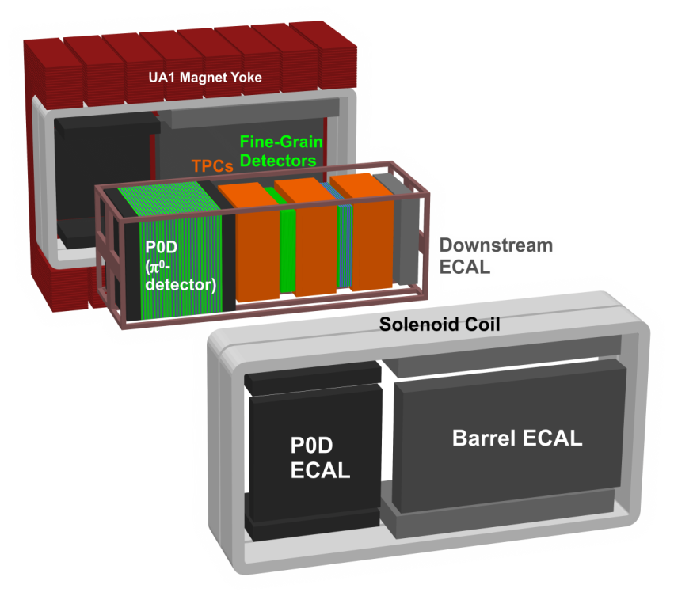
T2K Detectors
Far Detector:
Super-Kamiokande
Near Detectors at 280m
P0D: optimized to study
electromagnetic final
states in water and scintillator
TPC: precise tracking
and momentum, plus
particle identification
FGD: water and scintillator
targets
Side electromagnetic and hadronic calorimetry, 0.2T B field

Slide 25
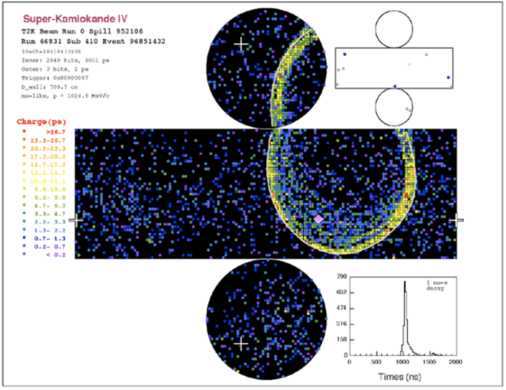
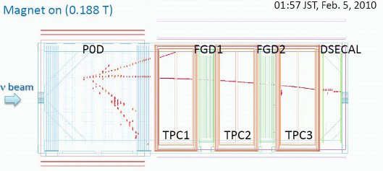
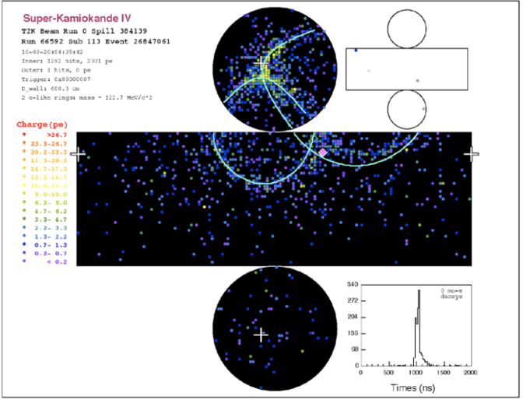
T2K Highlights
First neutrino events from J-PARC beam seen at Far detector (22 so far)
Near Detector complex commissioned and operating, events in all neutrino targets so far
T. Kobayashi, ν2010

Slide 26
Next Generation(s)
 | Moti-vattion | Beam Power (kW) | Detector | Base-line (km) | ν Ener gy (GeV) | Experi-mental Method | Integrated POT so far
MINERvA | ν inter-actions | 350 | Fine-Grained Scint. | 1.0 | 3.5 ++ (Wide) | Nucl. Targets | 11e19
T2K | ν_{e} appr. | 750 (50 so far) | Water Cerenkov+ND280 | 295 | 0.700 (Narrow) | Off-Axis | 3.4e19
NOvA | ν_{e} appr. | 700 | Liquid Scint. | 810 | 2.2 (Narrow) | Off-axis | -
Micro-BooNE | ν_{e} appr. And LAr R&D | 30 | Liquid Argon TPC | ≤1km | 0.7 (Wide) | 1st Max | -

Slide 27
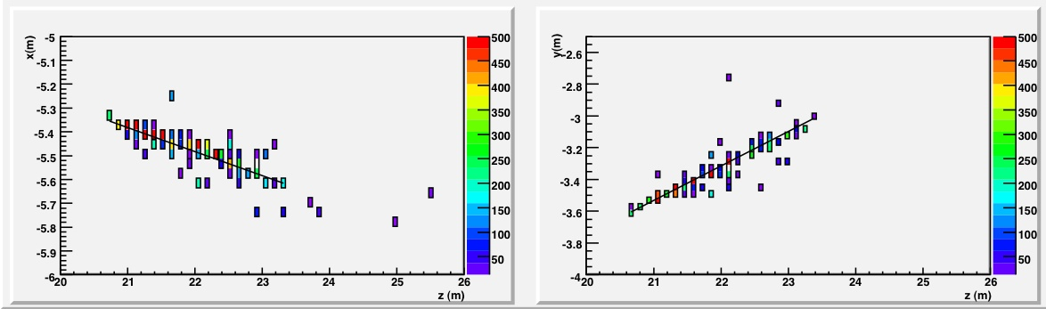
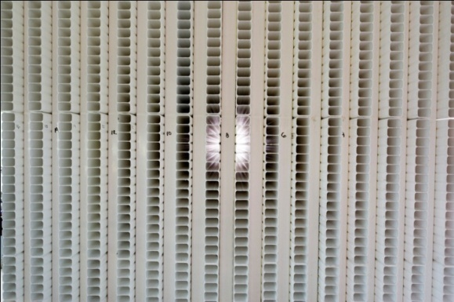
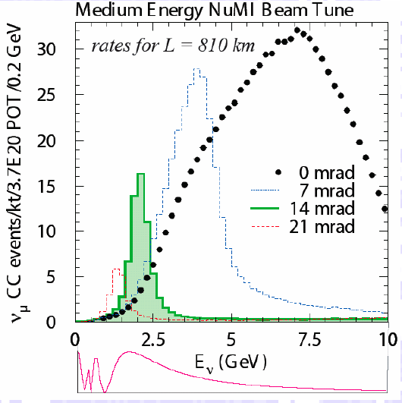

NOvA
Off-axis NuMI neutrino beam, 2GeV peak energy
14kton liquid scintillator totally active detector
ν_{e} CC
P. Shanahan, FNAL W&C 9/24/10
ν_{μ} NC
z (cm)

Slide 28





NOvA Progress since last NuFact
Far detector site
construction
Full scale proto-
type tests
Near Detector
on Surface starting
operations
Near Detector Building
Near Detector at 107mrad
Far Detector Building
P. Shanahan, FNAL W&C 9/24/10
September 22, 2010

Slide 29


MicroBooNE
Goals: put LAr TPC in Booster Neutrino beam
  Examine MiniBooNE excesses
  Meaure Performance of LAr TPC in low energy neutrino beam at high statistics
  Try to use tricks you will want for >>kton devices
    Long drift lengths
    Ar Purity without pumping
    cryostat down to vacuum
M. Soderberg ν2010

Slide 30
Next to Next Generation Technique:
Electron Neutrino Appearance
Goals: searching for CP violation, determining the neutrino mass hierarchy
Overall, two strategies
  Narrow Band Beam to focus on first oscillation maximum
  Wide band beam to see first and second max
Strategies vary, depend on
  Geography and existing “natural” resources
  Status of planning for LAr TPC

Slide 31
Next Generation and beyond…
LBNE: Fermilab to Homestake (1290km)
  Considering both LAr TPC and Water Cerenkov
  Synergy with Deep Underground Science
    detector charged with searching for proton decay as well
T2K++: use existing J-PARC beamline, upgrade, and use second far detectors,
  Okinoshima Island to see both maxima
  Second very large detector at Kamioka to focus on 1st max
CERN to Frejus or elsewhere in Europe
  Different baselines call for different far detector technologies

Slide 32



LBNE: Fermilab to Homestake
Progress this year in planning the development of a large undertaking:
  New Beamline
  New Detector
Fermilab

Slide 33



Is there Life after CNGS?
Several ideas exist for CERN-based long baseline neutrino experiments
Far detectors of Water Cerenkov or Liquid Argon TPC
Focus on low energy beams, shorter distances: CP Violation
Slide courtesy K Sakashita, ν2010

Slide 34

Summary of Future
Long Baseline Experiments
Slide courtesy K. Sakashita,ν2010

Slide 35
Lessons from Current Generation
Getting to design power takes time and experience
  MINOS example: 1st 2 years at ~ ½ intensity of 2nd 2 years
  CNGS Example: 2 years at low intensity, high intensity now
The fluxes you assumed aren’t necessarily right
  NuMI High Energy tail 50% higher than predicted
  MINOS Near Det. ν_{e} background prediction 20% high
The cross sections you assumed aren’t necessarily right
  MiniBooNE is seeing 20% higher σ(QE) than expected
Radiation shielding is harder than you imagined

Slide 36

Conclusions
This has been an exciting year
for conventional ν beam
experiment operations
  First beam on full detector:
    T2K, ICARUS, MINERvA
  First ν_{τ} event shown by OPERA
  NOvA Near Detector assembled, ready for data
Oscillation and cross section results have been exciting too, to be covered in later talks
Many lessons to take away for future plans

