Slide 1
Effect of Tau Neutrino Contribution to
Muon Signals at Neutrino Factories
Nita Sinha
The Institute of Mathematical Sciences
Chennai

Slide 2
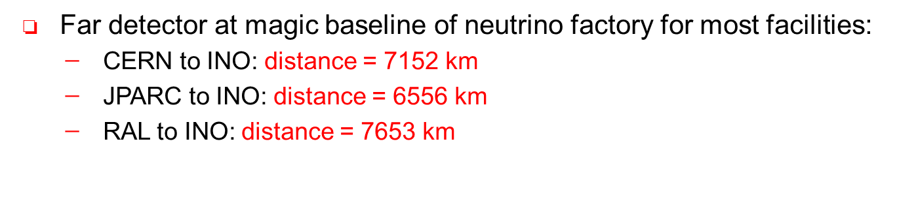
Towards Precision
Huge worldwide experimental effort is being devoted to precision
measurements in Neutrino Physics.
Since neutrino mass implies New Physics, many models have been proposed
to explain the tiny mass. It is therefore important to experimentally
determine all the neutrino mixing parameters to good precision and see
which of the models are consistent with the measurements
CP violation in the lepton sector may be able to explain the matter antimatter
asymmetry of the Universe
Neutrino Factories are one of the planned proposals towards this goal.
INO will be an excellent detector for a Neutrino factory beam,
Close to the Magic Baseline

Slide 3
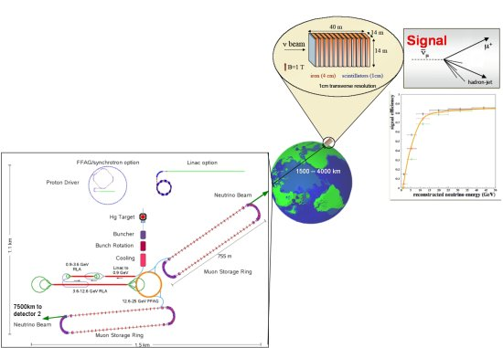
IDS-NF
Accelerator baseline

Slide 4
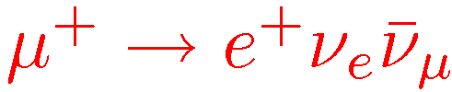

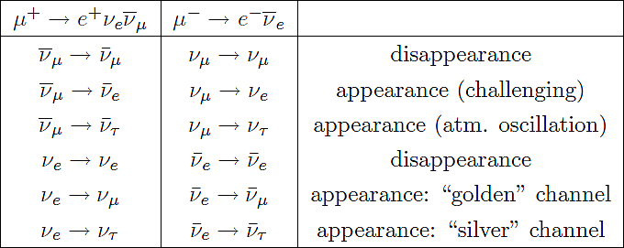
At a Neutrino Factory:
Neutrinos are produced from muon decay
0r
Advantages
Two neutrino Flavors  Many oscillation channels
Platinum
Well known and high flux
High Energy

Slide 5



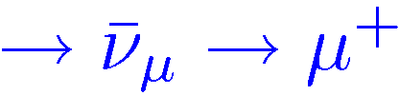

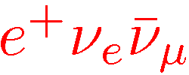
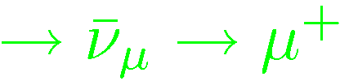



Muon Events
disappearance
can be used for precision of atmospheric parameters
Beam
Right Sign
μ⁻
μ⁺
Wrong Sign
μ’s from τ decays
Right Sign
Golden Channel
events for determination of θ₁₃ , δ_{CP,} mass heirarchy and octant of θ₂₃
Focus here is on this τ contribution
Wrong Sign
Most studies have dealt with the wrong sign events

Slide 6
Right sign Muon Events
Right sign muon events are useful for
precision measurements of Ѳ₂₃ , | ∆₂₃ |
understanding cross-section and flux uncertainties at the near detector
In particular, sensitive probe of whether ν_{μ} ν_{τ} mixing is maximal
Tau Contributions
Tau CC events kinematically suppressed, due to the large tau mass
But, ν_{μ} ν_{τ} oscillations are large substantial contribution
Enhancement of RS event rates at small final lepton energies,
affects the determination of deviation from maximality
In the absence of a tau detector, the contribution of µ’s from
decays of τ ’s need to be included in the theoretical estimates

Slide 7
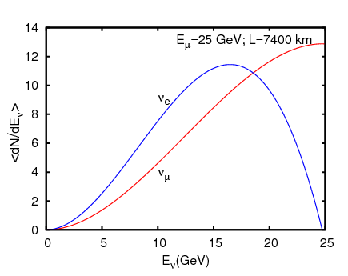
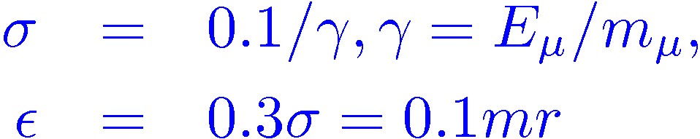
Fluxes
Neutrino fluxes are integrated over the muon beam angle assuming a gaussian divergence of the beam with a standard deviation σ and then averaged over a small neutrino opening angle. The spectrum at the baseline distance L from source to detector:
Baseline specifications:
Beam Energy: 25 GeV
Number of useful muons :
5 x10²⁰
Baseline length 7400 Km
Target mass 50 Kton

Slide 8

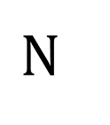


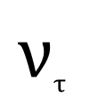
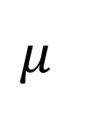


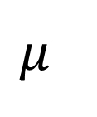

$$μ$$
$$ν_{μ}$$
$$ϑ_{μ}$$
$$Ν$$
X
$$μ$$
$$ϑ_{μ}$$
$$ν_{τ}$$
$$τ$$
$$φ_{μ}$$
$$ϑ_{τ}$$
X

Slide 9
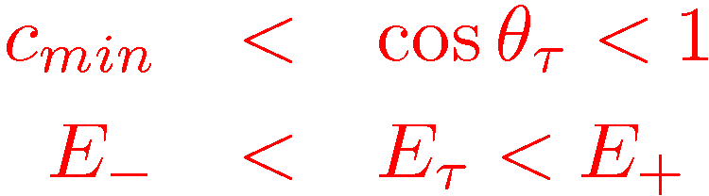
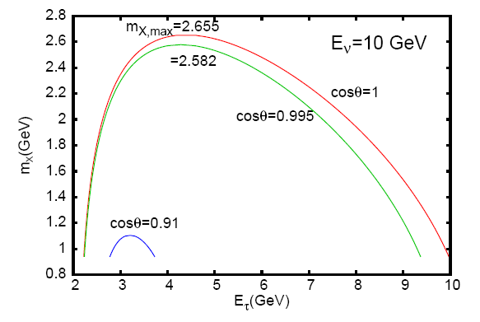
Kinematics
For τ production by CC reactions off a nucleon target, the tau angle and
energy are restricted:
Tau leptons produced
in forward direction

Slide 10
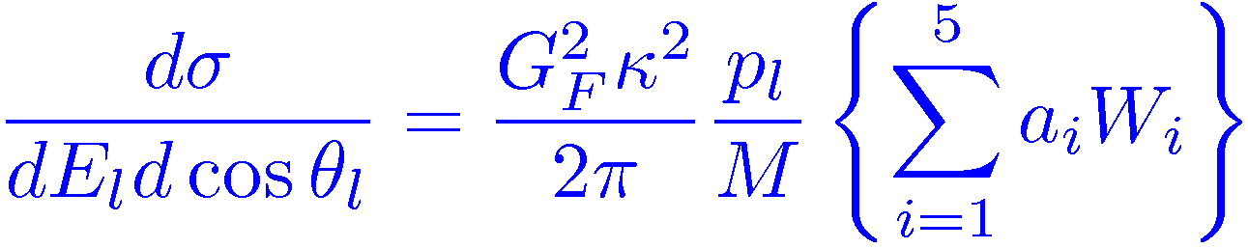
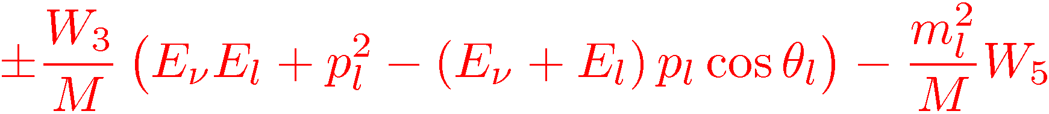
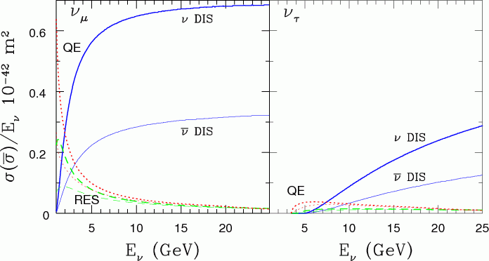
Cross Sections
Includes quasi-elastic, resonance and deep inelastic processes
The differential CS for CC interactions
Only appear
for massive
Charged leptons
W_{i} are structure
functions in the
hadronic tensor,
estimated for
each of the
subprocesses

Slide 11
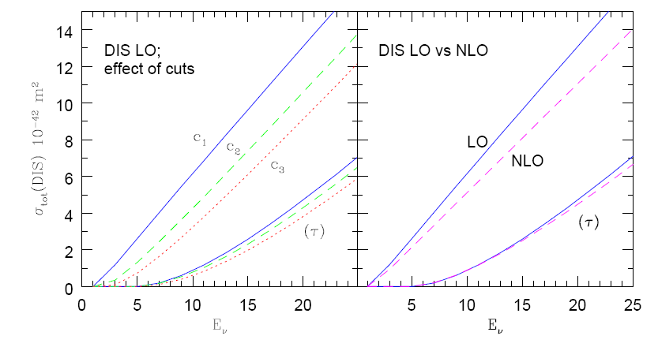
Uncertainties in Cross Sections
Separation between RS and DIS is arbitrary, and determined by a cut off, we impose
W > W_{cut} =1.4GeV But Q² is till undetermined. DIS reliable for Q² > few GeV²
some events satisfy > W_{cut} but have low Q² , making CS estimates uncertain
Approaches:
1.Remove events with
Q² < 1.69 (C₃ )
Underestimates
2. Scale Q² to Q_{min}²
Overestimates, (C₁ )
(CS are large for small x)
3. If Q² < 1, remove event,
Rescale if 1<Q² <Q_{min}² (C₂ )
Note, full NLO calculation would require target mass
corrections, and charm mass contributions
LO vs NLO uncertainty,
tiny compared to above

Slide 12
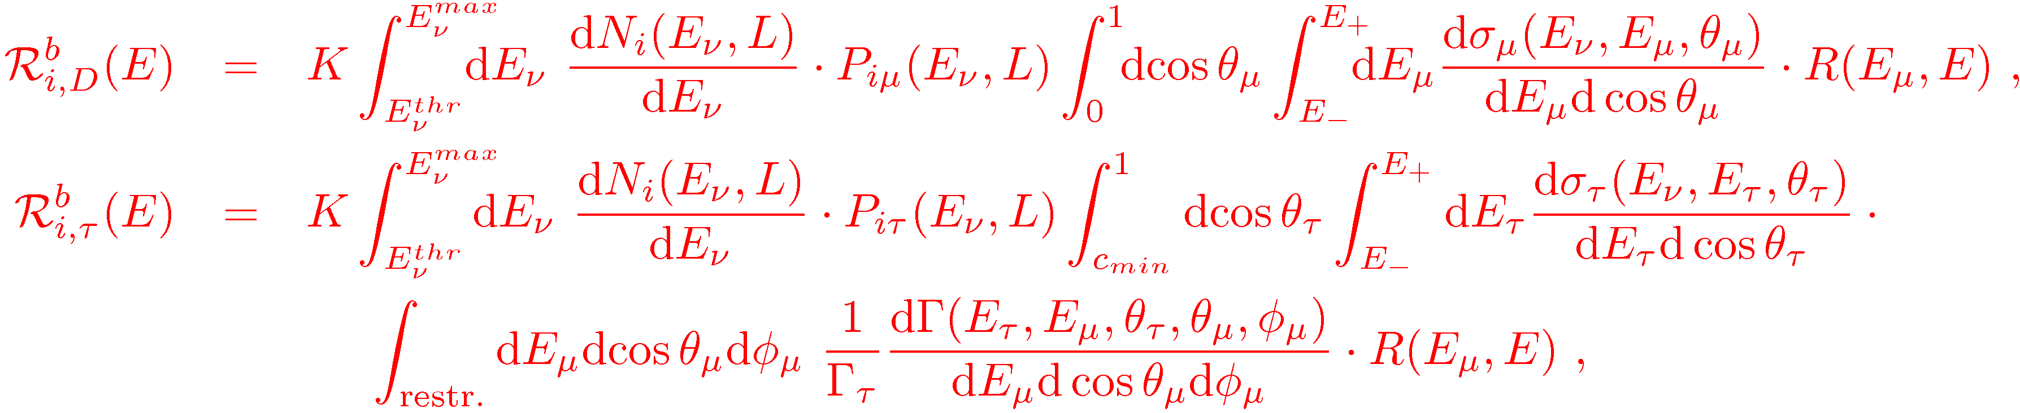
Events
Muon event rate, as a function of muon energy has the form:
Direct µ
Flux
Probability
Cross-section
µ’s from decays
of τ ‘s
b: beam type, µ⁺ , µ⁻
Number of target atoms
X number of years
R is the gaussian energy
resolution function of width σ
2 contributions to muon events :
Direct muons from CC interactions of muon.
“ Tau induced” muons from CC interactions of tau neutrinos (antineutrinos) on
target with subsequent decay of the produced taus into muons.

Slide 13
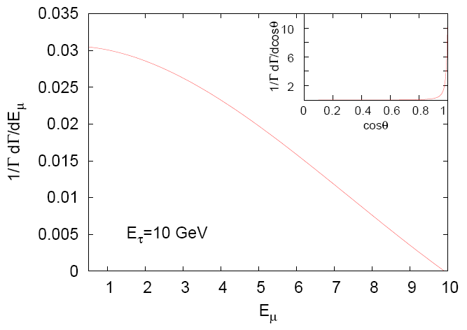
Use total events RS + WS, so that no CID is required, although RS give the dominant contribution. In fact can add events from both µ⁻ and µ⁺ beams.
Results in terms of final muon energy (can be easily reconstructed),
a gaussian resolution width of 7% used.
Decay Rate of tau
Larger decay rate at
low energy leads to
Larger contribution
to muon events
with lower energies

Slide 14
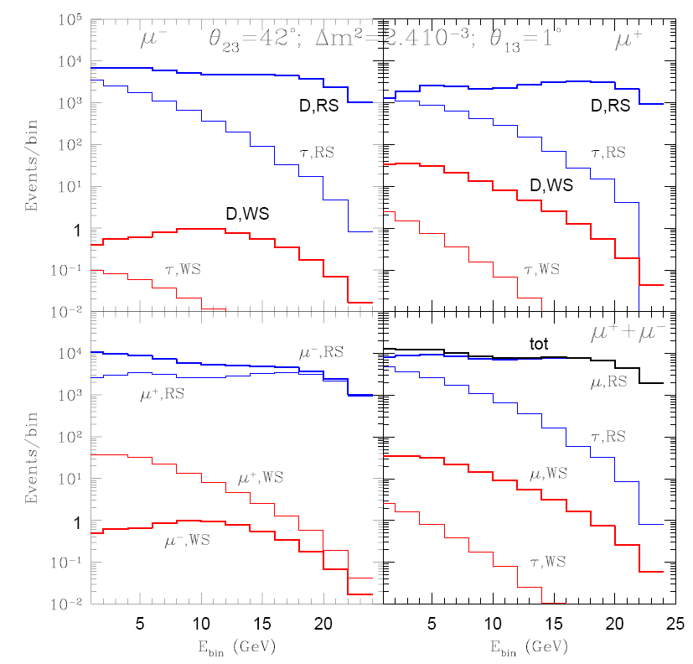
Muon Events
5 years data
50 Kton muon
detector
at 7400 Km
D Direct muons
τ From tau decays
Substantial contribution from tau decay to RS

Slide 15
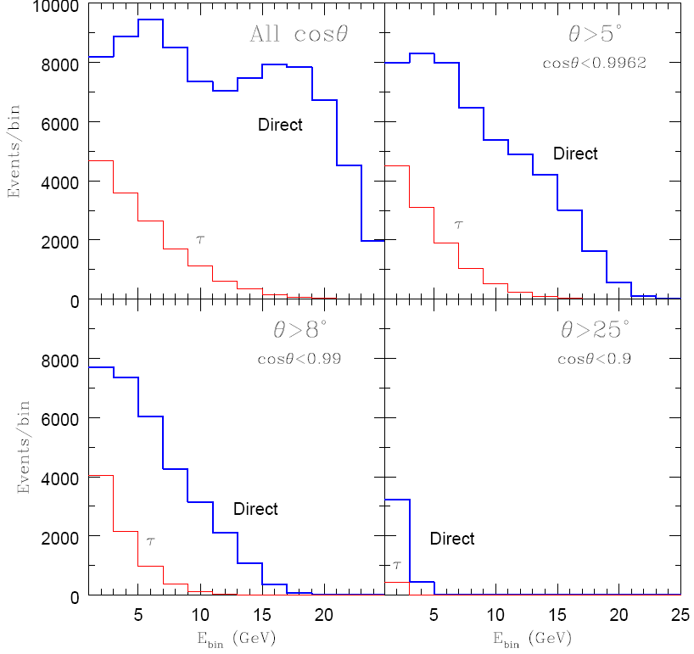
Can the events from tau contribution be
removed by kinematic cuts?
Rather large angular cuts or
energy cuts
(or a combination of both)
would be required to eliminate
the background from tau
production and decay.
The reduction in statistics would result in loss of sensitivity to Parameters.

Slide 16
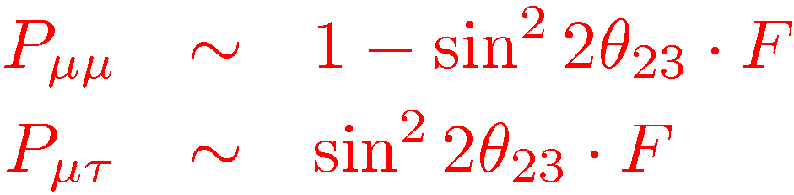
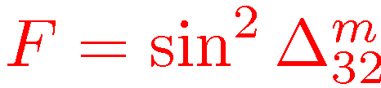
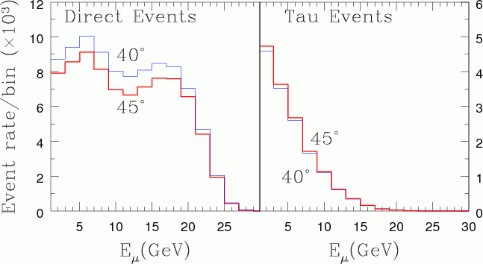
Effect of the tau contribution
To leading order in θ₁₃ ,
where
Since the θ₂₃ dependent terms come with opposite sign, the combination of muons from direct production and from tau decays marginally decreases the sensitivity of the event rates to this angle (and its deviation from maximality).
While increase in θ₂₃
decreases the direct
muon events, those from production and decay of taus tend to increase marginally with larger θ₂₃ .

Slide 17
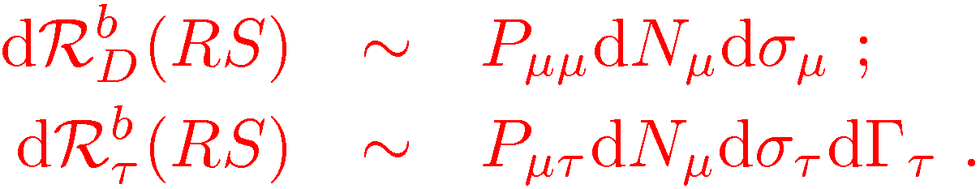
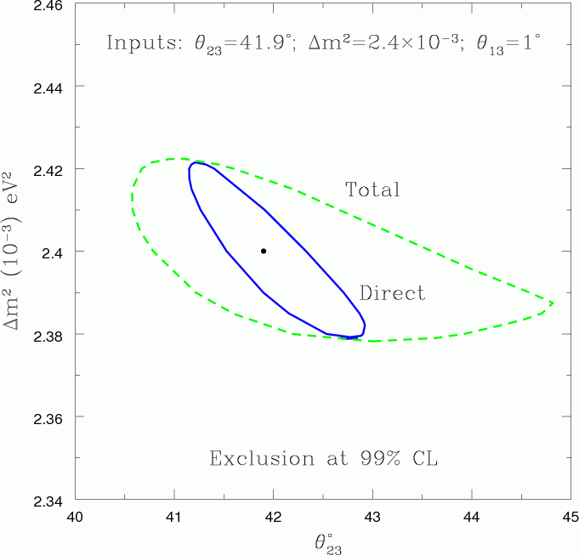
Estimating Deviation from maximality, using disappearance channel, including tau contributions
Known
Unknown, cannot be measured, more uncertain—larger normalization error used
Allowed parameter space in the
Δm² -- θ₂₃ plane at 99% CL from CC events directly producing muons (solid line) and with inclusion of muons from tau decay (dashed line)
Eefect on precision with which θ₂₃ :
a spread of 2deg if tau events are removed and 4.5deg when they are included.

Slide 18
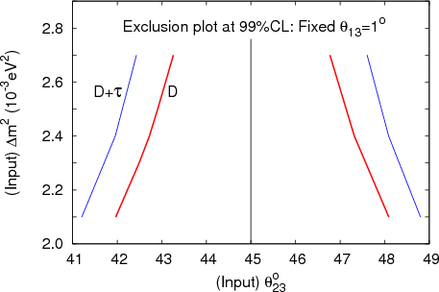
Maximum values of θ₂₃ that rule out maximal mixing
at 99% CL
The largest (smallest) true value
of θ₂₃ in the first (second)
octant that can be discriminated
from a maximal value of θ₂₃=pi/4
as a function of Δm² ,
when only Direct (D) and
total (D + tau) events are
considered.
Here θ₁₃ is kept fixed at 1 deg
D. Indumathi and Nita Sinha, PRD 80, 113012, 2009

Slide 19
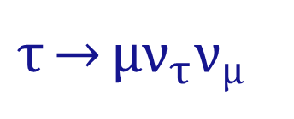
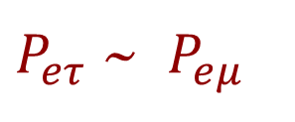
Contamination in the Golden channel?
$P_{eτ}$ ~ $P_{eμ}$
Contribution smaller
Wrong sign events, require charge identification
The background events need to be carefully taken into account
Need to reconstruct the neutrino energy
$$τ\overset{→}{}μν_{τ}ν_{μ}$$
But that is tricky here—in the tau contributions!
Missing energy!
Incorrect neutrino energy
Donini, Gomez Cadenas and Meloni, ArXiv: 1005.2275
Coloma’s talk

Slide 20
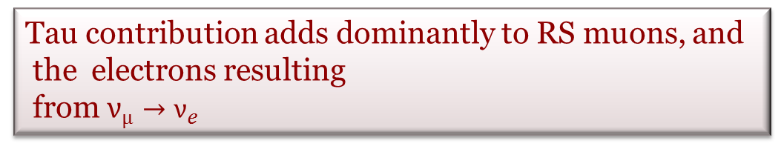
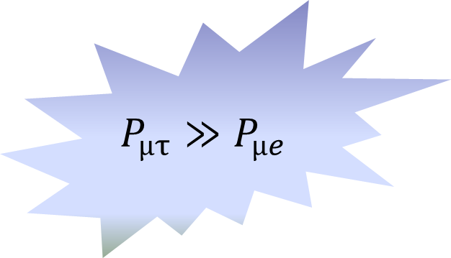
Platinum Channel
Additional channels help in removing discrete ambiguities
With electron detection—TASD or LAr
$$P_{μτ}≫P_{μe}$$
While, Platinum channel is just a T Conjugate of the golden channel
BUT the tau contamination here will be Much larger.
Sensitivity studies to parameters need to be REDONE
Tau contribution adds dominantly to RS muons, and
the electrons resulting
from $ν_{μ}→ν_{e}$

Slide 21
For a 25 GeV NF
PRELIMINARY
15 kTon
Length 4000Km
Lower energy threshold of 500MeV
Standard set up of Huber, Lindner ,
Rolinec and Winter

Slide 22
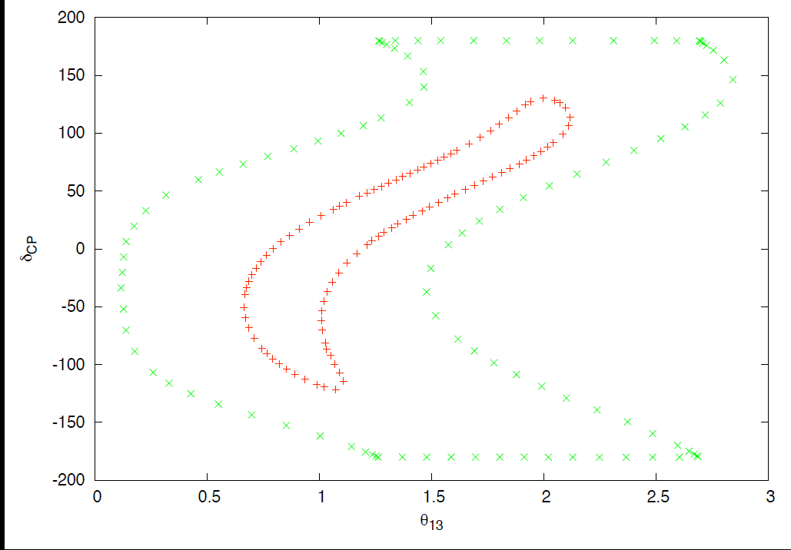

Allowed region in $δ_{CP}ϑ_{13} Plane$
PRELIMINARY
Dutta, Indumathi, Sinha, in preparation

Slide 23
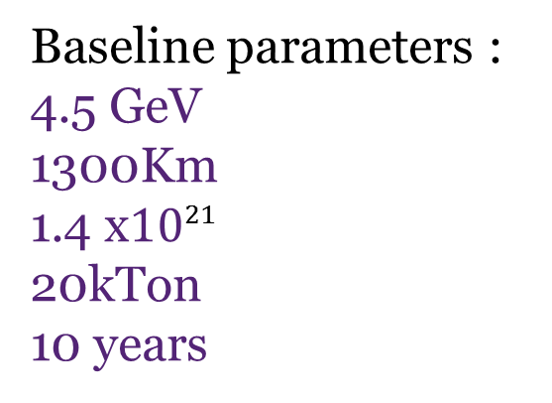
Platinum channel at Low Energy Neutrino Factory
Baseline parameters :
4.5 GeV
1300Km
1.4 x${10}^{21}$
20kTon
10 years
As per Bross et al. : Optimized LENF set up
PRELIMINARY
TASD
Efficiency:
37% below 1 GeV
47% above 1 GeV
Resolution = 10%

Slide 24
LAr
Efficiency 80%
Resolution = 5% for QE
=20% for non-QE
PRELIMINARY

Slide 25
Summary
The oscillations of the muon or electron neutrinos (anti-neutrinos) to
tau neutrinos (anti-neutrinos) results in tau leptons produced through
CC interactions in the detector which on leptonic decay add to the
right as well as wrong sign muon events obtained directly.
This tau contamination worsens the ability to discriminate against maximal ν_{μ} ν_{τ} mixing.
It is practically impossible to devise satisfactory cuts to remove this tau contamination.
Uncertainties from this tau background must be brought
under control before making precision parameter measurements at neutrino factories.

Slide 26
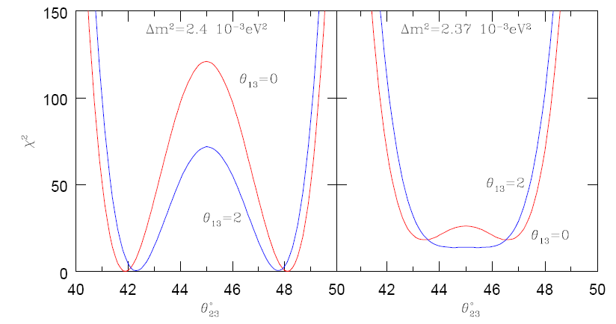
Plot of Chisq for 2 different θ₁₃ values
Small effect of nonzero θ₁₃ in discriminating maximal solution
No octant effect

Slide 27
