Slide 1
An overview on μ Physics
Giancarlo Piredda
INFN Roma- Sapienza
Nufact2010 October 20-25
Tata Institute for Fundamental Research, Mumbai

Slide 2
Outline
The role of μ in search for New Physics
  Search for
    Process forbidden in Standard Model (e.g. cLFV)
    Process well predicted in SM (e.g. (g-2)_{μ})
  The experimental situation
    (g-2)_{μ}
    The MEG project
    The μ to e conversion experiments
Conclusions
(Not intended nor possible to be full comprehensive)
Credits to:
  G. Cavoto, Y.Kuno, S. Mihara, D. Nicolo’, N. Saito, Fermilabg-2, F. Renga, P. Paradisi and the others that I forgot

Slide 3
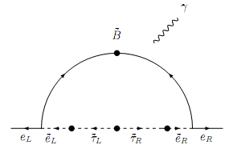
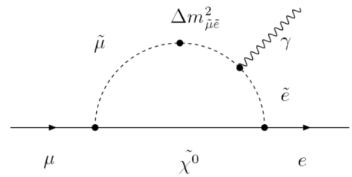
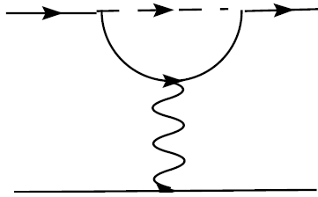
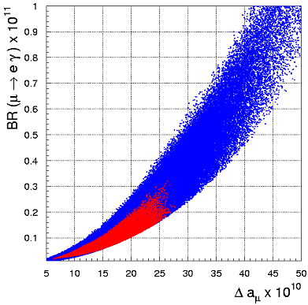
cLFV vs g-2, and EDM
Contribution to EDM, MDM of leptons from diagonal elements of the slepton mass matrix
LFV processes induced by off-diagonal terms (depend on how SUSY breaking is generated and what kinds of LFV interactions exist at the GUT scale)
μ→eγ
μZ→eZ
g-2
EDM
SUSY effect on g-2 ➔ deviations from SM predictions
an experimental clue: E821
results
Δa_{μ} ≠0 associated with SUSY
➔
G.Isidori et al.
Phys. Rev. D75 (2007) 115019
➔ strong physics case

Slide 4
Particle Dipole Moments
Magnetic and Electric Dipole Moments are related to Spin of the Particle: axial vector
T
+
+
-
-
MDM (Magnetic Dipole Moment)
Contains contributions from ALL PHYSICS!
- EW, QCD, and New Physics
⇒ precision test of the SM
⇒ the most precise determination of α_{EM} from electron g-2 (0.37 ppb)
EDM (Electric Dipole Moment)
If EDM nonzero, T is violated
⇒ CP violation in the lepton
sector (under CPT)
⇒ leptogenesis?
⇒ Baryon Asymmetry in the
Universe

Slide 5
Muon magnetic moment
Magnetic moment and spin can be related as
Dirac equation predicts g=2
Radiative corrections (including NEW PHYSICS) would make g≠2
a=0
a=1.2e-3 for e, μ, …
a=1.8 for proton
a≠0

Slide 6
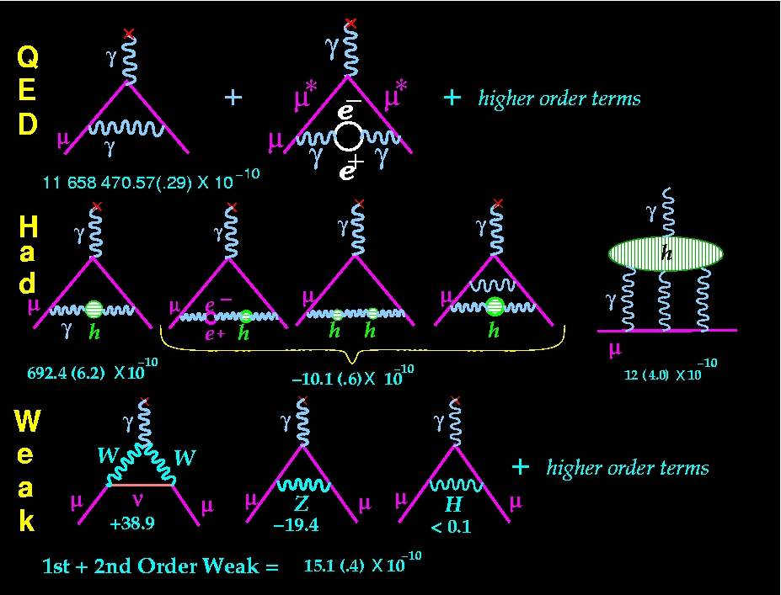
SM Contributions to a ≠0
Any particle which couples to muon/photon would contribute : QED >> Hadron > Weak
~1.2 x 10⁻³ (σ~1ppb)
~6.9 x10⁻⁸(σ~0.41ppm)
~1.5 x 10⁻⁹(σ~0.02ppm)
From Lee Roberts

Slide 7
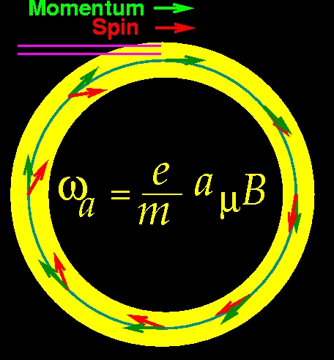
Muon Spin precession
Expected to be
Measured to be
G.W.Benett et al. Phys.Rev.D80:052008,2009

Slide 8

BNL E821 proposal to move to Fermilab

Slide 9
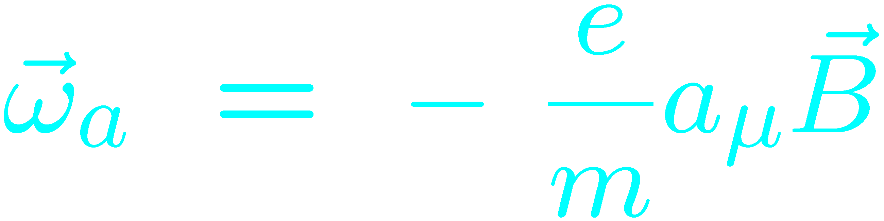
Experimental Technique: fill ring, count until all muons are gone; do it again
25ns bunch of 5 X 10¹² protons from AGS
x_{c} ≈ 77 mm
β ≈ 10 mrad
B·dl ≈ 0.1 Tm
Pions
Inflector
p=3.1GeV/c
Target
(1.45T)
Injection orbit
Muon polarization
Muon storage ring
injection & kicking
focus with Electric Quadrupoles
24 electron calorimeters
Central orbit
Storage
ring
Kicker
Modules
R=711.2cm
d=9cm
R
R
β
Electric Quadrupoles
x_{c}
(thanks to Q. Peng)

Slide 10
BNL, FNAL, and J-PARC
Done Proposals with diff techniques
See K.Ishida WG3
 | BNL-E821 | Fermilab | J-PARC
Muon momentum | 3.09 GeV/c (magic) |  | 0.3 GeV/c
gamma | 29.3 |  | 3
Storage field | B=1.45 T |  | 3.0 T
Focusing field | Electric quad |  | None
# of detected μ+ decays | 5.0E9 | 1.8E11 | 1.5E12
# of detected μ- decays | 3.6E9 | - | -
Precision (stat) | 0.46 ppm | 0.1 ppm | 0.1 ppm

Slide 11
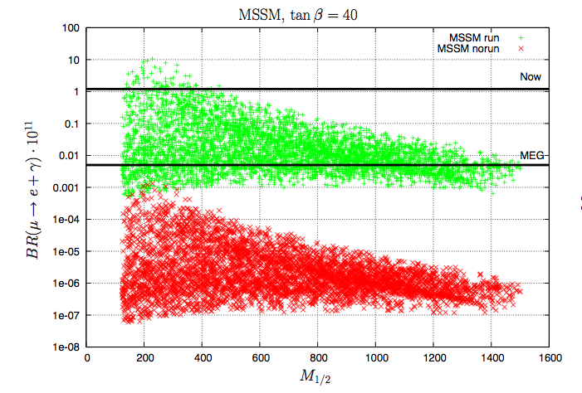
Lepton Flavor Violation of Charged Leptons
Contrary to the well established neutrino mixing the
charged lepton one not observed yet
LFV diagram in Standard Model
∝ (m_{ν}/m_{W})⁴
SO(10) SUSY GUT w/ see-saw
(Calibbi, Faccia, Masiero, Vempati '07)
ν
m
i
x
i
n
g
μ
ν
e
µ
e
W
Very Small (10⁻⁵²)
LFV diagram in SUSY
Large top Yukawa coupling
~
m
i
x
i
n
g
~
μ
e
μ
e
~
B
Discrimination power among models
Sensitive to new Physics beyond the Standard Model

Slide 12
The MEG Experiment at PSI
See also H. Nishiguchi WG4 oct 21
*The more intense DC μ beam in the world (up to 10^8 μ/s)
*The largest (800 l) Liquid Xenon Calorimeter for γ detection
* Dedicated e+ spectrometer with graded B field and high time resolution
A signal-like event

Slide 13
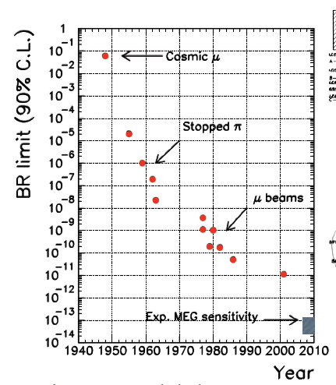
History
1947 – Hinks & Pontecorvo:
  First limit;
~1960 the lack of a 10⁻⁴ signal ->existence of at least 2 neutrinos!
1977 - Van der Schaaf et al. (PSI) Depommier et al. (TRIUMF):
  First experiments with muon beams.
1999 – MEGA (LANL):
  Present best limit;
  BR < 1.2 x 10⁻¹¹ @ 90% C.L.
MEG aims ~ 10⁻¹³

Slide 14
Experimental Signature
SIGNAL ∝ μ rate
To get 10⁻¹³ sensitivity:
  high statistics;
  high resolutions (energy, time, angle) for low background;
μ
e
γ
E_{γ} = E_{e} = 52.8 MeV, t_{eγ} = 180°, T_{e} -T_{γ} = 0
RADIATIVE DECAY ∝ μ rate
ACCIDENTAL
∝ (μ rate)²
DOMINANT
ν
e
ν
e
γ
μ
μ
γ
ν
ν

Slide 15
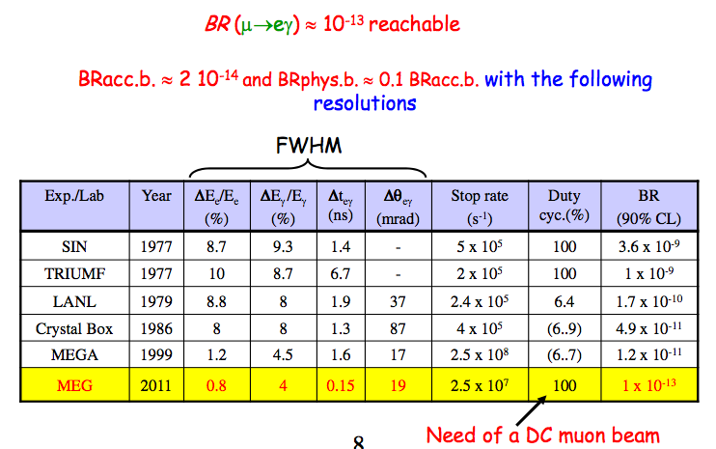
Required Performances

Slide 16
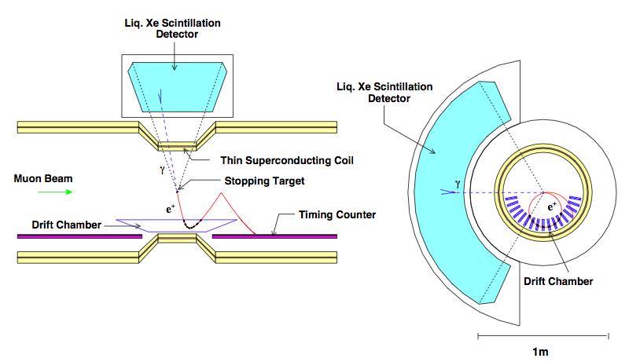
The MEG Experiment
~ 10% geometrical acceptance

Slide 17
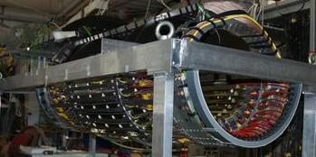
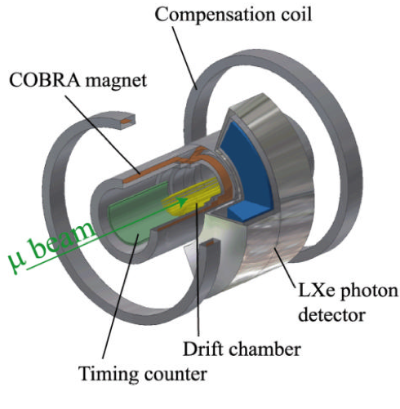
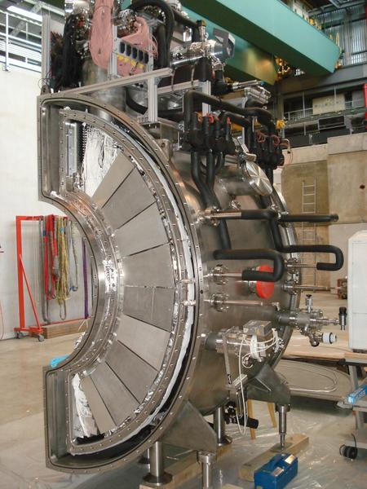
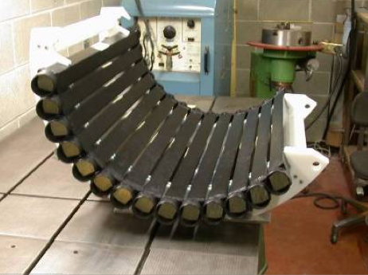
The MEG Experiment
Picture
~60 physicists, 12 Institutions, 5 Countries
Italy, Japan, Russia, Switzerland, USA

Slide 18
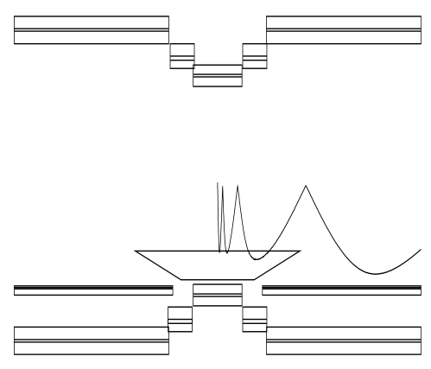
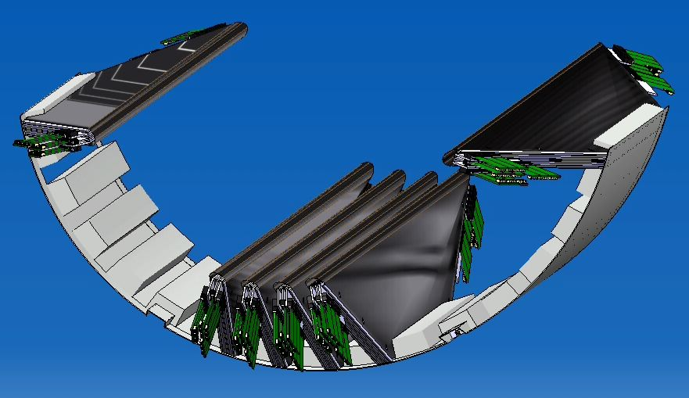
The Positron Spectrometer
16 low-mass Drift Chambers in a Helium atmosphere with a graded magnetic field :
  very low total material budget (< 0.005 X₀);
  fast expulsion of tracks from the spectrometer even at large polar angles.
Graded Field
Design resolutions
Momentum: 200 keV/c
Direction: 4.5 mrad

Slide 19
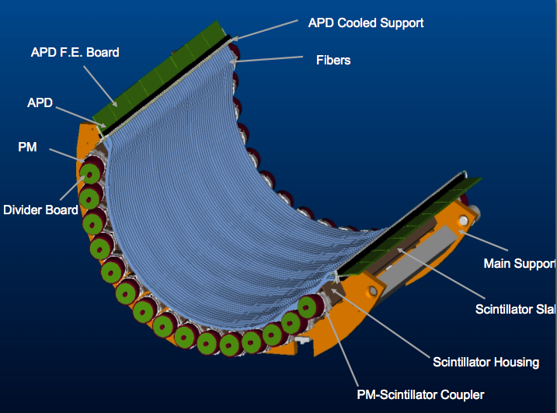
The Timing Counter
2 detectors (upstream & downstream) for precise positron timing and trigger;
15 plastic scintillating bars per detector read by PMTs:
  timing
  phi position
  trigger
1 layer of scintillating fibers per detector, read by APDs:
  z position
  trigger
Design ResolutionTime: 45 ps

Slide 20
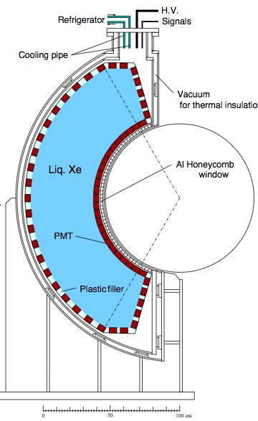
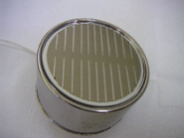
The LXe Calorimeter
The largest LXe calorimeter in the world:
  800 liters;
Fast response:
  t = 4ns / 22ns / 45ns;
Good light yield:
  ~ 75% of NaI(Tl);
Light collected by 846 PMTs.
Design RESOLUTIONS
Energy: 800 keV
Conversion Point: 2 - 4 mm
Time: 65 ps
Hamamatsu R9288

Slide 21
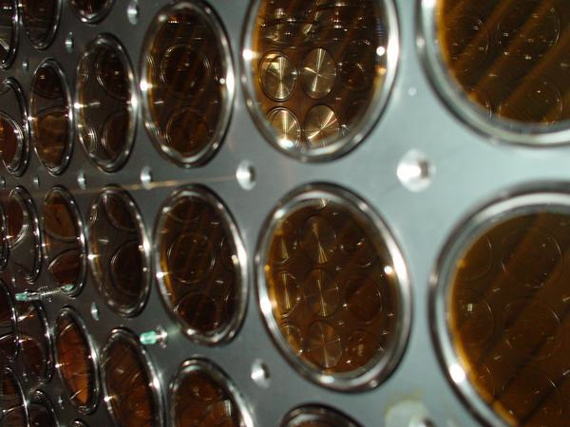
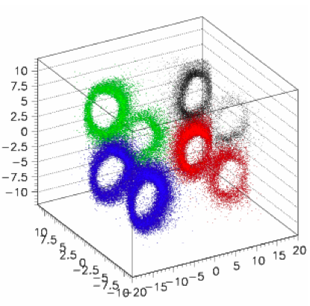
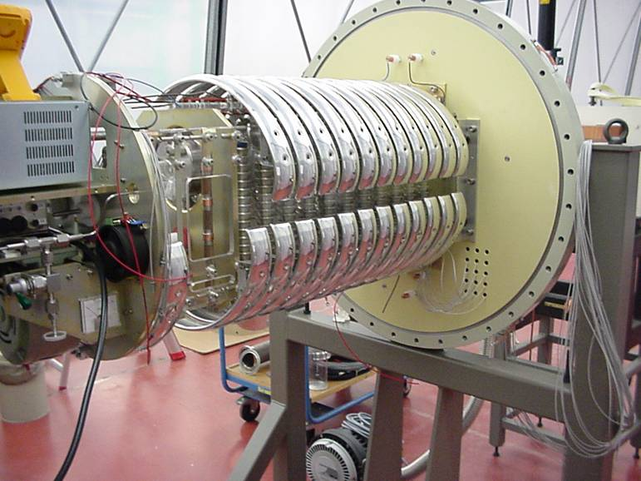
Calibrations
Charge Exchange (CEX)
LED
π⁻ + p → π⁰ + n
π⁰ → γ γ
Installed inside the XeC
PMT gain calibration
high energy photons for XeC energy & relative time calibrations
a sources
Cockcroft-Walton accelerator
Protons on a Lithium Tetra-borate target
low-energy photons for XeC energy & relative time calibration
Installed in wires inside the XeC
Calibration of Q.E., attenuation length, position

Slide 22
Resolutions (I)
CONTINUOUS IMPROVEMENTS
 | 2008 | 2009 (prelim.)
Gamma Energy | 2% (core) | 2% (core)
Gamma Timing | 80 ps | > 67 ps
Gamma Position | 5 / 6 mm | 5 / 6 mm
e+ Momentum | 1.6 % | 0.74% (core)
e+ Timing | < 125 ps | < 95 ps
e+ Angle | 10 / 18 mrad | 7 / 11 mrad
m Decay Point | 3.2 / 4.5 mm | 2.3 / 2.8 mm
Gamma-e+ Time | 148 ps | 142 ps (core)
Gamma-e+ Angle | 14 / 21 mrad | 13 / 15 mrad

Slide 23
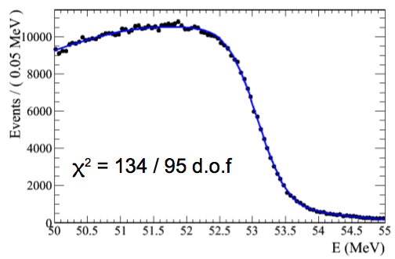
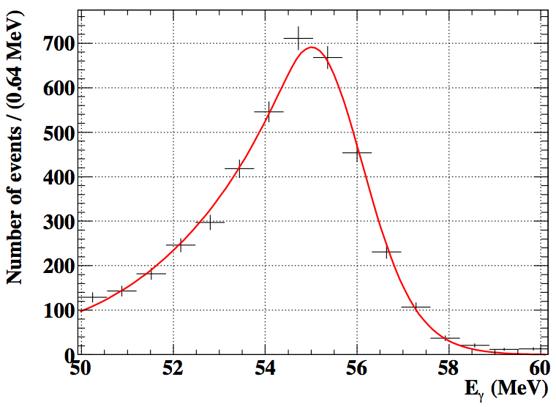
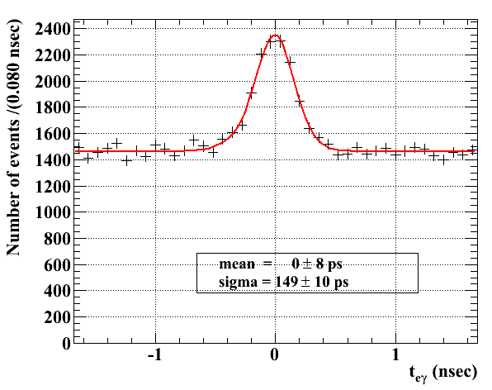
Resolutions (II)
From 2009 data
LXeCAL Energy
From charge exchange
~ 2% (core)
DCH Momentum from μ → e ν ν
~ 370 keV (core)
Teγ
from rad. decays
~ 142 ps

Slide 24
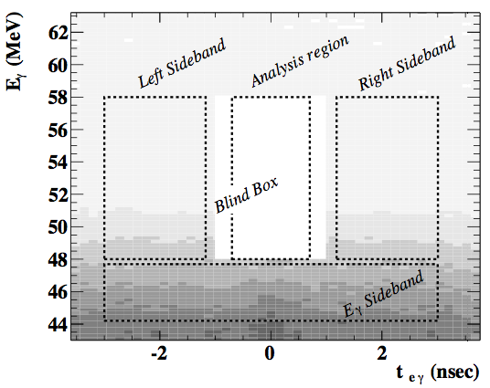
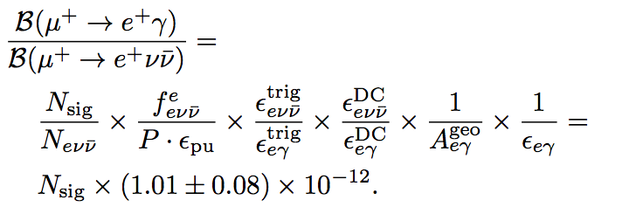
Analysis of 2009 Data
Data Set-> 46 days of data taking 6.5 x 10¹³ stopped μ.
Blind analysis :
  development and optimizations based on sideband data;
Extended Maximum Likelihood fit in 5 observables:
  E_{e}, E_{g}, T_{eg}, y_{eg}, f_{eg}
Normalization by counting the number of μ → e ν ν decays.
  Systematics cancel

Slide 25
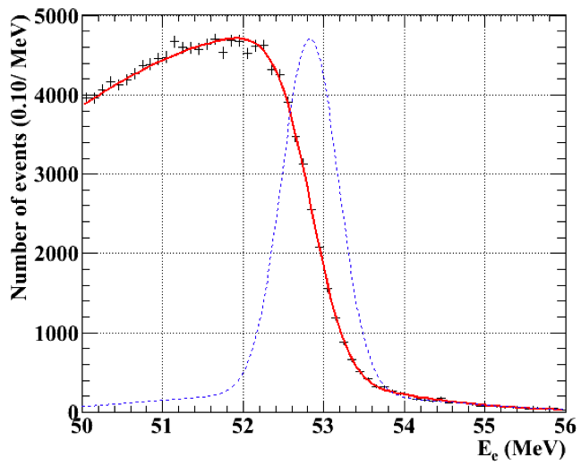
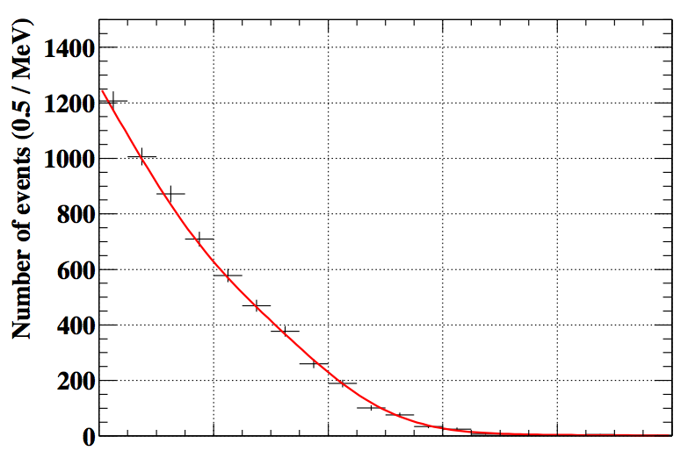
Likelihood Analysis (I)
Event-by-event PDFs:
  Position dependence in the LXe;
  two track quality categories;
PDFs Modeled from sidebands and calibrations;
Careful check for possible correlations;
3 different analysis frameworks for cross-checks.
EXPECTED UL
(from toy MC experiments)
~ 6.1 x 10⁻¹²
Ee
Eg

Slide 26
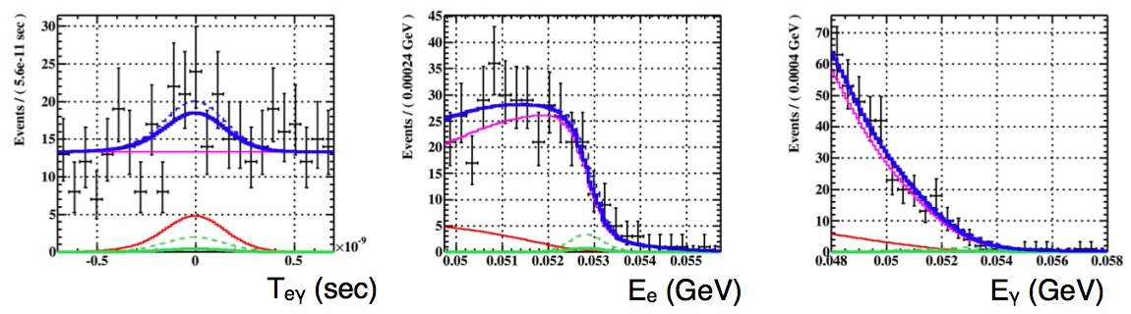
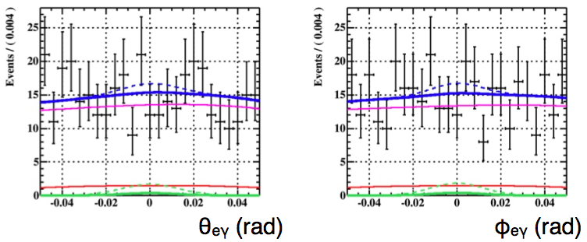
Likelihood Analysis (II)
PRELIMINARY
SIGNAL
RAD. DECAYS
ACCIDENTAL
TOTAL
(dashed: 90% U.L)
Best fit:
N_{S} = 3.0, N_{RD} = 35⁺²⁴₋₂₂ (expected N_{RD} = 32 ± 2)
N_{S} < 14.5 @ 90% C.L. (Feldman-Cousins)

Slide 27
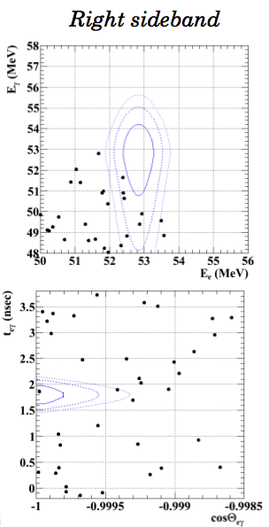
Control Samples
The strategy is applied to the Teγ sidebands to check the consistency of the data description;
Only accidental background is present:
  both Signal and Rad. Decays should give zero yield;
Results are consistent with N_{S} = N_{RD} = 0 and with Toy MC expectations
(fictitious ULs of
4 – 6 x 10⁻¹² are obtained)

Slide 28
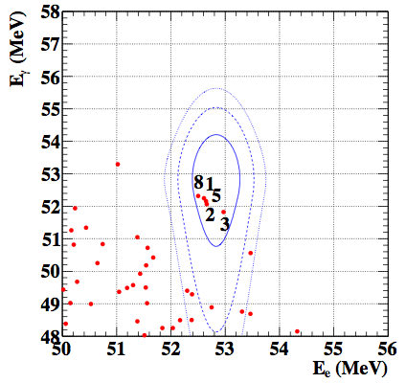
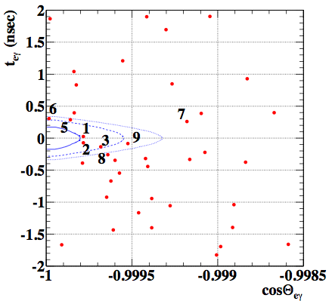
Signal Region
PRELIMINARY
Contours are 2D signal PDF for 1s (39.3 %), 1.64s (74.2%) and 2s (86.5%) regions.
The numbered events are ranked according to the S/B likelihood ratio.

Slide 29
Systematics
Parameters are fluctuated in the toy MC generation to include the systematics in the Feldman-Cousins procedure;.
Large uncertainty on the angular PDFs due to reconstruction biases
PARAMETER | UNCERTAINTY
Normalization | 8%
Eγ scale | 0.4%
Eγ resolution | 7%
Ee scale | 50 keV
Ee resolution | 15%
Teγ mean | 15 ps
Teγ resolution | 10%
Angle mean | 7.5 mrad
Angle resolution | 10%
Ee-φ correlation | 50%
PRELIMINARY

Slide 30
Upper Limit
From the U.L. on the number of signal events:
  N_{S} < 14.5 @ 90% C.L.
... and the normalization factor:
  BR(μ → e γ) = N_{S} x (1.01 ± 0.08) x 10⁻¹²
... we get the following U.L. on the Branching Ratio (syst. included):
  Looks different from estimated sensitivity
No lower limit:
  BR = 0 is within the 90% C.L. interval.
PRELIMINARY
BR(μ → e γ) < 1.5 x 10⁻¹¹ @ 90% C.L
.

Slide 31
Next Steps
MEG is taking data now (since August)
  2010 yield is x 3 2009 sample (stay tuned!)
  Will help in understanding the preliminary results
Meanwhile
  Additional calibration tools
    Monochromatic e+ beam for the spectrometer
    9 MeV γ-line induced by neutron generator in the LXe
The MEG data taking will continue in 2011 and 2012
  To reach an UL in the 10⁻¹³ range or
  To make a great discovery!

Slide 32

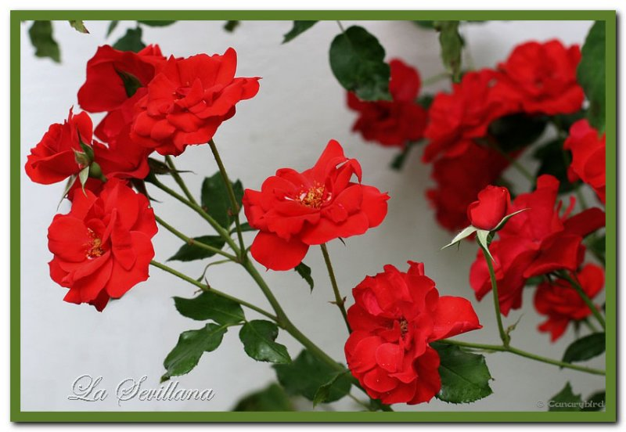
If they are roses…they will blossom
but if they are not and in any case there is an alternative…

Slide 33
What is μ-e Conversion ?
Y.Kuno WG4 Oct 21
1s state in a muonic atom
Neutrino-less muon
nuclear capture
(=μ-e conversion)
nucleus
−
−
μ
+
→
+
(
,
)
(
,
)
A
Z
e
A
Z
μ
−
lepton flavors
changes by one unit
muon decay in orbit
−
−
μ
◊
e
ν
ν
nuclear muon capture
Γ
μ
→
(
−
N
−
−
−
e
N
)
B
μ
→
=
(
N
e
N
μ
−
+
(
A
,
Z
)
◊
ν
+
(
A
,
Z
−
1
)
)
Γ
−
'
μ
→
ν
μ
(
N
N
)

Slide 34
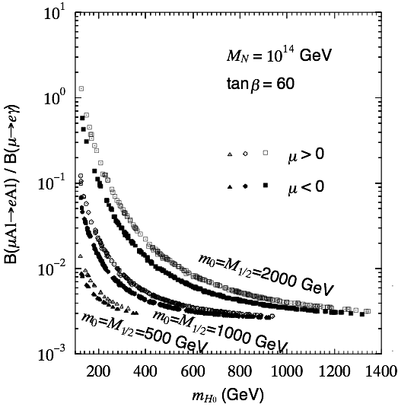








μ→eγ and μ-e conversion
Z’
Z’
If μ→eγ exits, μ-e conv must be
Even if μ→eγ is not observed, μ-e conv may be
  Loop vs Tree
  Searches at LHC

Slide 35

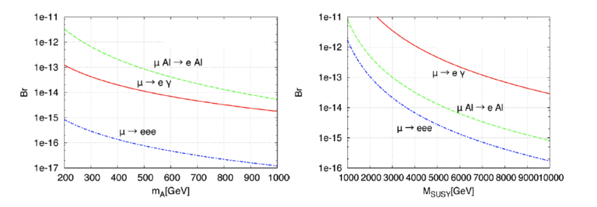
μ→eγ and μ-e conversion
Higgs exchange vs SUSY 1-loop
Hisano et al. ’10
Important to measure both μ→eγ and μ-e with similar sensitivity

Slide 36
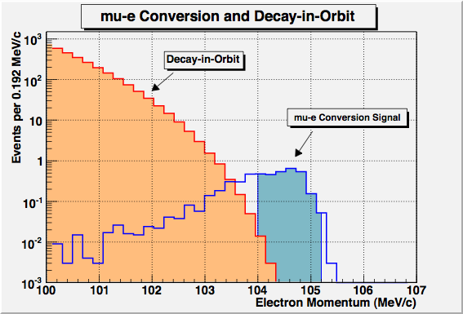
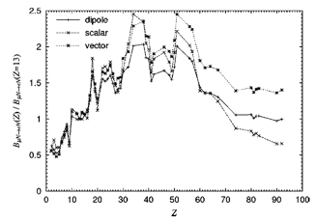
μ-e conversion signal
E_{μe} ~ m_{μ}-B_{μ}
  B_{μ}: binding energy of the 1s muonic atom
Improvement of a muon beam is possible, both in purity (no pions) and in intensity (thanks to muon collider R&D). A higher beam intensity can be taken because of no accidentals.
Potential to discriminate different models through studying the Z dependence
R.Kitano, M.Koike, Y.Okada
P.R. D66, 096002(2002)

Slide 37
History of μ-e conversion search
Year | Muon source | Target | Upper bound
1952 | Cosmic rays | Cu, Sn | 4×10⁻²
1955 | Nevis cycl. | Cu | 5×10⁻⁴
1961 | Berkeley synchroc. | Cu | 4×10⁻⁶
1961-62 | CERN synchroc. | Cu | 2.2×10⁻⁷
1972 | Virginia SREL synchroc. | Cu | 1.6×10⁻⁸
1977 | SIN | S | 7×10⁻¹¹
1984 | TRIUMF | Pb Ti | 4.9×10⁻¹⁰ 4.6×10⁻¹²
1992 | PSI | Pb | 4.6×10⁻¹¹
1993-97 | (only in conference proc.) | Ti | 6.1×10⁻¹³
2006 |  | Au | 7×10⁻¹³

Slide 38
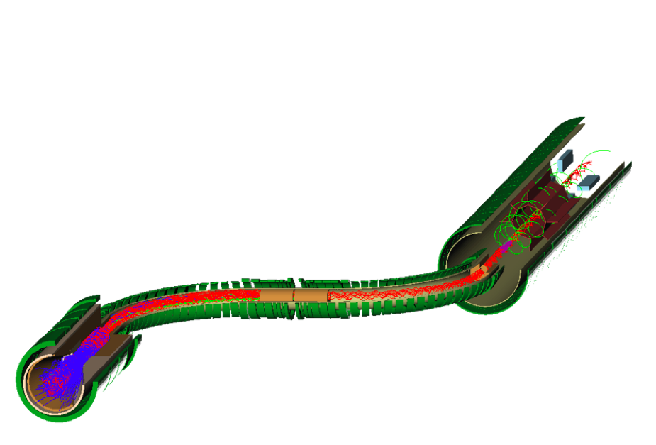
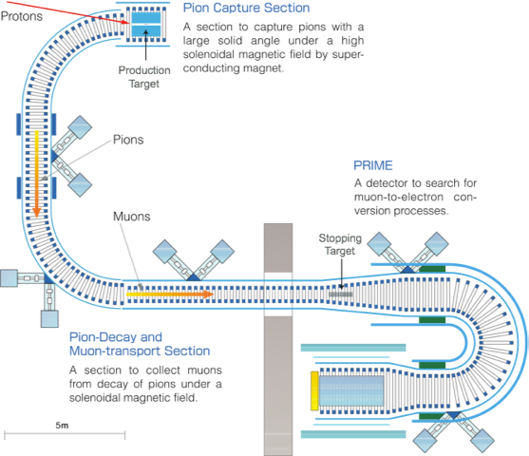
Mu2e (Fermilab) vs COMET(J-Parc)
 | Mu2e | COMET
Proton Beam | 8GeV, 20kW bunch-bunch spacing 1.69 μsec rebunching Extinction: 10⁻⁹ | 8GeV, 50kW bunch-bunch spacing 1.18-1.76 μsec empty buckets Extinction: 10⁻⁹
Mu Transport | S-shape Solenoid | U-shape solenoid
Detector | Straight Solenoid with gradient field Tracker and Calorimeter – 500 kHz DAQ | U-shape Solenoid with gradient field Tracker and Calorimeter- 1 kHz DAQ
Sensitivity Approval status | SES: 2.5×10⁻¹⁷ 90% CL UL: 6×10⁻¹⁷ ^{CD-0 (of 4)} | SES: 2.6×10⁻¹⁷ 90% CL UL: 6×10⁻¹⁷ ^{Stage 1 (of 2)}

Slide 39
Conclusions
Muon played an important role to establish the SM
We believe that could be same in going beyond the SM
Thanks to the intense muon beam described in this conference
very well designed and conducted. Many thanks to the Organizers!

Slide 40
More slides

Slide 41
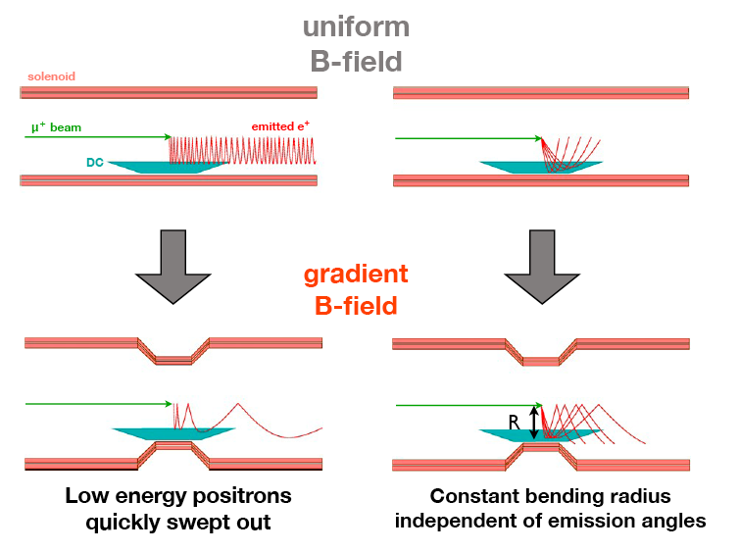
The Advantage of COBRA

Slide 42
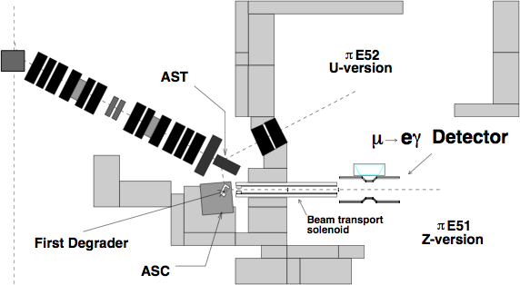
The πE5 Beam @ PSI
The most intense DC muon beam in the world:
  up to 10⁸ μ/s;
  only 3 x 10⁷ μ/s for the MEG running (reduced accidental rate);
Proton beam current : ~ 2.2 mA
Muon production : from π decaying in target proton surface
Muon Momentum : 28 MeV/c ± 3%

Slide 43
Data Sets
2008:
  ... days of data taking
  ~ ... stopped muons;
  Sensitivity ~ 1.3 x 10⁻¹¹ ;
  BR(m → e g) < 2.8 x 10⁻¹¹ Nucl. Phys. B 834 (2010) 1
2009:
  Significant hardware upgrades (DCH, electronics);
  46 days of data taking;
  ~ 6.5 x 10¹³ stopped muons.

Slide 44
Efficiencies
EFFICIENCIES
CONTRIBUTION | 2008 | 2009
Gamma | 63% | 58%
Positron | 14% | 40%
Trigger | 66% | 84%
DAQ | 62% | 81%

Slide 45
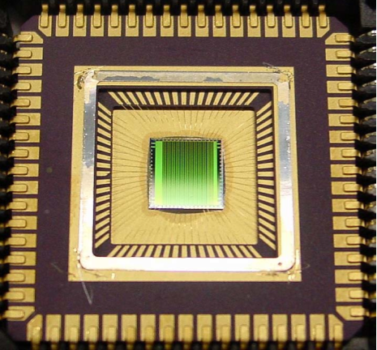
DAQ & Trigger
High accidental background rejection (~ 10⁷) with ~100% signal efficiency required at the trigger level:
  online determination of g energy, e – g timing and e – g collinearity (fully digital implementation);
  ~ 5 – 10 Hz trigger rate during normal data acquisition;
Very fast waveform digitalization (0.5 - 4.5 GHz) for offline analysis:
  custom chip (Domino Ring Sampling, DRS) designed @ PSI;
  10 channels x 1024 bins per chip;
  40 ps time accuracy at 2.5 GHz.

Slide 46
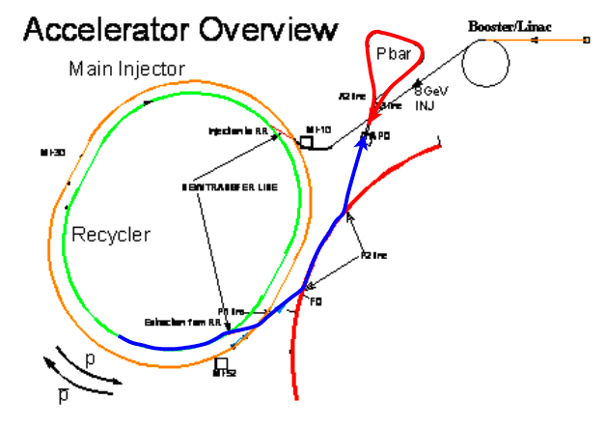
Proposal for g-2@Fermilab
Submitted to Fermilab PAC
  Contact persons: Lee Roberts (Boston U)
  Dave Hertzog (UIUC)
  Cost Estimate: ~$30 M (w/ contingency)
  The PAC
  endorsed the
  experiment
  Subject to DOE
  review in August

