Slide 1
Kaon Production Off the Nucleon
Mohammad Sajjad Athar
Aligarh Muslim University
M Rafi Alam
Aligarh Muslim University
I. Ruiz Simo and M. J. Vicente Vacas
Departamento de Fı´sica Teo´rica and IFIC, Valencia

Slide 2
Outlay
Introduction
Formalism
Effective Lagrangian Approach at Low Energies
Chiral Perturbation Theory
Results
Conclusion

Slide 3
Introduction
In order to determine precisely the neutrino oscillation parameters lots of experimental and theoretical efforts are going on.
Most of the neutrino experiments are using nuclear targets like Carbon, Oxygen, Argon, etc.
The total νN CC scattering cross section
σ ^{tot} = σ ^{QEL} ⊕ σ ^{1π} ⊕ σ ^{2π} ⊕ …….. ⊕ σ ^{1K} ⊕ ………. ⊕ σ ^{DIS}
σ ^{tot} = σ ^{QEL} ⊕ σ^{RES} ⊕ σ ^{DIS}

Slide 4
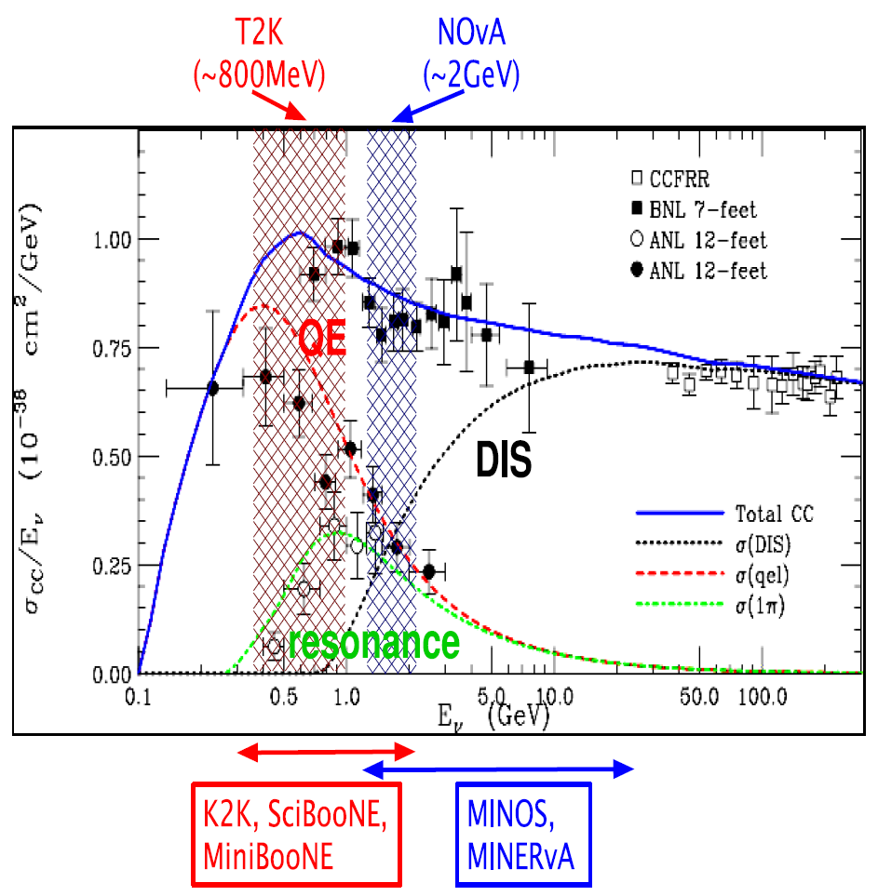

Slide 5
Examples of the different types of weak processes accompanying strange particle/particles
(ΔS= 1 processes have no NC contributions as they involve a change in strangeness and therefore in charge.)

Slide 6
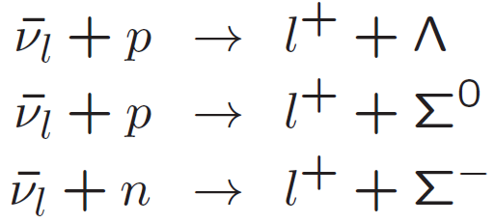

Slide 7
K ⁺ as background event in proton decay experiment
Limits on the proton’s life time are obtained by SuperK experiment
τ > 5.4 x 10³³ years from p → e + π⁰ decay mode
Two orders of magnitude bigger than predicted by Grand Unified Theories (GUT) 10³¹ yrs
τ > 2.3 x 10³³ years from p → K⁺ + ν decay mode
Supersymmetry theories predict τ ≈ 0.33 – 3 x 10 ³⁴ years for p → K⁺ + ν decay mode
Motivates the search for proton decay into this mode

Slide 8
LAGUNA plans to use detectors like GLACIER, MEMPHYS or LENA to test physics at the GUT scale
Extending the proton (and bound neutron) lifetime sensitivities up to 10³⁵ years
K⁺ life time ~ 12.8 ns and they decay into K⁺ → μ + ν_{μ} (63.43 %) or K⁺ → π ⁺ + π⁰ (21.13 %)
Main background sources are muon neutrinos produced by cosmic rays interactions
These neutrinos interact with the detector producing muon in the energy range where search for proton decay is performed.

Slide 9
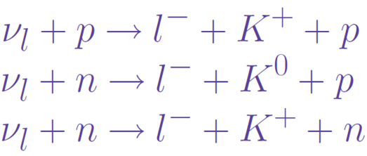
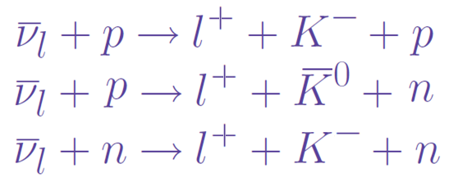
Main background reaction is
when neutrinos are in the energy range ~ 1 GeV.
Δ S=± 1 reactions are also important because they may be a test of the Cabibbo theory and towards our understanding of Strangeness Changing Weak Processes.

Slide 10
J. Bell et al. Phys. Rev. Lett. 41, 1008 (1978) at the Fermi Lab measured the ratio of the cross sections in the energy region of 10-30 GeV
and for
σ(ν_{μ} + p → μ ⁻ + π⁺ + p ) = 0.80 ± 0.12 x 10⁻³⁸ cm²
estimated
σ(ν_{μ} + p → μ ⁻ + K⁺ + p ) = 1.4 ± 0.8 x 10⁻⁴⁰ cm²

Slide 11
S. J. Barish et al. PRL33, 1446 (1974); PRD19, 2521(1979) at ANL for the neutrino energies 1.5 GeV < E_{ν}< 3 GeV measured the NC to CC ratio & Strange vs Non-Strange hadronic final states
and

Slide 12
W. A. Mann et al. Phys. Rev. D 34, 2545 (1986) 1 < E_{ν} < 5 GeV
Because of the lower threshold μ⁻ + K⁺ + p and μ⁻ + K⁺ + Λ dominate

Slide 13
R. E. Shrock (Phys. Rev. D 12, 2049, 1975) used a resonant Born model and estimated the charged and neutral
ν_{μ} + N → μ⁻ + K + Λ⁰ and ν_{μ} + N → μ⁻ + K⁺ + Σ cross sections (~ 10⁻⁴⁰ cm²) in the neutrino energy region up to 3 GeV
A. A. Amer (Phys. Rev. D 18, 2290, 1978) used a harmonic oscillator quark model to estimate cross section for K⁺ Λ production 1.35 – 2.65 ~ 10⁻⁴¹ cm²
H. K. Dewan (Phys. Rev. D 24, 2369, 1981) has studied S.C. C.C. reactions ν_{μ} + N → μ⁻ + Y + π and ν_{μ} + N → μ⁻ + N + K using Born approximations with hyperon-nucleon transition form factors determined from the Cabibbo theory with SU(3) symmetry.

Slide 14
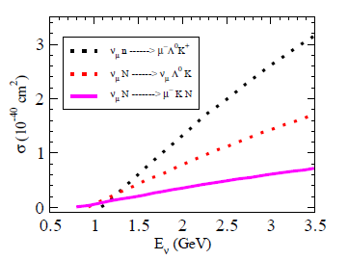
Estimated cross sections for probable neutrino- nucleon interactions (K. Datchev-MiniBooNE)

Slide 15
Estimated event rates for major Kaon-Production Channels for 0.45kT of fiducial volume at MiniBooNE
Kiril Datchev
Channel | Events
ν _{μ} + n → μ ⁻ + K⁺ + Λ⁰ | 143
ν _{μ} + p → μ ⁻ + K⁺ + p | 122
ν _{μ} + n → μ ⁻ + K⁰ + p | 91
ν _{μ} + n → μ ⁻ + K⁺ + n | 91
ν _{μ} + p → ν _{μ} + K⁺ + Λ⁰ | 83
ν _{μ} + n → ν _{μ} + K⁰ + Λ⁰ | 62

Slide 16
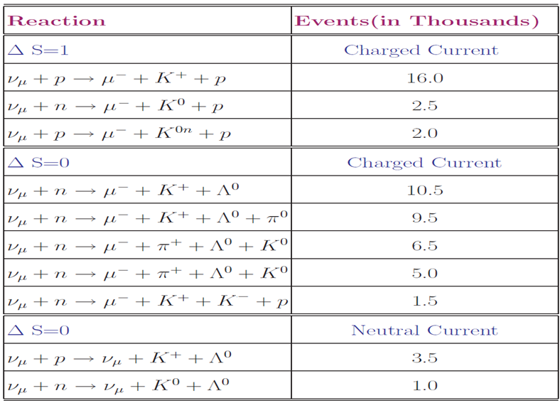
Channels of Kaon Production at Minerva, 3 Tons and 4 Years

Slide 17
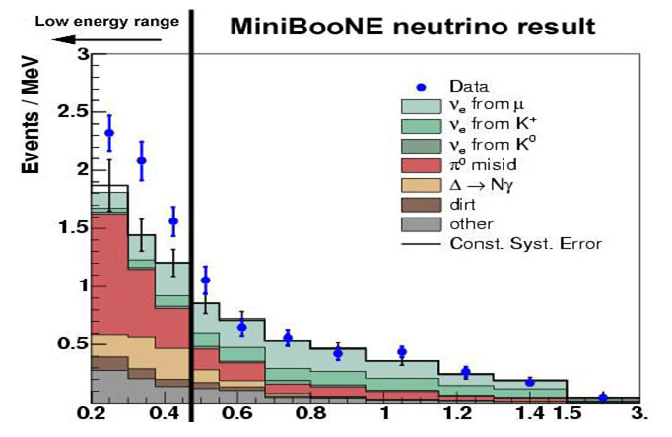
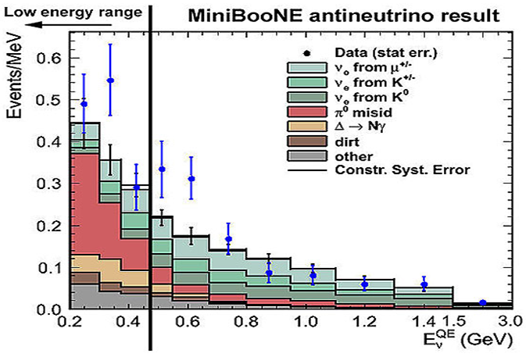
A comparison of the energy spectrum for MiniBooNE electron neutrino (left) and antineutrino (right) candidates. Data is shown in blue points and compared to expected backgrounds.
http://www.fnal.gov/pub/today/archive_2010/today10-06-18_readmore.html

Slide 18
Formalism

Slide 19
Chiral perturbation theory (ChPT) is the effective field theory (EFT) of the Strong interactions at low energies.
The theory introduces effective Lagrangians which involve only observable particles, mesons and baryons.
It respects the basic symmetries of the original QCD Lagrangian and organizes these Lagrangians according to the number of derivatives of the mesons and baryons fields.
Such a theory allows for a perturbative treatment of momentum as opposed to the coupling constant.

Slide 20
The lowest order chiral Lagrangian for the meson meson interaction, invariant under L. T., Parity, C. C. with only two derivatives is written in terms of the (covariant) derivatives and of the quark mass terms :
S. Scherer---- Adv. Nucl. Phys. 27 (2003) 277
U is a unimodular unitary (3 x 3) matrix containing the Goldstone boson(meson) fields.
f𝝅 denotes the pion-decay constant which is in the chiral limit=92.4MeV.

Slide 21
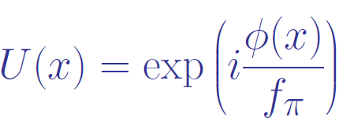
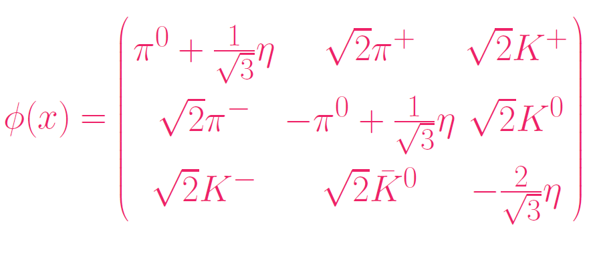
The SU(3) PS Meson Octet field φ(x) is given by
Each particle is representing a field

Slide 22
D_{μ} U is covariant derivative given as,
with l_{μ} and r_{μ} as left and right handed external fields.
For the charged current case,
g is the weak gauge coupling related with Fermi coupling constant G_{F} as,

Slide 23
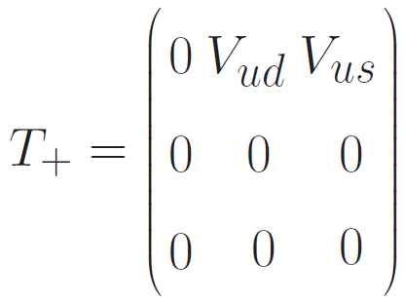
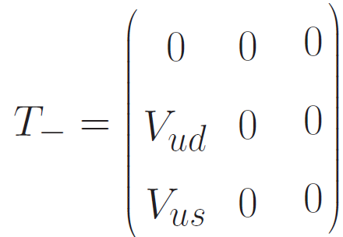
V_{ij} denote the elements of the CKM quark mixing matrix describing the transformation between the mass eigen states of the QCD and the weak eigen states.
|V_{ud}|=0.9735 ±0.0008 and |V_{us}|=0.2196 ±0.0023

Slide 24
Lowest order Chiral Lagrangian for the baryon octet in the presence of external current
where D = 0.804 , F = 0.463
B is the SU(3) Baryon Octet (½⁺) field
where each entry is a Dirac field

Slide 25
Covariant derivative of B is
Г_{μ} is the connection between covariant derivative
and the field u_{μ}
where u² = U

Slide 26
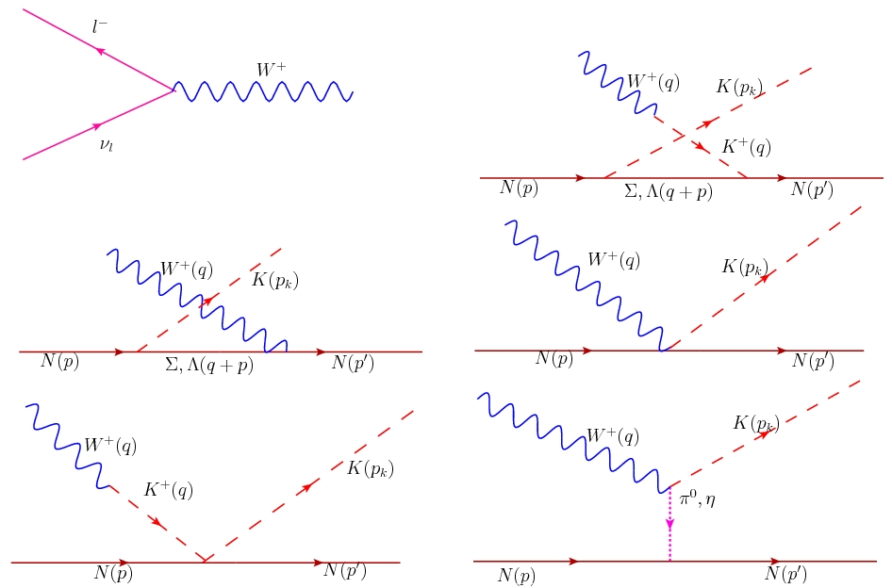
Feynman diagrams for the neutrino induced process: u-channel Kaon in flight , u-channel, contact term, Kaon in flight, pion/eta in flight

Slide 27
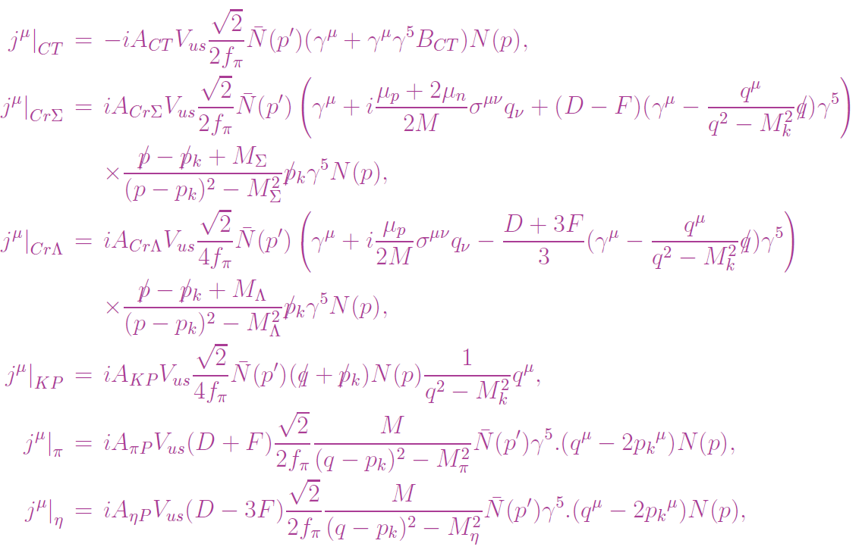
Contributions to the hadronic current for neutrino induced process

Slide 28
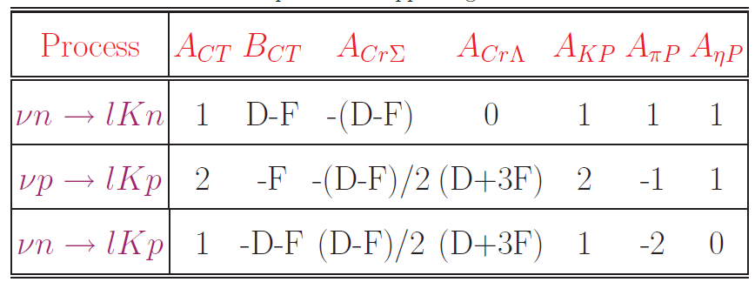
Values of the parameters appearing in the hadronic currents

Slide 29
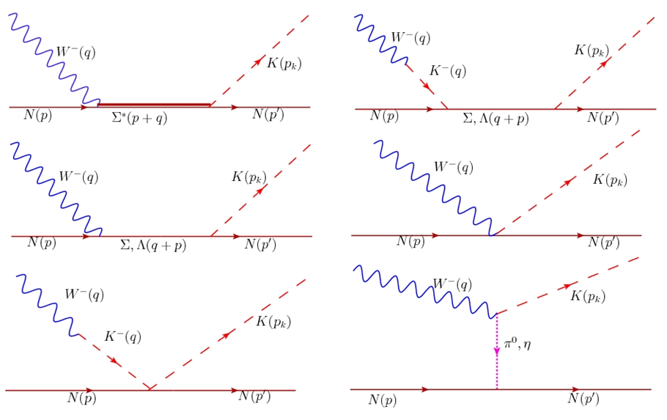
Feynman diagrams for the anti-neutrino induced process: 𝜮-resonance, s-channel Kaon in flight , s-channel, contact term, Kaon in flight, pion/eta in flight

Slide 30
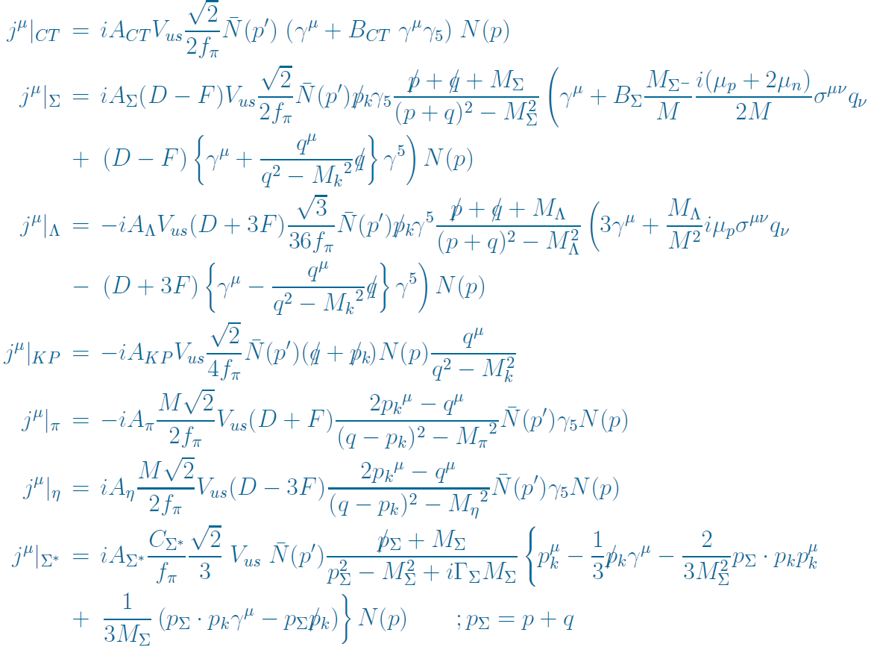
Contributions to the hadronic current for anti-neutrino induced process

Slide 31
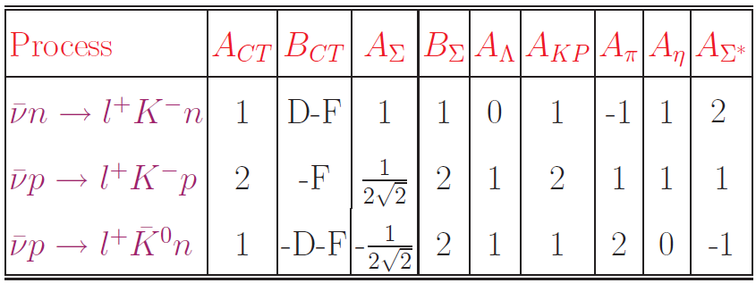
Values of the parameters appearing in the hadronic currents
C_{𝜮*} = 1.17

Slide 32
Basic reaction
Differential cross section in lab frame
Matrix Element

Slide 33
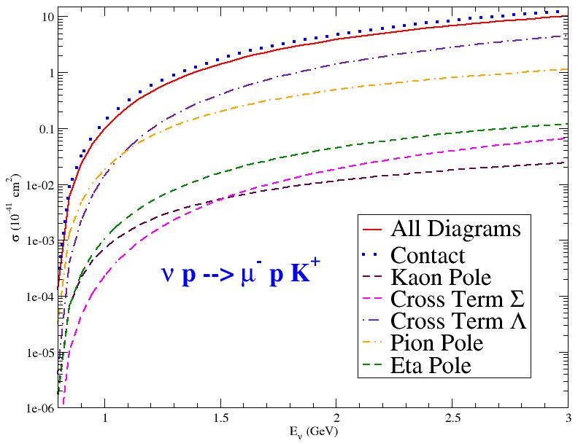

Slide 34
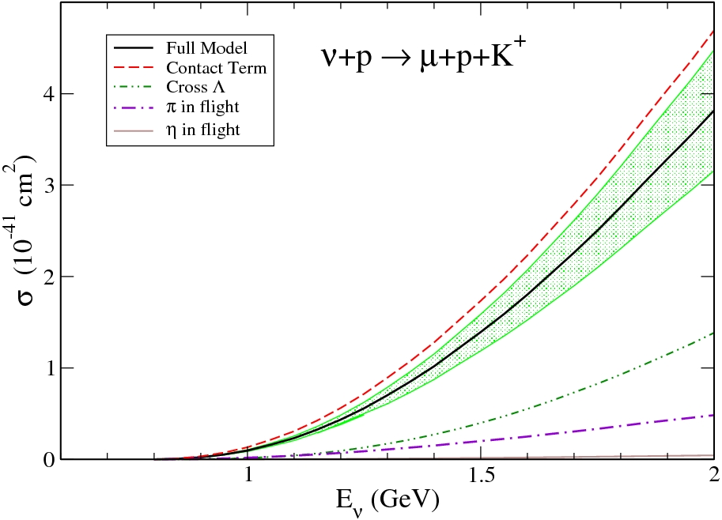
PHYSICAL REVIEW D 82, 033001 (2010)

Slide 35
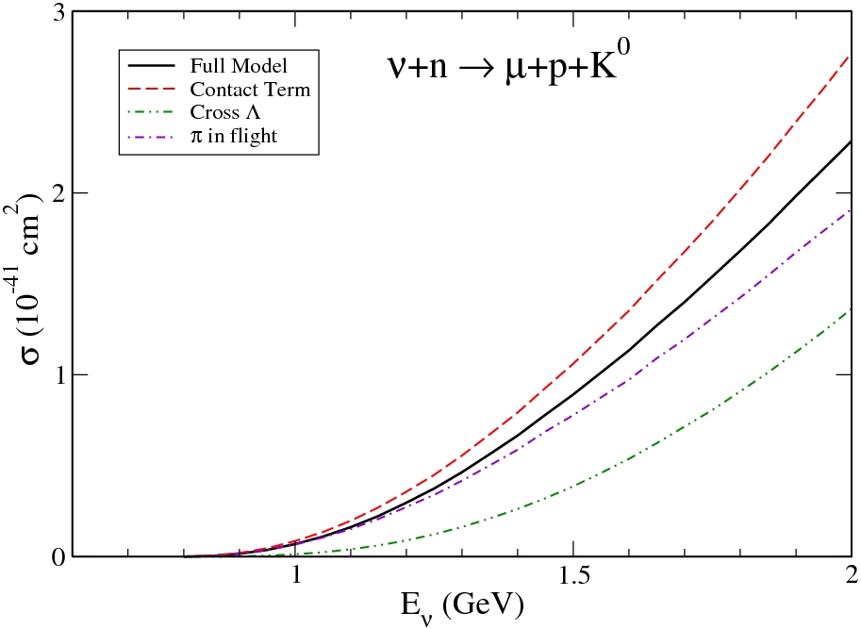

Slide 36
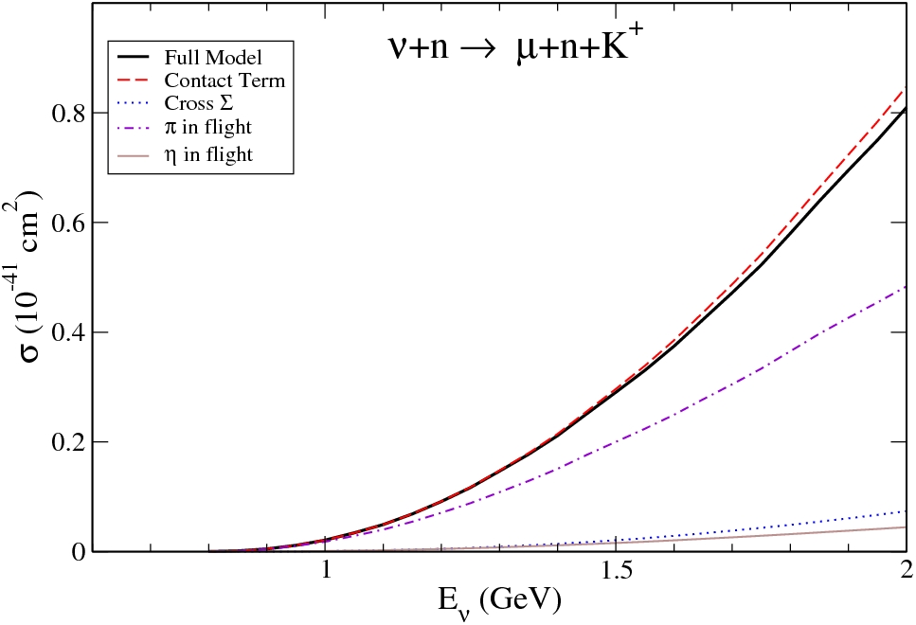

Slide 37
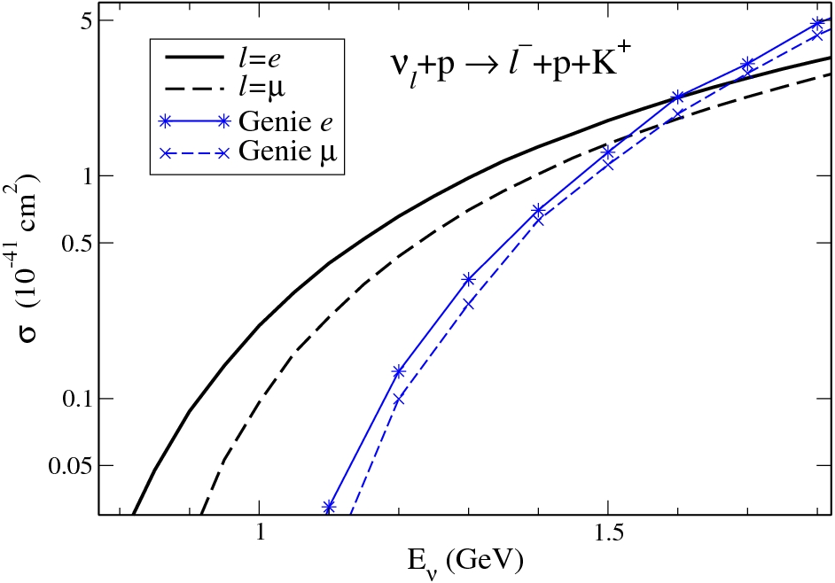

Slide 38
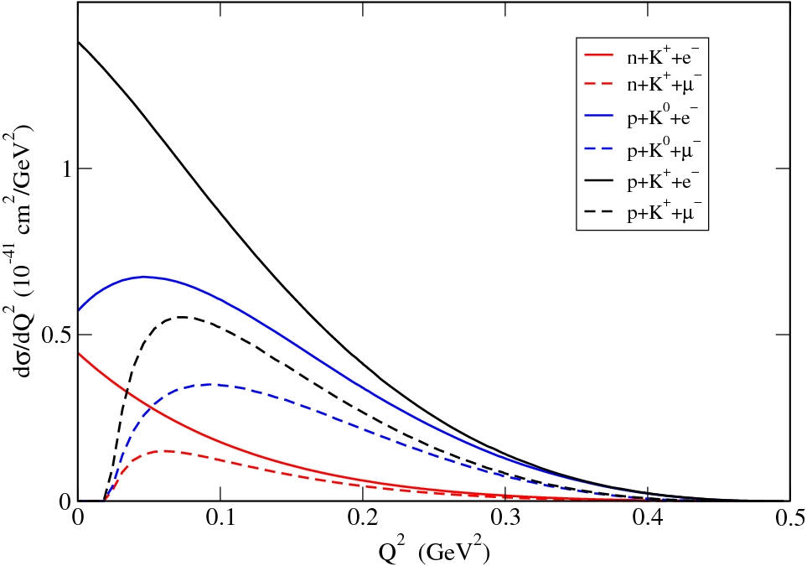
PHYSICAL REVIEW D 82, 033001 (2010)

Slide 39
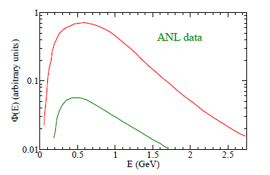
ANL Spectrum

Slide 40
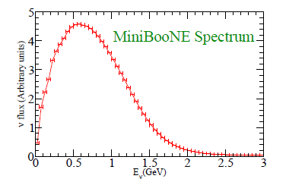
Predicted Neutrino flux ( x 10⁻¹⁰ ν _{μ} /POT/GeV/cm² ) at the MiniBooNE detector

Slide 41
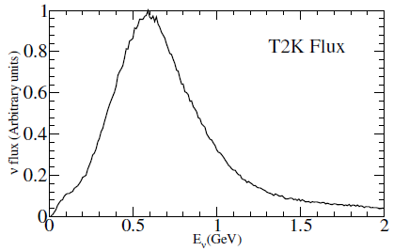
T2K Spectrum

Slide 42
For instance, the cross section for neutral current π⁰ production per nucleon has been measured by the MiniBooNE collaboration (Aguilar-Arevalo: 2009 ) obtaining σ = (4.76 ± 0.05 ± 0.76)×10⁻⁴⁰ cm² with a data set of some twenty thousand valid events.
The cross sections predicted by our model with the same neutrino flux are around two orders of magnitude smaller, that means that a few hundreds of kaons should have been produced.

Slide 43
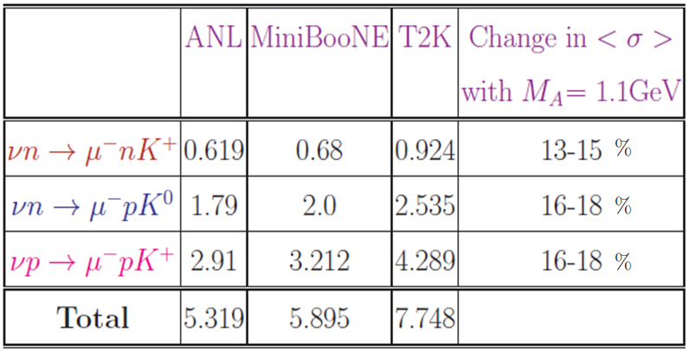
Flux averaged cross section for ν N →lNK in 10⁻⁴² cm² at M_{A} = 1 GeV

Slide 44
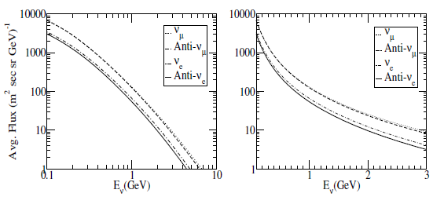
Atmospheric Neutrino Flux

Slide 45
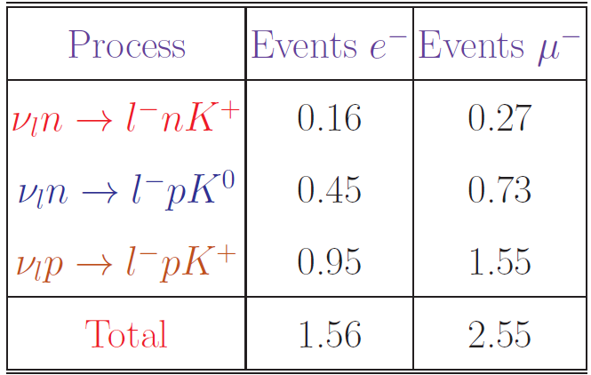
Number of events calculated for single kaon production in water corresponding to SuperK experiments
In the SuperK analysis the kaon production was modeled following Rein and Sehgal Ref. ANN. Phys. 1981 and that included associated kaon production.
Results have been presented for 22.5 kT water fiducial mass on an exposure of 1489 live days.
Sub-GeV events (E_{l} < 1.33 GeV and minimum observed momenta of electrons and muons are 100 MeV & 200 MeV respectively ) have been taken.

Slide 46
Conclusions
We have obtained cross sections that are around 2 orders of magnitude smaller than for pion production at the neutrino energies of 1 GeV.
2. However, these cross sections are large enough to be measured in the Minerva and T2K experiments.
3. In the energy region of atmospheric neutrino experiments or in the energy region of 0.8-1.2 GeV, the studied processes are the dominant source of Kaons.
4. Antineutrino induced Kaon production would be more interesting as there is contribution of resonance diagrams also in the scattering amplitude.

Slide 47
Thank You

