Slide 1
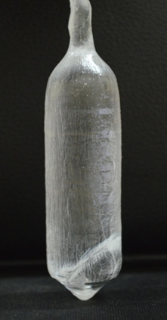
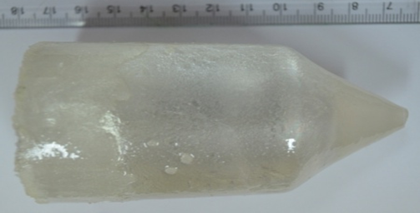
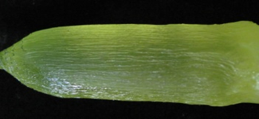
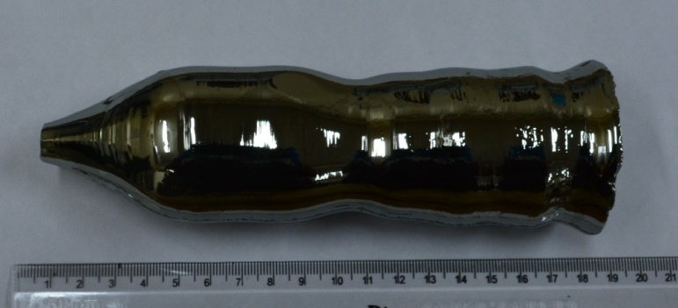
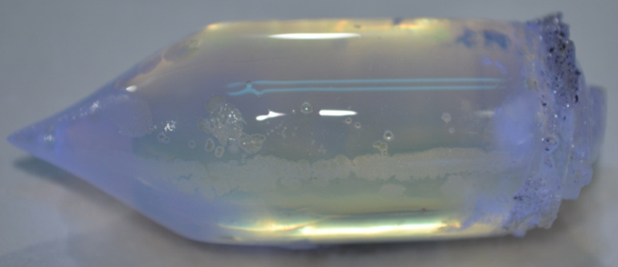
Single Crystals Grown for radiation detection
7/7/2022
LaBr₃:Ce Crystals 50 mm φ and 50 mm L
LiI:Eu Crystals 50 mm φ and 50 mm L
YAlO₃:Ce Crystal (size 30 mm φ and 40 mm L)
CsI:Tl Crystal (size 75 mm φ and 100 mm L)
Diameter controlled Ge single crystal Size: 50 mm φ and 150 mm L
Gd₃Ga₃Al₂O₁₂:Ce Crystal (size 30 mm φ and 40 mm L)

Slide 2
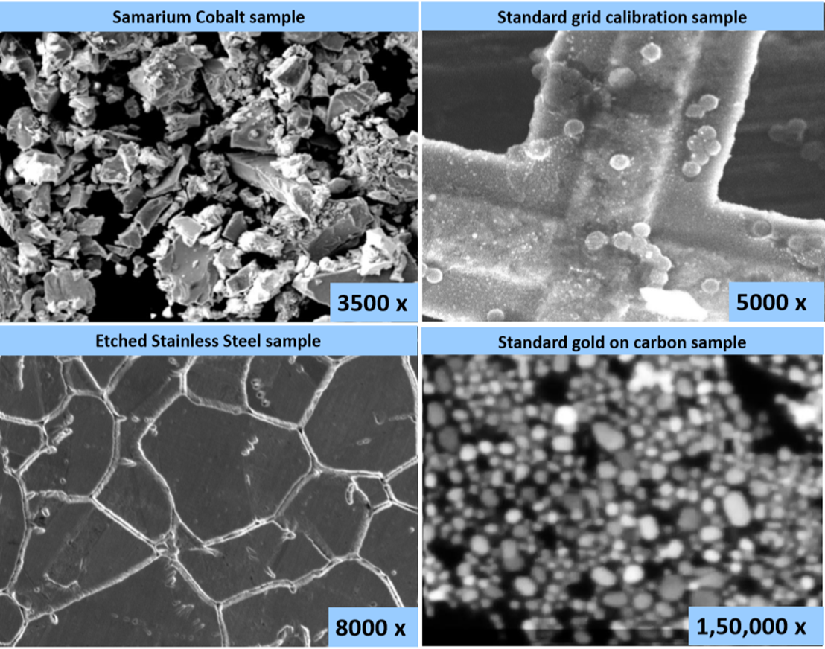
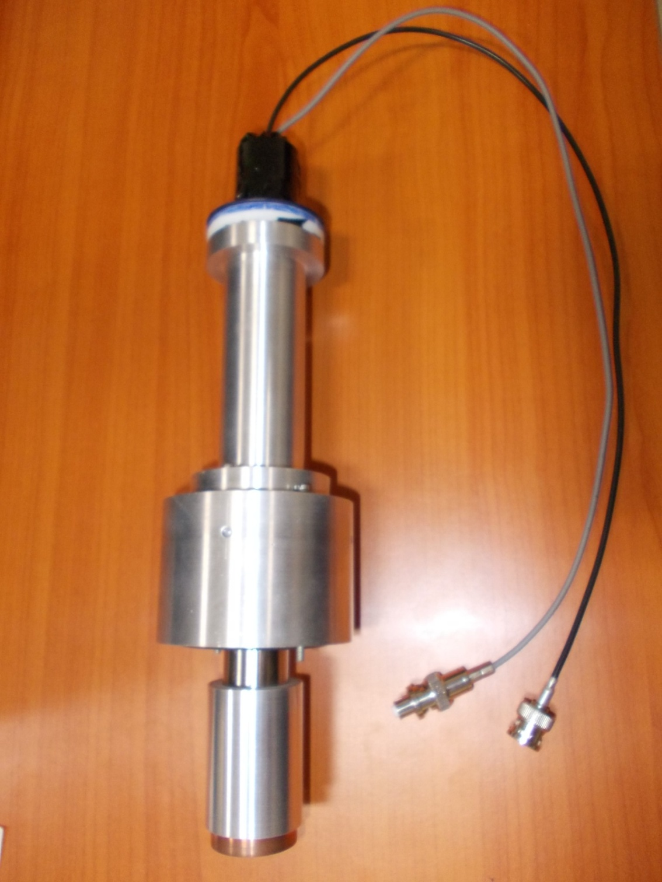
YAP crystal used to fabricate E-T detector for SEM
E-T Detector (for SEM) fabricated using the grown YAP crystal
Images recorded using SEM detector


Slide 3
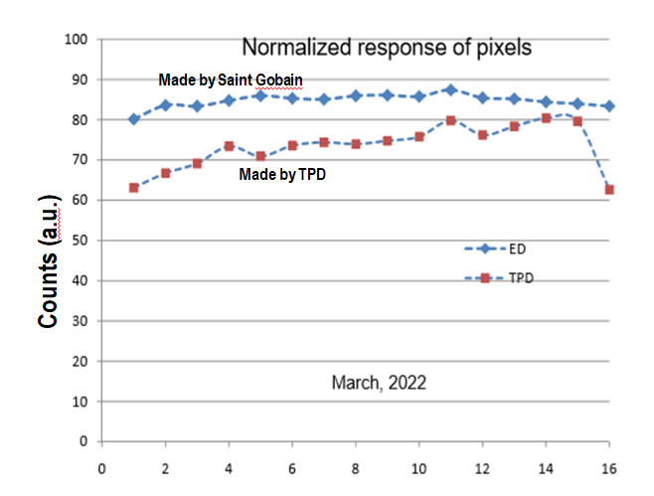
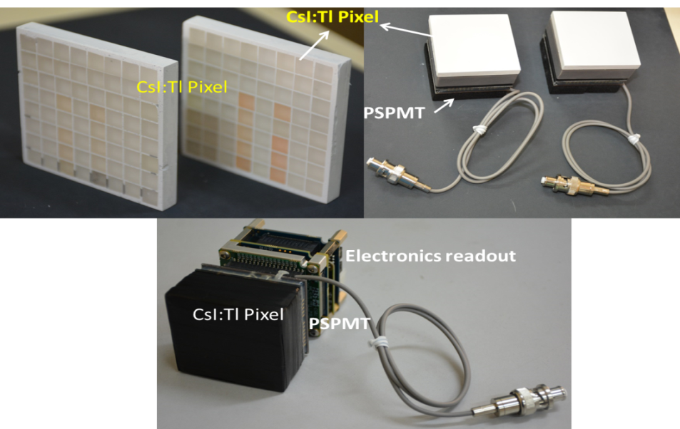
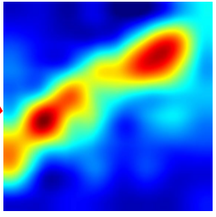
Development of 1D (16x1 matrix) and 2D (8x8 matrix) array of Pixelated CsI:Tl crystals for imaging applications
1 D array of Pixelated CsI:Tl crystals (16x1) dimension 3 mmx1.4mm with separation of 100 micron and mounting on silicon diode photodetectors for the X-ray Baggage Scanner project (TPD, ED, ECIL)
The response of each pixel with X ray is found to be comparable with Saint-Gobain made detectors
2D Pixelated CsI:Tl Single crystal mounted on PSPMT.
Spatially resolved image of a gamma source kept in a phantom.
The Small Organ Imaging Gamma camera is for detection of Sentinel node of Breast Cancer by uptake of ¹³¹I tracer isotope.(TPD & SSSIHL)

Slide 4
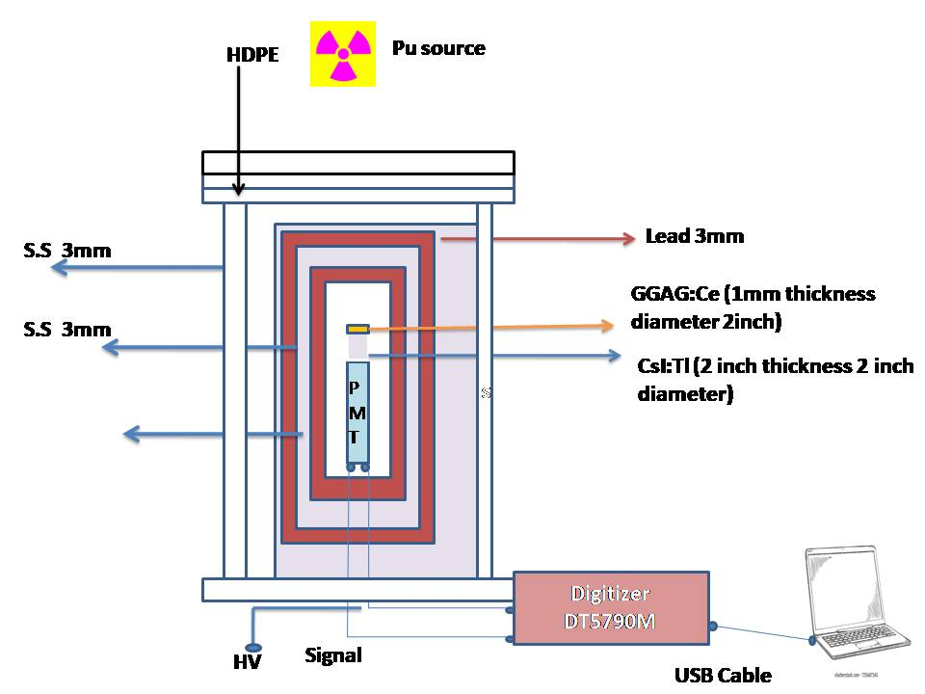
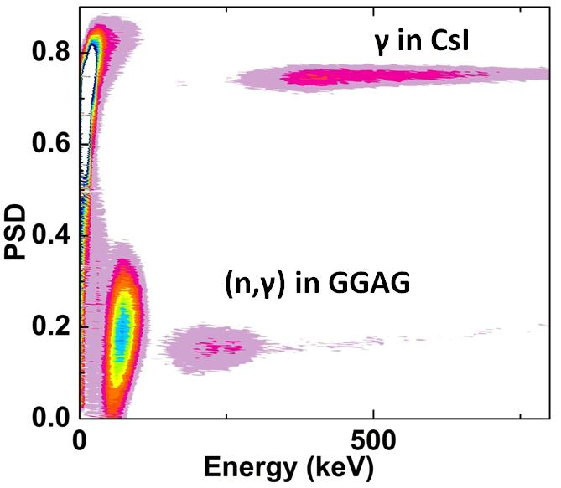
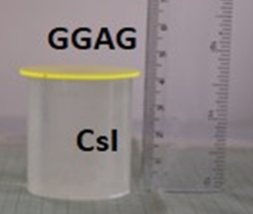
Development of Poshwisch detectors for discrimination of different radiations
2D Pulse Shape Discrimination plot of phoswich
Phoswich Geometry for neutron measurement from spontaneous fission of Pu
A novel versatile phoswich detector consisting of two single crystals to discriminate various kinds of radiations: US patent No. 16/358427
The pulse height spectra measured in GGAG crystal only for samples having Pu

Slide 5
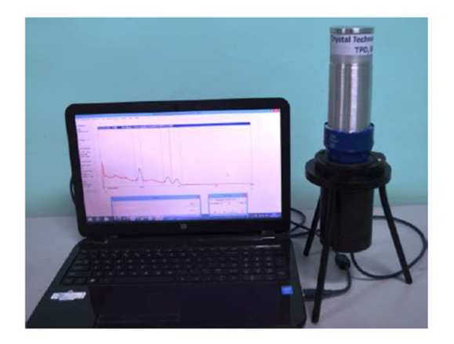
High energy Gamma Spectrometer based on BGO crystal
Phoshwich Detector

Slide 6
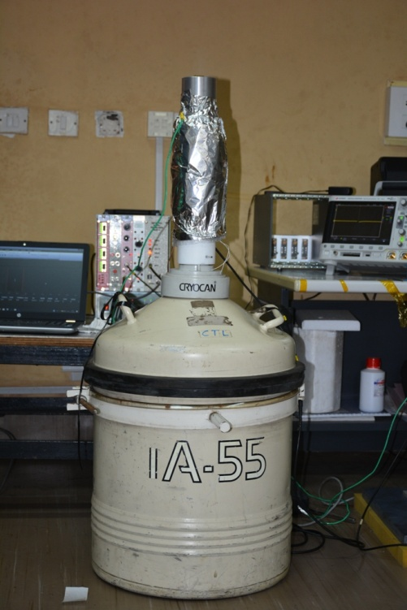
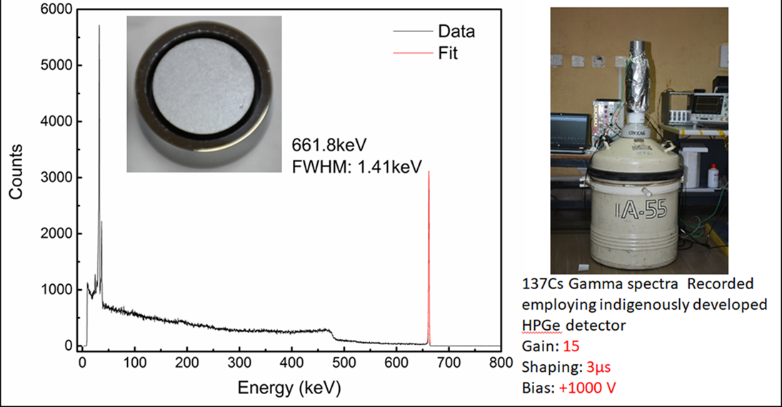
2022
HPGe Detector Development : TPD (Sensor), EmA&ID (Cryostat) & ED (Electronics)
HPGe diode developed at TPD from High Purity Ge Crystal from Umicore
7/7/2022
¹³⁷Cs γ
Gain: 15
Shaping: 3µs
Bias: +1000 V
Active Volume: 3 cc

Slide 7
Comparison with 8cc HPGe Commercial detector
Peak Position (KeV) | CTL P-Type, Planar, 3 cc Bias: +1250V FWHM (KeV) | FCD P-Type, Planar, 8 cc Bias: -1800V FWHM (KeV)
121.8 | 0.80 | 0.55
244.8 | 0.93 | 0.72
344.3 | 1.00 | 0.84

