Slide 1

Feasibility of Geophysical Studies at
Underground Facility
Anand.S.P.*, Geeta Vichare, A.K.Singh
Professor E
Indian Institute of Geomagnetism
Navi Mumbai, Maharashtra
Meeting @ TIFR, 6-7 August, 2022

Slide 2
Signals recorded by set-ups installed on the surface of the Earth show important components related to human activities and environmental factors.
Near Surface Geophysics & Critical Zone Geophysics
(Reynolds, 2011)

Slide 3
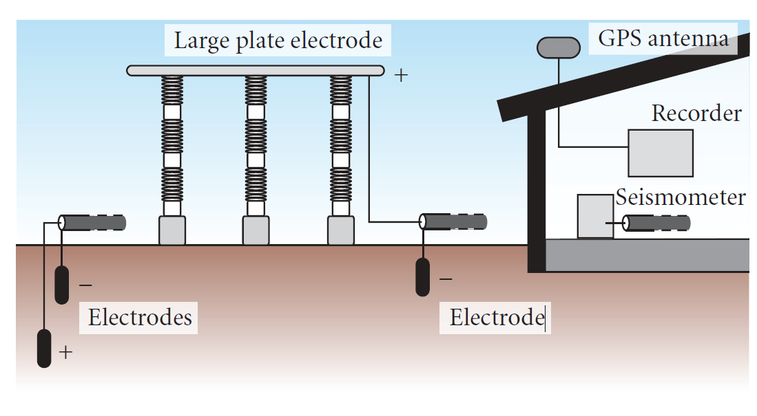
Electric currents induced by Seismic Waves
(Takeuchi et al, IJG, 2011)

Slide 4
Signals recorded by set-ups installed on the surface of the Earth show important components related to human activities and environmental factors.
Near Surface Geophysics & Critical Zone Geophysics
(Reynolds, 2011)

Slide 5
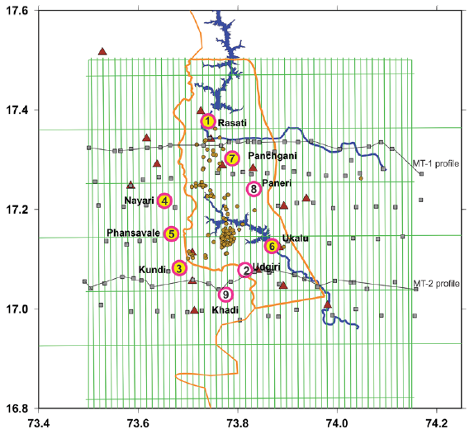
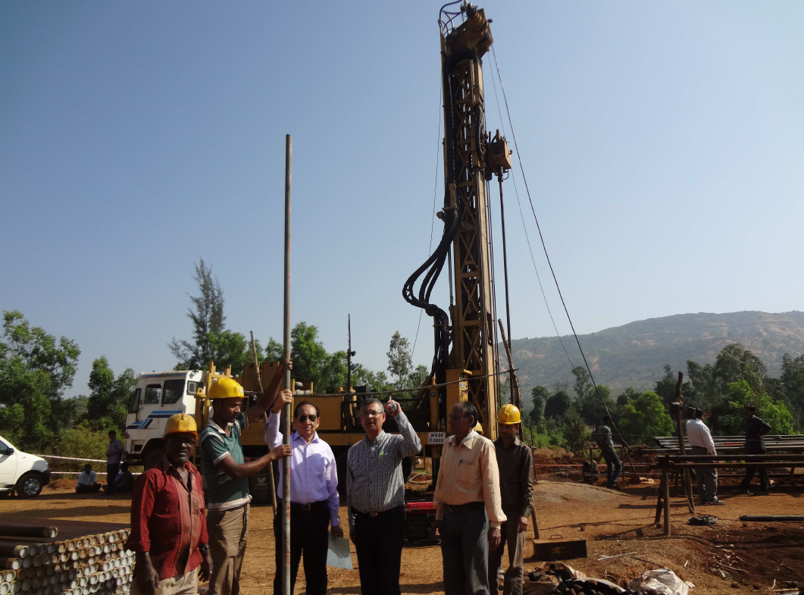
Deep Borehole Observatory in Koyna
Fault Zone Observatory at 5000m to study reservoir triggered earthquakes
(i) Arrays of three-component geophones and deformation sensors at different levels, (ii) pore pressure transducers (iii) temperature sensors, and (iv) gas/fluid testing equipment.
Borehole seismic network is being deployed to precisely locate earthquakes and refine the
information about probable fault zones and to effectively eliminate the noise due to the overlying basalt cover.
(Roy, JGSI, 2013; Gupta et al, GSL,2016 )

Slide 6
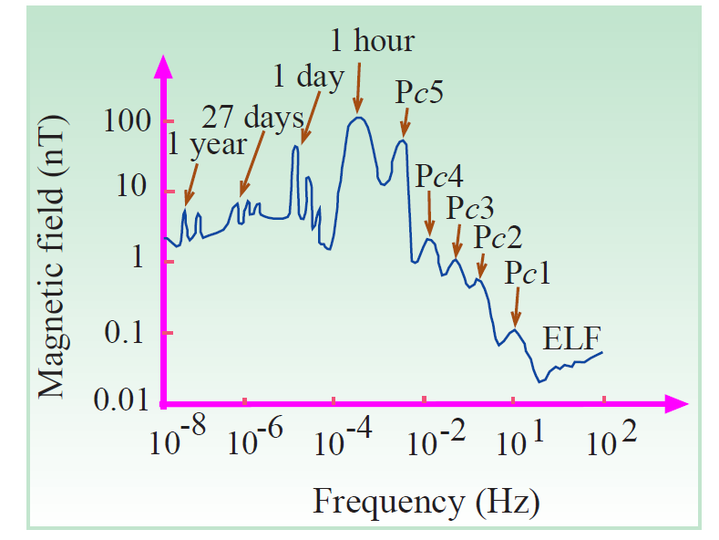
Monitoring of Telluric Currents
Telluric currents - natural electrical phenomena in the Earth or its bodies of water.
Strongest electric currents are related to lightning phenomena or space weather events.
Earth electricity can cause damage to structures, and may be useful for earthquake forecasting and other applications.
Different causes of Earth Electricity
Space & Atmospheric
Oceanic
Surface
Ground Water
Terrestrial (volcanic, seismic, radioactive emission etc.)
Lighting activity: How much current is generated at surface and at depth.
Measurement of Electric and Magnetic field at the surface and in the UL.
The amplitude spectrum of the geomagnetic fields
(Helman, Ann.Geop, 2013)

Slide 7
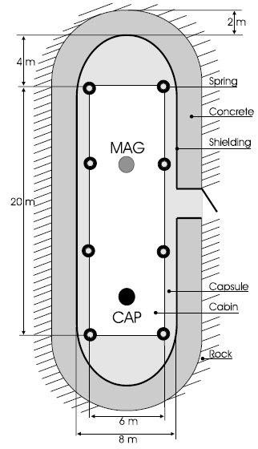
Monitoring Seismic and Magnetic Signals in UL
Simultaneous seismic and magnetic measurements in the Low-Noise Underground Laboratory (LSBB) France, during the 2001 Bhuj Earthquake
(Gaffet et al., GJI,2003)

Slide 8
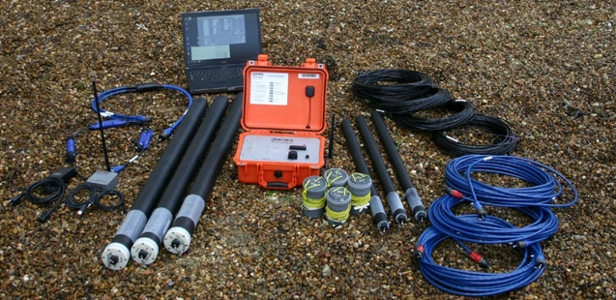
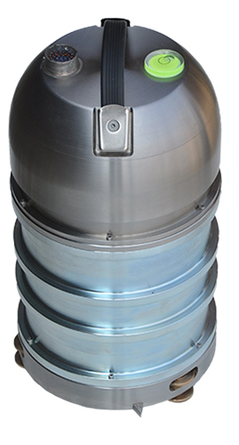
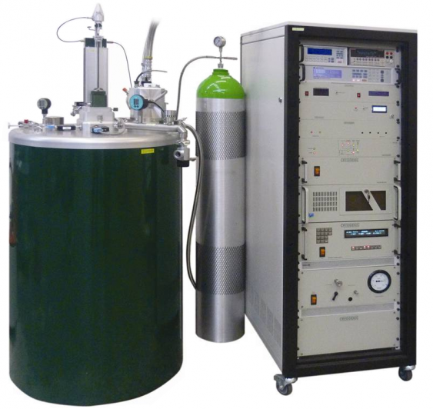
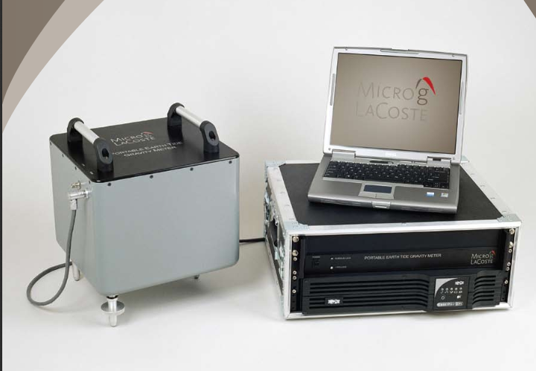
Geophysical Observatory
Quantification of noise (?) 2) Seismic waves 3) Electric currents 4) Magnetic field
5) Gravity field
(2)
(3)
(4)
(5)
Requirement: Mechanically, electrically & Electromagnetically clean space

