Slide 1
A proposal for an underground facility for nuclear astrophysics
Satyaranjan Santra
Nuclear Physics Division
Bhabha Atomic Research Centre, Mumbai
Discussion meeting on underground facility in India
6th August, 2022

Slide 2
Outline of the presentation
Underground facilities for nuclear astrophysics
Reactions of interest
Present status of a few
Proposed accelerator
Proposal for AJT & RMS
Summary
Discussion meeting on underground facility in India
6th August, 2022

Slide 3
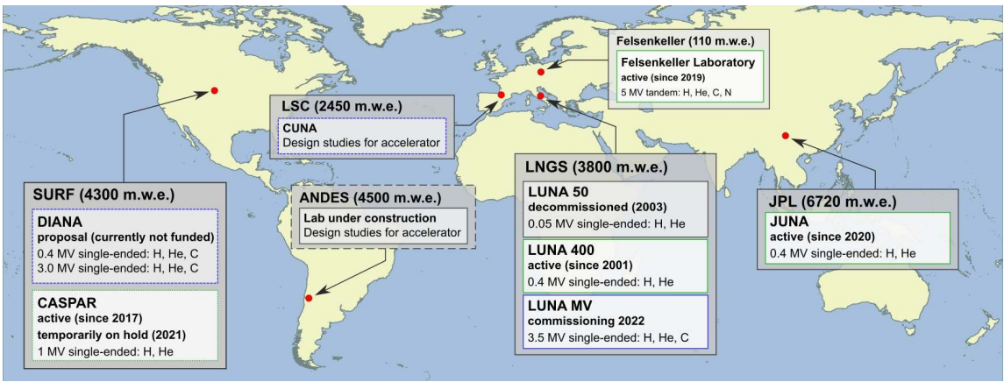
Underground accelerator facilities around the World
Laboratorio Subterráneo de Canfranc (LSC), Spain
Agua Negra Deep Experiment Site, Argentina & Chile
6 Major facilities:
5 of them are very recent (within last 5 years)
SURF:Sanford underground Research Facility, South Dakota
CASPAR:Compact Accelerator System for Performing Astrophysical Research

Slide 4
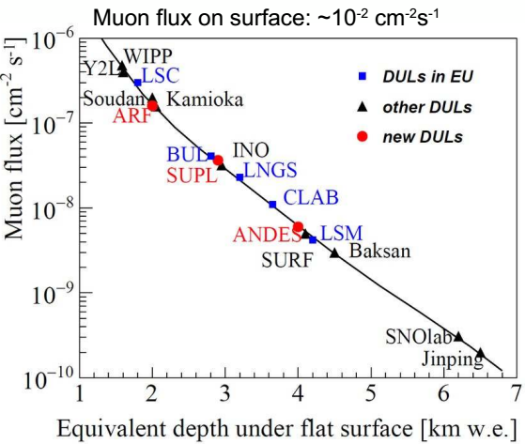
Flux attenuation at different underground labs
Facility | Depth | Flux attenuation
 |  | Muon | Neutron | Gamma
LUNA, Italy | 1.4 km, 3.1 kmwe | 10⁻⁶ | 10⁻³ | 10⁻³
JUNA, China | 2.4 km, 6.72 kmwe | 10⁻⁸ | 10⁻⁵ | 10⁻⁵
CASPER, USA | 1.49 km, 4.3 kmwe | 10⁻⁶ | 10⁻³ | 10⁻³
Felsenkeller, Germany | 50 m, 140 mwe | 4x10⁻¹ |  | 4x10⁻¹
CANFRANC (Spain) | 0.85 km, 2.5 kmwe | 5x10⁻⁷
ANDES (S America) | 1.75 km, 4.5 kmwe | 10⁻⁶
CARNFRANC
(LUNA)
(CASPAR)
(JUNA)

Slide 5
Reactions of interest - 1
SL no. | Reactions | Physics | Gammow peak (keV) | X-section (barn) | Labs interested | Existing error | Reference
1 | ¹⁴N(p,γ)¹⁵O | CNO | 148 | 10⁻¹³ | LUNA, CASPER
2 | ¹²C+^{12,13}C | C burning | 820 | 10⁻¹³ (2.4 MeV) | LUNA
3 | ¹³C(α,n)¹⁶O | Heavy Ion synthesis, AGB | 300 | 10⁻¹⁶ | LUNA, JUNA, CUNA, CASPER | 60% | Astrophys. J., 414 (1993) 735
4 | ²²Ne(α,n)²⁵Mg | Heavy Ion synthesis, AGB |  |  | LUNA, CUNA, CASPER
5 | ²²Ne(p,γ)²³Na | Synthesis in AGB stars | 190 | 2.4x10⁻³ (290 keV) | LUNA | Up to 3 orders
Same reaction is addressed by multiple labs → to reduce uncertainties using different techniques

Slide 6
Reactions of interest - 2
SL no. | Reactions | Physics | Gammow peak (keV) | X-section (barn) | Labs interested | Existing error | Reference
6 | ¹²C(α,γ)¹⁶O | Massive star | 300 | 10⁻¹⁷ | LUNA, JUNA | 60% | NPA, 758 (2005) 363
7 | ¹⁸O(p,α)¹⁵N | CNO | 160 | 3x10⁻⁵ (240 keV) | LUNA
8 | ¹⁹F(p,α)¹⁶O | F abundance | 100 | 7x10⁻⁹ | JUNA | 80% | PLB, 748 (2015) 178
9 | ²⁵Mg(p,γ)²⁶Al | Galaxy ²⁶Al | 58 (reso) | 2x10⁻¹³ | JUNA | 20% | PLB 707 (2012) 60
Gamow energies ~ a few keV to 100’s of keV
Cross sections ~ as low as 10⁻¹⁷ barn → not possible to measure over ground due cosmic background

Slide 7
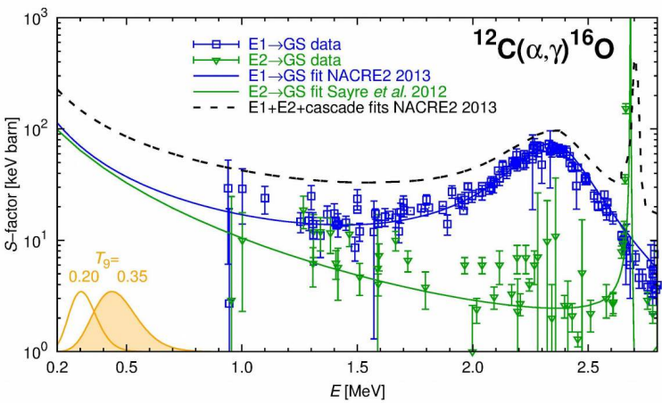
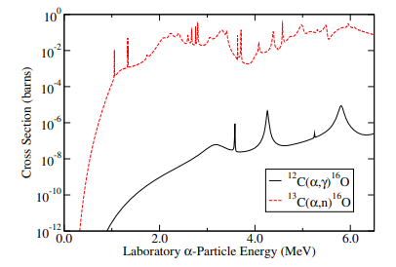
¹²C(α,γ)¹⁶O, holy grail in Nuclear Astrophysics
Highly sought-after reaction data related to carbon/oxygen ratio in the Universe.
JUNA approach: high-intensity alpha beam on carbon target
Felsenkeller: Carbon beam on helium gas target, inverse kinematics (¹³C(α,n)¹⁶O x-section is 5 order more, tgt contamination is a problem)

Slide 8
Gamow energies for ¹²C(α,γ)¹⁶O reaction at diff. sites
Nearly all models of different nucleosynthesis environments are affected by the production of carbon and oxygen
Precise (within 10%) determination of the reaction rate of ¹²C(α,γ)¹⁶O is a key ingredient
Propose to use inverse kinematics i.e., Carbon beam on helium gas target and Recoil Mass Separator

Slide 9
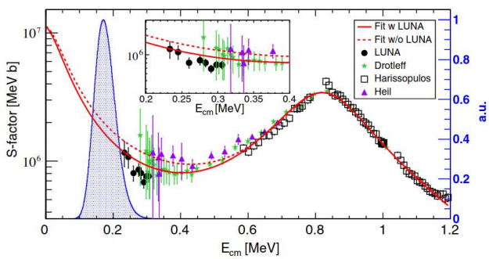
13C(α,n): S-process for Heavy Ion formation
Normalization of data under debate
Data unavailable in Gammow region
Beam from MV machine with inverse kinematics can be used covering a wide range of energies
RMS for background reduction

Slide 10
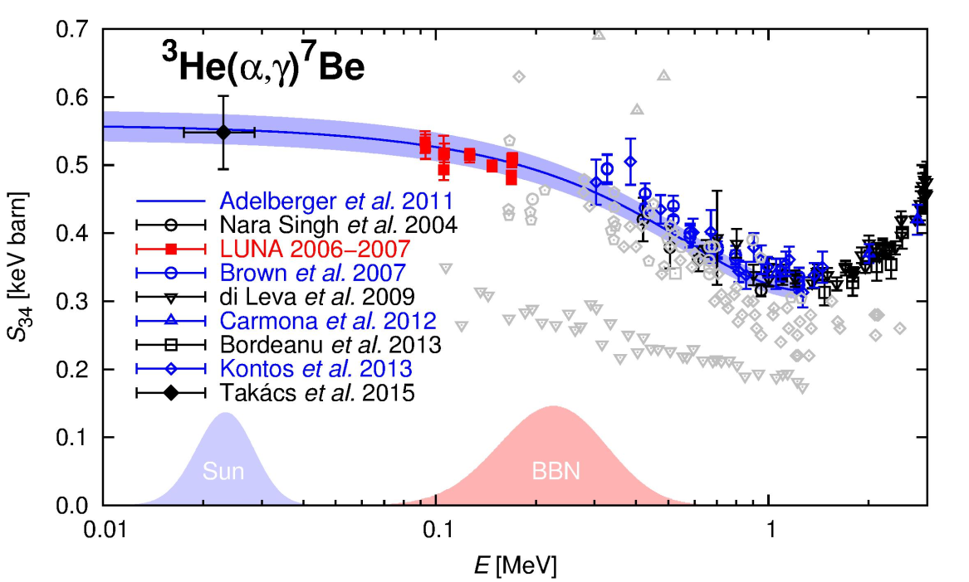
³He(α,γ)⁷Be: PP chain & Li abundance
Affects i) hydrogen burning in Sun and production of ii) 7Li in Big bang nucleosynthesis and iii) 7Be and 8B solar neutrino fluxes.
Direct measurement data around Gamow peaks (25 and 250 keV) are sparse
Proposed underground accelerator facility can cover the entire energy (20-500 keV) of interest and RMS for background reduction

Slide 11
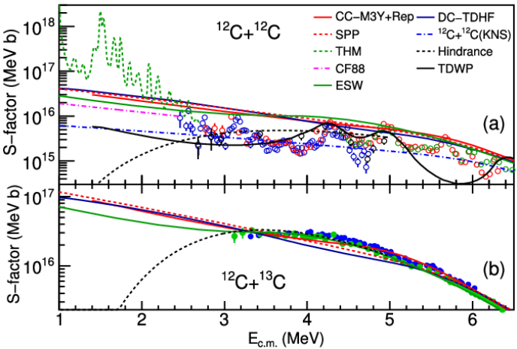
¹²C+^{12,13}C fusion: ²³Na/²⁰Ne
Direct measurement data around Gamow peaks (<1 MeV) not available
¹²C(¹²C,pγ)²³Na and ¹²C(¹²C,αγ)20Ne . Ratio of ²³Na to ²⁰Ne important
Proposed underground accelerator facilities can cover the entire energy of interest

Slide 12
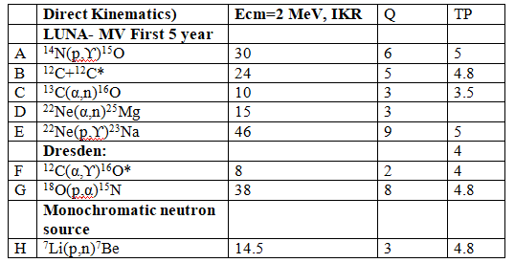
Required terminal voltage for proposed experiments
Maximum energy chosen to cover is 2 MeV, because
High energy data required for S-factor normalization
To avoid tail of resonances around 1 MeV for some reactions, normalization at higher energy required
Inverse kinematics and RMS to be used to reduce background

Slide 13
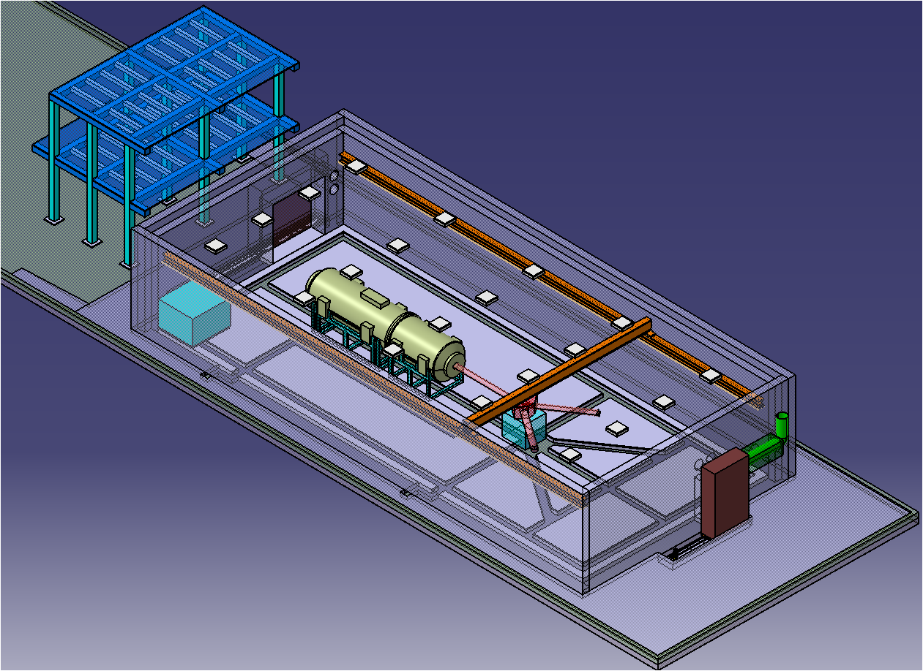
Proposal for an underground accelerator facility
Phase I: 400 kV high current accelerator with an ECR source
Timeline = 2024-2034; Cost~140 Cr (excluding tunnel works)
Phase-II : 5 MV single ended ECR based Pelletron accelerator
Timeline=2034-2039, Cost~150 Cr)
Space =50 m x 20 m Project duration=15 years Tentative cost=290 crore

Slide 14
Implementation/Delivery
Year | Implementation/Delivery
Phase-I
1st – 3rd | Building of tunnels and caverns; design of laboratories, beam lines & experiments
4th to 7th | Procurement and commissioning of a 400 keV machine; setting up of experimental facilities including beam lines, detector array, target assembly and data acquisition system
7th – 10th | Phase-I activities including a few challenging experiments will be completed
Phase-II
11th – 15th | Procurement and commissioning of 5 MV machine; setting up of experimental facilities; Experiments using MV machine

Slide 15
End of first presentation
Summary at the end of 2nd presentation

Slide 16
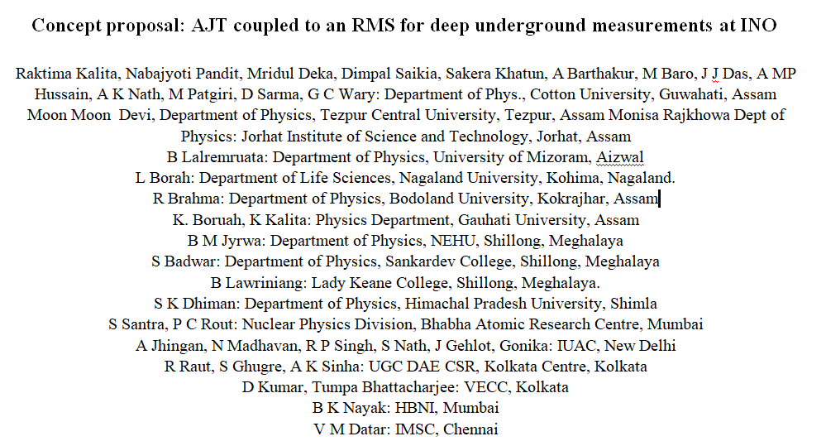
AJT coupled to an RMS for deep underground measurements - J J Das
Nabajyoti Pandit
Dimpal Saikia

Slide 17
CUPAC-NE Proposal for Underground facility
If the “accelerator system for nuclear astrophysics at INO site” is approved,
then
CUPAC-NE collaboration would like to participate in construction of some instrumentations of common interest:
AJT ( Advanced Jet Target) Close loop supersonic Jet target
An RMS of MD-ED-MD type (with rotation) with compact foot print
Strictly monochromatic neutron source for investigation of s-process in AGB stars
Explore extracting beam in space charge limited domain

Slide 18
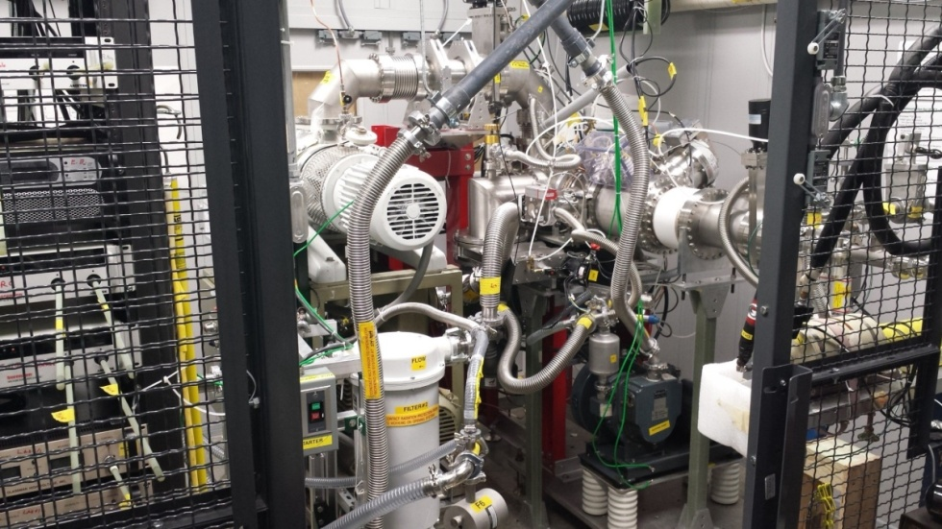
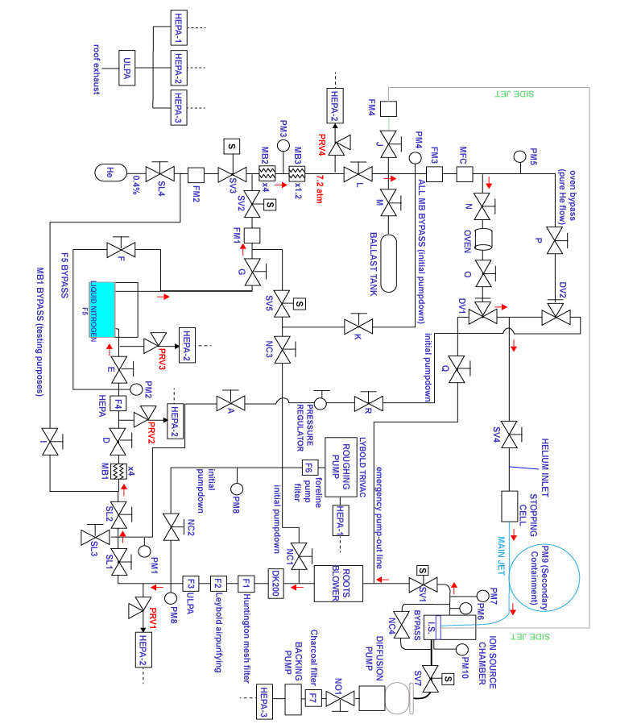
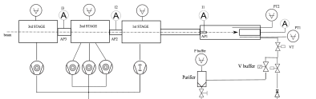
Advanced Jet Target system
ORNL [Das2013]
Recirculation gas target >99% gases: 8 Roots blower, 10 1000l/s turbo pumps, compressors, filters and purifiers, exhaust system
Design of windowless gas target
Simplified scheme of the LUNA recirculation gas target

Slide 19
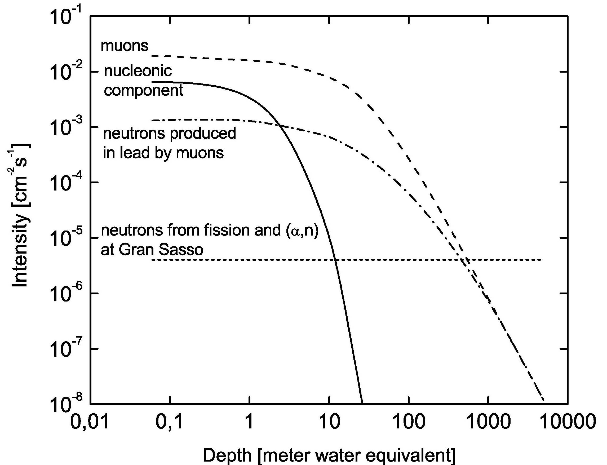
Recoil mass separator at Underground: first time
LUNA Data precision limited by backgrounds: natural, beam induced and target
→RMS can provide a solution: NOT used underground so far
Inverse kinematics→interchange target & projectile → improves accuracy: reduces systematic errors
CUPAC-NE-BARC Concepts: AJT+RMS
AJT: Reduce systematic errors (use ³He,³H gas target with recirculation target)
RMS: Eliminate beam and natural background and target impurity
Novel RMS design: very compact PIMS + HIRA ED1 slot+ RIB optics for IKR

Slide 20
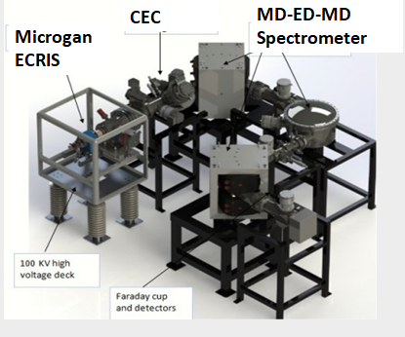
Recoil mass separator at Underground: first time
Propose: A Rotatable PIMS spectrometer: MD-ED-MD
Doubly focusing spherical ED, No quadrapoles
Novelty of the concept: MD-ED-MD similar to HIRA (ED-MD-ED)
Compact foot print, no quadrapoles, hardware corrections of aberrations
Spherical doubly focusing ESA (Electrostatic Analyzer) [Das 1997]
Anode slot like HIRA for High current operation [Sinha 1997]
Experience in ion optics: GIOS, GICOZY for inverse kinematic reactions IKR [Das 2005], SIMION 8.2
PIMS spectrometer

Slide 21
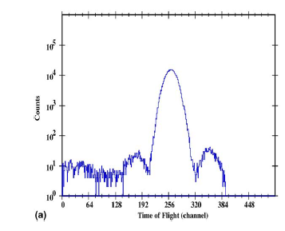
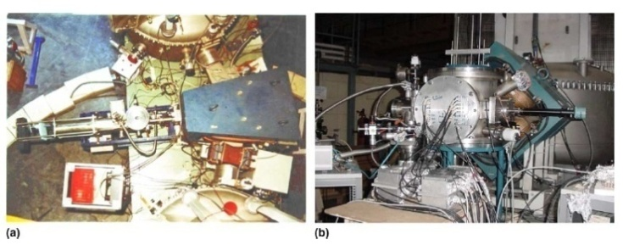
HIRA spectrometer layout and optics
RTS
⁷Be ToF spectra
⁷Be
Momentum filter slits

Slide 22
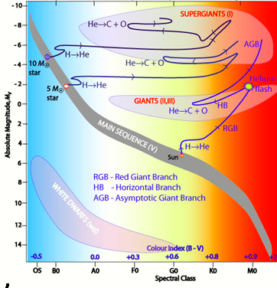
Investigation of s-process for neutron sources in AGB stars using monochromatic neutron source
Novelty of the concept:
Strictly monochromatic neutron beam, kinematic reconstruction
p(⁷Li,⁷Be)n at 14.5 MeV with ⁷Be kinematic coincidence
Normalization of neutron flux using counting of ⁷Be in PPAC
Neutrons produced in <1Sr forward solid angle due to IKR, so >90% contamination caused by backward scattered neutrons vastly eliminated.
Reconstruction of neutron energy from Be angle using kinematics
NOT done before

Slide 23
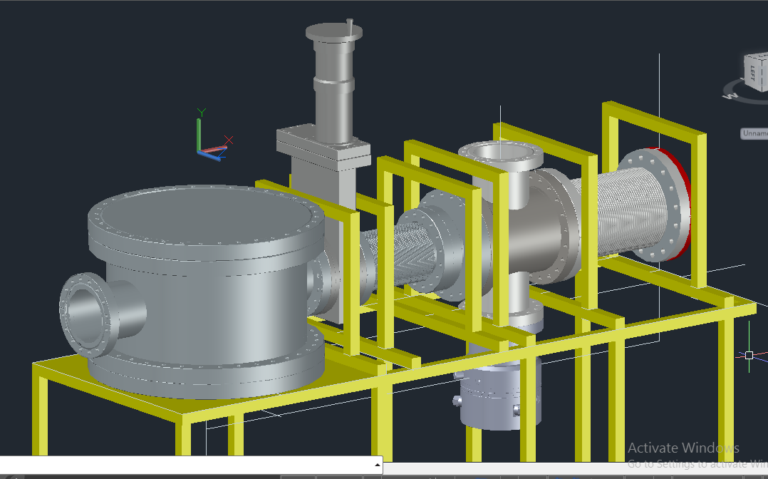
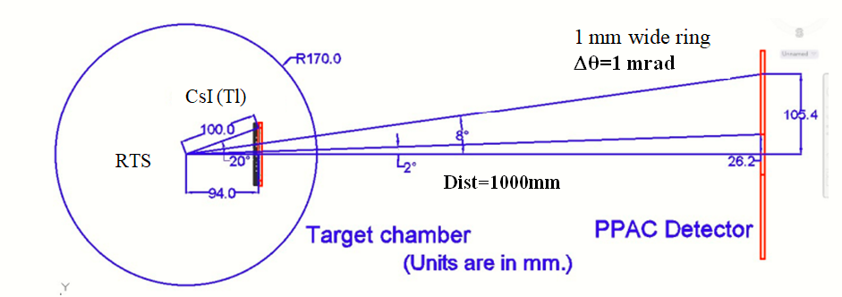
Potential CUPAC-NE-BARC contribution : monochromatic neutron source
p(⁷Li,⁷Be)n at 14.5 MeV with ⁷Be in kinematic coincidence
No neutrons

Slide 24
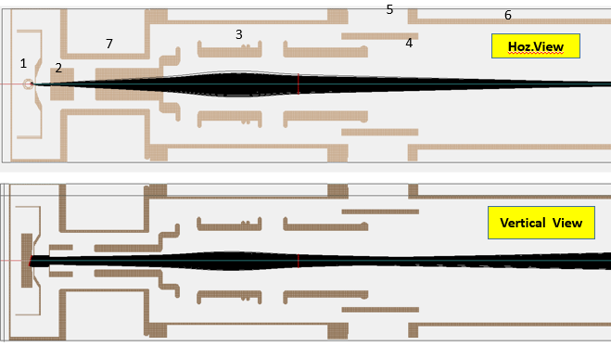
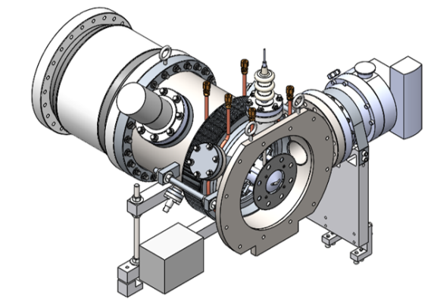
Potential CUPAC-NE contribution : Space charge limited beam extraction
Commercial accelerators don’t have space charge Compensation, current LIMIT <1 mA.
Some hands on experience at Cotton
Designed and implemented Space charge compensation at ISTF3, ORNL
Would like to explore ~5 mA
SIMION 8.0: Space charge can be estimated.
Gerald Alton suggested following:
Trap electrons by a negative electrode. High +ve charge of Beam attracts electrons and exits as space charge balanced beam

Slide 25
Summary & conclusions
A lot of opportunity exists to explore the reactions of interest to nuclear astrophysics, specially relevant to He and C, due to unavailability of data around the Gamow region and large uncertainties in experimental data
To keep pace with the international community of nuclear astrophysics a deep (>1.5 km) underground accelerator facility is essential
Proposed Accelerator facility, with 400 keV (phase-I) and 5 MV single ended (phase-II), will be able to cover the energy range of interest including inverse kinematics
The above facility coupled with Recoil Mass Separator and windowless gas target will be a unique facility in the world
Thank you for your kind attention

