Slide 1

Multi-Purpose HPGe-Detector Array for Up-coming Indian Underground facility
Venktesh Singh
(Ph.D.)
Department of Physics
School of Physical and Chemical Sciences
Central University of South Bihar, Gaya – 824236 (Bihar)
+ Dr. Lakhwinder Singh and Dr. Budhendra Kumar Singh

Slide 2
Why? [Merits, Uniqueness, Competitive Edges …]
Matured Technology; Industry Support - Less (entry level) investment
Excellent Resolution –
resolve structures (peaks, end-points ....) , smoking-gun
Signatures for certain BSM scenarios
Fast (enough) timing –
slow detector response time [thermalization (bolometers) / drift (TPCs) ] problematic in vetoing anti-coincidences.
Zero loss of fiducial mass while integrations

Slide 3
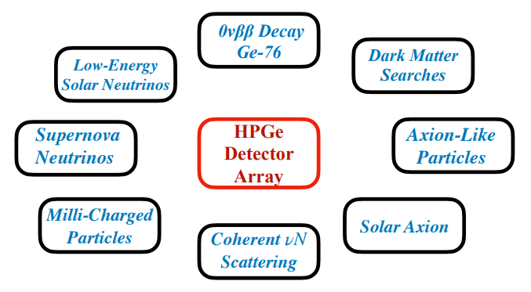
Multipurpose Detector
Detector with large mass,
sub-keV threshold,
ultra-low background and
excellent energy resolution will open a large variety of physics channels

Slide 4
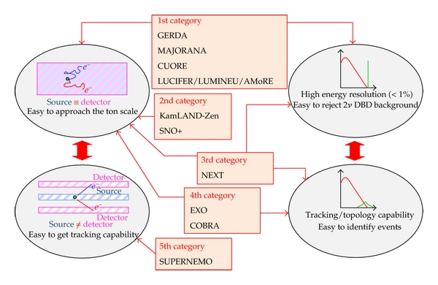
Neutrinoless Double-Beta Decay
Neutrinoless double - beta decay is an interesting venue to look for the most important and fundamental question whether neutrinos have Majorana or Dirac nature.
⁷⁶Ge has an abundance of 7.75% in natural Germanium.
A ⁷⁶Ge - 0νββ experiments with discovery potential at a half-life of 10²⁸ yr (corresponding to a m_{ββ} < 10 - 20 meV) has following requirement:
10 ton-years of data to get a few counts.
The best possible energy resolution and a very low background event rate to get statistical significance.
Unavoidable continuous 2νββ background, ranging up to Q_{ββ}, an excellent resolution of the order of 0.1-0.2% at Q_{ββ} can be achieved with Ge-isotopes.
Phys. Rev. D 101, 013006

Slide 5
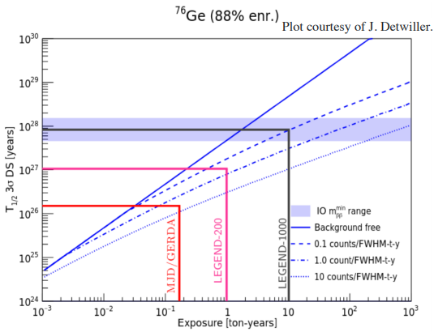
Neutrinoless Double-Beta Decay
Neutrinoless double - beta decay is an interesting venue to look for the most important and fundamental question whether neutrinos have Majorana or Dirac nature.
⁷⁶Ge has an abundance of 7.75% in natural Germanium.
A ⁷⁶Ge - 0νββ experiments with discovery potential at a half-life of 10²⁸ yr (corresponding to a m_{ββ} < 10 - 20 meV) has following requirement:
If an experiment’s background is zero both the discovery sensitivity as well as the limit sensitivity scale linearly with the exposure, while in the background-dominated regime both sensitivities scale with the square root.
10 ton-years of data to get a few counts.
The best possible energy resolution and a very low background event rate to get statistical significance.
Unavoidable continuous 2νββ background, ranging up to Q_{ββ}, an excellent resolution of the order of 0.1-0.2% at Q_{ββ} can be achieved with Ge-isotopes.
Background requirement for discovery are more stringent than for exclusion.
Phys. Rev. D 101, 013006

Slide 6
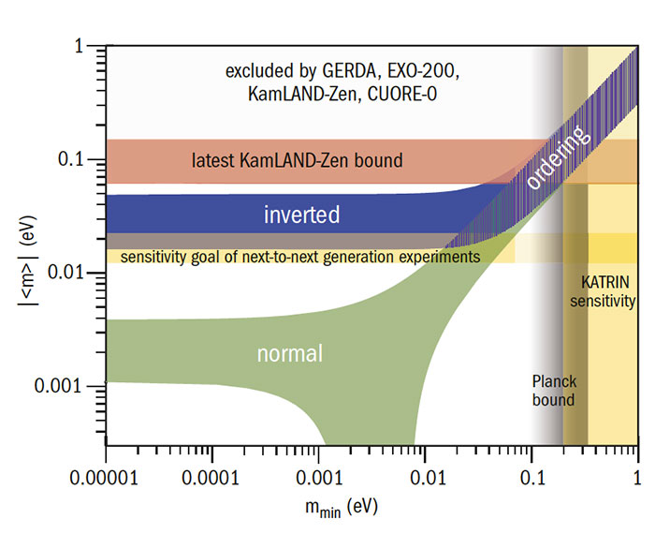
Neutrinoless Double-Beta Decay
Neutrinoless double - beta decay is an interesting venue to look for the most important and fundamental question whether neutrinos have Majorana or Dirac nature.
⁷⁶Ge has an abundance of 7.75% in natural Germanium.
A ⁷⁶Ge - 0νββ experiments with discovery potential at a half-life of 10²⁸ yr (corresponding to a m_{ββ} < 10 - 20 meV) has following requirement:
10 ton-years of data to get a few counts.
The best possible energy resolution and a very low background event rate to get statistical significance.
Unavoidable continuous 2νββ background, ranging up to Q_{ββ}, an excellent resolution of the order of 0.1-0.2% at Q_{ββ} can be achieved with Ge-isotopes.
Phys. Rev. D 101, 013006
LEGEND’s ultimate goal is to achieve 3-σ discovery sensitivity covering the full parameter space remaining for the inverted neutrino mass ordering, under the assumption of light left-handed neutrino exchange as the dominant mechanism.

Slide 7
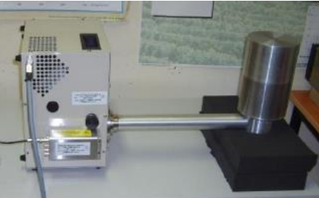
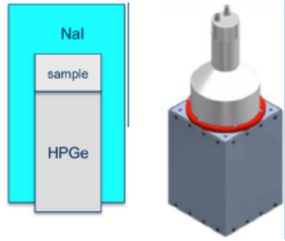
World Data Net Integration Requirements
These three main parameters allow determining the reaching potential of the experiment and its sensitivity:
the mass M of the relevant isotope (⁷⁶Ge in our case),
the data-taking time T,
and the background index B (in units of cts/(keV·kg·yr))
Competitive Detector Mass @ 0.5T
Enough deep @ 2 km
Challenges
Zero BKG (contributions from the ²³⁸U and ²³²Th chains; ⁴²Ar; Cosmogenic isotopes ⁶⁸Ge and ⁶⁰Co and the backgrounds from these cosmogenic can be managed.)
Materials Radio activity Free (Decays of α-emitting isotopes on the surfaces of detectors are difficult to quantify a priori, as they are dependent upon a surface contamination mechanism that is not well understood.)
← INO @ 2km
← INO
← KGF (cosmic muon flux)
← KGF (neutrino+proton)
International Collaboration may be interested
TEXONO @ Taiwan; CDEX @ China; LEGEND, GERDA @ Italy; PIRE-GEMADARC @ USA and many more

Slide 8
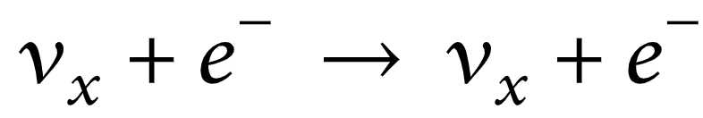
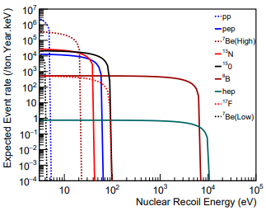
Solar Neutrinos
Detecting these neutrinos by placing a detector in a underground is always challenging.
A suitable energy threshold for detecting each of these neutrinos is difficult to achieve.
A precision measurement of pp neutrinos would allow us to monitor the Sun in close to real time, and will also test of main energy generation mechanisms.
pp - neutrinos are ~92% of the solar neutrino flux (SSM)
Detection through neutrino - electron elastic scattering
Coherent elastic neutrino-nucleus scattering has not been used for detecting pp neutrinos because of the low amount of energy transferred to a nucleus during the interaction. However, utilizing internal charge amplification, the charge carriers created by phonon excitation can be used to detect pp neutrinos because of the extremely low energy threshold of the detector.
Ge internal charge amplification (GeICA) will amplify the charge carriers induced by neutrino interacting with Ge atoms through emission of phonons. It is those phonons that will create charge carriers through the ionization of impurities to achieve an extremely low energy threshold of ∼0.01 eV.
Measurement of electron neutrino survival probability and the neutrino mixing angle in low energy, deviation from prediction would indicate new physics.

Slide 9
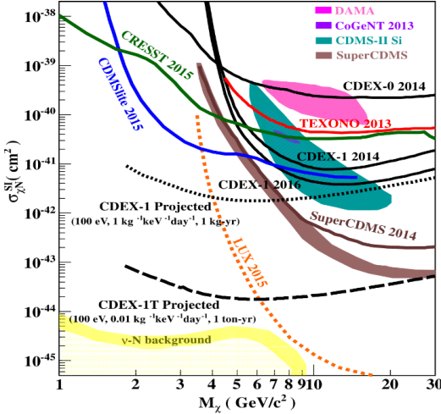
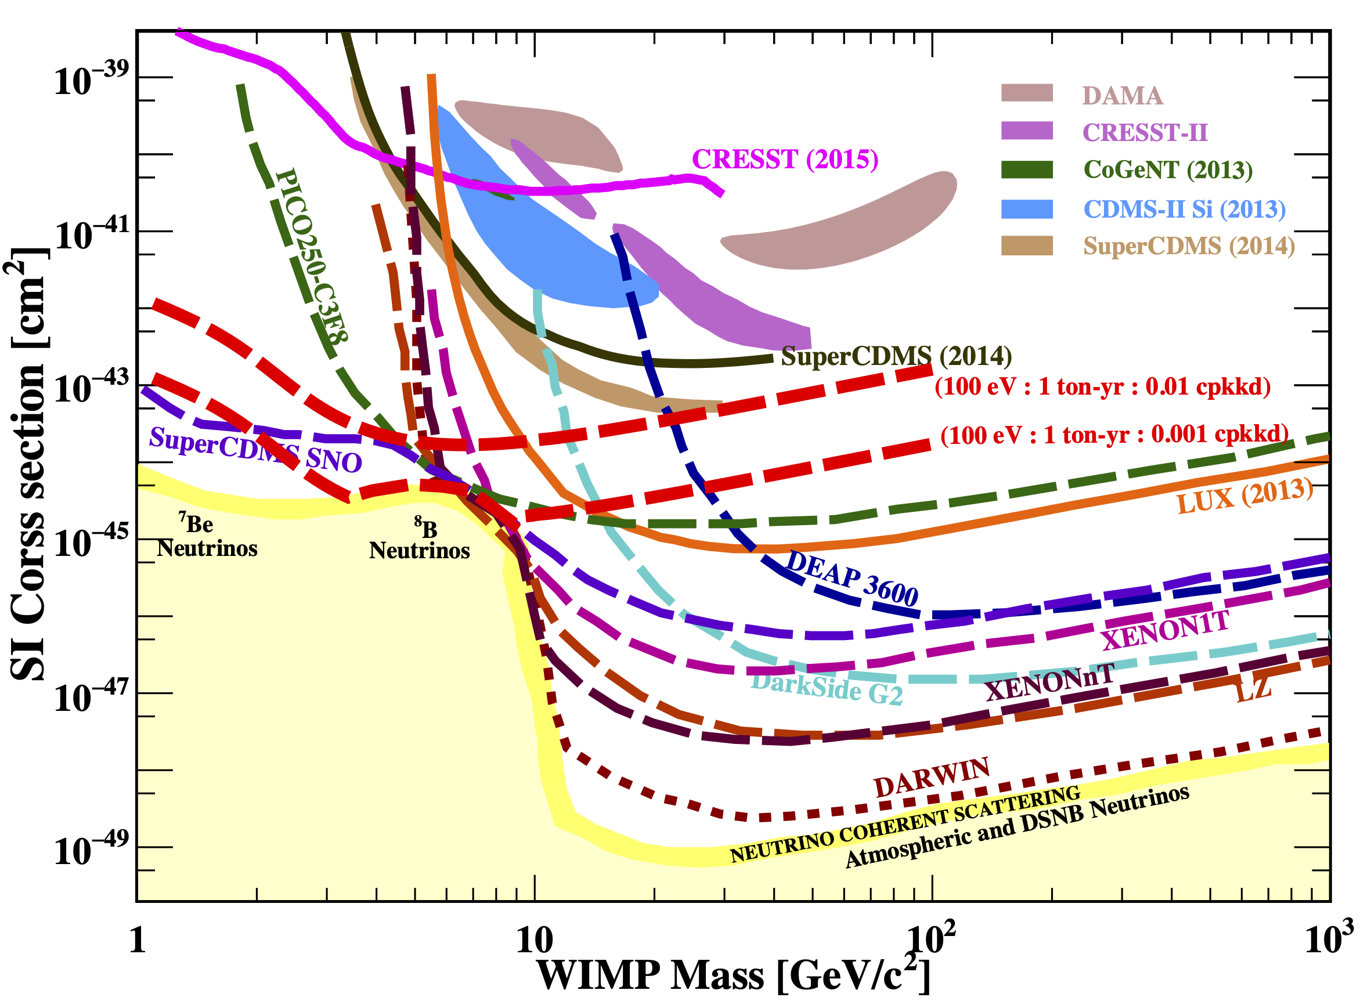
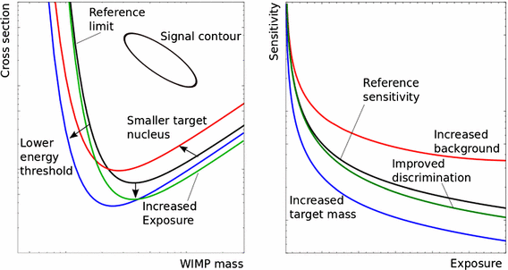
Sensitivity to WIMPs
Illustrative impact of the energy threshold, exposure and target nucleus. Impact of background and exposure on the sensitivity.
Chin. J. Phys. 58 (2019) 63-74;

Slide 10
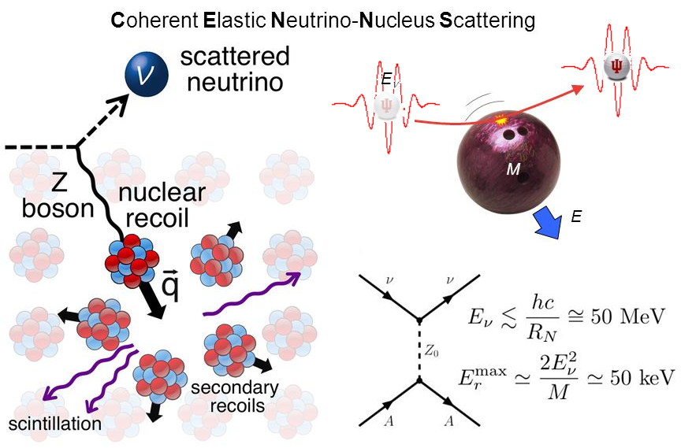
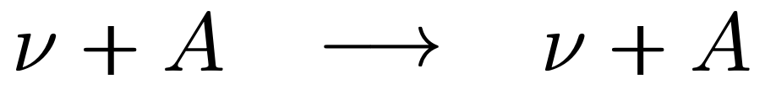
Coherent Neutrino-Nucleus Scattering
Coherent Neutrino-Nucleus Scattering (CNNS) is irreducible background for dark matter searches, But could be potential scientific goal of Underground faculty.
Sensitive to all neutrino flavours
Low threshold and excellent energy resolution detectors will be able to detect and study this standard model process, with full Coherency.
Being a standard model process, the CNNS cross section can be measured to a high precision, deviation from prediction would indicate new physics
Solar-⁸B Neutrino and Galactic supernova neutrinos
https://doi.org/10.1007/s12648-018-1202-8
Phys. Rev. D 93 (2016) 11, 113006

Slide 11
Many more new Physics
The large mass, low-energy threshold and ultra-low background,
will open a large variety of relevant physics channels:
                Solar Axions.
                Axion-Like Particles.
                Milli-Charged Particles.
                Bosonic -SuperWIMPs.
                Dark Photon.
                Electromagnetic Properties of Neutrino etc.

Slide 12
Broader Impacts
The technology of larger, low-background HPGe arrays will enable
A new generation of highly-efficient gamma spectroscopy measurements;
Nuclear structure;
Nuclear astrophysics;
Environmental monitoring; atmospheric, ocean, and groundwater environmental transport;
Methods of radioactive dating;
Reactor monitoring;
Bioassay for determining very low occupational exposures to radiation;
A biological studies involving radiotracers at very low activities etc.

Slide 13
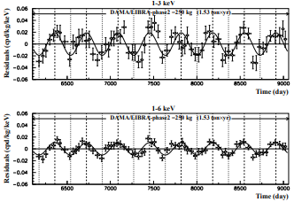
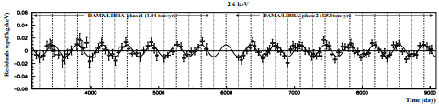
Phases of the Experiment
Phase I : Develop a prototype conventional Ge-detector in cooperation with national and International collaborators.
Phase II will start with the construction of the experimental facility.
Phase III : In parallel with the second phase of the experiment, techniques to reduce the background in the region of interest.
Phase IV: The ultimate experiment discovery-potential requires 500 kg of enriched point-contact (Internal Amplification) germanium detectors.
Meanwhile we may explore the DAMA/LIBRA 9-sigma results.
The DAMA/LIBRA experiment is a particle detector experiment designed to detect dark matter using the direct detection approach, by using a matrix of NaI(Tl) scintillation detectors to detect dark matter particles in the galactic halo.
arXiv:2110.04734

Slide 14
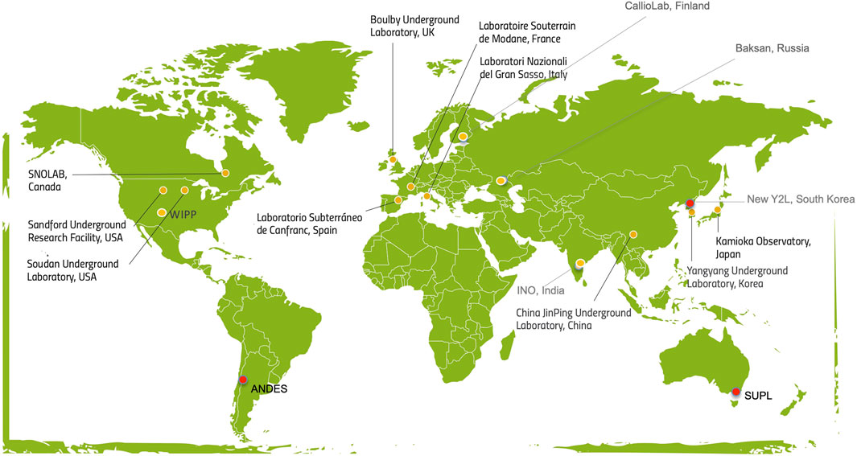
We should rethink about the revival of KGF mine.
It still has the potential to change the scenario of underground physics in India.

Slide 15

Mahabodhi Tree
Bodh Gaya

