Slide 1

Prototype development of cryogenic bolometer for Neutrinoless Double beta decay
TIFR, BARC, VECC, IIT (Ropar), Univ. of Lucknow
The India-based TIN detector (Tin.Tin)
http://www.tifr.res.in/~tin.tin/

Slide 2

Nuclear Double Beta Decay
_{Z+1}A
_{Z}A
2νββ : 2nd order weak interaction, normal beta decay (βν) suppressed by Q-value or J^{π}
_{Z+2}A
Neutrinoless Double Beta Decay
0νββ : Lepton number violating process occurs if neutrinos have mass and are their own antiparticles
test the true nature of neutrino Dirac/Majorana
the measurement of effective neutrino Majorana mass.
Γ_{0ν2β}∝ [phase-space (∝ Q⁵)] × [Nuclear ME] ² × |⟨ m_{ν} ⟩|²

Slide 3
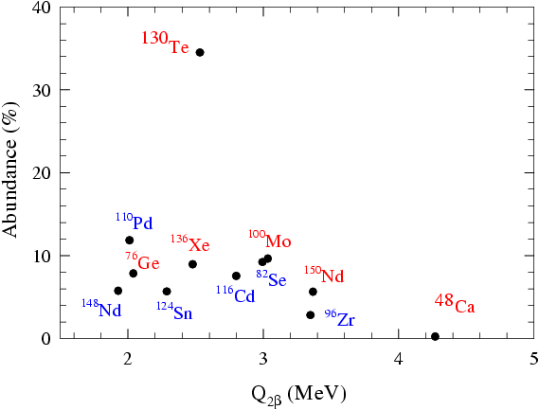
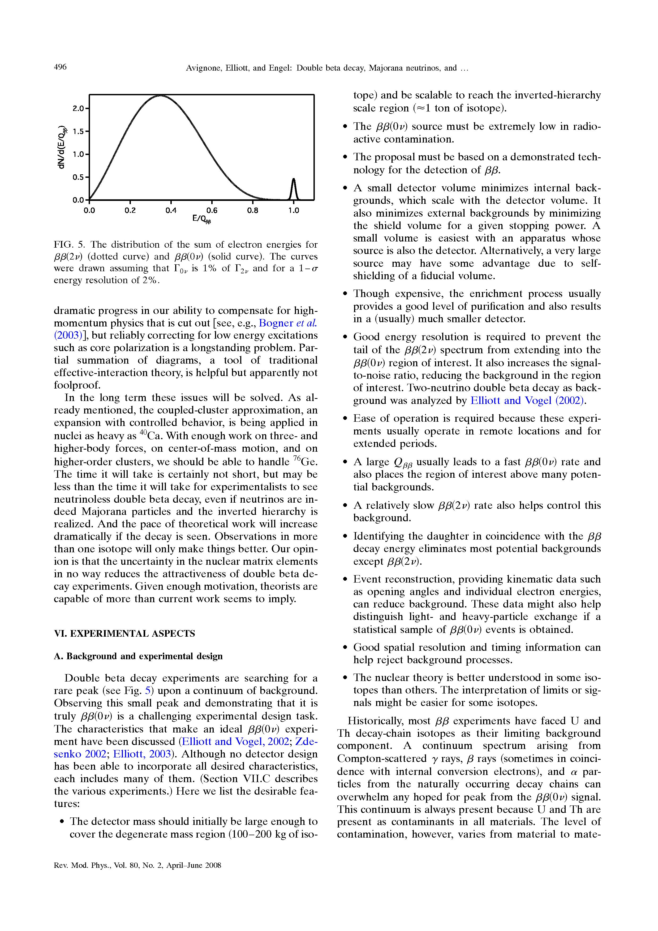
Γ_{0ν2β}∝ [phase-space (∝ Q⁵)] × [Nuclear ME] ² × |⟨ m_{ν} ⟩|²
High Q_{2β} and abundance desirable
}
Identification experiments
Simultaneous emission of two electrons
Constancy of the sum energy of the two emitted electrons
Sum energy peak ⇨ High resolution
Extremely low event rates ⇨ very large sources and detector
Active source (DBD nuclei integral part of the detector)
Passive Source (DBD source external to the detector)

Slide 4
Experimental Considerations
Background reduction
N_{ονββ}~√ N_{bkg}
N_{bkg}= B(c/kev/t) • ΔE • t
Underground location (reduce cosmic ray background)
Careful choice of materials (detector & environs- ^{235,238}U, ²³²Th,⁴⁰K, radiative impurities) and shielding
Electronic rejection of background events
Neutron background minimization (U/Th induced and muon induced)
Present Status
2νββ detected in several (~12) nuclei, half life measured.
Improvement in sensitivity possible by background reduction in some cases
No 0νββ observed
Small scale experiments ~ kg ; T _{½} ~10²⁴- 10²⁵ years, <m_{ν}> ~0.75 eV
Many new experiments (~ton scale) are planned/proposed, R&D in progress
For a conclusive proof, 0νββ measurement in several isotopes is essential

Slide 5
Major ongoing and proposed 0νββ experiments.
Experiment | Isotope | Q_{ββ} (MeV) | Technique | Expected <m_{ee}>(meV)*
GERDA | ⁷⁶Ge | 2039.6 | Semiconductor HPGe detector; good energy resolution and efficiency | 15-35
MAJORANA | ⁷⁶Ge | 2039.6 | Semiconductor HPGe detector; good energy resolution and efficiency | 15-35
SuperNEMO | ⁸²Se | 2995.0 | Tracking + calorimeter; Good background rejection Possibility of DBD in multiple isotopes (¹⁵⁰Nd) | 44-140
LUCIFER | ⁸²Se | 2995.0 | Scintillating bolometer; Good energy resolution and efficiency | ~76
AMoRE | ¹⁰⁰Mo | 3034.0 | Scintillating bolometer, Good energy resolution and efficiency | 20-60
MOON | ¹⁰⁰Mo | 3034.0 | Tracking + Scintillator; Background rejection | ~100
COBRA | ¹¹⁶Cd | 2802.0 | CdZnTe Semiconductor detector; good energy resolution, particle ID
CUORE | ¹³⁰Te | 2533.0 | Cryogenic bolometer, Good energy resolution and efficiency | 50-130
EXO | ¹³⁶Xe | 2479.0 | liquid TPC, ionization + scintillation; high efficiency, Particle ID, daughter identification (¹³⁶Ba) proposed | 14-33
KamLAND-Zen | ¹³⁶Xe | 2479.0 | liquid Scintillator, ultra-low background | 25-60
*for about 5-10 years of running time for full scale detector.
Current Science 112, 1375 (2017)

Slide 6
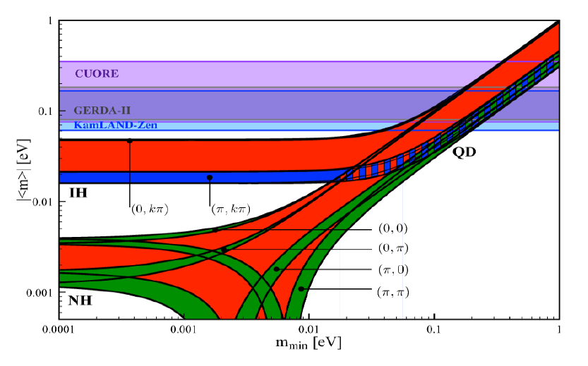
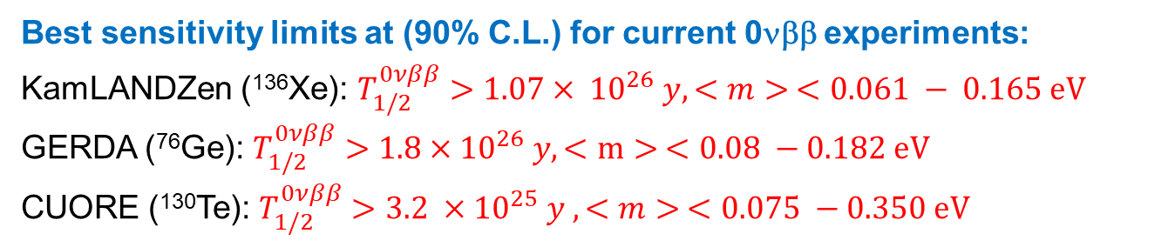
Effective Majorana mass as a function of lightest neutrino mass
Sergei Petcov, doi: 10.5281/zenodo.4134015
Best sensitivity limits at (90% C.L.) for current 0νββ experiments:
KamLANDZen (¹³⁶Xe): $T_{1/2}^{0νββ}>1.07× {10}^{26} y, <m> <0.061 − 0.165 eV$
GERDA (⁷⁶Ge): $T_{1/2}^{0νββ}>1.8×{10}^{26} y, <m> <0.08 −0.182 eV$
CUORE (¹³⁰Te): $T_{1/2}^{0νββ}>3.2 ×{10}^{25} y , <m> <0.075 −0.350 eV$

Slide 7
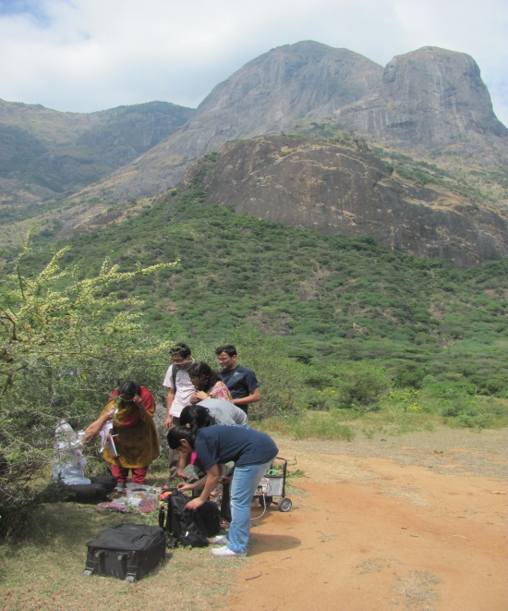
Initiative for DBD experiment in India
A multi-institutional effort
Proposal for an experiment at site of the INO
¹²⁴Sn (Q =2292.64 ± 0.39 keV)
Sn has T_{C} ~ 3.7 K
Electronic specific heat falls off exponentially below T_{C}
Only lattice specific heat (~T³) present below ~ 500 mK
Z=50 shell is closed
Simple metallurgy
¹²⁴Sn: T_{1/2} > (0.8-1.2) x 10²¹ yrs Nucl. Phys. A 807, 269(2008)
Strongly Multi-disciplinary project
Nuclear Physics, Particle Physics, Low Temperature Physics, Material Science, Physical Chemistry

Slide 8
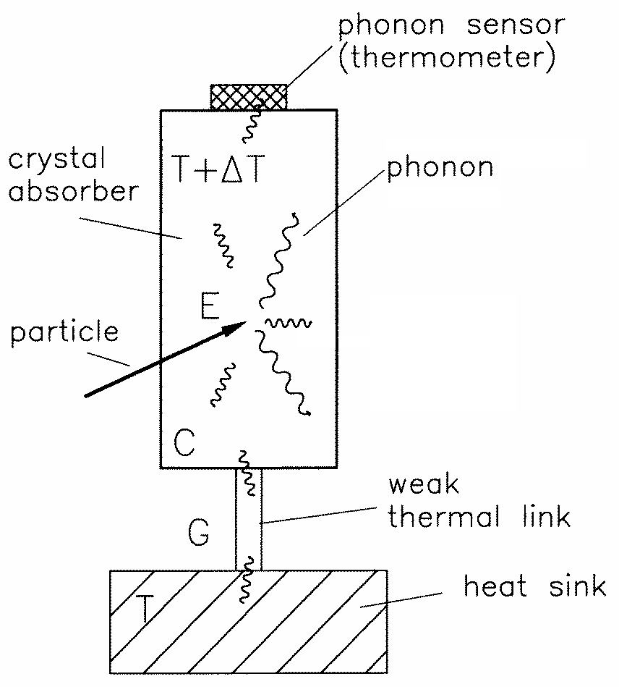
Low Temperature Bolometry
A bolometer is a calorimetric detector.
Energy of particle → Thermal energy in detector → measurable temperature rise if net heat capacity is very low
Bolometer Schematic
C_{D}
C_{S}
T₀
Incident Energy
R₁
R₂
Pulse decay time
Sensor- contact
T_{S}
t
Resolution of Bolometer
Limited by Thermodynamical fluctuation noise {δE=(kT²C(T))^{1/2}}
Depends only on operating temperature and specific heat
Independent of incident Energy
Challenge: to make measurements in time domain at mK temperature

Slide 9
Work plan
Make a natural Sn bolometric detector ~ 0.5−1 Kg (TIFR, BARC)
Radiation background studies (TIFR, IIT -Ropar)
Detector and background simulations (TIFR, IIT- Ropar)
Sensor development (TIFR, BARC)
Reliable NTME calculations (Univ. of Lucknow, IIT-KGP, PRL)
Precision Q value measurement (VECC), (Q_{ββ} = 2292.64 ± 0.39 keV)
Enrichment of ¹²⁴Sn (collaboration with Russia?)
Constraining NTME, GT measurement in NDBD nuclei
Strongly Multi-disciplinary project
Nuclear Physics, Neutrino Physics, Low Temperature Physics, Material Science, Physical Chemistry

Slide 10
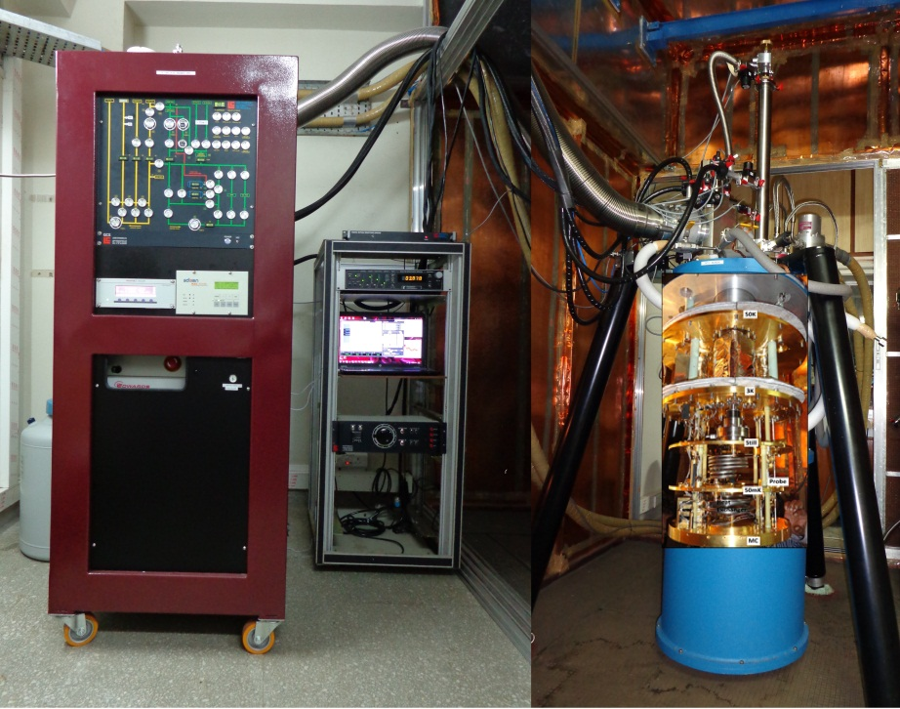
Cryogen free dilution refrigerator installed at TIFR
Base Temp. ~7 mK
cooling power
1.4 mW@120mK
V. Singh et. al. Pramana 81 (2013) 719

Slide 11
Thermometer
°
thermometer
Energy deposited by Particle → Heat
→ rise in Temperature - Δ T → read by thermometer
phonons
Change in physical property – e.g. resistance with T
⁷¹Ge, ⁷⁵Ge → decay As, Se, Ga
Ge
thermal neutrons
R (T) = R₀ exp( T₀/T)^{0.5}

Slide 12
NTD Ge Sensor R&D
  Neutron irradiation at Dhurva Reactor (BARC, Mumbai)
Isotope | Isotopic Abundance (%) |  | Products (half-life) | Stable end product ( mode) | Dopant Type
 | Set 1 | Set 2
⁷⁰Ge | 21.5 | 21.9 | ⁷¹Ge* (11.43d) | ⁷¹Ga (e⁻ capture) | p
⁷²Ge | 26.8 | 27.0 | ⁷³Ge (stable ) | ⁷³Ge | -
⁷³Ge | 10.8 | 8.8 | ⁷⁴Ge (stable ) | ⁷⁴Ge | -
⁷⁴Ge | 34.1 | 35.1 | ⁷⁵Ge* (82.78min) | ⁷⁵As (β-decay) | n
⁷⁶Ge | 6.8 | 7.2 | ⁷⁷Ge* (11.3,38.8hrs) | ⁷⁷As*,⁷⁷Se (β-decay) | n
Radioactive impurity studies (~2 year cooldown period)
Fast neutron induced defect studies (PALS, Channeling)
  Annealing at 600 ºC for 2 hrs in vacuum cures defects
Sensor Fabrication
S. Mathimalar et. al., NIM A 774 (2015) 68,
S. Mathimalar et. al. NIM B 345 (2015) 33.

Slide 13
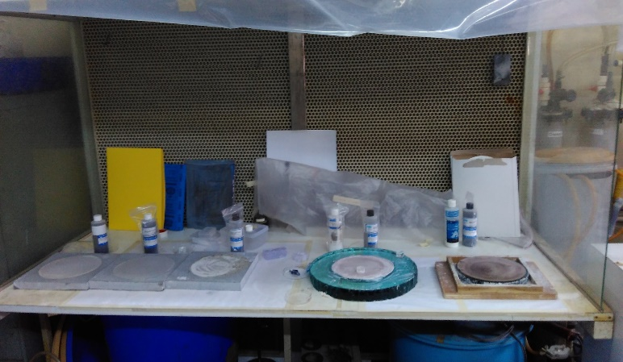
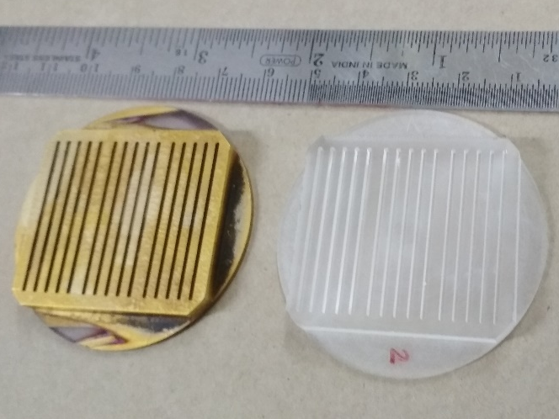
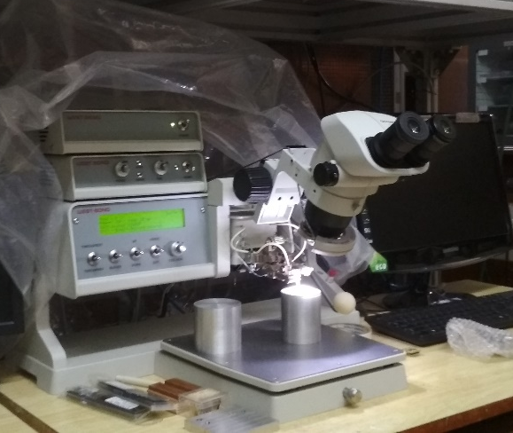
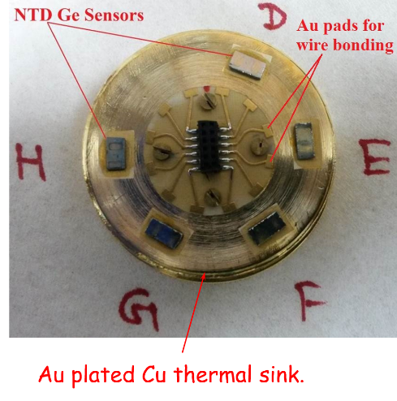
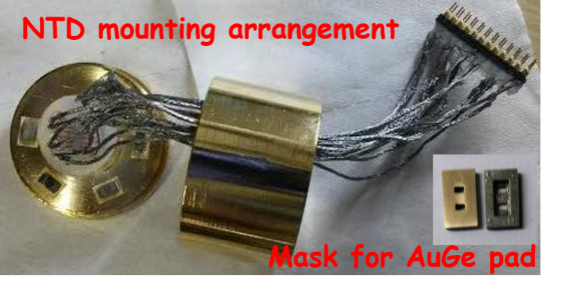
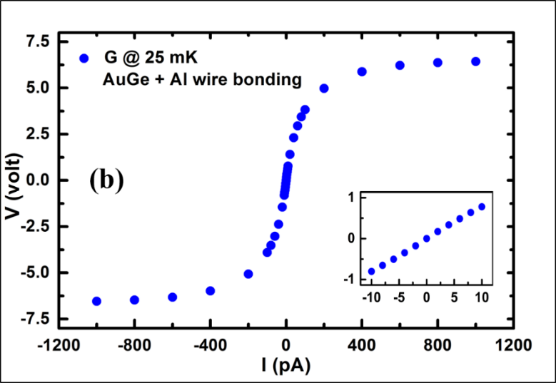
NTD Ge fabrication & characterisation
Mechanical polishing setup
Wire bonding machine
Mask for NTD Ge

Slide 14
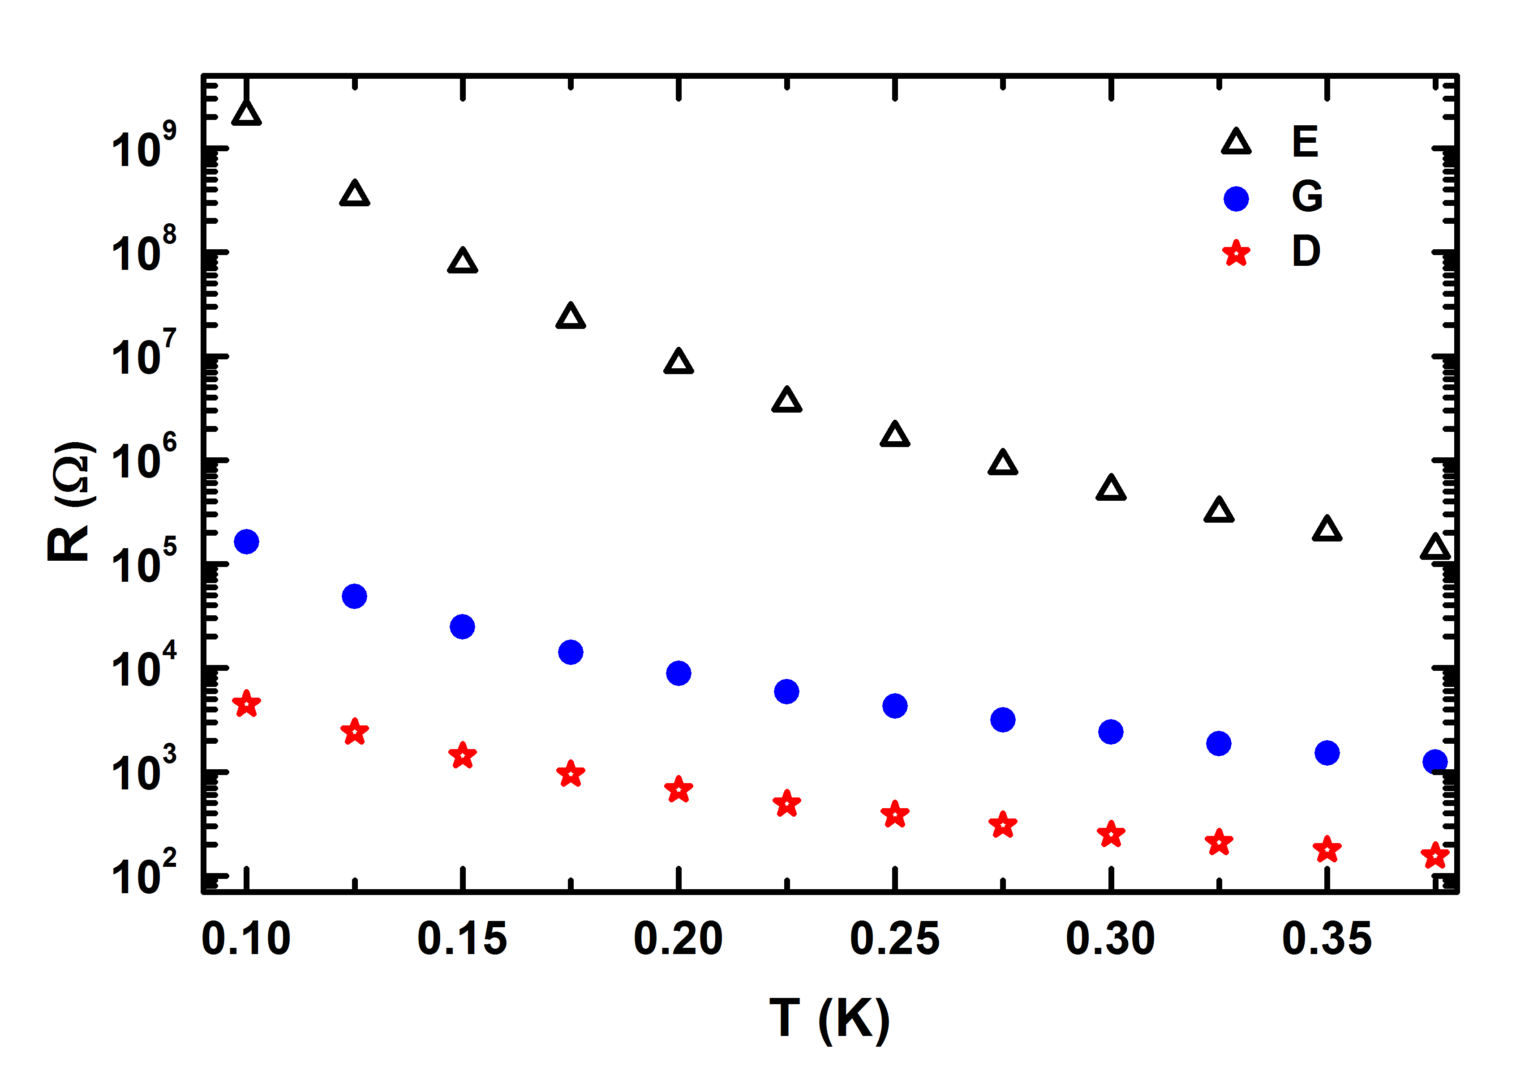
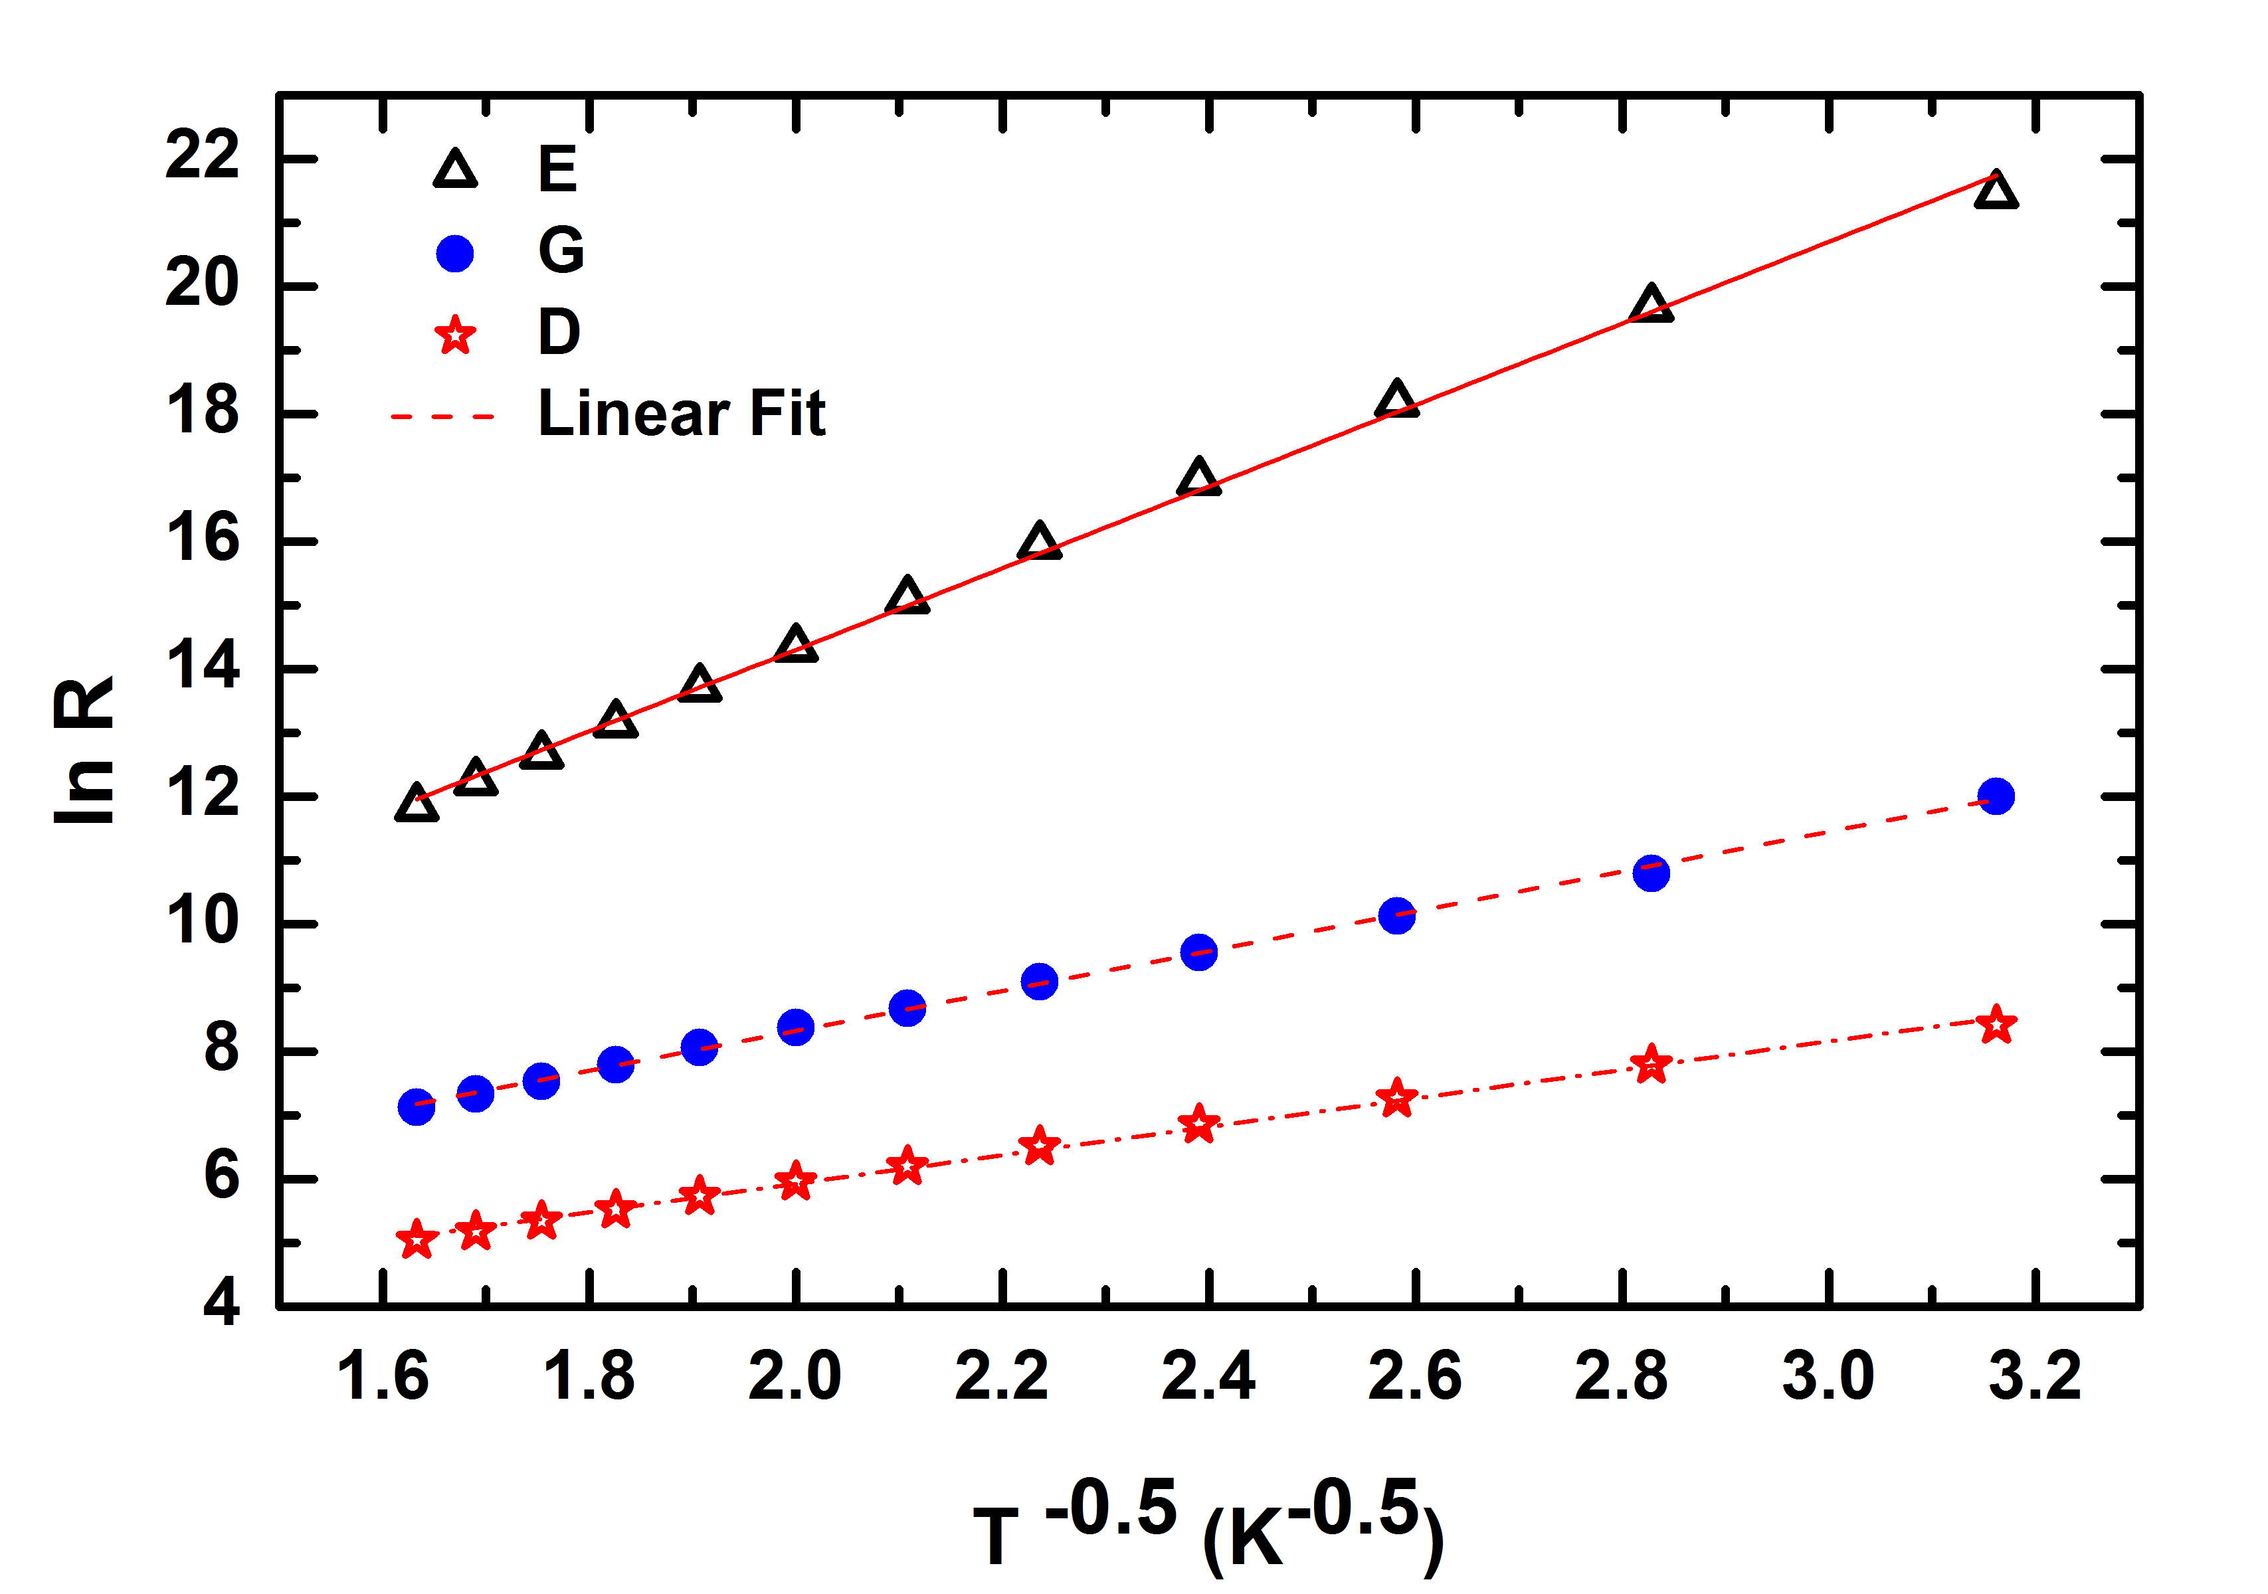
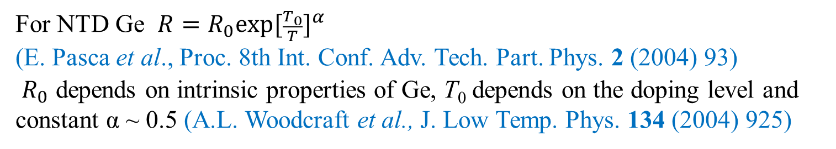
Characterization of NTD Ge at T < 300 mK
Resistance of the NTD Ge samples were measured in the temperature range 100 mK – 350 mK
For NTD Ge $R=R_{0}exp⁡{[\frac{T_{0}}{T}]}^{α}$
(E. Pasca et al., Proc. 8th Int. Conf. Adv. Tech. Part. Phys. 2 (2004) 93)
$R_{0}$ depends on intrinsic properties of Ge, T₀ depends on the doping level and constant α ~ 0.5 (A.L. Woodcraft et al., J. Low Temp. Phys. 134 (2004) 925)
ln R varies linearly with T^{--0.5}
A. Garai et al. Journal of Low Temp. 10.1007/s10909-015-1379-6
Mathi et al. 10.1109/WOLTE.2014.6881014

Slide 15
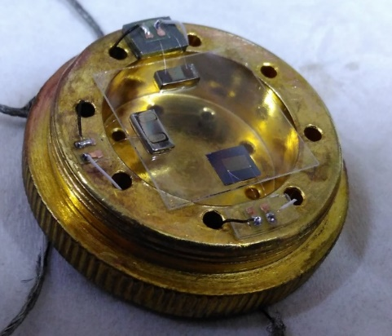
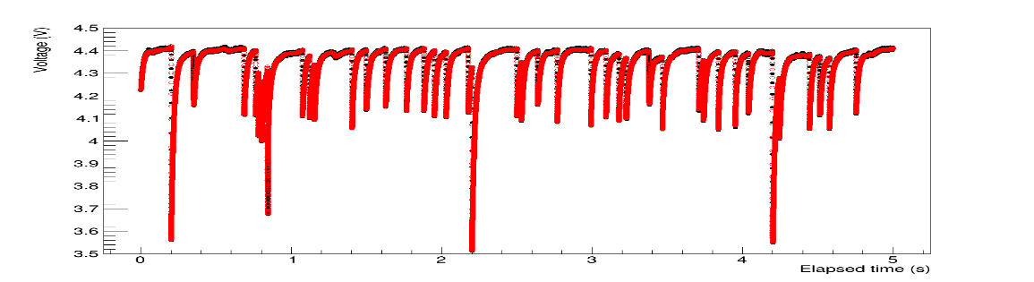
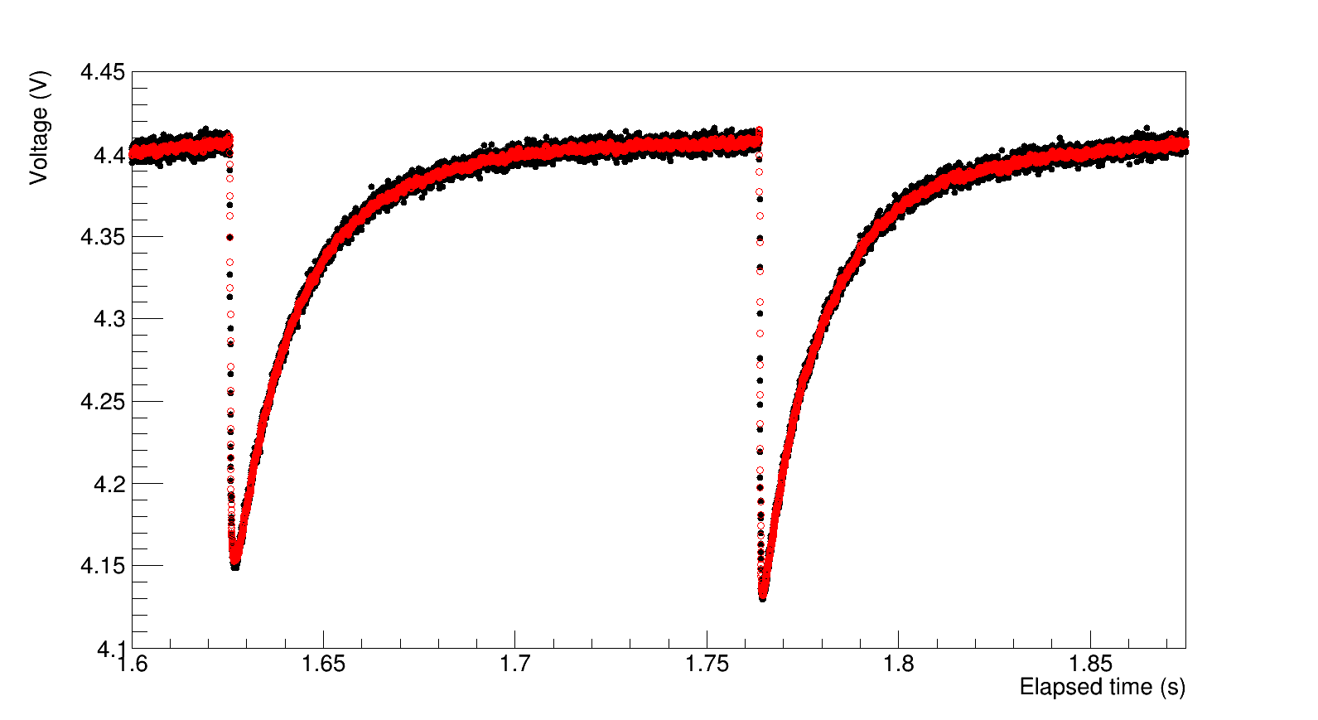
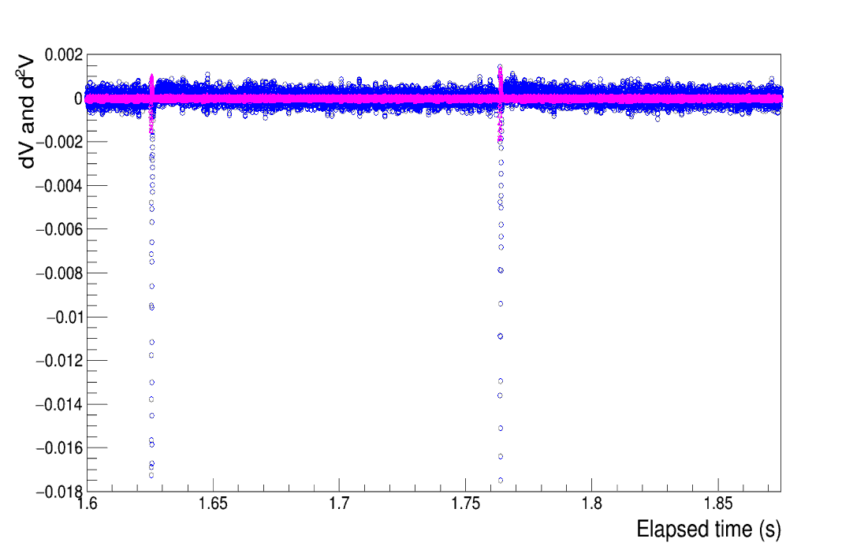
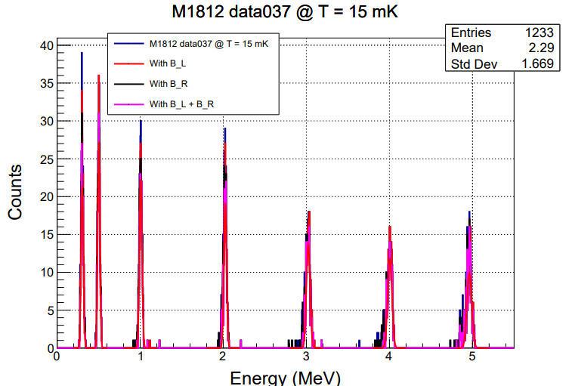
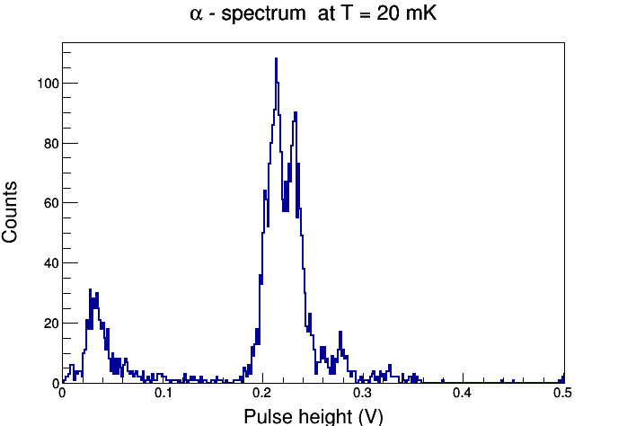
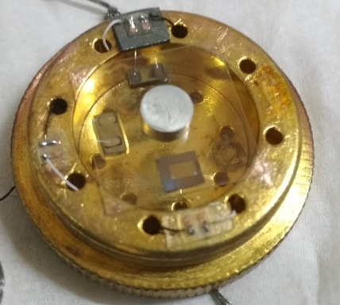
Test with blank sapphire with Sn
NTD Ge sensor
Sapphire
Heater

Slide 16
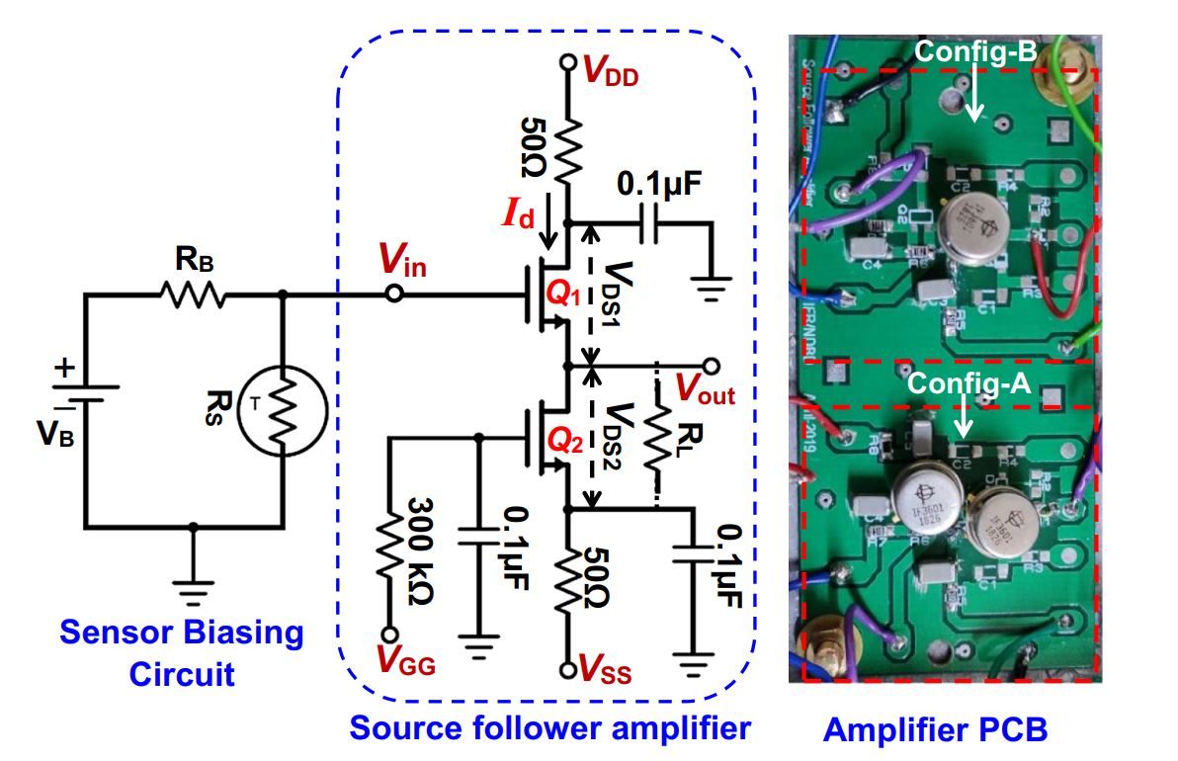
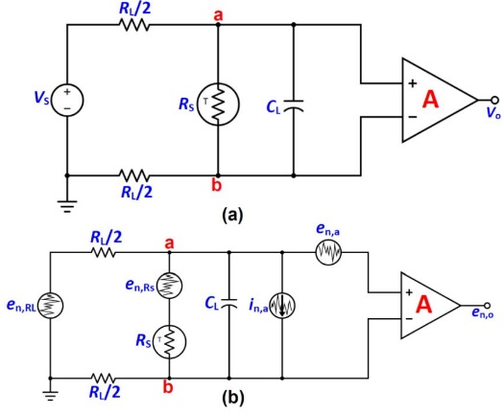
Low temperature electronics R&D
A cryogenic front-end pre-amplifier for bolometer
Ideally the performance of a bolometer detector is expected to be superior due to its good intrinsic resolution. However, electronic noise is the limiting factor.
signal integration due to large cable capacitance, is prone to EMI noise due to longer length cables
Si-FET at cryogenic temperature of ~120 K intermediate 1st stage amplifier : designed, fabricated, tested in a Ln2 cryostat
A. Reza, V. Vatsa et al., J. Low Temp. Phys., 199, 200–205 (2020)
Analytical model for electronic noise is being developed
Since electrical noise is the dominating reason limiting the resolution of bolometer.
Bolometer readout circuit & equivalent noise model

Slide 17
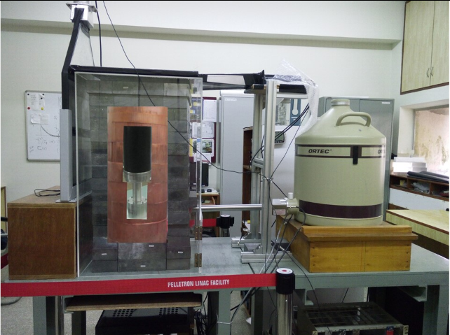
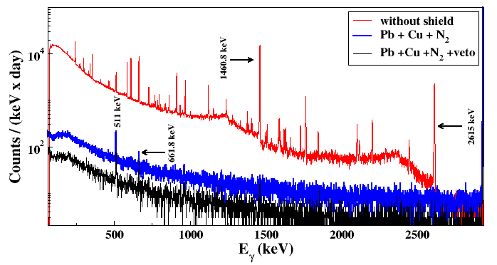
TiLES (Tifr Low background Experimental Setup)
Plastic Scintillator
Cu
Roman Pb
Sensitivity of the setup:
~1 mBq/g ( ~10 ppb)
Detector surrounded by OFHC Cu (5 cm), Pb (10 cm) (²¹⁰Pb < 0.3 Bq/kg).
N₂ purging system and active muon veto (plastic scintillators)
TiLES is used for material screening such as ETP Cu, INO site rock, CsI crystals for DINO, etc.

Slide 18
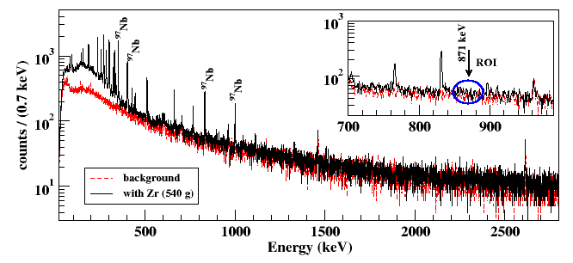
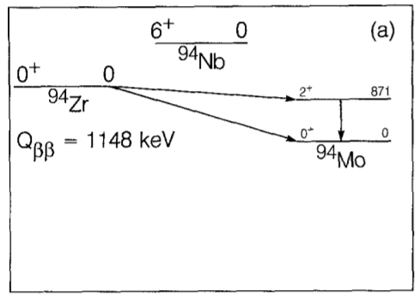
DBD to excited state in ⁹⁴Zr
Decay Scheme of ⁹⁴Zr
Gamma ray spectra of ^{nat}Zr in TiLES for t = 7d
The current best experimental limits are T_{1/2} > 1.3 x 10¹⁹ y (68% C.L.) (Norman et al., Phys. Lett. B 195, 126 (1987)).
540 g of ^{nat}Zr (99.5% purity) counted in the TiLES,
Double beta decay of ⁹⁴Zr to the 1st excited state in ⁹⁴Mo
T_{1/2} > 2.0 x 10²⁰ y 68% C.L, 6.12 x 10¹⁹ y at 90% C.L..
N. Dokania et al EPJ A 53 (2017) 74

Slide 19
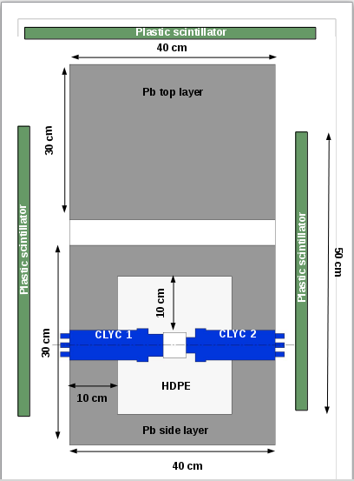
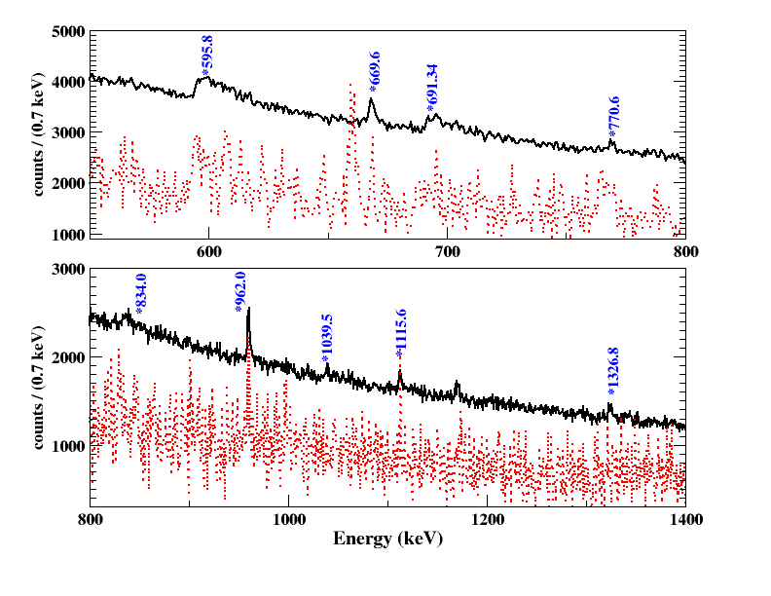
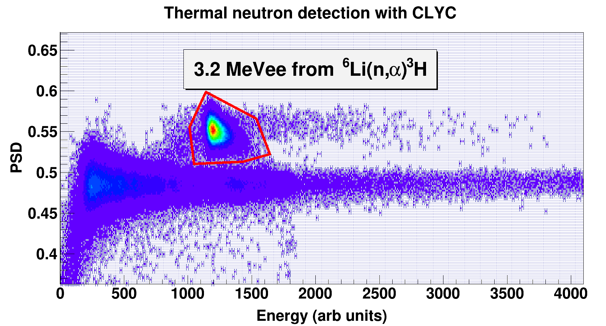
MINT: Muon Induced Neutron detector setup at Tifr
Muon detectors (plastic Scintillators)
Neutron detectors (CLYC)
Pb
Pb
provides crucial input for validation of GEANT4.10.05 simulation of both muon induced neutron production and neutron inelastic scattering.
Gamma spectrum gated by muons in TiLES
HDPE
(n,n’γ)
PSD
Counts/(0.7 keV))
E
Energy(keV)
Harisree Krishnamoorthy, NUPHYS2018
HK et al, EPJA 55 (2019) 136

Slide 20
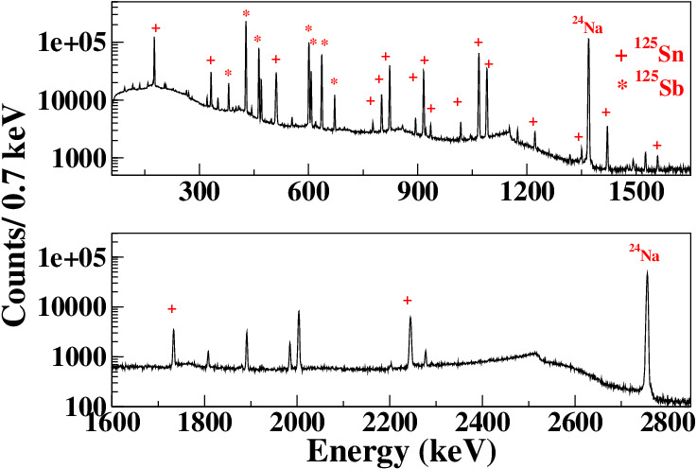
n-induced background in ¹²⁴Sn
¹²⁴Sn (n, γ) ¹²⁵Sn
¹²⁵Sn : β decay →¹²⁵Sb,
Q_{β} = 2357 keV
T_{1/2} = 9.52m, 9.64 days
¹²⁵Sb β-decay → ¹²⁵Te
(T_{1/2} =2.75 y, Q_{β}=766 keV)
¹²⁴Sn (n, γ) ¹²⁵Sn (n, γ) ¹²⁶Sn
¹²⁶Sn β- decay →¹²⁶Sb
(T_{1/2} = 2.3 X 10⁵ years, Q_{β} = 378 keV)
¹²⁶Sb β-decay → ¹²⁶Te
(T_{1/2} =12.35 days, Q_{β} = 3673 keV)
(Q_{ββ} of ¹²⁴Sn = 2293 keV )
Simulation studies to estimate neutron flux at INO site based on rock composition carried out.
N. Dokania et al., JINST, 10 (2015) T12005
n-induced reactions in Sn, Pb, Cu are being studied at PLF and Dhruva
G. Gupta et al. ARI 158 (2020), 108923

Slide 21
Nuclear Structure Aspect
Several nuclear models to calculate the NTME
  Shell-model and variants
  QRPA and extensions
  Alternative models
The NTME (M_{2ν}) is sensitive to details of the nuclear structure
  Spectroscopic properties of the initial and final nucleus
  Pairing and Deformation
Observed physical properties of nuclei:Test of nuclear models
Uncertainty in estimated neutrino mass upto a factor of 10 due to uncertainty in NTMEs.
Experiments to constrain NTME are essential
Occupational Probabilities of valence orbitals relevant to NDBD of 124Sn
Measurement of transfer cross-sections (d,p) (p,d), (⁴He,³He), (³He,⁴He) in ¹²⁴Sn & ¹²⁴Te
A. Shrivastava et al. Phys Rev C105, 014605 (2022)

Slide 22
Studies on β <- -> α transition in Sn and Sn-rich alloys for a cryogenic tin bolometer (Tin pest problem)
0.22 % Sn-Bi is suggested as a good candidate for the fabrication of Sn-Bi bolometers.
Baking the TIN.TIN detector for a few minutes at 323 K would reduce the risk of tin pest.
Mazumdar, et al. Scripta Materialia 199 (2021), 113858
& Materials Research Express 6 (2019) 076521 ,

Slide 23
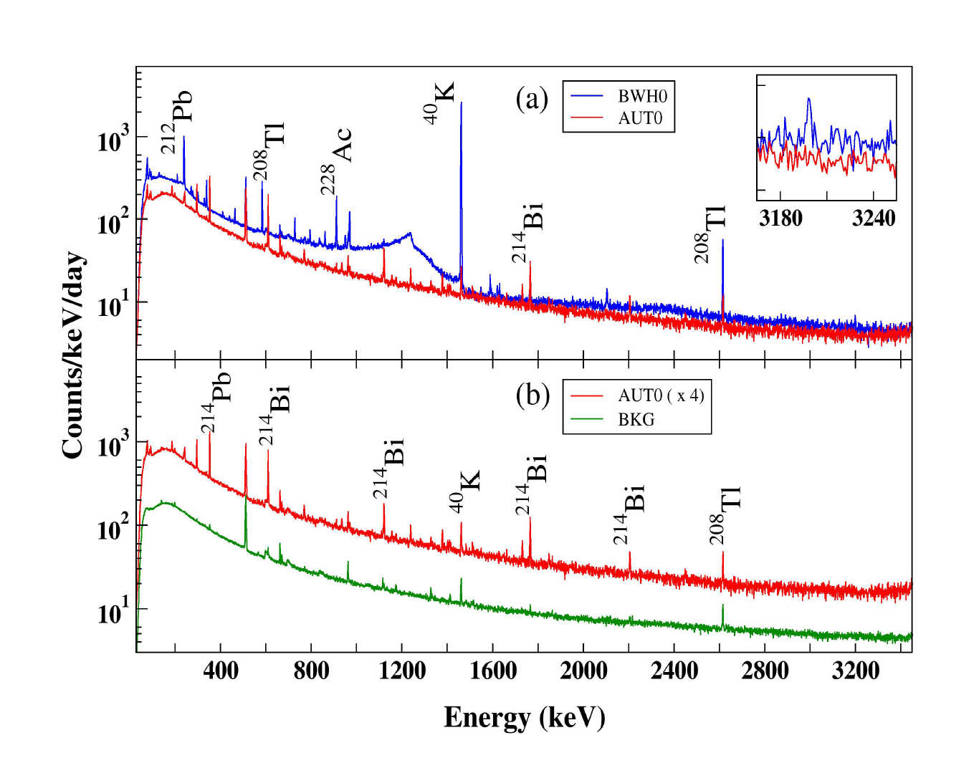
Radiation background studies relevant to rare decays
Measurements of muon induced neutron background and neutron capture gamma background carried out.
Aut rock studies (radiopurity and neutron activation) are carried out
low backgruond counting setup used for qualifying/screening materials :CsI crystals grown at BARC for DINO, Vizag, jadguguda, Jhakri, Atal , Zojila rock samples
D₂O radiopurity measurements for DLS
Radionuclide | AUTB | BWH
²³²Th | 12±1 ppb | 338±14 ppb
²³⁸U | 60±2 ppb | 9±1 ppb
⁴⁰K | <2 ppb | 2179±139 ppb
S. Thakur et al. , Nucl. Inst. Meth. A 1038 (2022) 166892
Notes:
The neutron background is quite difficult to suppress

Slide 24
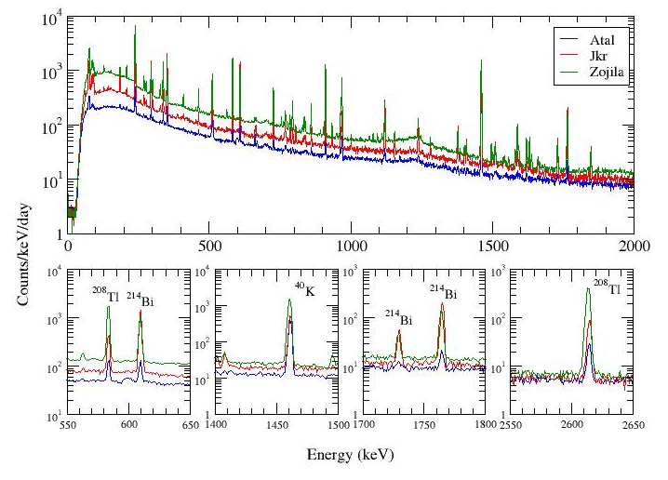
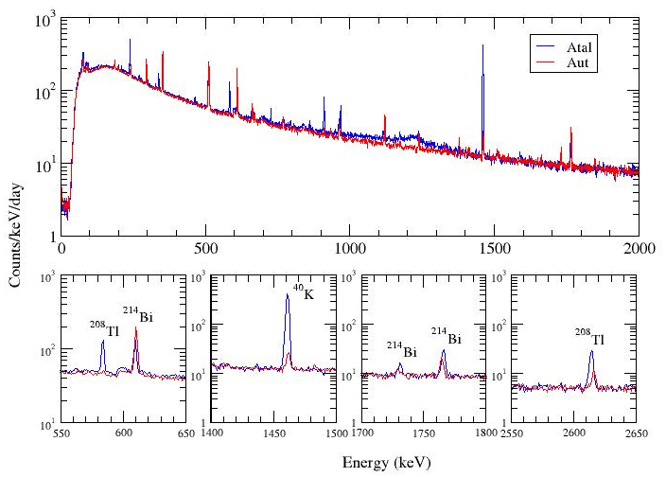
Rock sample studies
Sample Name | Mass (g) | Density (g/cc) | Counting time (d)
AUT | 27.50 | 2.93 | 23.4
Jhakri | 10.77 | 2.12 | 8.6
Atal | 6.89 | 2.96 | 28.9
Zojila | 130.02 | 2.75 | 19.77
Rock sample | Concentration(ppb)
 | 232Th | 238U | 40K
AUT | 12 | 60 | <2
Atal | 580 | 115 | 1304
Jhakri | 1924 | 1597 | 1334
Zojila | 1106 | 140 | 491
BWH | 338 | 9 | 2179
Preliminary results

Slide 25
…Next Step..
Measurements with ^{nat}Sn bolometer using Am-Pu source
Rare decay studies using low BKG setup (DBD to excited state in ⁹⁴Zr).
NTD Ge Sensor development (contd..)
2νββ measurements in ¹²⁴Sn
…Future Goal..
After prototype demonstration
Build a large scale detector (~ 1 ton)
( 3phases: 100 Kg, 500 Kg, 1000 Kg)
Fn =G^{0ν} |M^{0ν}|² = 8.569 x 10⁻¹³ yr⁻¹ (PHFB)
= 1.382 x 10⁻¹³ yr⁻¹ (SM)
With 90 % enrichment, background ~ 0.01 counts/ keV.kg.yr
m_{ν}~100 meV in 1 yr (SM) , m_{ν}~50 meV in 1 yr (PHFB)

Slide 26

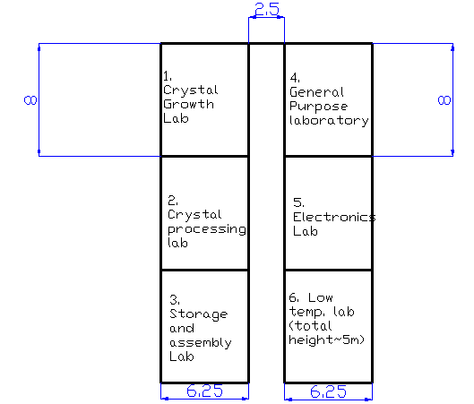
Space requirement and a possible layout
10m x10 m x 10 m high
24m x15 m x 3.5 m high
Control + DAQ room
Low background counting lab 8m x6.5 m x 3.5 m high
Future expansion scope?

Slide 27
Tin.Tin Collaboration
TIFR, Mumbai
Vivek Singh, Neha Dokania, S. Mathimalar,
A. Garai , Harisree krishnamoorthy,
Aparajita Mazumdar, Ghnashyam Gupta, Ashif Reza
Vishal Vatsa, Nishant Jangid
M.S. Pose, Mallikarjun
V. Nanal, V.M. Datar*,
S. Ramakrishnan*, R. Palit, S. Wategaonkar*
BARC, Mumbai
A. Shrivastava, K.C. Jagadeesan, S.V. Thakare,
Kamalesh Dasgupta, S.G. Nakhate, Soumen Bhattacharyya
IIT Ropar P.K. Raina, Pushpendra P Singh,
R.G. Pillay*, Swati Thakur
Univ. of Lucknow P.K. Rath
PRL V.K.B. Kota VECC Parnika Das
http://www.tifr.res.in/~tin.tin/

Slide 28
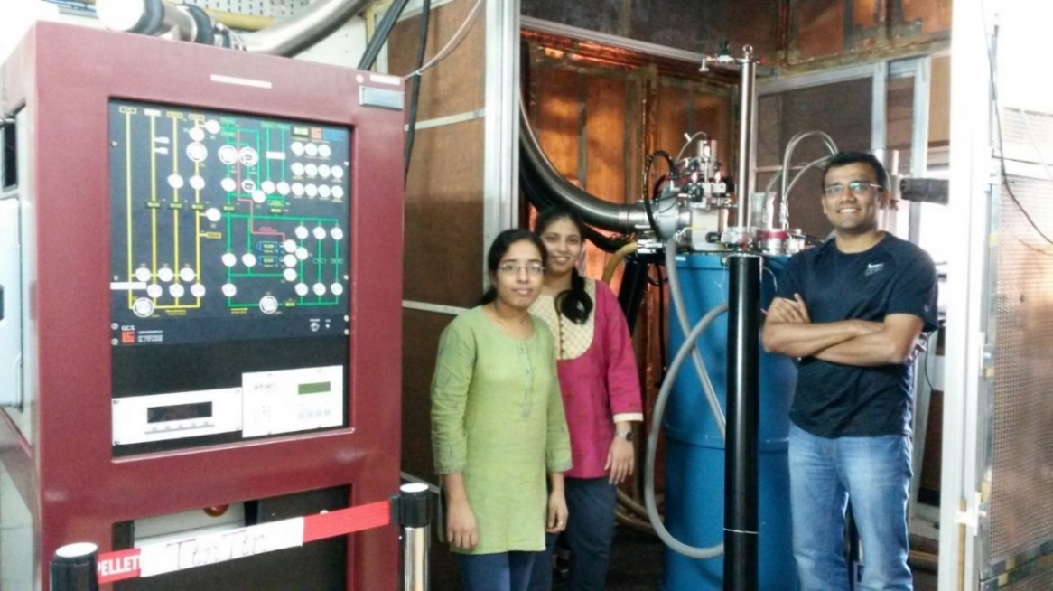
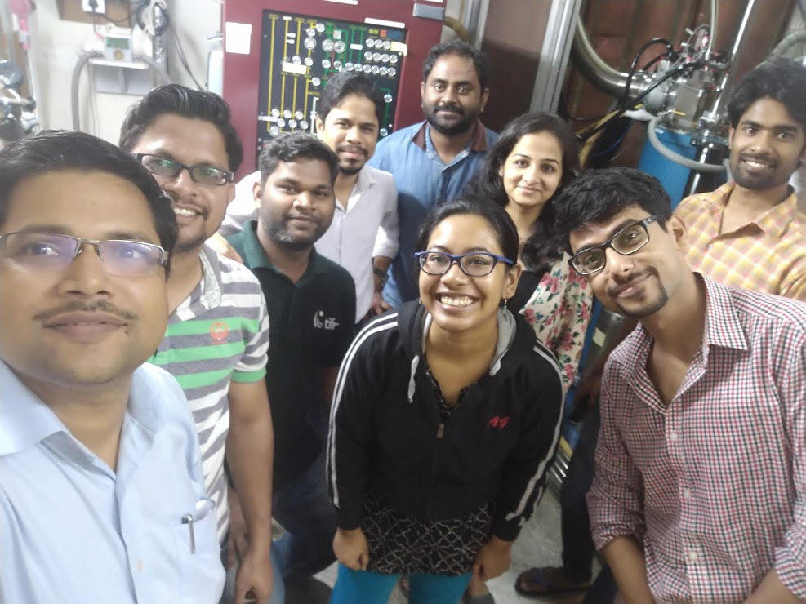
Acknowledgement
Tin.Tin Collaboration
INO collaboration
Pelletron Linac Facility
& colleagues from TIFR-BARC
http://www.tifr.res.in/~tin.tin/

Slide 29
Backup slides

Slide 30
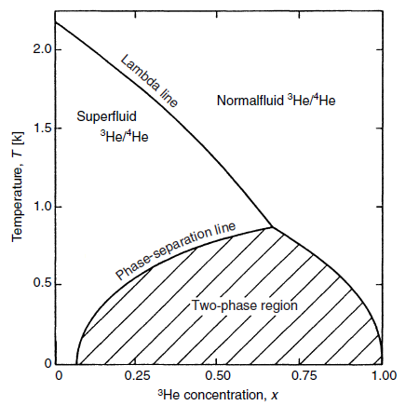
How do we get mK temperature?
³He-⁴He Dilution Refrigerator
liquid ⁴He ~ 4.2 K, ³He ~ 3.2 K
Pumping on liq. ⁴He ~1.2 K, ³He ~ 0.3 K
Cooling through the continuous cycle of a ³He / ⁴He mixture for lower temperatures
When a mixture of the two isotopes of helium is cooled below a critical temperature, it separates into two phases.
The lighter "concentrated phase" is rich in ³He and the heavier "dilute phase" is rich in ⁴He. Since the enthalpies of the ³He in the two phases are different, it is possible to obtain cooling by "evaporating" the ³He from the concentrated phase into the dilute phase.
This process continues to work even at the lowest temperatures because the equilibrium concentration of ³He in the dilute phase is still finite even as the temperature approaches absolute zero.
(originally proposed by H. London in 1951)
Phase diagram for a mixture of ³He / ⁴He
Fraction of ³He

Slide 31
Challenges in the ¹²⁴Sn NDBD experiment
Make a natural Sn bolometric detector ~ 0.5−1 Kg
Radiation background studies
Detector and background simulations
Thermalization issues
  between the electronic and phononic systems
  ballistic phonons, single crystal vs polycrystalline Sn
Allotropic transition in Sn : the sample disintegrates due to a sudden increase in the volume, affects the longevity, alloying with Bi for suppression of tin pest
Vibration effect
Sensor development
Reliable NTME calculations
Enrichment of ¹²⁴Sn
Constraining NTME, GT measurement in NDBD nuclei

Slide 32
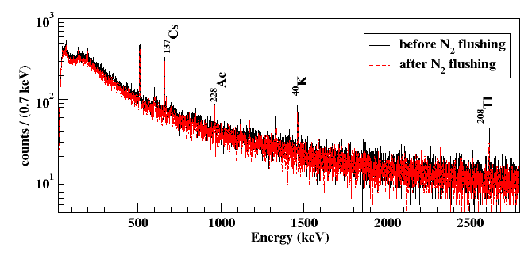
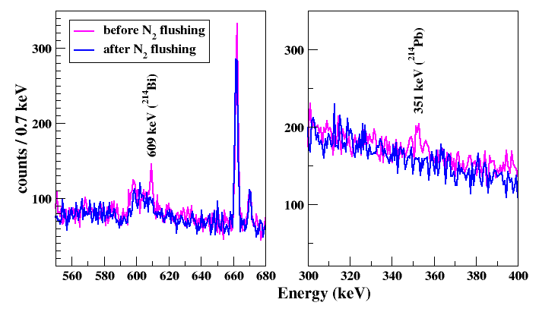
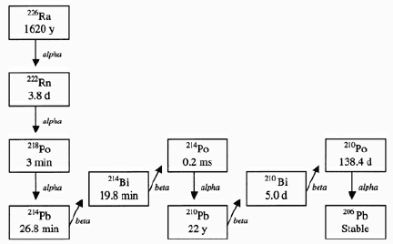
N₂ flushing in the TiLES
Radon produced in the natural decay chains of U and Th get trapped in the volume of the detector.
Boil-off nitrogen from LN₂ cylinder at a pressure of ~8 mbar flowed in the volume around the detector setup kept inside a sealed Perspex box.
Gamma ray spectra of room background in TiLES (t = 7d)
Decay scheme of ²²²Rn (in ²³⁸U)

Slide 33
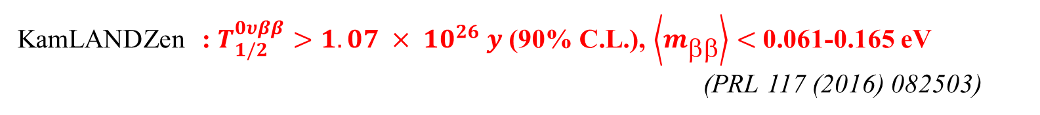
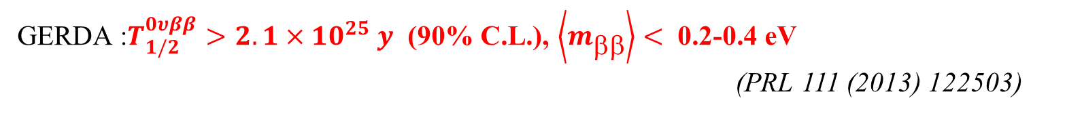
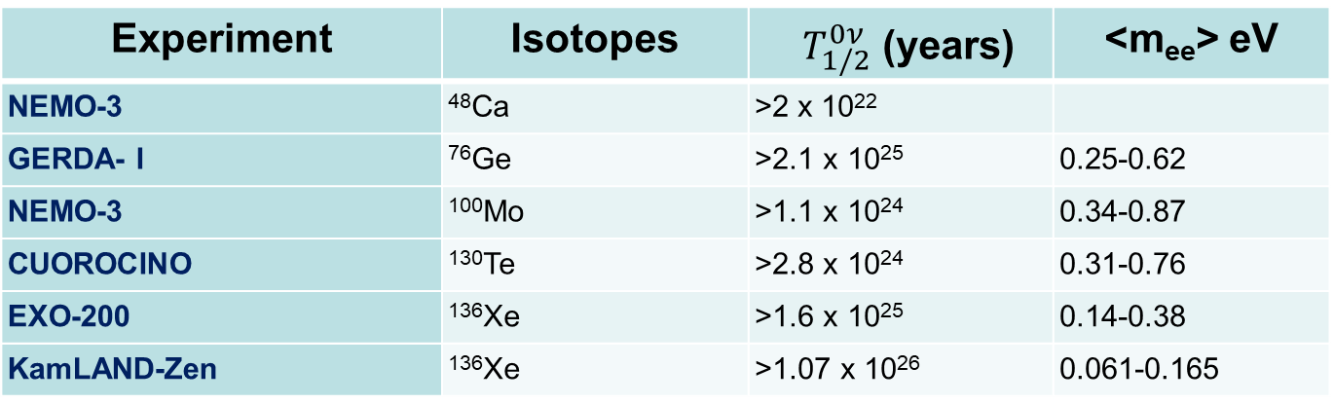
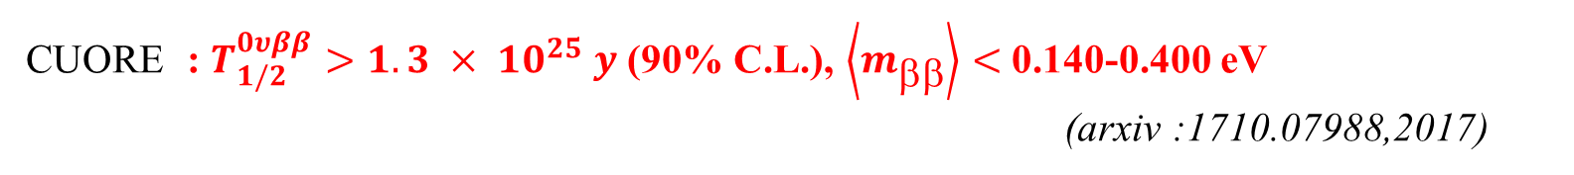
Best Limits so far…
GERDA :$T_{1/2}^{0υββ}>2.1×{10}^{25} y$ (90% C.L.), $\left\langle m_{ββ}\right\rangle <$ 0.2-0.4 eV
(PRL 111 (2013) 122503)
KamLANDZen : $T_{1/2}^{0υββ}>1.07 × {10}^{26} y$ (90% C.L.), $\left\langle m_{}\right\rangle <$0.061-0.165 eV
(PRL 117 (2016) 082503)
CUORE : $T_{1/2}^{0υββ}>1.3 × {10}^{25} y$ (90% C.L.), $\left\langle m_{}\right\rangle <$0.140-0.400 eV
(arxiv :1710.07988,2017)
Experiment | Isotopes | $T_{1/2}^{0ν}$ (years) | <m_{ee}> eV
NEMO-3 | ⁴⁸Ca | >2 x 10²²
GERDA- I | ⁷⁶Ge | >2.1 x 10²⁵ | 0.25-0.62
NEMO-3 | ¹⁰⁰Mo | >1.1 x 10²⁴ | 0.34-0.87
CUOROCINO | ¹³⁰Te | >2.8 x 10²⁴ | 0.31-0.76
EXO-200 | ¹³⁶Xe | >1.6 x 10²⁵ | 0.14-0.38
KamLAND-Zen | ¹³⁶Xe | >1.07 x 10²⁶ | 0.061-0.165
Direct neutrino mass measurement – KATRIN (³H, Q~18 keV , sensitivity ~ 0.2 eV), HOLMES +ECHO (¹⁶³Ho- EC, Q ~ 2.55 keV, sensitivity < 2 eV), MARE (¹⁸⁷Re, Q ~2.49 keV , sensitivity <0.2 eV)
Current Science 112, 1375 (2017)

Slide 34
Utilities
5T electrical Crane
Chilled water
AHU
UPS
place for keeping compressors, pumps
Some of the labs need class 1000/10000 clean room
Change room/buffer access for personnel/equipment entering the assembly/process room
Control room
Surface labs

Slide 35
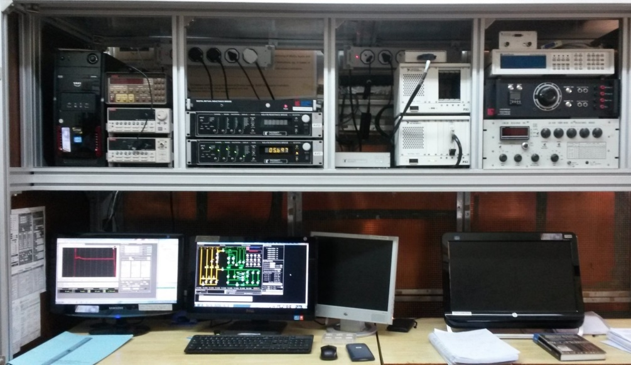
The CFDR-1200 diagnostics
MC Temperature sensor: Speer, CMN, FPD(0.015-3.3K)
Automatic temperature control
Temperature stability ~0.1%, accuracy ~ 1 mK
Optically isolated RS232 adapter for PT and pressure gauge communications

