Slide 1

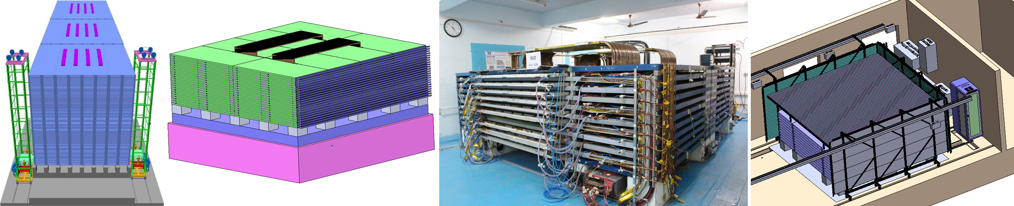


An overview of the ICAL detectors
B.Satyanarayana
Department of High Energy Physics & INO Cell
Tata Institute of Fundamental Research, Mumbai, INDIA, 400005

Slide 2
Facts and Figures of ICAL detectors
Parameter | ICAL | e-ICAL | m-ICAL
No. of modules | 3 | 1 | 1
Module dimensions | 16.2m×16m×14.5m | 8m×8mx2.3m (90:1) | 4m×4mx1m (720:1)
Detector dimensions | 49m×16m×14.5m | 8m×8mx2.3m | 4m×4mx1m
No. of active layers | 150 | 22 | 10
Iron plate thickness | 56mm | 56mm | 56mm
Gap for RPC trays | 40mm | 40mm | 45mm
Magnetic field | 1.3Tesla | 1.3Tesla | 1.3Tesla
RPC dimensions | 1,950mm×1,910mm×24mm | 1,950mm×1,910mm×24mm | 1,950mm×1,910mm×24mm
Readout strip pitch | 30mm | 30mm | 30mm
No. of RPCs/Road/Layer | 8 | 4 | 2
No. of Roads/Layer/Module | 8 | 4 | 1
No. of RPC units/Layer | 192 | 16 | 2
No. of RPC units | 28,800 (107,266m²) | 352 (1,311m²) (90:1) | 20 (74.5m²) (1440:1)
No. of readout strips | 3,686,400 | 45,056 (90:1) | 2,560 (1440:1)

Slide 3
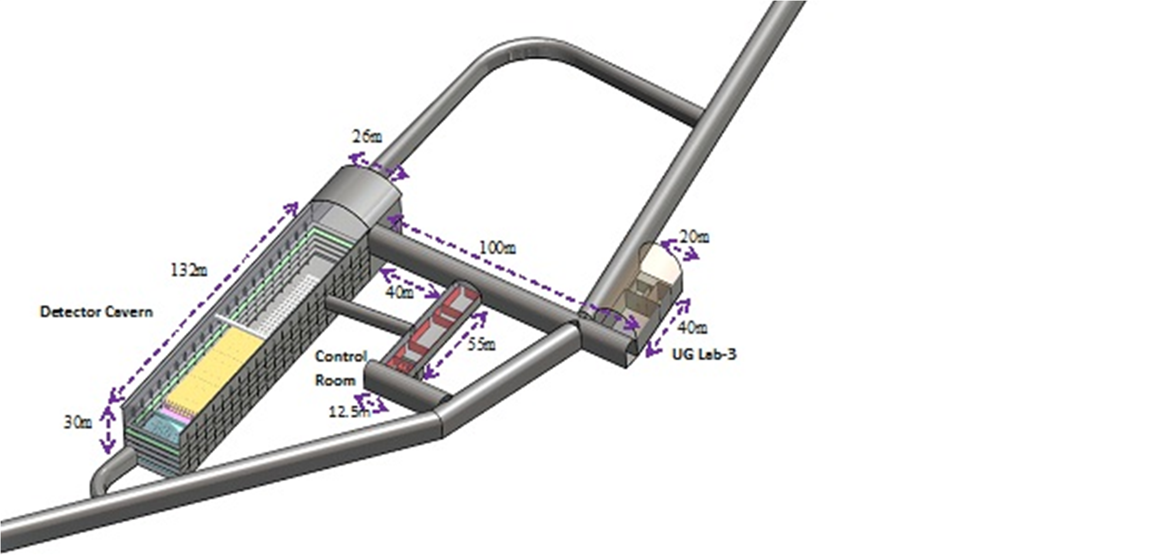
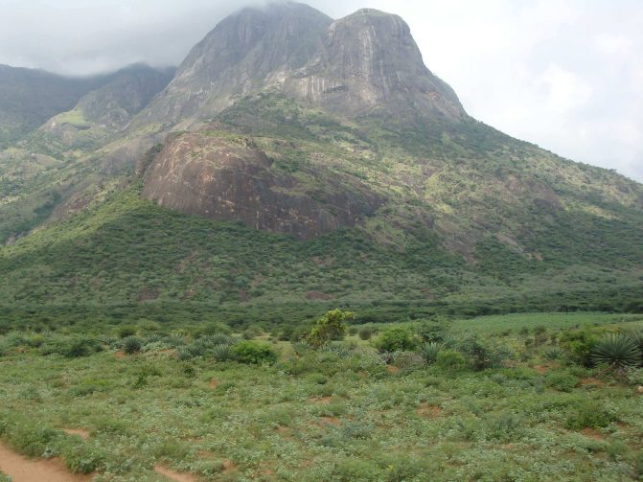
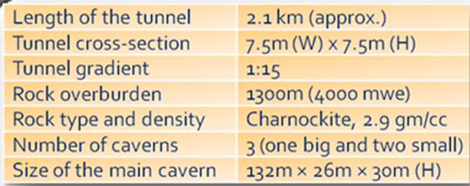
Underground laboratory of the INO project
What INO can do?
Measure atmospheric muon neutrinos and antineutrinos, separately.
Will target the open problem of ordering of the three tiny neutrino masses - Mass Hierarchy.
Will help address CP violation in the neutrino sector, which could help in our understanding of why there is a preponderance of matter over anti-matter in the universe.
A. Kumar, et al, Pramana – J. Phys. (2017) 88:79
Bodi West Hills, Pottipuram, Theni: 9º58′ North; 77º16′ East, 110km West of Madurai (South India)

Slide 4
The choice of detector: ICAL
Use (magnetised) iron as target mass and Resistive Plate Chambers (RPCs) as active detector elements.
Atmospheric neutrinos have large L and E range. So ICAL has large target mass: 50kton in its current design.
Nearly 4π coverage in solid angle (except near horizontal).
Upto 20 GeV muons contained in fiducial volume; most interesting region for observing matter effects in 2–3 sector is 5–15 GeV.
Good tracking and energy resolution.
ns time resolution for up/down discrimination; good directionality.
Good charge resolution; magnetic field ∼1.3 Tesla.
Ease of construction (modular; 3 modules of 17 kTons each).
Note: ICAL is sensitive to muons only, very little sensitivity to electrons; Electrons leave few traces (radiation length 1.8 (11) cm in iron (glass)).

Slide 5
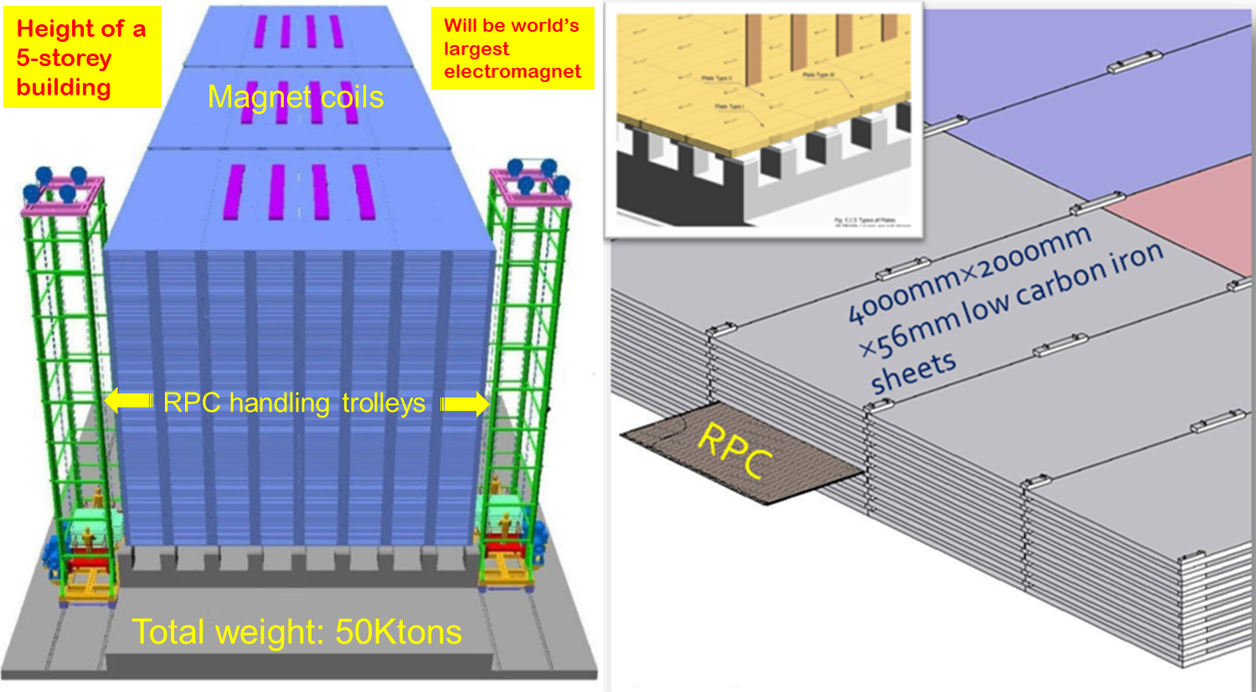

Slide 6
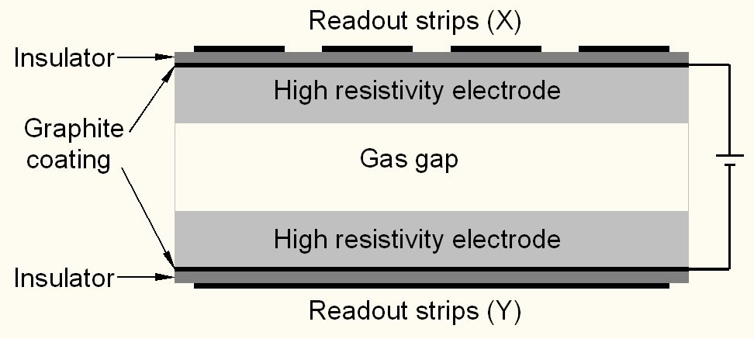
Resistive Plate Chambers (RPCs)
Operated in the Avalanche mode with the gas mixture of R134a:Isobutane:SF₆::95.5:4.2:0.3

Slide 7
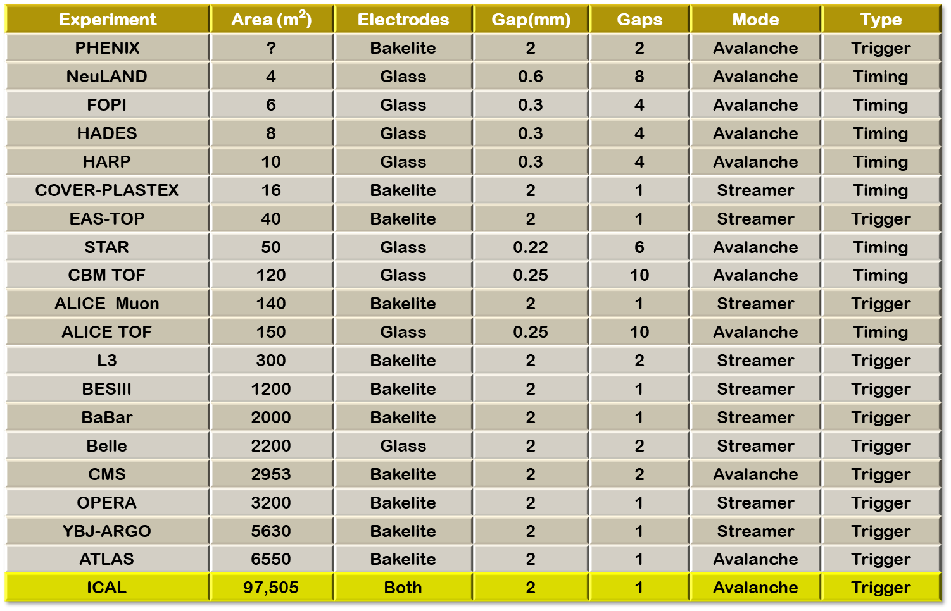

Slide 8
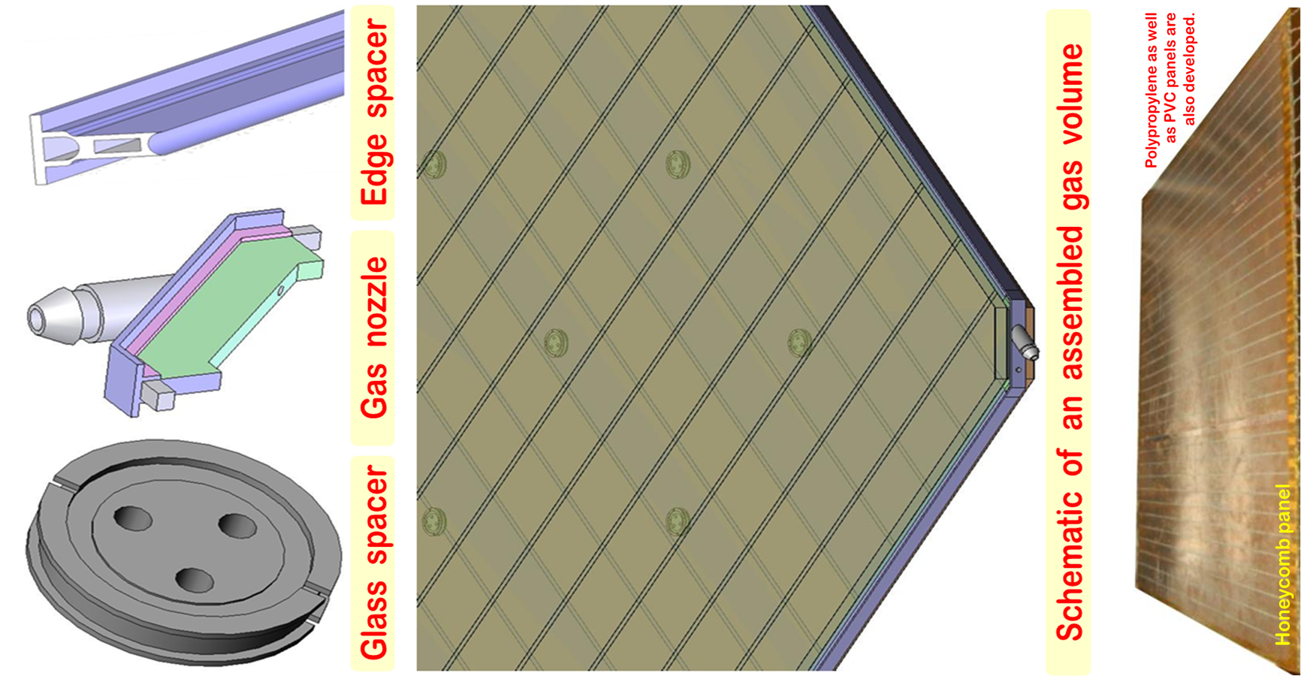
Materials for RPC fabrication

Slide 9
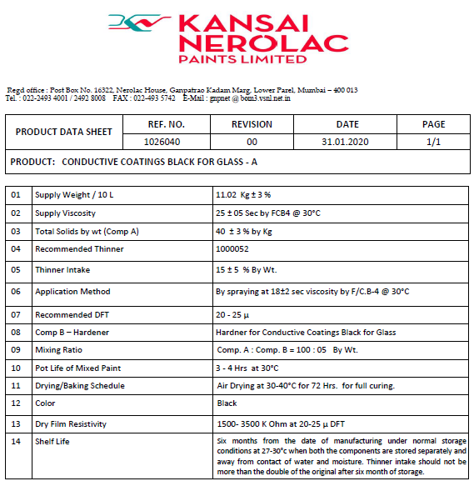


Slide 10
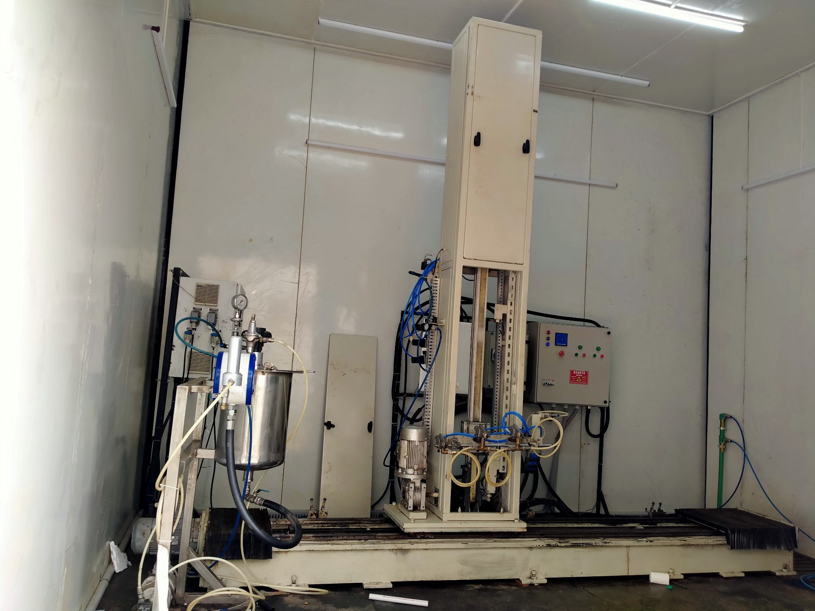
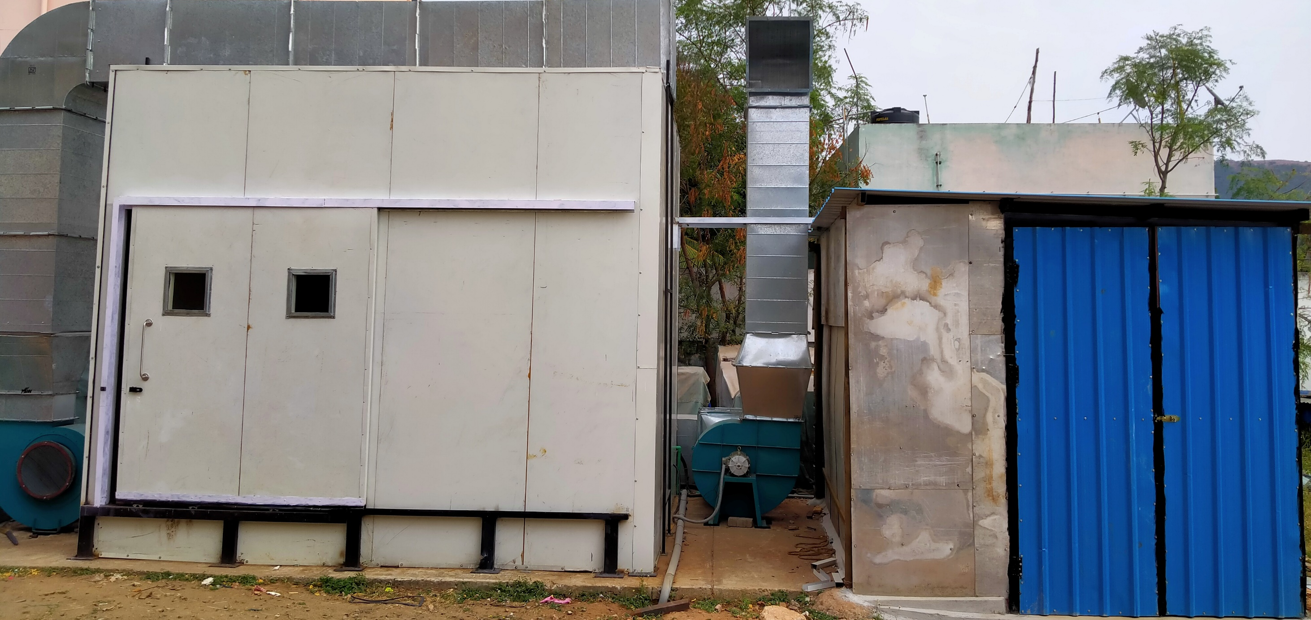
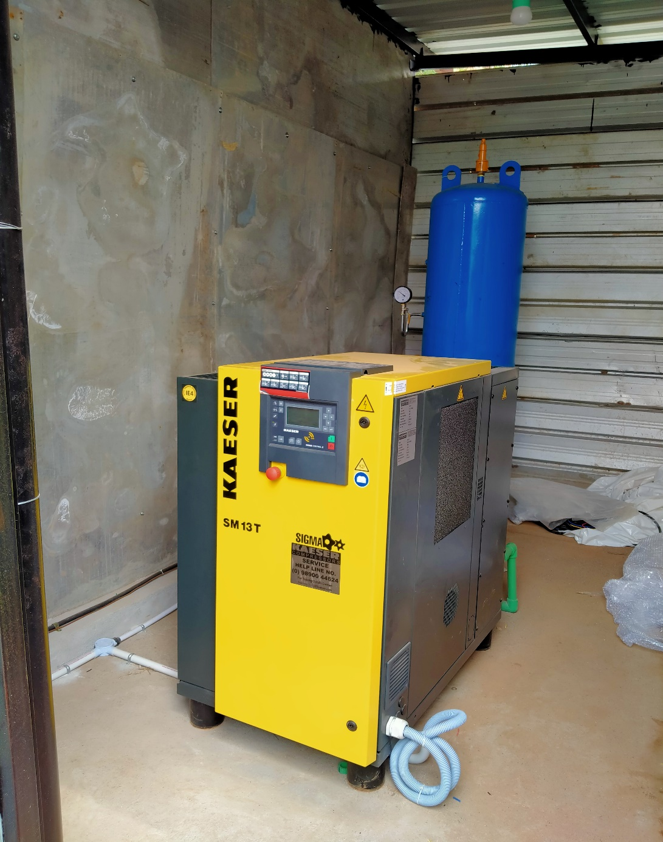
Spray painting plant at IICHEP

Slide 11
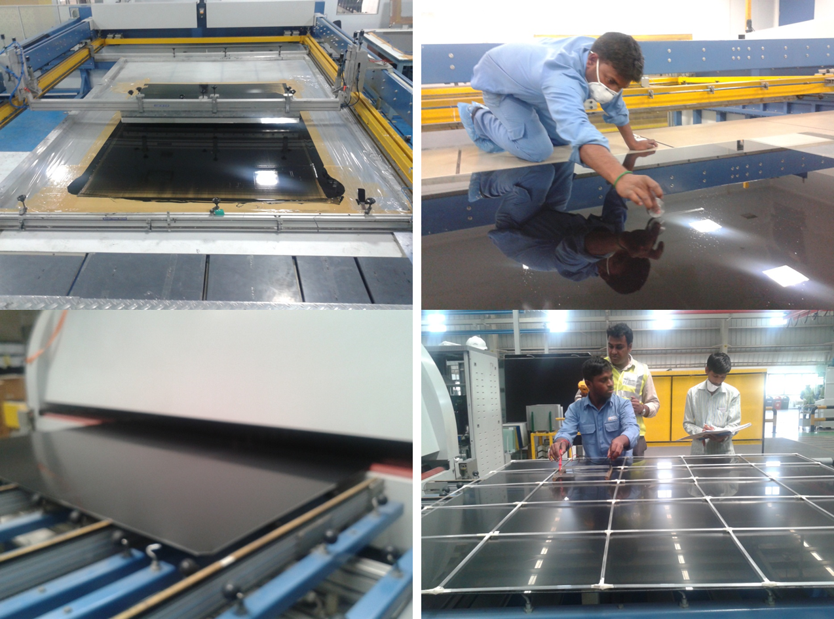

Slide 12
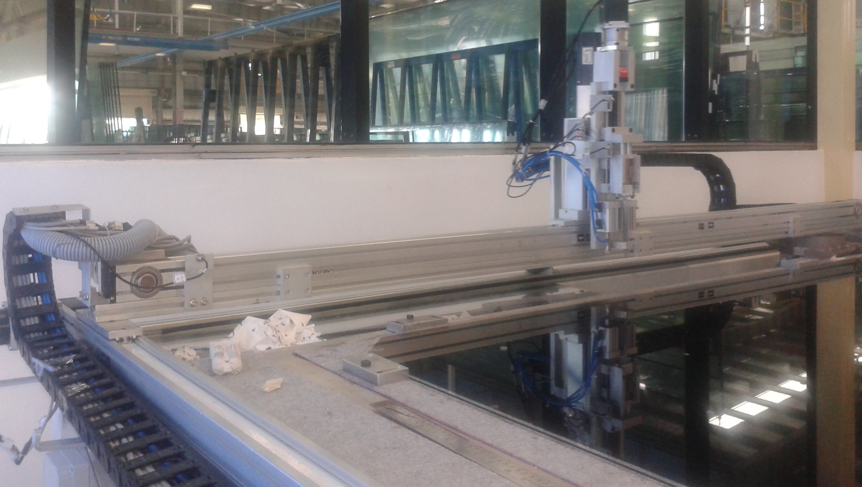

Slide 13
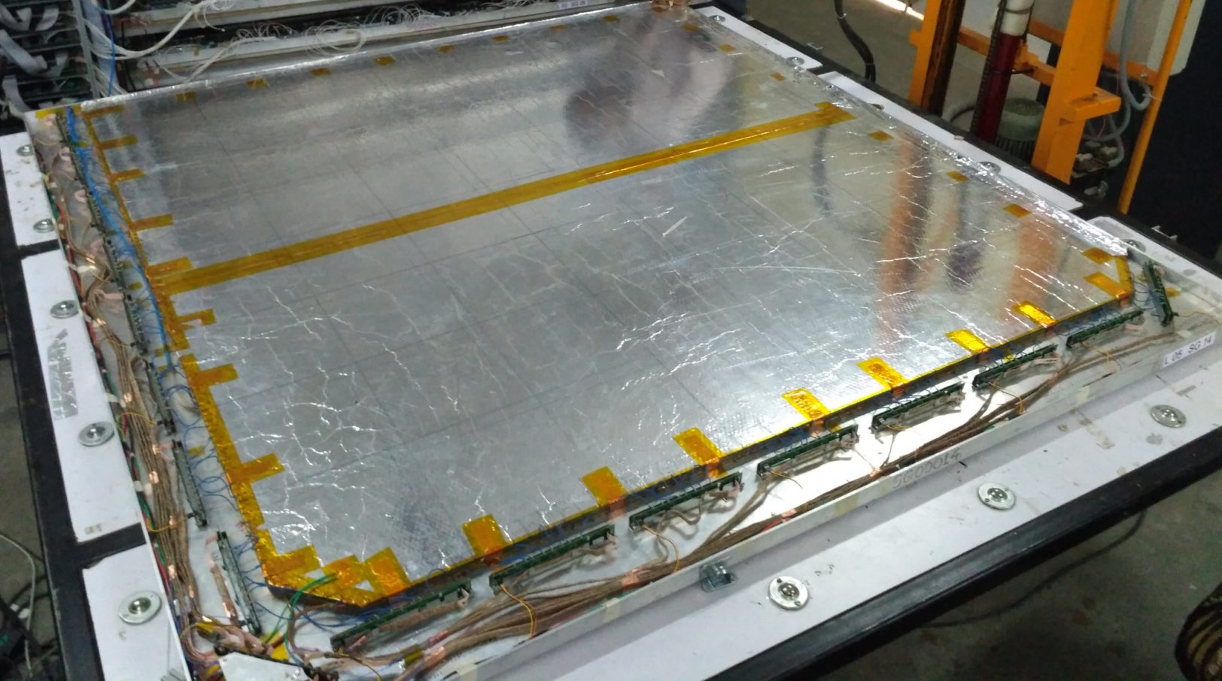

Slide 14
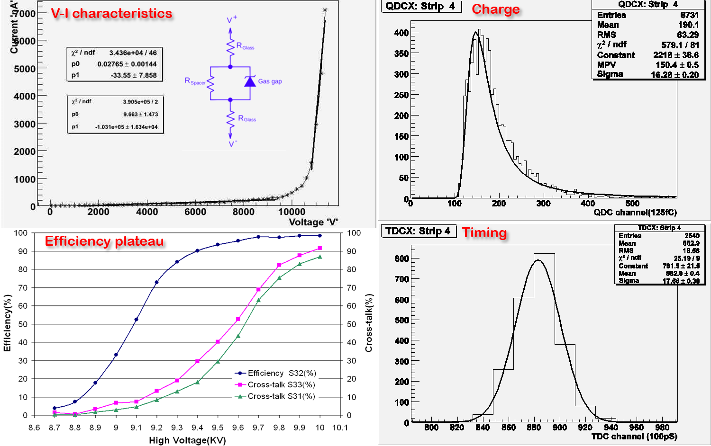

Slide 15
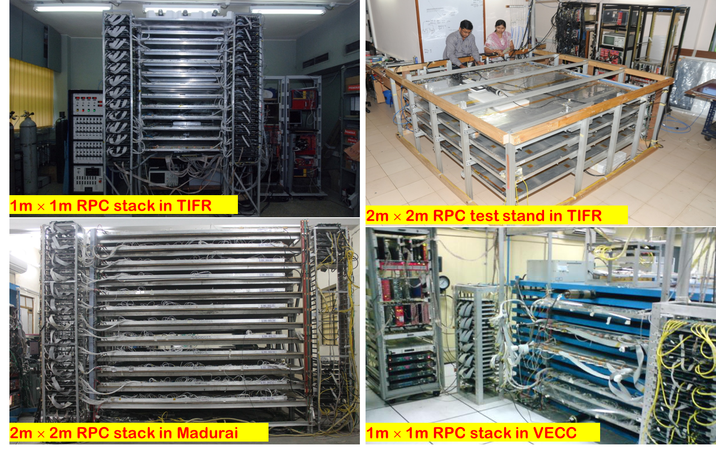

Slide 16
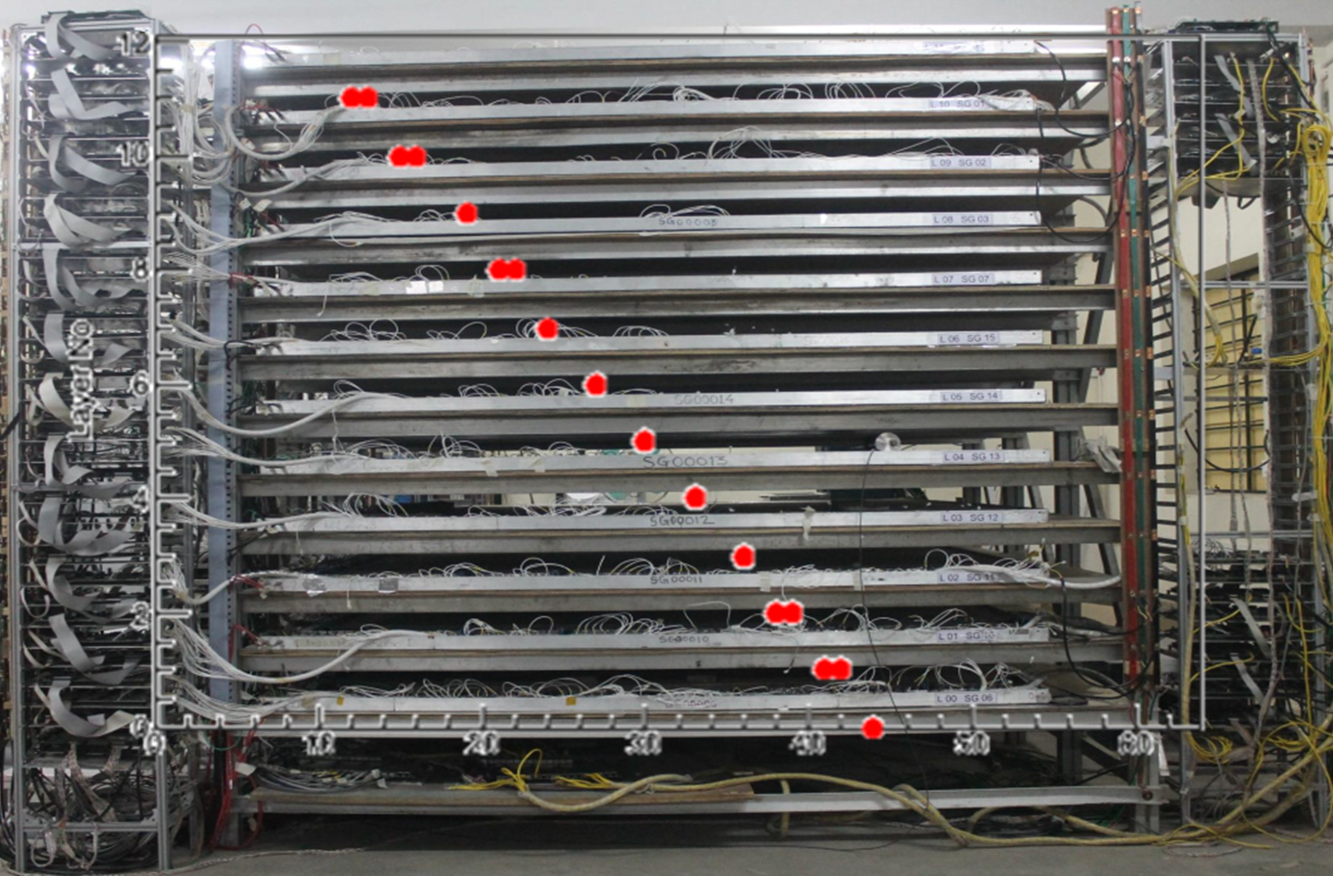

Slide 17
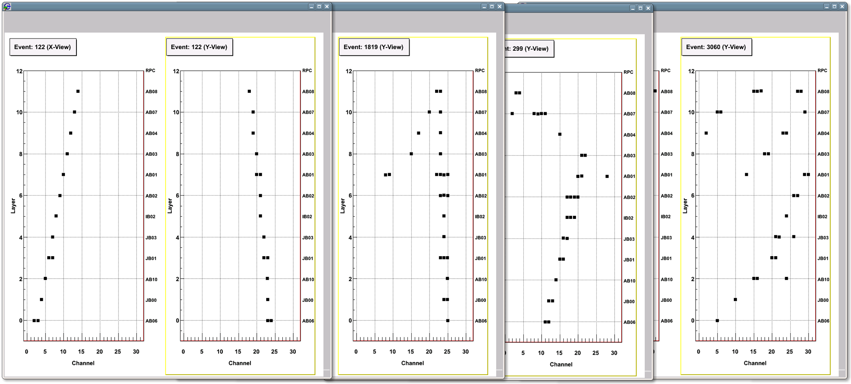
A collage of cosmic ray muon events

Slide 18
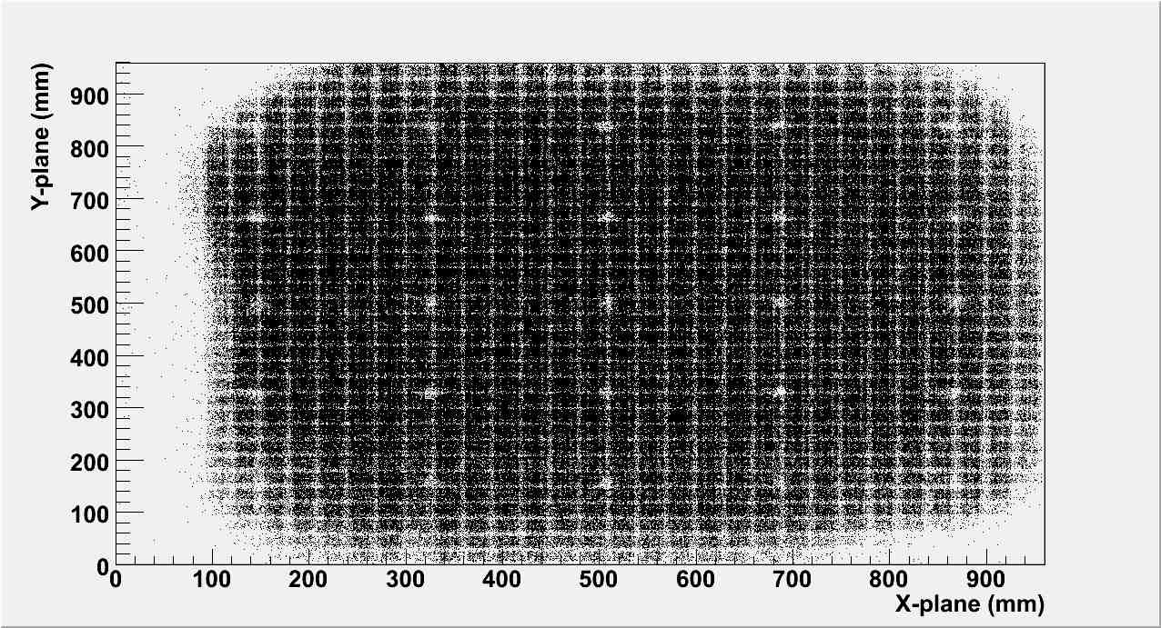
Selfie tomography of an RPC detector!

Slide 19
Muons and hadrons in the RPC stack

Slide 20
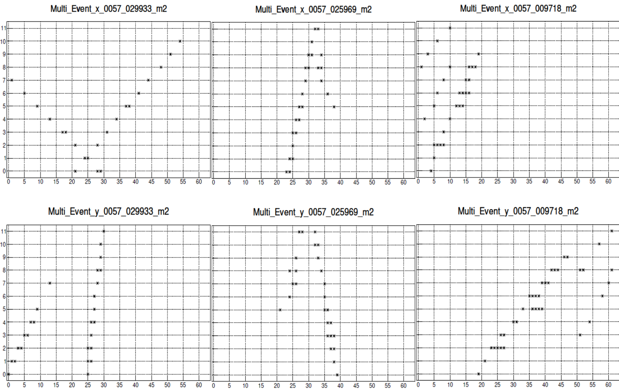

Slide 21
Characterisation studies of RPCs

Slide 23
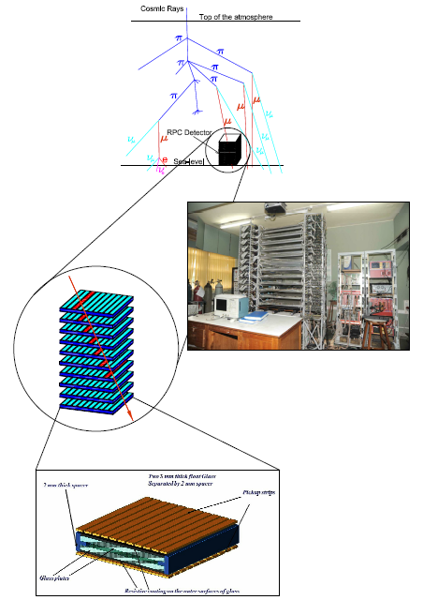
Functions of ICAL electronics
Signal pickup and analog front-end
Strip hit latch (1-bit ADC)
Pulse shapers, timing units
Background noise rate monitor
Digital front-end and controller
Data network interface and architecture
Multilevel trigger system
Backend data concentrators
Event building, data storage systems
On-line data quality monitors
Slow control and monitoring
  Gas system, magnet, power supplies
  Ambient parameters (T, P and H)
  Safety and interlocks
Remote access to detector sub-systems and data

Slide 24
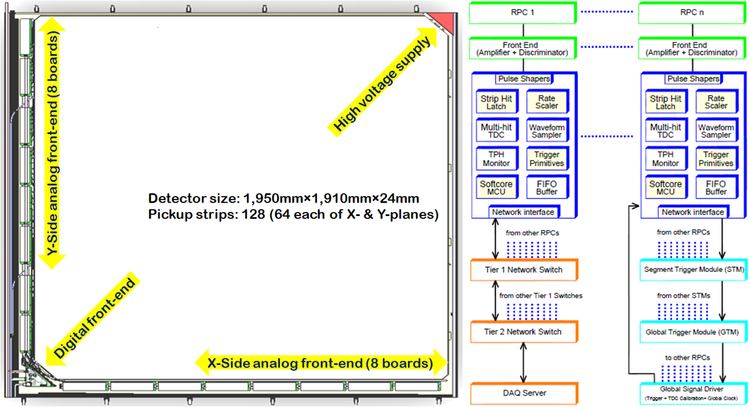

Slide 25
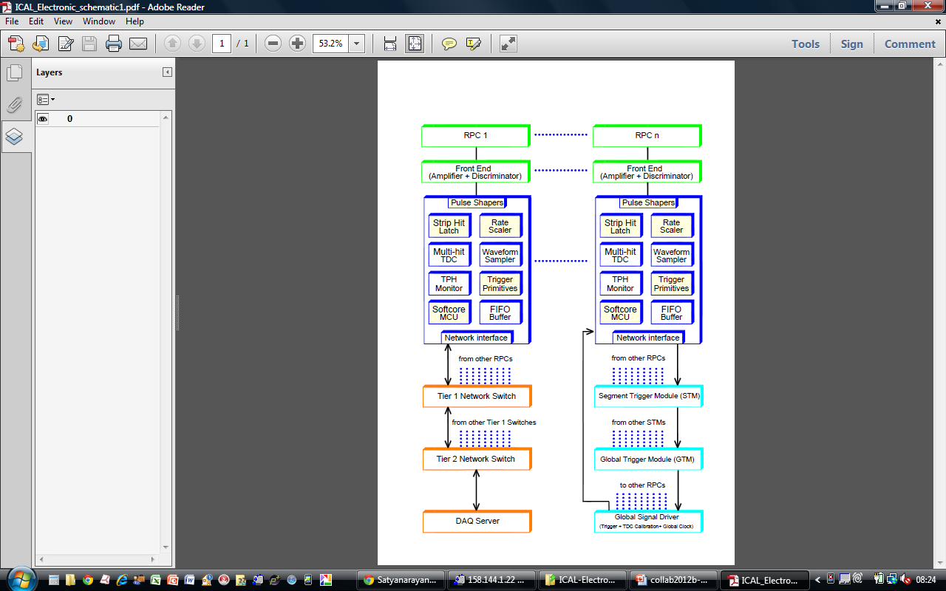
Components of ICAL electronics
Analog Front-end based on Anusparsh ASIC
Digital Front-end (RPCDAQ) using a TDC ASIC
Trigger System
Global services, calibration and synchronisation
Network and backend hardware
Backend software
Power supplies
Electronics integration

Slide 26
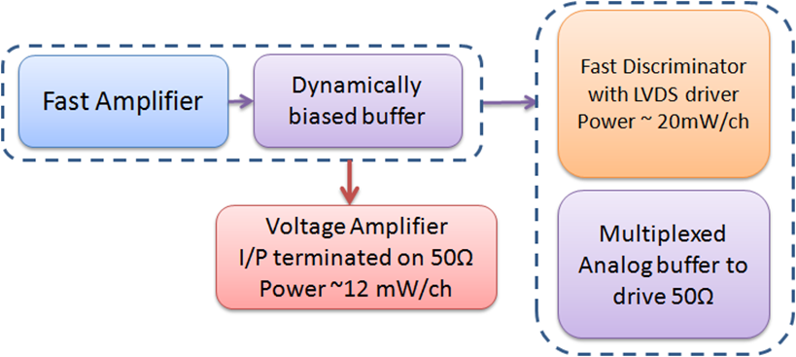
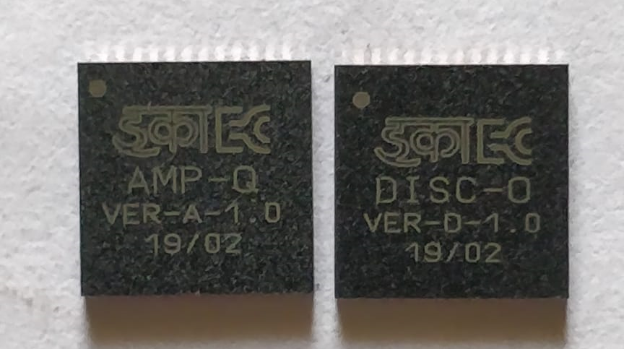
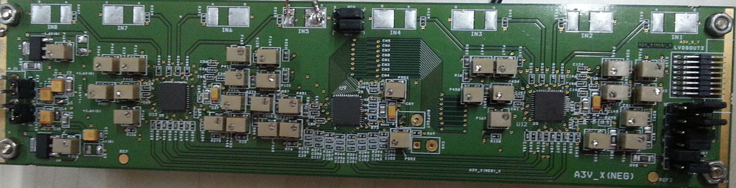
Analog front-end electronics for RPCs

Slide 27
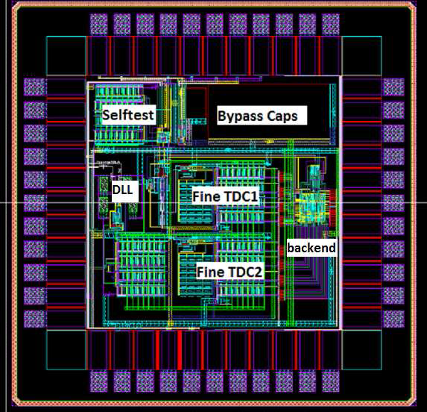
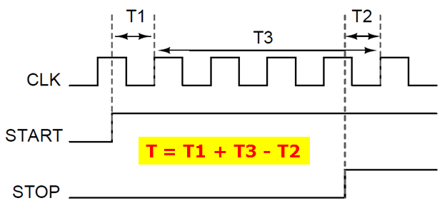
Multi-hit Time-to-Digital Converter ASIC
Principle
  Two fine TDCs to measure start/stop distance to clock edge (T₁, T₂)
  Coarse TDC to count number of clocks between start and stop (T₃)
  TDC output = T₃+T₁-T₂
Specifications
  19 bit parallel output
  Clock period, Tc = 4ns
  Fine TDC interval, Tc/32 = 125ps
  Coarse TDC output: 14 bits
  Fine TDC output: 5 bits
  Coarse TDC interval: 214 * Tc = 65.536ms

Slide 28
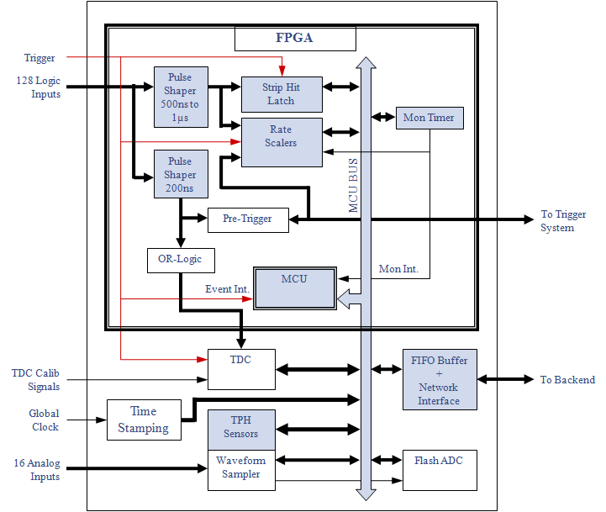
DFE module – the workhorse
Unshaped, digitized, LVDS RPC signals from 128 strips (64x + 64y)
16 analog RPC signals, each signal is a summed or multiplexed output of 8 RPC amplified signals.
Pre-trigger signals sent to the global trigger system
Global clock, trigger and TDC calibration signals from backend
TCP/IP connection to backend for command and data transfer.
Each RPC via the DFE module is an Ethernet host with unique private IP address and in principle can be accessed from anywhere.

Slide 29
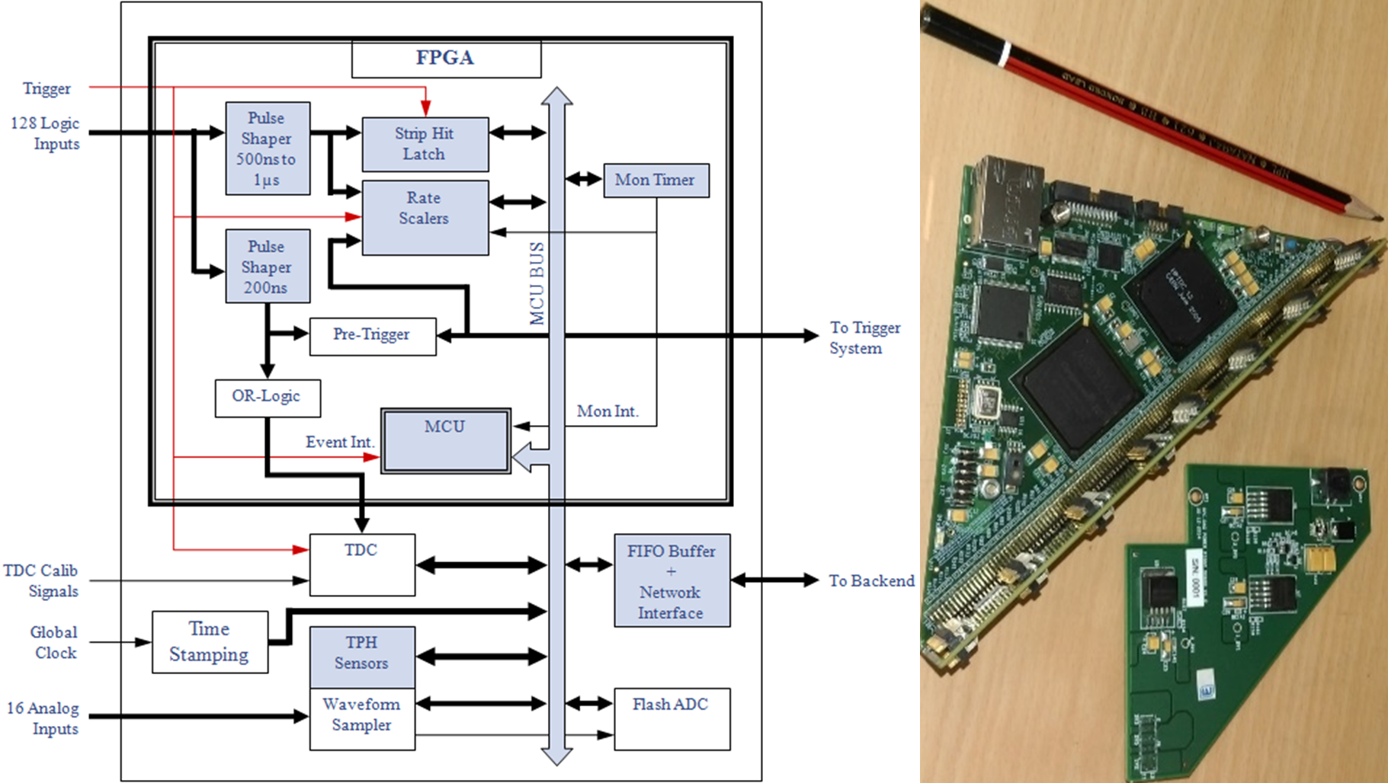

Slide 30
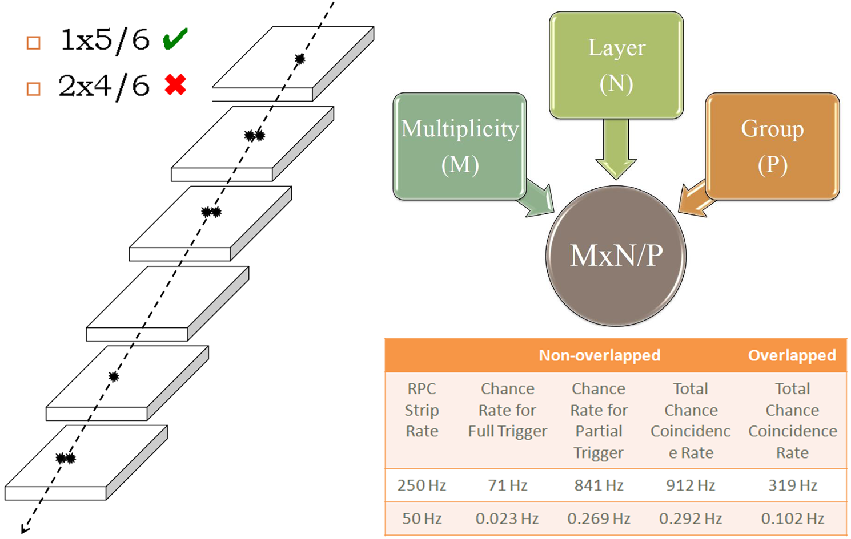

Slide 31
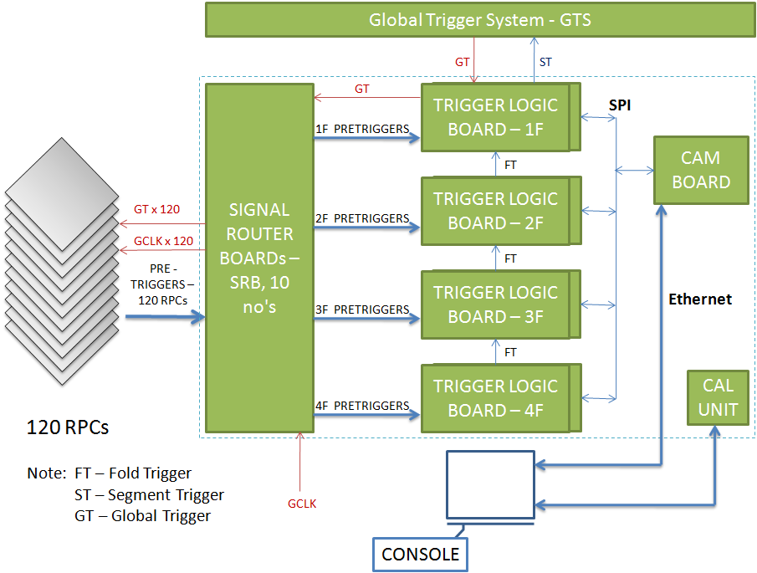

Slide 32
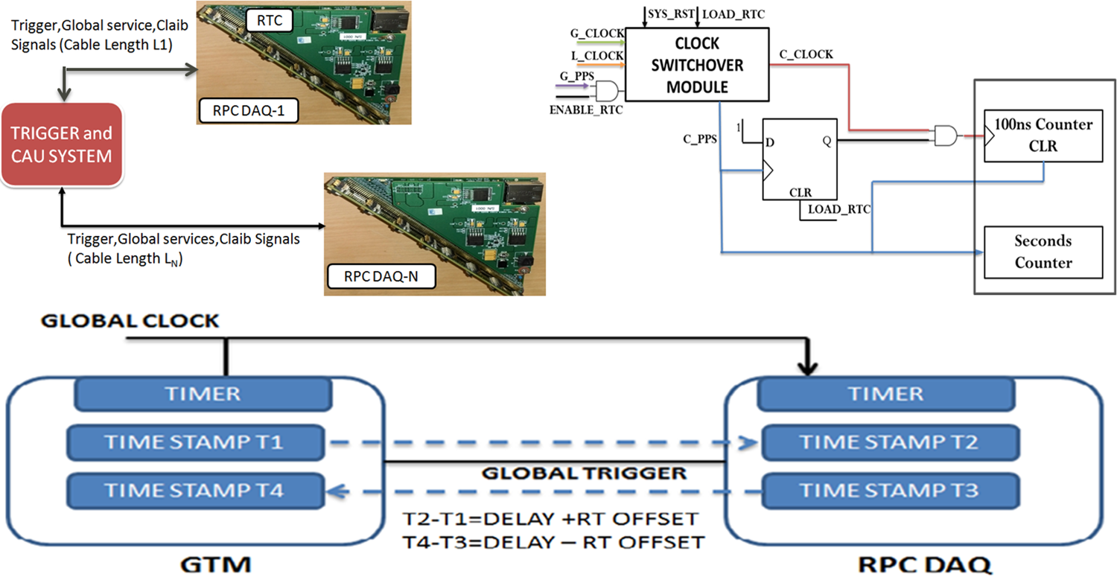

Slide 33
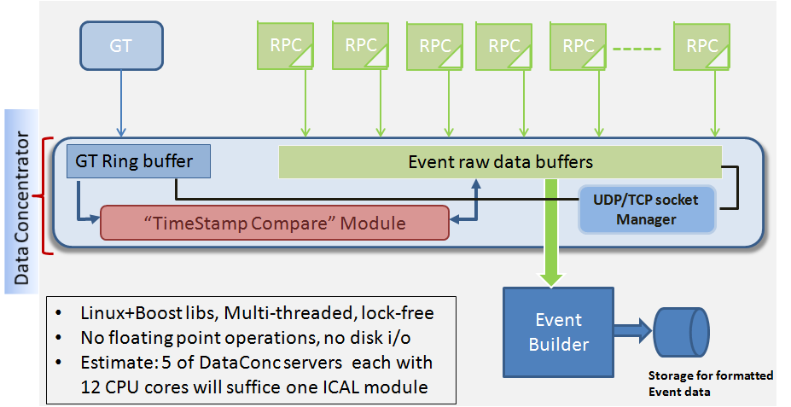

Slide 34
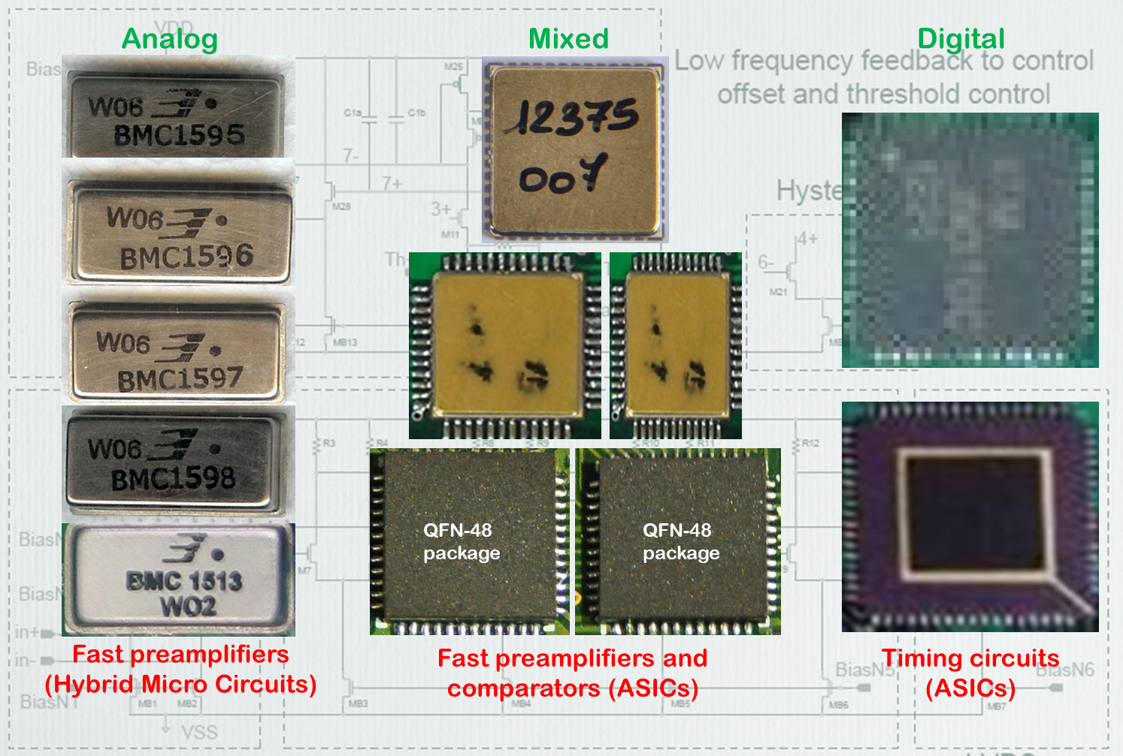
Generations of signal processing electronics

Slide 35
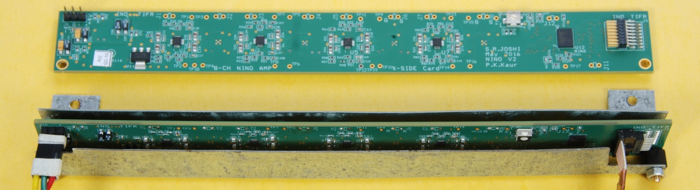
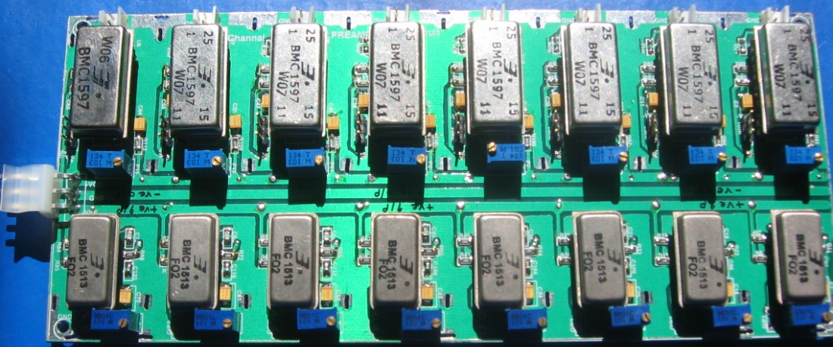
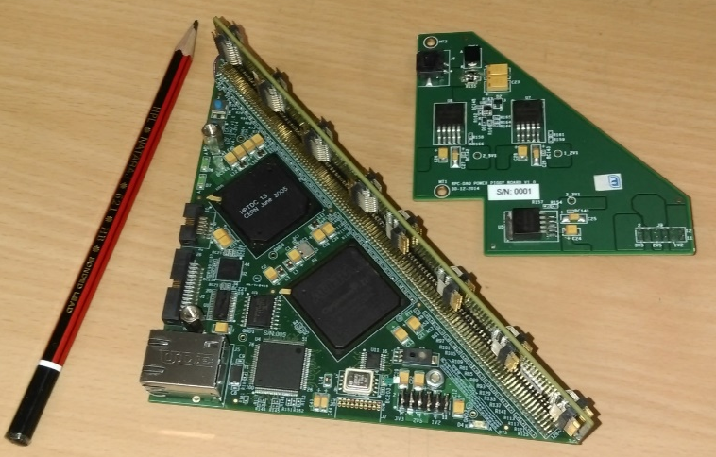
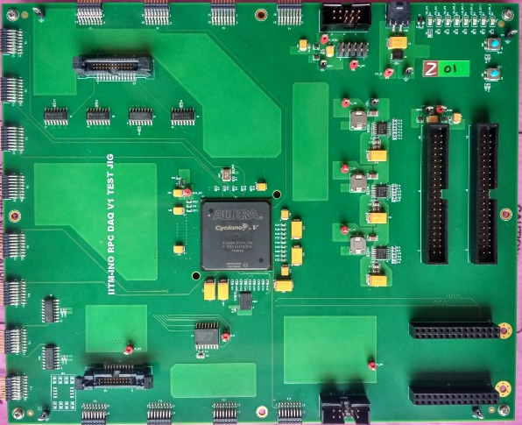
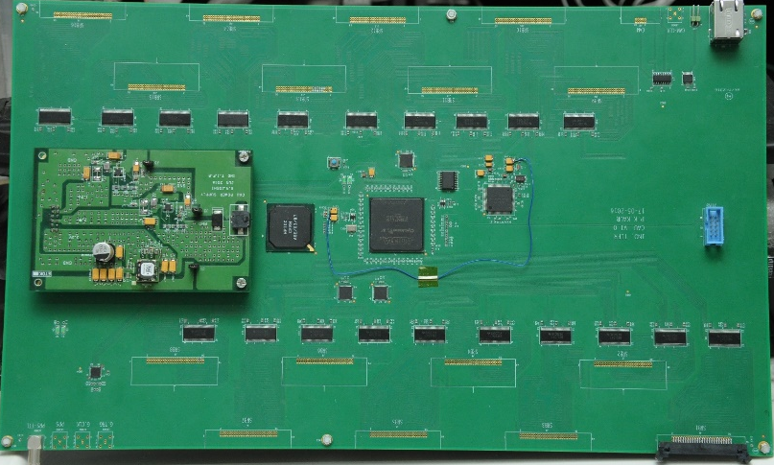
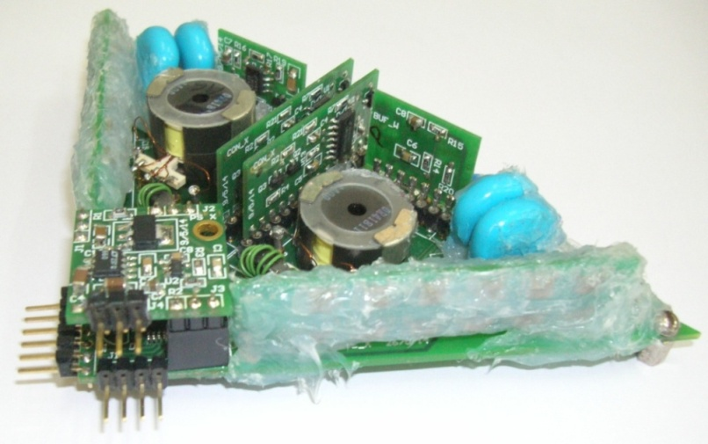
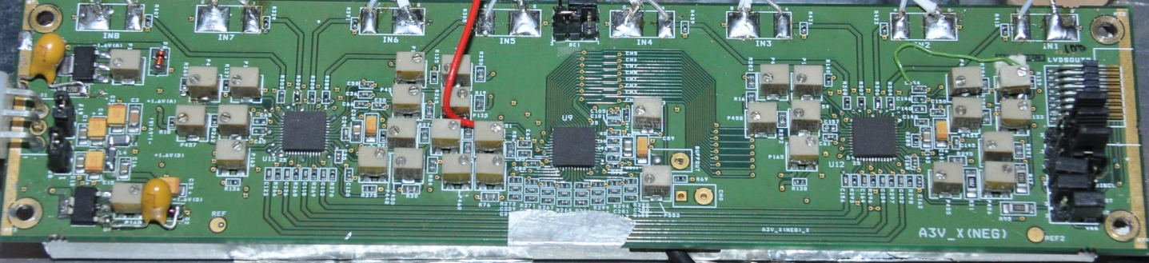
ICAL detector’s electronics boards

Slide 36
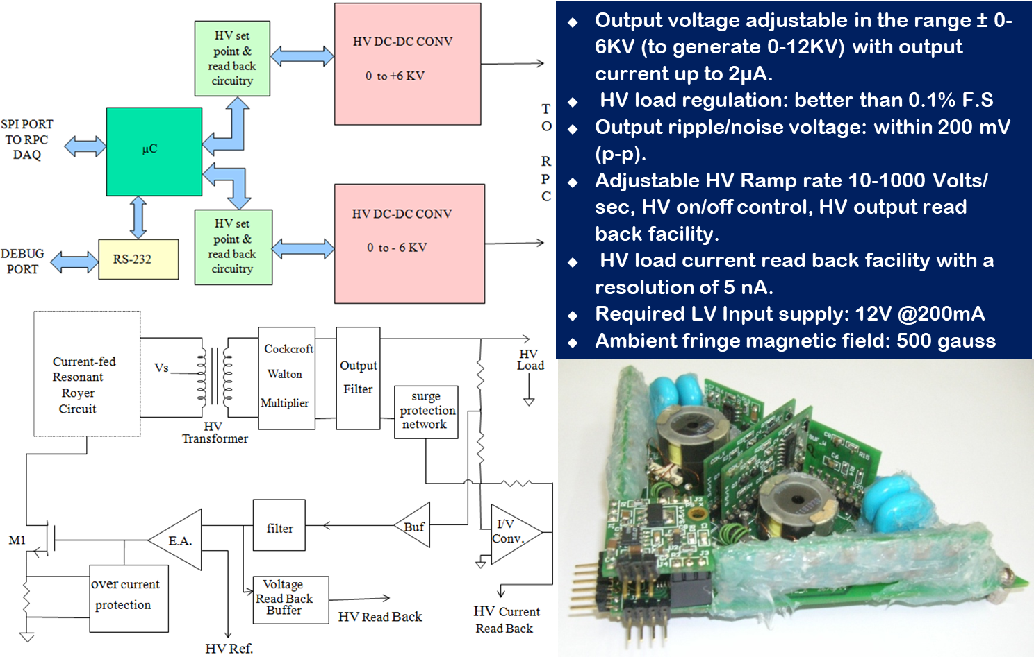

Slide 37
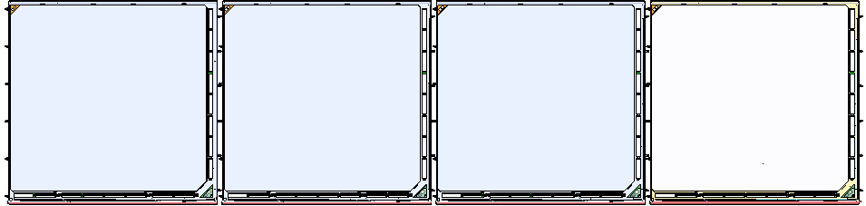
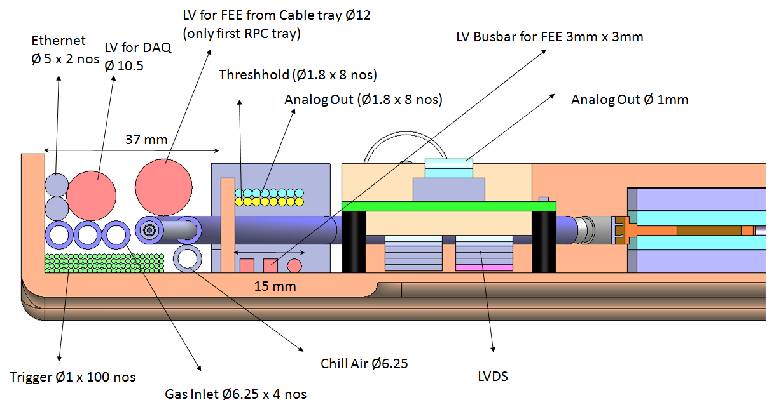
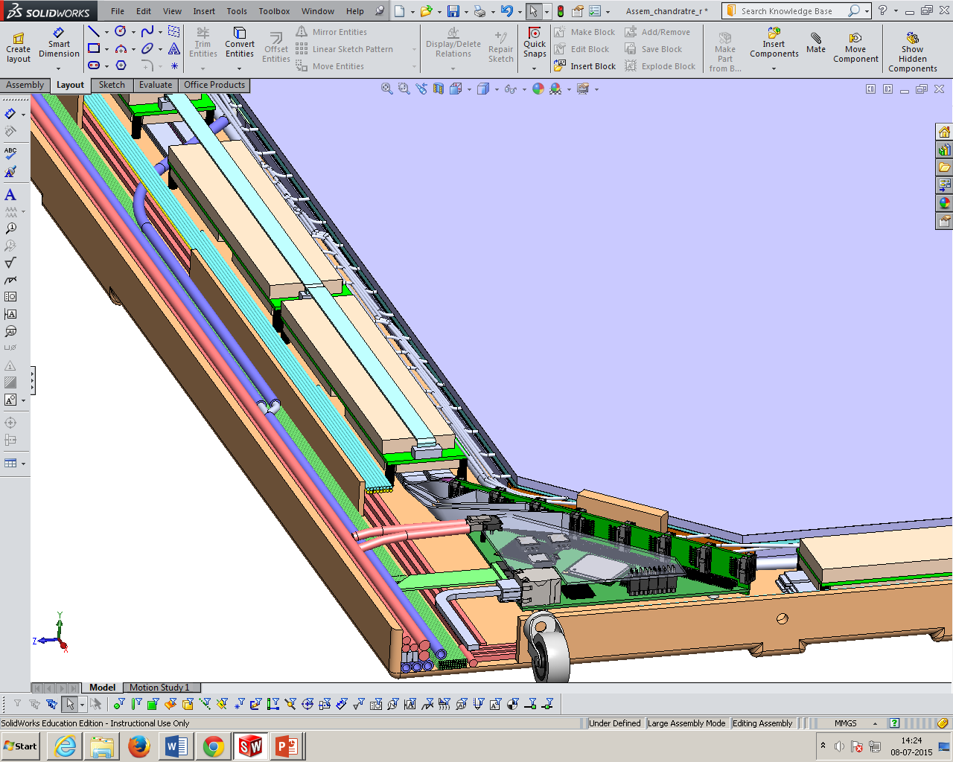
Installation of RPCs in the ICAL detectors

Slide 38
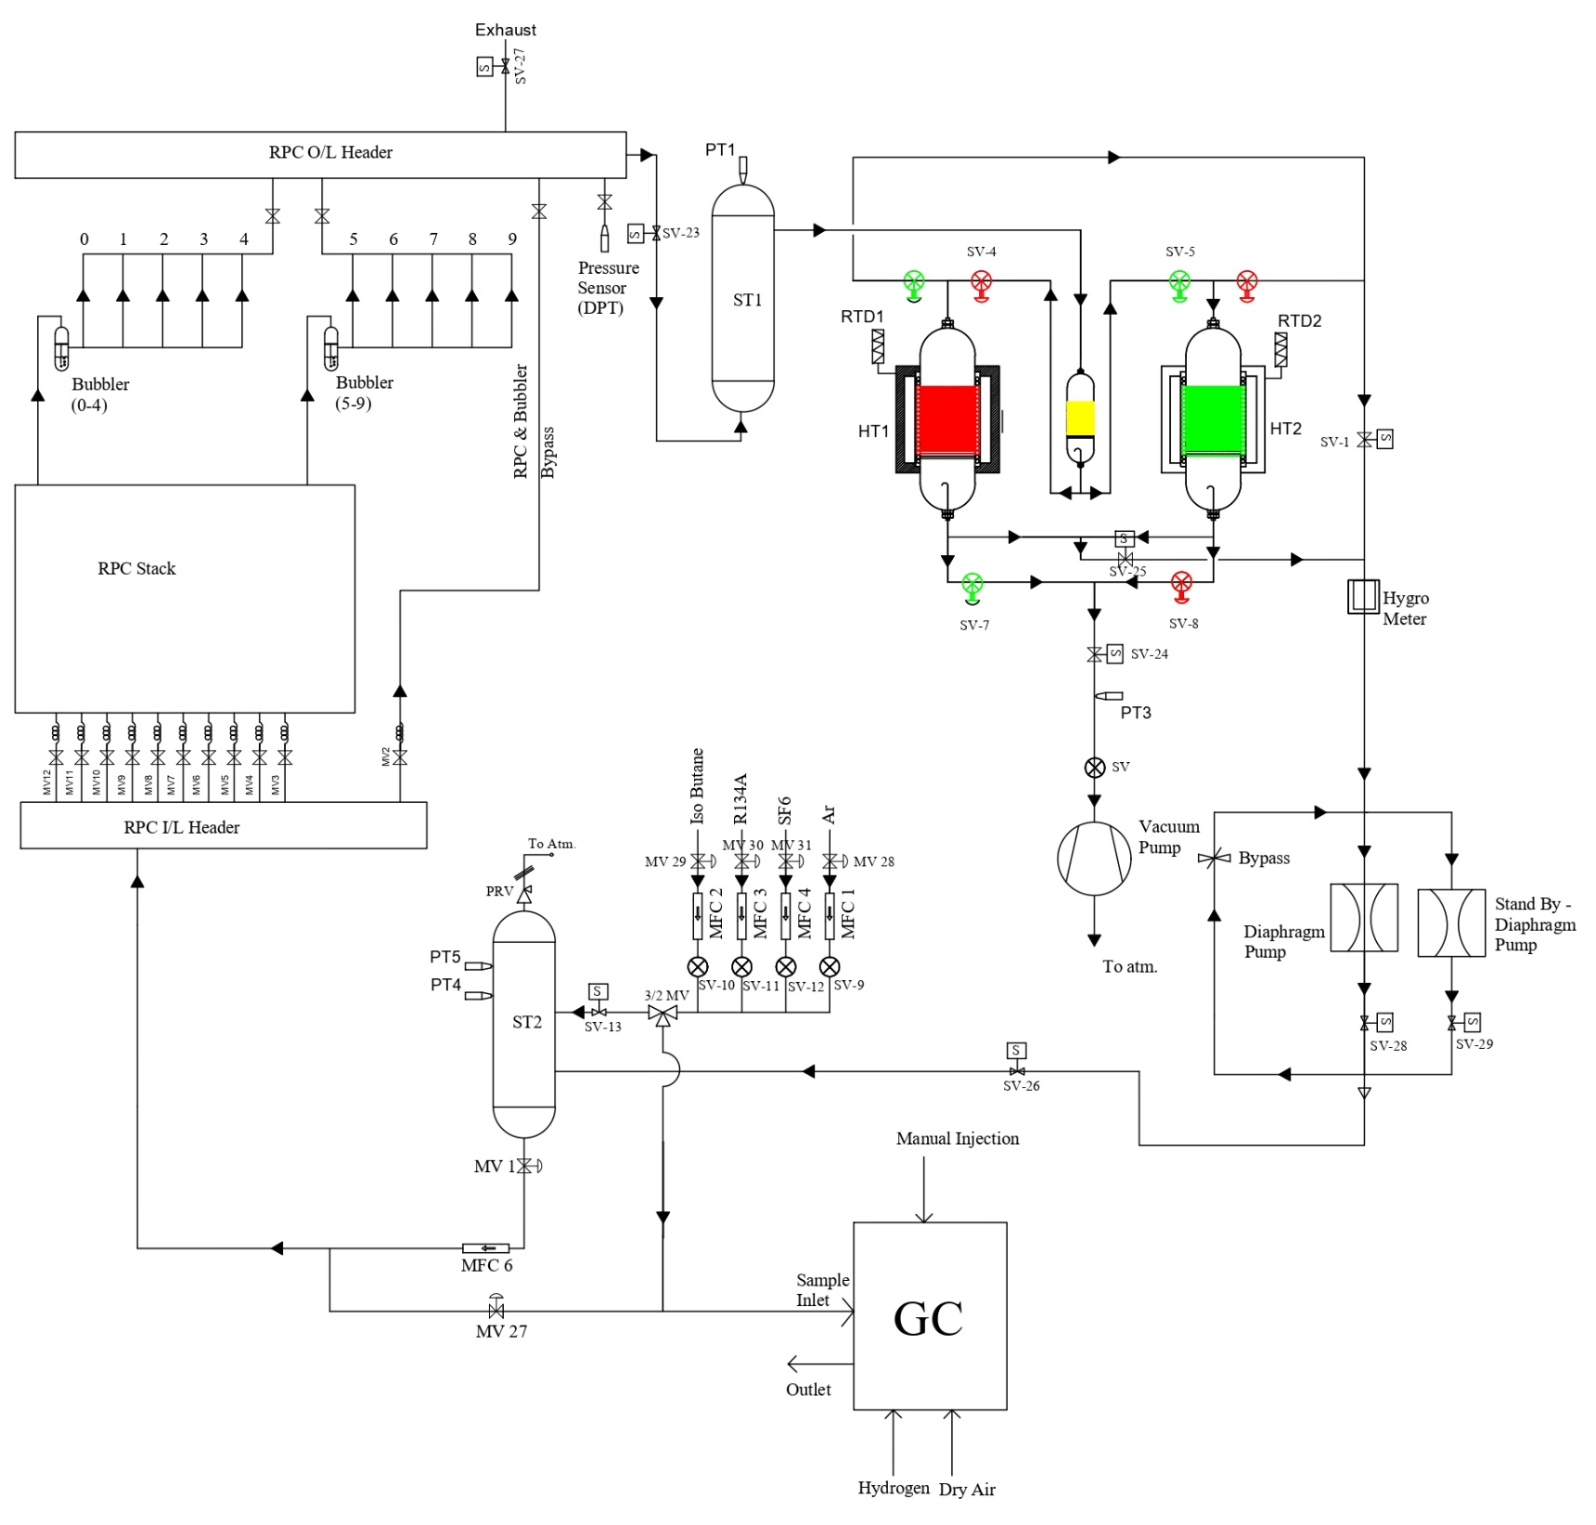
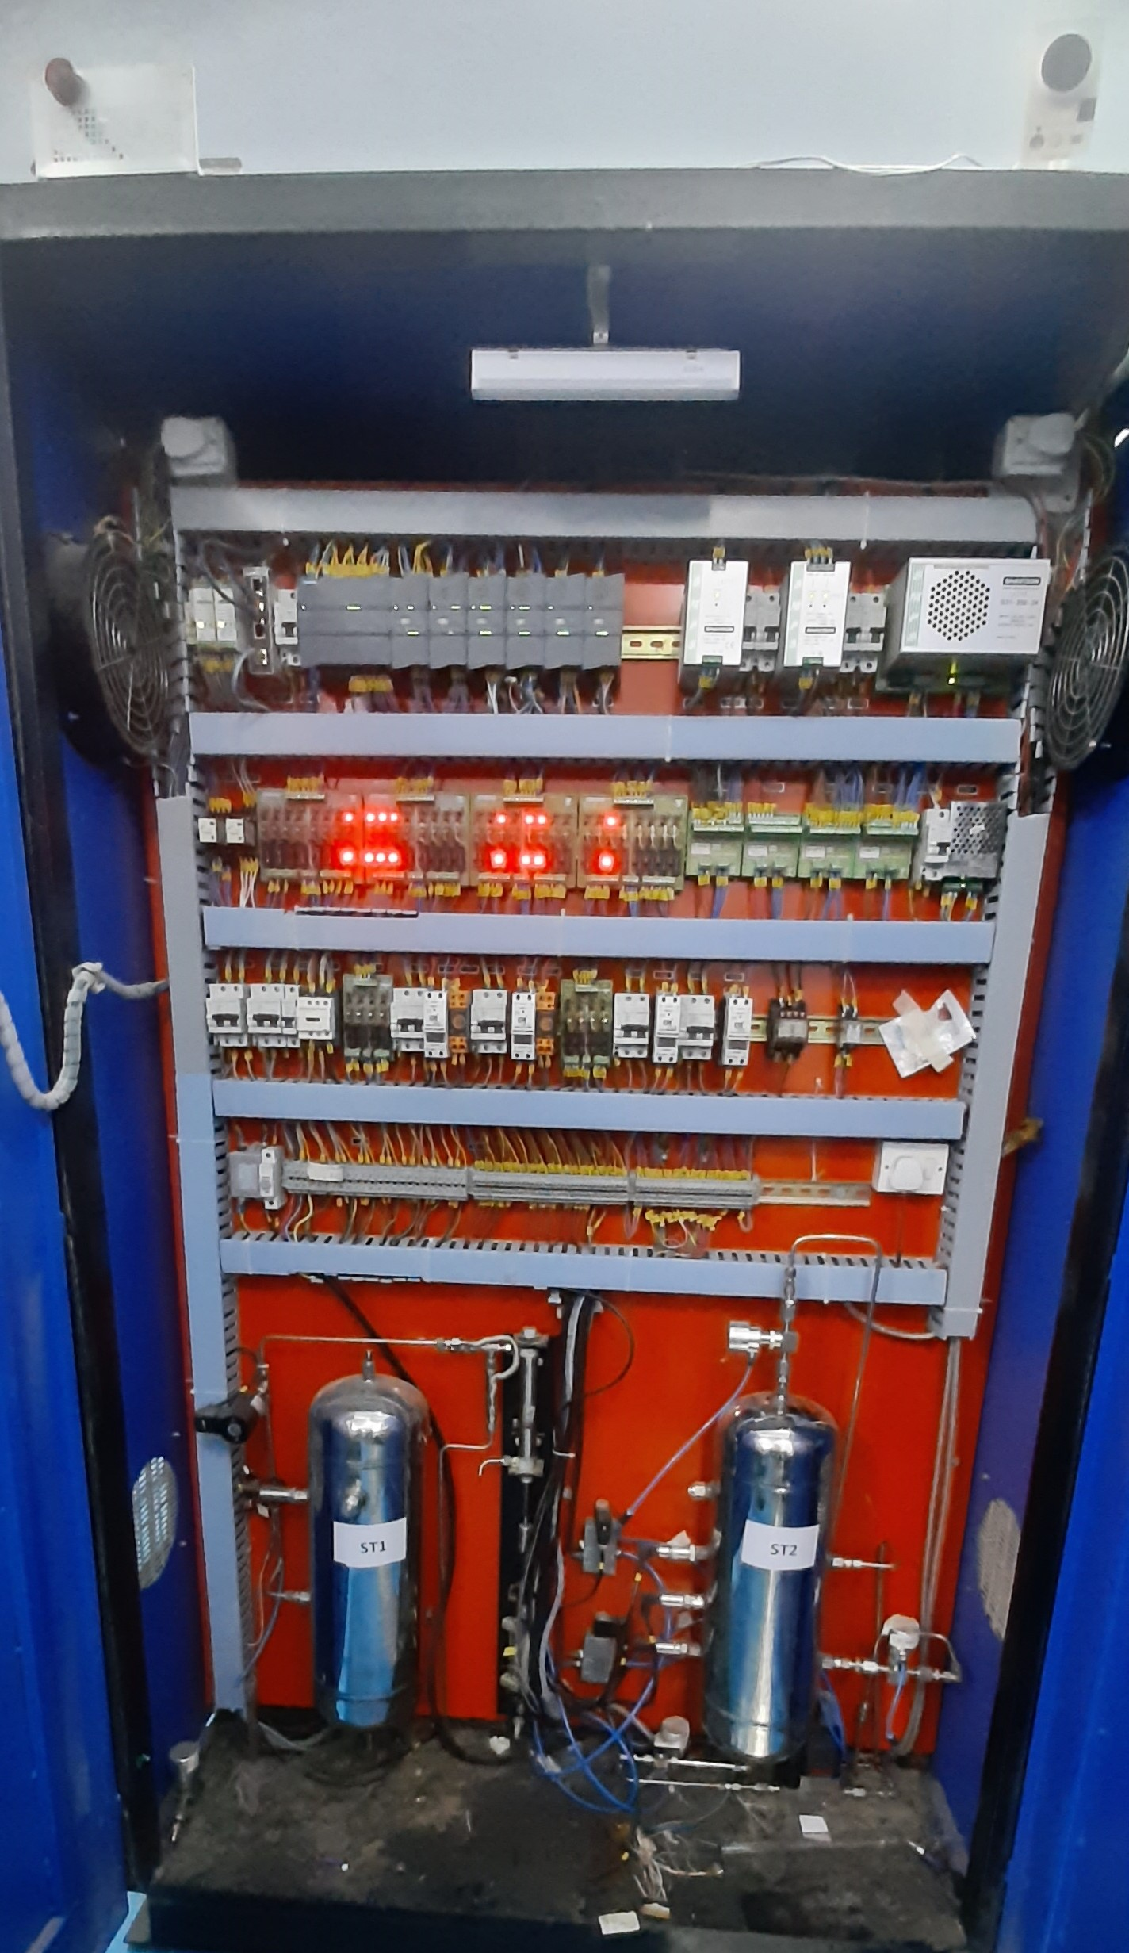
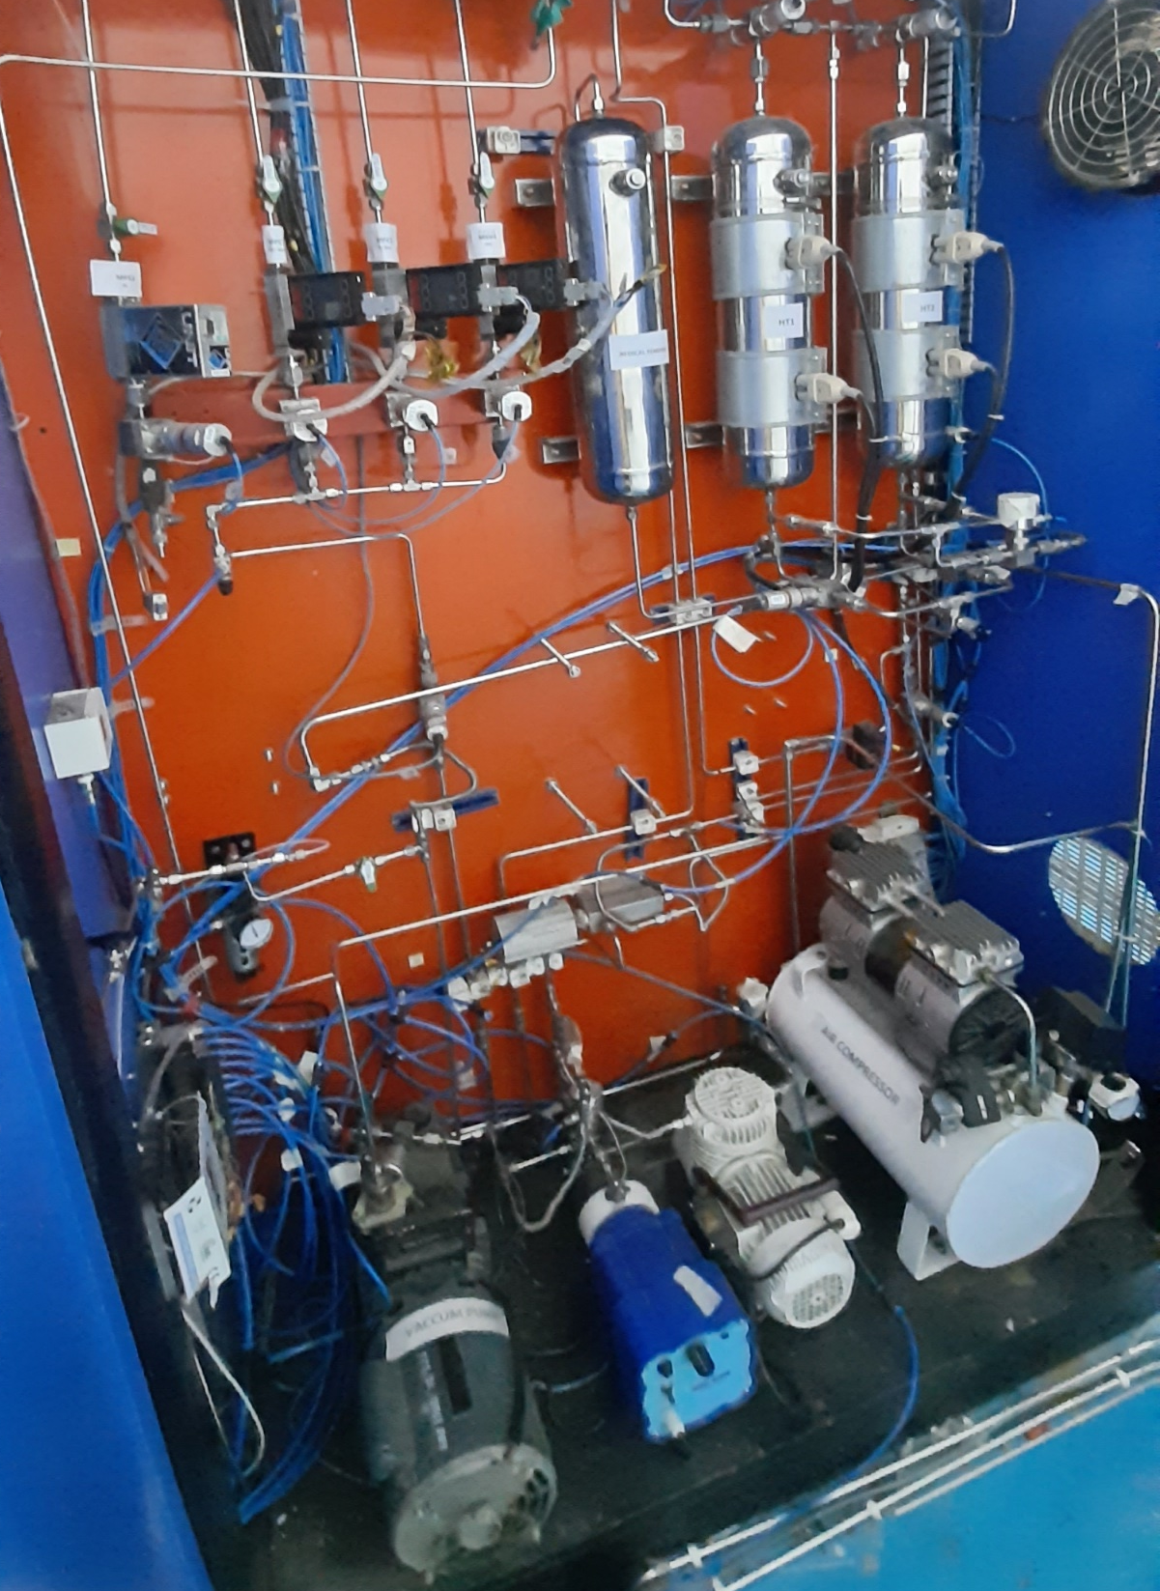
Closed loop gas system
ICAL detector holds about 200,000 litres of gas all the time. Gas recycling system ensures that almost no gas is wasted.

Slide 39



Online gas chromatograph

Slide 40


Slide 41


mini-ICAL detector taking data at IICHEP
85-ton, 4m×4m×11 layer magnet, with 20, 2mx2m RPCs and ICAL electronics operating for 2 years.

Slide 42



Studies with a compact muon veto detector
320mm×960mm
440mm×440mm
Muon trigger rate ~2 Hz
150mm×200mm

Slide 43


Veto efficiencies for different CCMVD geometries
The advantages of locating a large detector such as ICAL at a shallow depth of 100 m, are obvious.
Muon background at such a depth at ICAL of about 3×10⁸ /day and the small atmospheric neutrino event rate of about 3 per day in the same detector.
If one were to build a cosmic muon veto detector which could detect muons with > 99.99% efficiency, the fraction that would escape detection would be of the same order or similar to that which survives after traversing a rock cover of about 1 km.

Slide 44





Structure of veto detector around mini-ICAL
Staggering of scintillator layers
Cross-section of scintillator a strip (10/20mm)
Structure of scintillator wall
A di-counter assembly

Slide 45


Extruded plastic scintillators by Fermilab
Polystyrene+PPO/POPOP
4.7 m long extruded plastic scintillator strips
Extruded plastic scintillator factory at Fermilab, USA

Slide 46


Kuraray WLS fibres
Fiber type: Y-11 (175) MJ.
K-27 dye in core material that controls light yield optimization is at 175 ppm concentration.
M is for multi(double)-cladding fiber.
J is a long term stable type for attenuation length.
non-S type: good attenuation length, but mechanically weak.
Core: Polystyrene (n_{d}=1.59).
Inner cladding: Polymethylmethacrylate (PMMA, n_{d}=1.49).
Outer cladding: Fluorinated PMMA (n_{d}=1.42).
Thickness of claddings each is 2% of the fiber diameter.
Attenuation length: >3.6m.
Diameter: 1.400±0.006mm, RMS≤0.037mm.
Fibre testing at TIFR

Slide 47


Hamamatsu S13360-2050VE SiPM
(-dG/dT = 2%)

Slide 48





SiPM, scintillator and fibre characterisation
(OV: 2.5V)
(OV: 3.0V)
(OV: 3.5V)
M. Jangra, et al, DSA-II
Fibre:
λ_{S} = (0.88±0.03) m
λ_{L} = (10.11±0.09) m
Scintillator

Slide 49
Comic veto detector requirements
Design Requirements
  Charge, position, relative arrival time for SiPM signal on mini-ICAL trigger
  Event Marker used to collate the CMVD event data with the mini-ICAL data
  Charge: Dynamic range of 100pC, least count of 20fC, single Photo-Electron (PE) charge ~100fC
  Relative arrival time: Least Count of 100ps
  Closed loop gain/biasing control for every SiPM or Di-Counter.
  In-situ calibration
Supporting results from test studies
  Single PE avalanche charge: 0.242pC
  Typical PE yields for 10/20mm scintillators: 34/57
  Typical muon yield: 8.33pC (10mm) and 13.82pC (20mm)
  Position resolution (on scintillator strip): 9.18±2.27cm

Slide 50

Scintillator+Fibre+SiPM coupling scheme

Slide 51


Slide 52


Di-counter assembly table with exhaust

Slide 53

Electronics and DAQ for the veto detector
Trip-T
32 channel charge amplifier
Charge and time of arrival output per channel
48 deep analog pipeline storage per channel
16 digital outputs crossing set threshold
VMM-3
64 channel bi-polar inputs
Fast digital output signal per channel
The peak charge and peak to reference clock TAC values stored in analog memory.
The digital data read out on two lines @200Mbps.
Individual threshold can be set per each channel

Slide 54


Master plan of the IICHEP Campus, Madurai
To be setup on a 12.2 hectares land close to Madurai Kamaraj University.
Will be the nodal centre for all activities, and will operate and maintain the INO laboratory.
Will be a particle detector R&D laboratory for basic and applied sciences & technology.

Slide 55


e-ICAL detector laboratory layout

Slide 56

Conceptual design of the e-ICAL
The 700 ton device will be built at IICHEP, Madurai campus in the next 2.5 years, for which all the requisite clearances were obtained from the state government.

Slide 57

RPC production schedule
Alternate paint R&D and production 6-8 moths
Polycarbonate parts, HV lugs etc. 6-8 months
Pickup panels, Mylar sheets etc. 6 months
RPC tray (by RTD, BARC) Will be ready
AFE, DFE, HV module, integration plan On
RPC gap production +8-10 months
Assembly of RPC detectors starts Jan-Feb 2022
Start of installation and commissioning Mar-April 2022
How about building a temporary assembly bay in the IICHEP campus?

Slide 58

Status and future outlook
Development and characterisation of large area glass RPC detectors completed. They are being produced in multiple industries now.
Closed loop gas system is designed and produced. Understood the operational aspects.
Entire electronics and power supplies designed, reviewed and produced for RPC test stands and for m-ICAL.
m-ICAL is constructed using the ICAL design components and is operational for more than two years.
Useful experience gained and a number of problems were identified from m-ICAL – useful when scaling up production for e-ICAL and ICAL.
All the detector components required for cosmic muon veto detector are procured and characterised. All the jigs and infrastructure are in place. Detector production to start soon. To be installed by September 2021.
Production plans for RPC detectors, electronics and closed loop gas system for the e-ICAL are all ON. To be ready in about two years.

Slide 59
Backup slides

Slide 60
Comparison of angular spectrum of cosmic rays

